Slide 1
CY 2550 Foundations of Cybersecurity
Cryptography

Slide 2
The Science of Secrets
Cryptography: the study of mathematical techniques to providing aspects of information security services
Creating secrets
Cryptanalysis: the study of mathematical techniques for attempting to defeat information security services
Breaking secrets
Cryptology: the study of cryptography and cryptanalysis

Slide 3
Terminology
Plaintext
Encryption
Ciphertext
Decryption
Plaintext
Encryption_Key
Decryption_Key

Slide 4
Parties
The Good Guys
The Bad Guys
Alice
Bob
Carl
Eve
Mallory

Slide 5
Fundamental Goals
Confidentiality – no eavesdropping
Integrity – no unauthorized modifications
Authenticity – no spoofing or faking
Non-repudiation – no disclaiming of authorship

Slide 6
Additional Goals of Modern Crypto
Pseudo-random number generation
Anonymity
E-voting
Secret sharing
Zero-knowledge proof
Secure multi-party computation
Computation over encrypted data (homomorphic encryption)

Slide 7
Cryptographic Protocols
Protocols that
Enable parties to…
Achieve goals to…
Overcome adversaries
Need to understand
Who are the parties and the context in which they act?
What are the security goals of the protocols?
What are the capabilities of the adversaries?

Slide 8
Attacker Threat Model
Interaction with messages and the protocol
Passive: only observes and attempts to decrypt messages
Only threatens confidentiality
Active: observes, modifies, or deletes messages
Threatens confidentiality, integrity, and authenticity
Full knowledge of the chosen cryptographic algorithm
Kerchhoff’s Principle
A cryptosystem should be secure even if everything about the system, except the key, is public knowledge
Shannon’s Maxim
The enemy knows the system
No security through obscurity

Slide 9
Attacker Threat Model
Interaction with cipher algorithm
Chosen-plaintext attack
Attacker may choose a number of messages and obtain the ciphertexts for them
Chosen-ciphertext attack
Attacker may choose a number of ciphertexts and obtain the plaintexts
Both attacks may be adaptive
Choices may change based on results of previous requests
Computationally bounded
Finite resources to calculate and store things
No quantum computers

Slide 10
Cryptography and Cryptanalysis through history

Slide 11
Approaches to Secure Communication
Steganography
Cryptography
“covered writing”
hides the existence of a message
depends on secrecy of method
“hidden writing”
hide the meaning of a message
depends on secrecy of a short key, not method

Slide 12
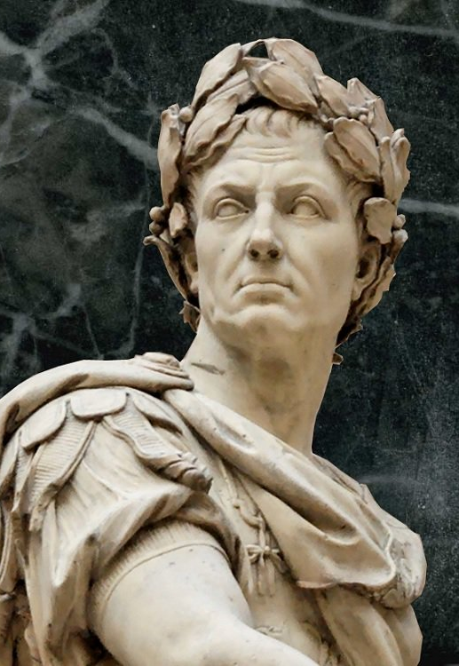
Caesar Shift
Simple symmetric substitution cipher
Key is a number k
To encrypt, “shift” each letter by k positions
To decrypt, “shift” each letter back by k positions
HEY BRUTUS BRING A KNIFE TO THE PARTY
K = 3
KHB EUXWXV EULQJ D NQLIH WR WKH SDUWB

Slide 13
Cryptanalysis of Shift Cipher
Brute force: try all 25 possible keys (assuming English text)
K = 0 and K = 26 don’t make sense
Lessons?
Simple, exhaustive key search can be effective
Key space needs to be large enough to prevent attack

Slide 14
Monoalphabetic Substitution Cipher
Replace each letter X with π(X) where π is a permutation
In this cipher, the key is the permutation π
Key space is all possible permutations
For English: 26! = 4*10²⁶
HELLO WORLD
A B C D E F G H I J K L M N O P Q R S T U V W X Y Z
π
π = C A D O Z H W Y G B Q X L V T R N M S K J I P F E U
YZXXT PTMXO

Slide 15
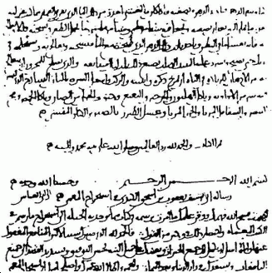
Cryptanalysis of Monoalphabetic Substitution
Dominates cryptography through the first millennium
Exhaustive search is infeasible (26! = 4*10²⁶ possible keys)
Frequency analysis
Remember Al-Kindi from 800 AD?

Slide 16
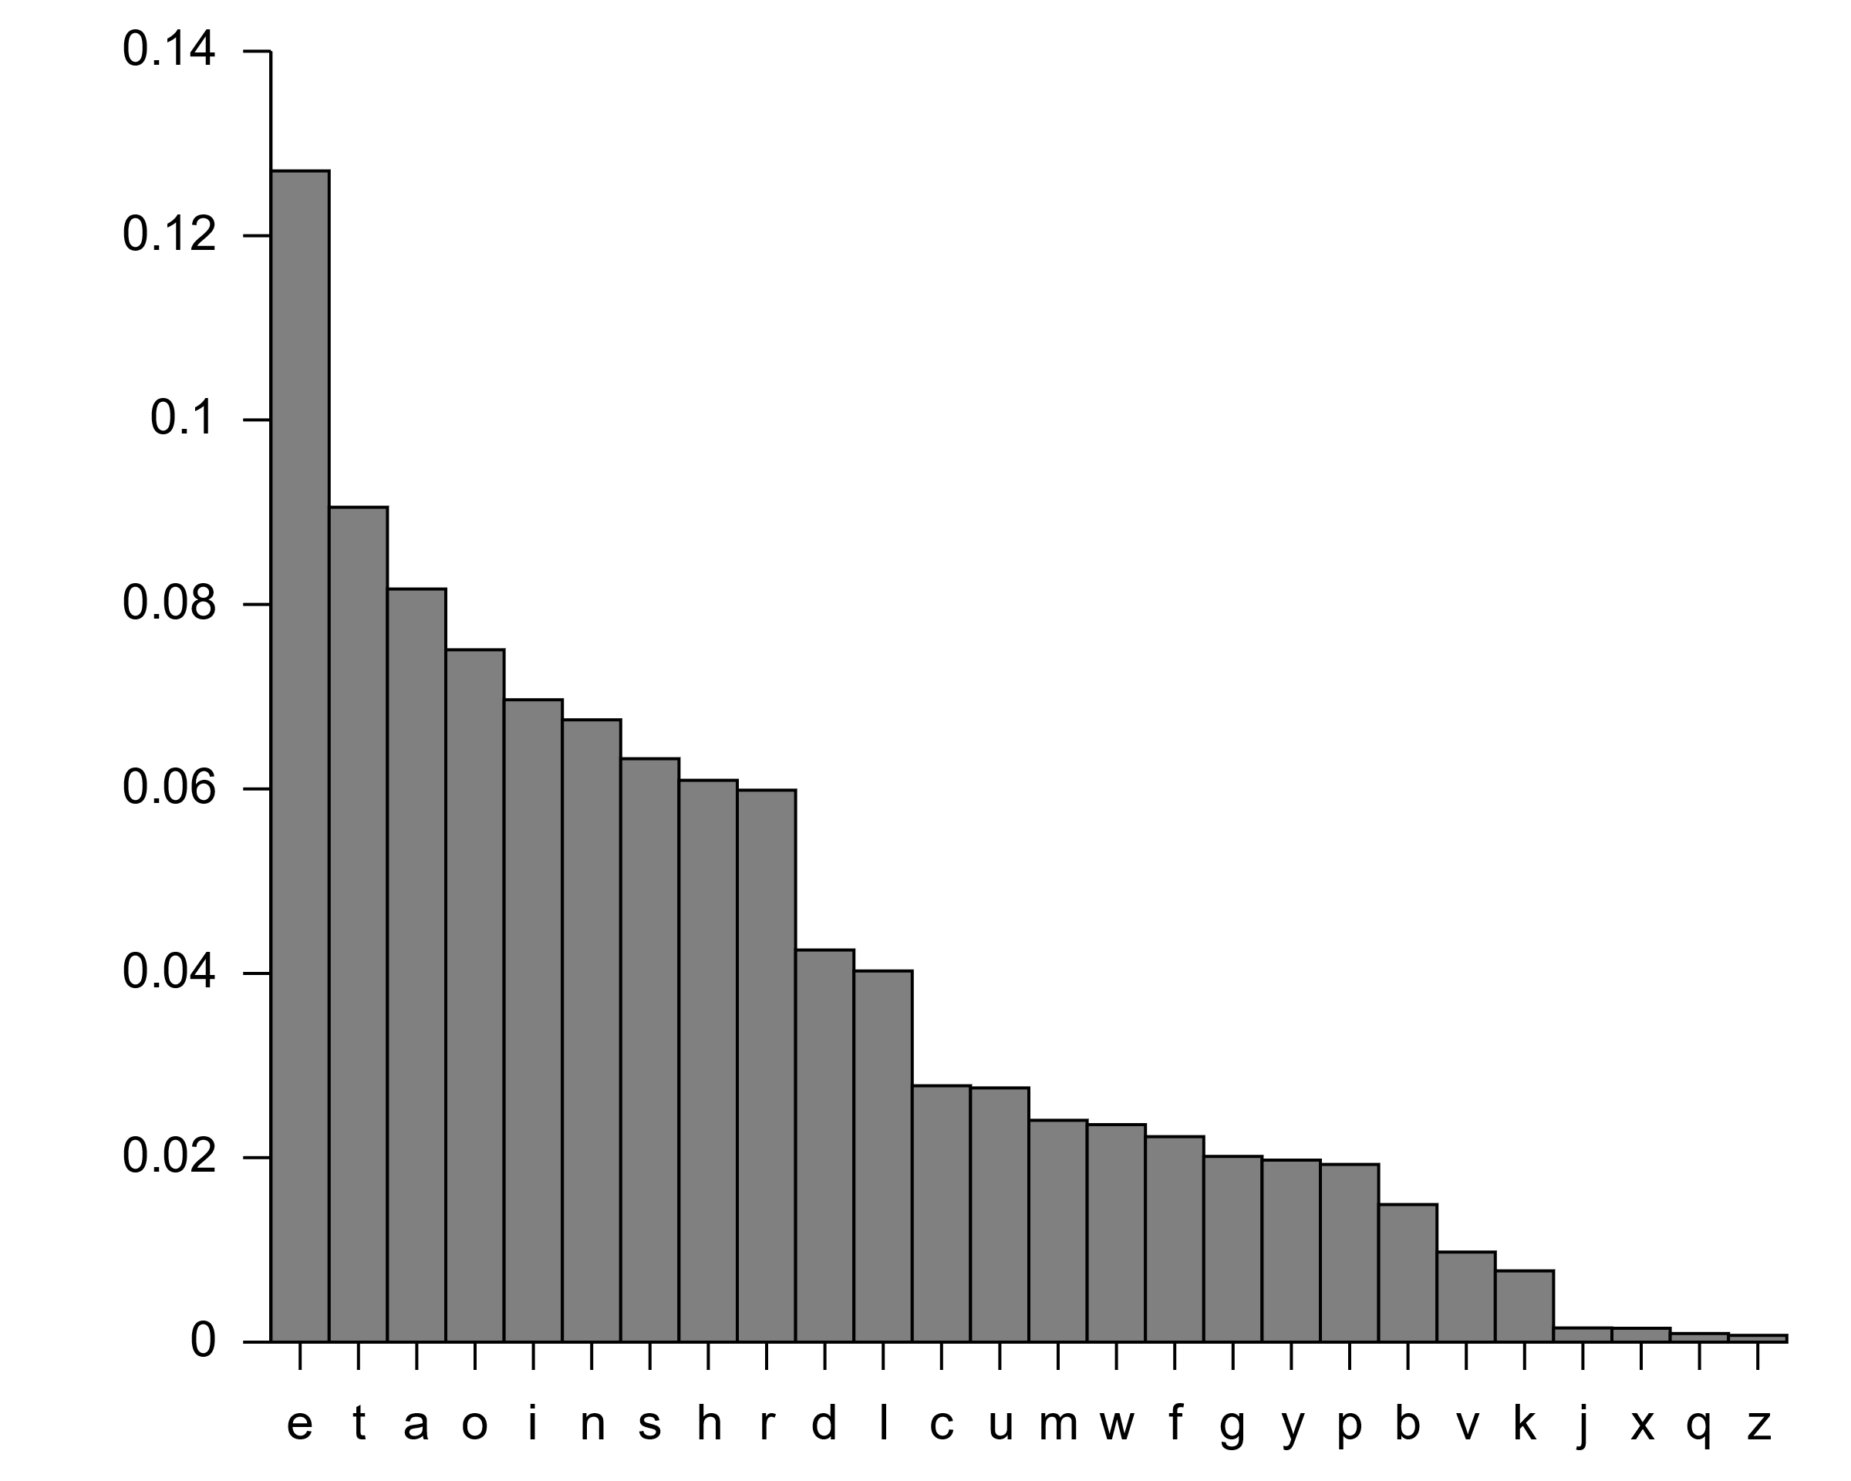
Frequency Analysis
Human languages have patterns
Frequency of letter usage
Frequency of n-letter combinations
These patterns survive substitution
π = B A D C Z H W Y G O Q X L V T R N M S K J I P F E U

Slide 17
Cryptanalysis of Monoalphabetic Substitution
Dominates cryptography through the first millennium
Exhaustive search is infeasible (26! = 4*10²⁶ possible keys)
Frequency analysis
Remember Al-Kindi from 800 AD?
Lessons?
Use large blocks: instead of replacing ~6 bits at a time, replace 64 or 128 bits
Leads to block ciphers like DES and AES
Use different substitutions to prevent frequency analysis
Leads to polyalphabetic substitution ciphers and stream ciphers

Slide 18
Vigenère Cipher (1596)
Main weakness of monoalphabetic substitution ciphers:
Each letter in the ciphertext corresponds to only one letter in the plaintext
Polyalphabetic substitution cipher
Given a key K = (k₁, k₂, …, k_{m})
Shift each letter p in the plaintext by k_{i}, where i is modulo m
A | B | C | D | E | F | G | H | I | J | K | L | M | N | O | P | Q | R | S | T | U | V | W | X | Y | Z
0 | 1 | 2 | 3 | 4 | 5 | 6 | 7 | 8 | 9 | 10 | 11 | 12 | 13 | 14 | 15 | 16 | 17 | 18 | 19 | 20 | 21 | 22 | 23 | 24 | 25
Plaintext
CRYPTOGRAPHY
Key
LUCK
LUCKLUCK
(Shift 11 20 2 10 11 20 2 11 …)
Ciphertext
NLAZEIIBLJJI

Slide 19
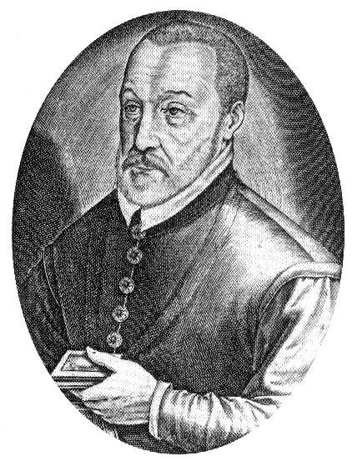
Cryptanalysis of Vigenère Cipher
Essentially a collection of shift ciphers
One letter in ciphertext corresponds to multiple letters in plaintext
Frustrates, but doesn’t stop frequency analysis
Cracking Vigenère (1854 or 1863)
Guess the key length x using Kasisky test or index of coincidence
Divide the ciphertext into x shift cipher encryptions
Use frequency analysis on each shift cipher

Slide 20
Kasisky Test
Plaintext
T H E S U N A N D T H E M A N I N T H E M O O N
Key
K I N G K I N G K I N G K I N G K I N G K I N G
Ciphertext
D P R Y E V N T N B U K W I A O X B U K W W B T
Distance = 8
Repeating patterns (of length >2) in ciphertext are a tell
Likely due to repeated plaintext encrypted under repeated key characters
The distance is likely to be a multiple of the key length

Slide 21
Cryptanalysis of Vigenère Cipher
Cracking Vigenère (1854 or 1863)
Guess the key length x using Kasisky test of index of coincidence
Divide the ciphertext into x shift cipher encryptions
Use frequency analysis on each shift cipher
Lessons?
As key length increases, letter frequency becomes more random
If key never repeated, Vigenère wouldn’t be breakable

Slide 22
One Time Pads and Perfect Secrecy

Slide 23
One Time Pad (1920s)
Fix the vulnerability of the Vigenère cipher by using very long keys
Key is a random string that is at least as long as the plaintext
Similar encryption as with Vigenère (different shift per letter)

Slide 24
Cryptanalysis of OTP
Intuitively, the key is random, so ciphertext is also random
OTP achieves Perfect Secrecy
Shannon or Information Theoretic Security
Basic idea: ciphertext reveals no “information” about plaintext
An encryption over message space M is perfectly secure iff
∀ probability distribution over M
∀ message m ∈ M
∀ ciphertext c ∈ C for which P(c) > 0
we have
P(PT=m | CT=c) = P(PT=m)
Where PT is plaintext and CT is ciphertext

Slide 25
In English
The adversary believes the probability that the plaintext is m is P(PT=m) before seeing the ciphertext
Maybe they are very sure, or maybe they have no idea
The adversary believes the probability that the plaintext is m is P(PT=m | CT=c) after seeing that the ciphertext is c
P(PT=m | CT=c) = P(PT = m) means that after knowing that the ciphertext is c, the adversary’s belief does not change
Intuitively, the adversary learned nothing from the ciphertext

Slide 26
Put Another Way
Imagine you have a ciphertext c where the length |c| = 1000
I can give you a key k_{i} with |k_{i}| = 1000 such that:
The decrypted message m_{i} is the first 1000 characters of Hamlet
Or, I can give you a key k_{j} with |k_{j}| = 1000 such that:
The decrypted message m_{j} is the first 1000 characters of the US Constitution
If an algorithm offers perfect secrecy then:
For a given ciphertext of length n
All possible corresponding plaintexts of length n are possible decryptions

Slide 27
Cryptanalysis of OTP
Intuitively, the key is random, so ciphertext is also random
OTP achieves Perfect Secrecy
Shannon or Information Theoretic Security
Basic idea: ciphertext reveals no “information” about plaintext
Caveats
If the length of the OTP key is less than the length of the message…
It’s not a OTP anymore, not perfectly secret!
If you reuse the OTP key…
It’s not a OTP anymore, not perfectly secret!
Major issue with OTP in practice?
How to securely distribute the key books to both parties

Slide 28
Modern Symmetric Block Cyphers

Slide 29
Symmetric Key Cryptography
Algorithms that use a single key for encryption and decryption
i.e. the algorithm is reversible
∀ k ∀ m D_{k}(E_{k}(m)) = m where m is a message, k is a key, and D_{k} and E_{k} are decryption and encryption using k
Historic examples:
Caeser shift, mono and polyalphabetic substitution, OTP
Modern examples:
DES, 3DES, RC4, Blowfish, Twofish, AES
Warning: many of these methods are known to be vulnerable

Slide 30
Why Block Ciphers?
One way to defeat frequency analysis
Use different keys in different locations
Examples: OTP, stream ciphers
Another way
Make the unit of transformation larger
Instead of encrypting letter by letter (~6 bits), encrypt block by block (n bits)

Slide 31
Data Encryption Standard (DES)
Designed by IBM, with modifications proposed by the NSA
US national standard from 1977 to 2001
Block size is 64 bits
Key size is 56 bits
Has 16 rounds
Designed mostly for fast implementation in hardware
Software implementation is somewhat slow
Considered insecure now
Vulnerable to brute-force attacks, key too short

Slide 32
Advanced Encryption Standard (AES)
In 1997, NIST made a formal call for algorithms stipulating that the AES would specify an unclassified, publicly disclosed encryption algorithm, available royalty-free, worldwide
Goal: replace DES for both government and private-sector encryption.
The algorithm must implement symmetric key cryptography as a block cipher and (at a minimum) support block sizes of 128-bits and key sizes of 128-, 192-, and 256-bits.
In 1998, NIST selected 15 AES candidate algorithms.
In 2000, NIST selected Rijndael (invented by Joan Daemen and Vincent Rijmen) as the AES

Slide 33
AES Features
Designed to be efficient in both hardware and software
Block size: 128 bits
Variable key size: 128, 192, or 256 bits
No known weaknesses

Slide 34
AES Example
Alice
Eavesdropper
Bob
K_{AES}
K_{AES}
M
E_{KAES}(M)
E_{KAES}(M)
M

Slide 35
Block Cypher Modes

Slide 36
Need for Encryption Modes
A block cipher encrypts only one block
But a message may be longer than one block
Need a way to extend the algorithm to encrypt arbitrarily long messages
Need to ensure that if block cipher is secure, then whole encryption is secure
Unit test vs. integration test
Whole operation should be IND-CPA secure if block cipher is IND-CPA secure

Slide 37
Electronic Code Book (ECB) Mode
Message is broken into independent blocks
Each block is encrypted separately
Plaintext 1
Plaintext 2
Plaintext n
Block Cipher Encryption
Block Cipher Encryption
…
Block Cipher Encryption
Key
Key
Key
Ciphertext 1
Ciphertext 2
Ciphertext n

Slide 38
Cryptanalysis of ECB Mode
Deterministic
The same data block always gets encrypted the same way
Reveals patterns when data repeats!
m encrypted with k always produces the same c
This is the same problem we had with the Vigenère cipher
Do not use ECB mode in practice

Slide 39
Cipher Block Chaining (CBC) Mode
Uses a random Initialization Vector (IV)
Block i depends on block i-1
is exclusive bitwise OR
(XOR)
Plaintext 1
Plaintext 2
Plaintext n
IV
Block Cipher Encryption
Block Cipher Encryption
…
Block Cipher Encryption
K
K
K
Ciphertext 0
Ciphertext 1
Ciphertext 2
Ciphertext n

Slide 40
Cryptanalysis of CBC Mode
CBC randomizes the encryption
IV ensures initial block is randomized
Dependency between blocks propagates randomness
Usage in practice: choose random IV and protect its integrity
The IV is not secret (it becomes part of the ciphertext)
Do not let the adversary control the IV
CBC is IND-CPA assuming
Block cipher itself is secure
IV is truly random
IV is sufficiently large

Slide 41
Review of Computational Complexity

Slide 42
Towards Computational Security
Perfect secrecy is too difficult to achieve in practice
Imagine trying to do OTP encryption with every website that uses HTTPS
Computational security uses two relaxations:
Security is preserved only against computationally bounded adversaries
Limits on computational power and storage
No quantum computers
Adversaries may successfully crack encryption with a very small probability
So small that (we hope) it becomes negligible

Slide 43
Crash Course in Computational Complexity
O(1)
Constant Time
(define (add2 num)
(+ 2 num))
(define (sum lon)
(cond [(empty? lon) 0]
[(cons? lon) (+ (first lon1) (sum (rest lon)))]))
Assuming a list of length n
O(n)
Linear Time

Slide 44
Crash Course in Computational Complexity
Two lists of length n
O(n²)
Quadratic Time
(define (make-list-of-sums lon1 lon2)
(cond [(empty? lon1) ‘()]
[(cons? lon1) (append (helper (first lon1) lon2)
(make-list-of-sums (rest lon1) lon2))]))
(define (helper num lon2)
(cond [(empty? lon2) ‘()]
[(cons? lon2) (cons (+ num (first lon2))
(helper num (rest lon2)))]))

Slide 45
Crash Course in Computational Complexity
O(n log n)
Quicksort
(define (fibonacci n)
(if (<= n 1) n (+ (fibonacci (- n 2)) (fibonacci (- n 1)))))
O(2^{n})
Exponential Time

Slide 46
Applications to Cryptography
O(1) < O($√n$) < O(n) < O(n log n) < O(n²) < O(n³) < … < O(2^{n}) < O(n!) < …
When we desire computational security, we want algorithms where:
Verifying a given solution can be done in polynomial time or faster
Computing a novel solution takes O(2^{|k|}) time or worse
This is what we mean by a computationally bound adversary
Given infinite computers, a O(2^{|k|}) time problem can be solved

Slide 47
The IND-CPA Game

Slide 48
Towards Computational Security
Perfect secrecy is too difficult to achieve in practice
Imagine trying to do OTP encryption with every website that uses HTTPS
Computational security uses two relaxations:
Security is preserved only against computationally bounded adversaries
Limits on computational power and storage
No quantum computers
Adversaries may successfully crack encryption with a very small probability
So small that (we hope) it becomes negligible

Slide 49
The Asymptotic Approach
Consider a cryptographic algorithm with a security parameter
Typically key length, e.g. 1024 or 2048 bits
Assume the algorithm is efficient, e.g. runs in polynomial time
As the security parameter (key length) increases:
The cryptographic computations become slower, but…
The computational effort (time) to crack a message also grows
A crypto algorithm is asymptotically secure if every Probabilistic Polynomial Time (PPT) algorithm succeeds in cracking the scheme with only negligible probability
Negligible means heads to 0 exponentially fast as the security parameter increases

Slide 50
Ciphertext Indistinguishability under a Chosen-Plaintext Attack (IND-CPA)
Round 1: choose k and encryption algo
k, E_{k}
Round 2: choose two plaintext messages
m₀ , m₁ ∈ M
Round 3: choose a random binary number
b ← _{R} {0, 1}
Round 4: encrypt the corresponding message
c = E_{k}(m_{b})
Round 5: guess the value of b
b' ∈ {0, 1}
Adversary wins if b = b’

Slide 51
Analyzing the IND-CPA Game
If E is a perfectly secure algorithm, what is the probability that b = b’?
P(Mallory wins) = ½
k, E_{k}
m₀ , m₁ ∈ M
If E is a Caesar shift, what is the probability that b = b’?
b ← _{R} {0, 1}
c = E_{k}(m_{b})
b' ∈ {0, 1}
P(Mallory wins) = 1
Adversary wins if b = b’

Slide 52
Analyzing the IND-CPA Game
If E is computationally secure algorithm, what is the probability that b = b’?
P(Mallory wins) = ½ + negligible(|k|)
k, E_{k}
m₀ , m₁ ∈ M
b ← _{R} {0, 1}
c = E_{k}(m_{b})
b' ∈ {0, 1}
Adversary wins if b = b’

Slide 53
Intuition of IND-CPA Security
Information theoretic (perfect) security means
Given m₀ and m₁
P(CT=c | PT=m₀) = P(CT=c | PT=m₁)
for any adversary
Computational security means
Given m₀ and m₁
P(CT=c | PT=m₀) ≈ P(CT=c | PT=m₁)
for a computationally bounded adversary
Computational security is the foundation of all modern cryptography

Slide 54
Public Key Cryptography

Slide 55
AES Example
Alice
Eavesdropper
Bob
K_{AES}
K_{AES}
M
E_{KAES}(M)
E_{KAES}(M)
M

Slide 56
Weakness of Symmetric Key Crypto
How do you securely exchange keys with someone?
Easy(ish) to do if you can meet them in person
However, the Internet is untrusted
You can’t exchange shared secrets over an untrusted medium
Alice
Eavesdropper
Bob
K_{AES}
K_{AES}
K_{AES}

Slide 57
Public Key Cryptography
Public key cryptography, a.k.a. asymmetric cryptography
Each principal has two keys: private (secret) and public
A message encrypted with one key must be decrypted by the other
Thus, the public key can be sent in-the-clear over the Internet
Security is based on Very Hard Math Problems
O(1) time to verify a given solution for a given instance
Exponential time to check all possible solutions for a given instance
Many different algorithms that offer different security properties
Diffie-Hellman, RSA, Goldwasser-Micali, ElGamal
Forms the basis for most modern secure protocols
IPsec, SSL, TLS, S/MIME, PGP/GPG, etc.

Slide 58
Diffie-Hellman
Really should be called Diffie-Hellman-Merkle
Ralph Merkle developed the mathematical theories
Whitfield Diffie and Martin Hellman developed the protocol
Security is based on the discrete logarithm problem
Compute k such that $b^{k}=g$, where b, g, and k are all integers
Possible that no solution exists given arbitrary b and g
Best known algorithms are exponential time

Slide 59
Diffie-Hellman Protocol
Red = secret, blue = public
Alice and Bob agree on a prime p and a base g which is primitive root modulo p
Alice chooses a secret integer a; Bob chooses secret b
Alice → Bob: ${A=g}^{a} \% p$; Bob → Alice: $B=g^{b} \% p$
Alice computes $s=B^{a} \% p$; Bob computes $s=A^{b} \% p$
Alice and Bob now share secret key s

Slide 60
Diffie-Hellman Example
Alice
Eavesdropper
Bob
Knows | Doesn’t Know
p = 23, g = 5
a = 6 | b = ?
$${A=g}^{a} \% p$$ $$8=5^{6} \% 23$$
B = 19
$s=B^{a} \% p$ $2={19}^{6} \% 23$
Knows | Doesn’t Know
p = 23, g = 5
 | a = ?, b = ?
A = 8, B = 19
$s={19}^{a} \% 23$ $s=8^{b} \% 23$
Knows | Doesn’t Know
p = 23, g = 5
b = 15 | a = ?
$${B=g}^{b} \% p$$ $$19=5^{15} \% 23$$
A = 8
$s=A^{b} \% p$ $2=8^{15} \% 23$
Calculating s requires solving for a or b, which is the discreet logarithm problem

Slide 61
More On Diffie-Hellman
Diffie-Hellman can be used for public key cryptography
Alice’s public key is <${A=g}^{a} \% p$, $g$, $p$>, private key is a
Diffie-Hellman is the basis for protocols with Perfect Forward Secrecy
a and b must be thrown away at the end of the session
Don’t worry if you have never heard of PFS

Slide 62
RSA
Invented by Rivest, Shamir, and Adleman in 1978
Equivalent system invented by Clifford Cox in 1973, but GCHQ classified it
RSA is the dominant public key cryptosystem today for historical reasons
Algorithm was commercialized by RSA Security
RSA Security created a certificate authority that eventually became Verisign

Slide 63
RSA Algorithm
Security is based on the difficulty of factoring the product of primes
Alice chooses two secret primes p and q, n = pq
Choose e such that 1 < e < n – (p + q – 1), and gcd(e, n – (p + q – 1)) = 1
<n, e> is Alice’s public key
Private key $d= e^{−1} \% \left(n −\left(p+q−1\right)\right)$
Encryption and decryption
Given a message M, 0 < M < n
Compute ciphertext C = Me % n
To decipher, compute C^{d} % n = (Me % n)^{d} % n = M^{ed} % n = M

Slide 64
RSA Example
Choose primes p and q: p = 11, q = 7
Compute public key <n, e>: n = pq = 77, 1 < e = 37 < n – (p + q – 1) = 60
Compute private key d: d = 13 (ed = 481, ed % 60 = 1)
Encrypt M: If M = 15 then C = Me % n = 15³⁷ % 77 = 71
Decrypt C: C^{d} % n = M = 71¹³ % 77 = 15

Slide 65
Attacks Against RSA
The length of n = pq reflects the strength
700-bit n factored in 2007
768 bit factored in 2009
1024 bit for minimal level of security today
Likely to be breakable in near future
2048 bits recommended for current usage
RSA encryption/decryption speed is quadratic in key length
Factoring is easy with a quantum computer

Slide 66
Public Key Crypto Example
Brand new AES symmetric key
Alice
Eavesdropper
Bob
S_{a}
P_{a}
M
P_{a}
P_{a}
K_{AES}
E _{KAES}(M) E _{Pa}(K_{AES})
E _{KAES}(M) E _{Pa}(K_{AES})
E _{KAES}(M)
K_{AES}
Why bother with the symmetric key?
Why not just encrypt M with P_{a}?
Performance
Asymmetric crypto is slow, symmetric is fast
Use asymmetric for K (which is small)
Use symmetric for M (which is large)
M

Slide 67
Chosen Plaintext Attacks
Problem: RSA and Diffie-Hellman are deterministic
They do not include any randomness by default
Given a message M and public key P, the encrypted message E _{P}(M) will always be the same
Attackers can decrypt messages using a chosen plaintext attack
Attacker constructs a set of likely messages M’
For each $m∈M′$, if E _{P}(m) == E _{P}(M) then m is the plaintext
Practical implementations of RSA must carefully pad messages
Adds randomness to M that prevents chosen plaintext attacks
Also prevents other classes of attacks

Slide 68
Digital Signatures and Authentication

Slide 69
Cryptographic Hash Functions
Cryptographic hash function transform input data into scrambled output data
Arbitrary length input → fixed length output
Deterministic: hash(A) = hash(A)
High entropy:
md5(‘security’) = e91e6348157868de9dd8b25c81aebfb9
md5(‘security1’) = 8632c375e9eba096df51844a5a43ae93
md5(‘Security’) = 2fae32629d4ef4fc6341f1751b405e45
Collision resistant
Locating A’ such that hash(A) = hash(A’) takes a long time
Example: 2²¹ tries for md5

Slide 70
Well Known Hash Functions
MD5
Outputs 128 bits
Collision resistance totally broken in 2004
SHA1
Outputs 160 bits
Partially broken: method exists to find collisions in 2⁸⁰ tries
Deprecated
SHA2 (SHA-224, SHA-256, SHA-384, SHA-512)
SHA-224 matches the 112 bit key length of 3DES
SHA-256, SHA-384, SHA-512 match the key lengths of AES (128, 192, 256 bits)
Considered safe

Slide 71
The Future: SHA3
2007: NIST opens competition for new hash functions
2008: Submission deadline, 64 entries, 51 make the cut
2009: 14 candidates move to round 2
2010: 5 candidates move to round 3
2011: final round of public comments
2012: NIST selects keccak (pronounced “catch-ack”) as SHA3
Created by Guido Bertoni, Joan Daemen, Gilles Van Assche, Michaël Peeters

Slide 72
Digital Signatures
Alice
Bob
S_{a}
P_{a}
P_{a}
M
M’
H(M)
M E _{Sa}(H(M))
H(M’) ?= H(M)
What can you infer about a signed message?
The holder of S_{a} must have produced the signature, since P_{a} decrypts the hash
The message was not modified, otherwise the hash would not match

Slide 73
Encryption vs. Signatures
Public Key Encryption
Digital Signatures
What does encryption give you?
Confidentiality – only the holder of the private key can read the message
Integrity – if the message is modified, it will no longer decrypt properly
What does encryption not give you?
Authentication – you have no idea who used your public key to encrypt the message
What do signatures give you?
(Weak) Authentication – only the holder of the private key could have signed the message
Integrity – if the message is modified, the signature will be invalid
What do signatures not give you?
Confidentiality – the message is not encrypted, it’s public

Slide 74
Authenticating Public Keys

Slide 75
Authentication
Does public key cryptography provide authenticity guarantees?
Yes – if you obtain Alice’s public key through a secure, out-of-band exchange
No – if you obtain Alice’s key via an untrusted network

Slide 76
The Monster-in-the-Middle Attack
Bob has no way of knowing that P_{e} does not belong to Alice
Alice
Mallory
Bob
P_{a}
S_{e}
M
P_{a}
P_{e}
S_{a}
P_{a}
P_{e}
K_{AES}
E_{KAES} (M) E _{Pe}(K_{AES})
E _{KAES}(M)
K_{AES}
E _{KAES}(M)
K_{AES}
Total compromise! The attacker can read, modify, or drop the message
M
M
Alice has no idea message has been compromised
E_{KAES} (M) E _{Pa}(K_{AES})

Slide 77
Signing Public Keys
The only way to authenticate a public key is to rely on trust
One or more third-party, trusted principals vouch for Alice’s key by signing it
Bob can verify the signatures using the public keys of the trusted third-parties
If Alice’s key is not signed, maybe Bob should not trust it
Question: who do you trust?
Web of trust: a social network of private individuals who sign each others keys
OpenPGP keys
Certificate authorities: companies that verify individuals and sign public keys for a fee
X.509 certificates (more on these later)

Slide 78
PGP and GPG
Pretty Good Privacy (PGP) – Phil Zimmermann, 1991
Widely used open source encryption software
Helped originate the OpenPGP standards for key exchange and digital signatures
Supports RSA keypairs as well as many symmetric cypher suites
Gnu Privacy Guard (GPG) – 1999
Open source implementation of the OpenPGP standards
Installed by default on most Linux/Unix/BSD systems

Slide 79
Web of Trust
Fred
P_{f}
Bob
Eric
Is this Fred’s key?
No way to tell, none of my friends can vouch for it.
e
P_{b}
P_{e}
Alice
Dave
a
d
d
f
Is this Eric’s key?
Maybe. Dave is two hops away, but I don’t know Fred.
P_{a}
Chris
P_{d}
b
c
b
c
Is this Dave’s key?
Bob and Chris say it is, and I trust them, so I trust this key.
e
P_{c}
a
d

Slide 80
Public Key Infrastructure (PKI)
The whole chain is valid because I trust Verisign.
P_{Verisign}
Alice
Is this GoDaddy’s key?
P_{GoDaddy}
Is this BofA’s key?
Verisign
P_{Verisign}
Your OS and web browser ship with ~200 trusted public keys by default.
P_{BofA}
GoDaddy

Slide 81
Transport Layer Security (TLS)

Slide 82
SSL/TLS
Application-layer protocol for confidentiality, integrity, and authentication between clients and servers
Introduced by Netscape in 1995 as the Secure Sockets Layer (SSL)
Designed to encapsulate HTTP, hence HTTPS
Transport Layer Security (TLS) is the upgraded standard
Defined in an RFC in 1999
Supersedes SSL: SSL is known to be insecure and should not be used
Sits between transport and application layers
Thus, applications must be TLS-aware
Server must have an asymmetric keypair
X.509 certificates contain signed public keys
PKI rooted in trusted (?) Certificate Authorities (CAs)

Slide 83
Goals of TLS
Confidentiality and integrity: use BofA’s public key to negotiate a session key; encrypt all traffic
Authentication: BofA’s cert can be validating by checking Verisign’s signature
Verisign
S_{Verisign}
https://www.bankofamerica.com
Trusted Key Store
Verisign
S_{BofA}
BofA
Contains BofA’s public key
Signed by Verisign

Slide 84
Let’s Talk about Certificates
Suppose you start a new website and you want TLS encryption
You need a certificate. How do you get one?
Option 1: generate a certificate yourself
Use openssl to generate a new asymmetric keypair
Use openssl to generate a certificate that includes your new public key
Problem?
Your new cert is self-signed, i.e. not signed by a trusted CA
Browsers cannot validate that the cert is trustworthy
Users will be shown a scary security warning when they visit your site
Option 2:
Get a well-known CA to sign your certificate
Any browser that trusts the CA will also trust your new cert

Slide 85
Certificate Authorities
Certificate Authorities (CAs) are the roots of trust in the TLS PKI
Let’s Encrypt, Verisign, Thawte, Geotrust, Comodo, GlobalSign, Go Daddy, Digicert, Entrust, and hundreds of others
Issue signed certs on behalf of third-parties
How do you become a CA?
Create a self-signed root certificate
Get all the major browser vendors to include your cert with their software
Keep your private key secret at all costs
What is the key responsibility of being a CA?
Verify that someone buying a cert for example.com actually controls example.com
Any CA can issue a cert for any domain!
The only thing that stops me from buying a cert for google.com is a manual verification process

Slide 86
Acquiring a Certificate
Generate a new certificate using the data in the CSR, sign it with the CA’s private key
Generate a new keypair
Verify that the requestor owns the domain in the CSR
Generate a Certificate Signing Request (CSR).
Contains BofA’s details, the DNS name for the cert, and P_{BofA}
S_{BofA}
P_{BofA}
S_{Verisign}
Verisign
CSR
bofa.com
P_{BofA}
BofA

Slide 87
X.509 Certificate (Part 1)
Certificate:
Data:
Version: 3 (0x2)
Serial Number:
0c:00:93:10:d2:06:db:e3:37:55:35:80:11:8d:dc:87
Signature Algorithm: sha256WithRSAEncryption
Issuer: C=US, O=DigiCert Inc, OU=www.digicert.com, CN=DigiCert SHA2 Extended Validation Server CA
Validity
Not Before: Apr 8 00:00:00 2014 GMT
Not After : Apr 12 12:00:00 2016 GMT
Subject: businessCategory=Private Organization/1.3.6.1.4.1.311.60.2.1.3=US/1.3.6.1.4.1.311.60.2.1.2=Delaware/serialNumber=5157550/street=548 4th Street/postalCode=94107, C=US, ST=California, L=San Francisco, O=GitHub, Inc., CN=github.com
Subject Public Key Info:
Public Key Algorithm: rsaEncryption
Public-Key: (2048 bit)
Modulus:
00:b1:d4:dc:3c:af:fd:f3:4e:ed:c1:67:ad:e6:cb:
Issuer: who generated this cert? (usually a CA)
Certificates expire
Used for revocation
Github’s public key
Subject: who owns this cert?
This is Github’s certificate
Must be served from github.com

Slide 88
X.509 Certificate (Part 2)
Additional DNS names that may serve this cert
X509v3 extensions:
X509v3 Subject Alternative Name:
DNS:github.com, DNS:www.github.com
X509v3 CRL Distribution Points:
Full Name:
URI:http://crl3.digicert.com/sha2-ev-server-g1.crl
Full Name:
URI:http://crl4.digicert.com/sha2-ev-server-g1.crl
X509v3 Certificate Policies:
Policy: 2.16.840.1.114412.2.1
CPS: https://www.digicert.com/CPS
Authority Information Access:
OCSP - URI:http://ocsp.digicert.com
If this cert is revoked, it’s serial will be in the lists at these URLS
This cert’s revocation status may also be checked via OSCP

Slide 89
TLS Connection Establishment
S_{BofA}
BofA
ClientHello(Version, Prefs, Nonce_{c})
ServerHello(Version, Prefs, Nonce_{s})
Certificates(C_{BofA}, C_{Verisign})
Certificate chain
Both sides derive symmetric session key K from the PreMasterKey
ServerHelloDone
ClientKeyExchange(E _{PBofA}(PreMasterKey))
Encrypted using server’s public key
ChangeCipherSpec
E _{K}(Finished)
Encrypted using symmetric session key
ChangeCipherSpec
E _{K}(Finished)

Slide 90
TLS Authentication
During the TLS handshake, the client receives a certificate chain
Chain contains the server’s cert, as well as the certs of the signing CA(s)
The client must validate the certificate chain to establish trust
i.e. is this chain authentic, correct, cryptographically sound, etc.
Client-side validation checks
Does the server’s DNS name match the common name in the cert?
E.g. example.com cannot serve a cert with common name google.com
Are any certs in the chain expired?
Is the CA’s signature cryptographically valid?
Is the cert of the root CA in the chain present in the client’s trusted key store?
Is any cert in the chain revoked? (more on this later)

Slide 91
Little Green Locks
If the TLS handshake succeeds, and the server’s certificate chain is valid, then the connection is authenticated and encrypted
Green lock icon indicates secure TLS connection to the user

Slide 92
Extended Validation Certificates
What differs between a DV and an EV certs?
To get a DV cert, the CA verifies that you control the given common name
To get an EV cert, the CA does a background check on you and your company
EV certs cost a lot more than DV certs
Other than the background check, EV certs offer the same security as DV certs
How does your browser tell the difference between DV and EV certs?
Remember the policy number in the X.509 certificate?
Each CA designates certain magic policy numbers to indicate EV status
Your browser contains a hard-coded list of magic policy numbers to identify EV certs :(

Slide 93
Key Compromise and Revocation

Slide 94
Key Compromise
C_{BofA} is totally legit
S*_{BofA}
S_{BofA}
S_{BofA}
BofA
*BofA
BofA
ClientHello
ClientHello
BofA
*BofA
BofA
Secret key compromise leads to many devastating attacks
Attacker can successfully MitM TLS connections (i.e. future connections)
Attacker can decrypt historical TLS packets encrypted using the stolen key
Changing to a new keypair/cert does not solve the problem!
The old, stolen key is still valid!
Attacker can still MitM connections!

Slide 95
Expiration
Certificate expiration is the simplest, most fundamental defense against secret key compromise
All certificates have an expiration date
A stolen key is only useful before it expires
Ideally, all certs should have a short lifetime
Months, weeks, or even days
Problem: most certs have multi-year lifetimes
This gives an attacker plenty of time to abuse a stolen key
X.509 Certificate
Validity
Not Before: Apr 8 00:00:00 2014 GMT
Not After : Apr 12 12:00:00 2016 GMT

Slide 96
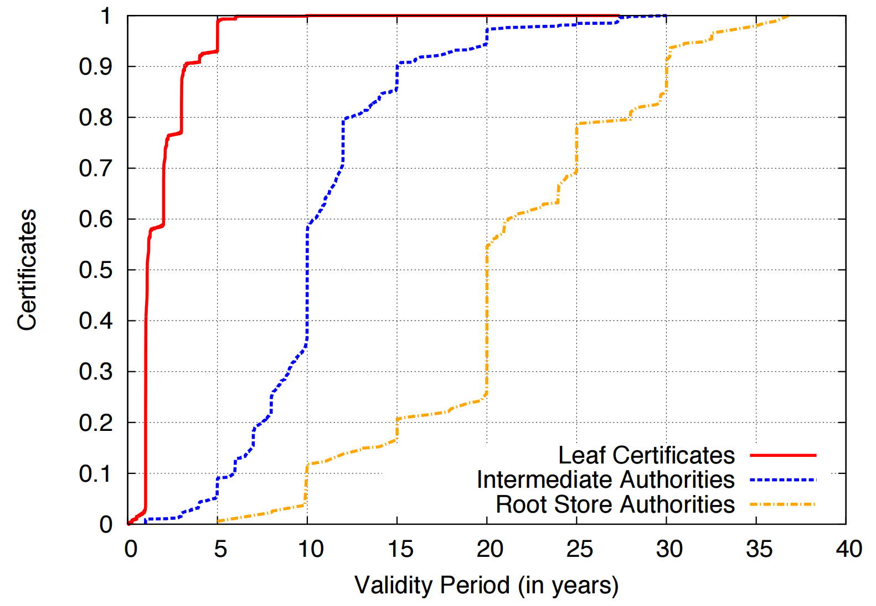
Certificate Lifetimes

Slide 97
Revocation
Certificate revocations are another fundamental mechanism for mitigating secret key compromises
After a secret key has been compromised, the owner is supposed to revoke the certificate
CA’s are responsible for hosting databases of revoked certificates that they issued
Clients are supposed to query the revocation status of all certificates they encounter during validation
If a certificate is revoked, the client should never accept it
Two revocation protocols for TLS certificates
Certificate Revocation Lists (CRLs)
Online Certificate Status Protocol (OCSP)

Slide 98
Certificate Revocation Lists
CRLs are the original mechanism for announcing and querying the revocation status of certificates
CAs compile lists of serial numbers of revoked certificates
URL for the list is included in each cert issued by the CA
CRL is signed by the CA to protect integrity

Slide 99
X.509 Certificates, Revisited
If the cert is revoked, this serial number will appear in the CRL
Certificate:
Data:
Subject: businessCategory=Private Organization/1.3.6.1.4.1.311.60.2.1.3=US/1.3.6.1.4.1.311.60.2.1.2=Delaware/serialNumber=5157550/street=548 4th Street/postalCode=94107, C=US, ST=California, L=San Francisco, O=GitHub, Inc., CN=github.com
X509v3 extensions:
X509v3 Subject Alternative Name:
DNS:github.com, DNS:www.github.com
X509v3 CRL Distribution Points:
Full Name:
URI:http://crl3.digicert.com/sha2-ev-server-g1.crl
Full Name:
URI:http://crl4.digicert.com/sha2-ev-server-g1.crl
Authority Information Access:
OCSP - URI:http://ocsp.digicert.com
URLs where clients can find the CRLs for this cert

Slide 100
CRL Example
Whoa, C_{BofA} has been revoked!
CRL
C_{a}
C_{b}
C_{BofA}
http://crl.verisign.com/master.crl
Please revoke C_{BofA}
BofA
We’ve been robbed!
S_{BofA}
BofA
S*_{BofA}
*BofA

Slide 101
Problems with CRLs
Clients should check the revocation status of every cert they encounter
Leaf, intermediate, and root certs
Problems
Latency – additional RTTs of latency are needed to download CRLs before a page will load
Size – CRLs can grow to be quite large (~MBs), downloads may be slow
MitM attackers can block access to the CRL/OCSP URLs
Browsers default-accept certificates if the revocation status cannot be checked
Known as soft-fail or fail-open security posture
Does caching CRLs mitigate these performance problems?
Yes, somewhat
But caching CRLs for long periods is dangerous: they may be out of date

Slide 102
Online Certificate Status Protocol
OCSP is the modern replacement for CRLs
API-style protocol that allows clients to query the revocation status of one or more certs
No longer necessary to download the entire CRL
CA’s host an OCSP server that clients may query
OCSP URL included in OCSP-compliant certs
Responses are signed by the CA to maintain integrity
Responses also include an expiration date to prevent replay attacks

Slide 103
X.509 Certificates, Revisited
Query the serial number to see if this cert has been revoked
Certificate:
Data:
Subject: businessCategory=Private Organization/1.3.6.1.4.1.311.60.2.1.3=US/1.3.6.1.4.1.311.60.2.1.2=Delaware/serialNumber=5157550/street=548 4th Street/postalCode=94107, C=US, ST=California, L=San Francisco, O=GitHub, Inc., CN=github.com
X509v3 extensions:
X509v3 Subject Alternative Name:
DNS:github.com, DNS:www.github.com
X509v3 CRL Distribution Points:
Full Name:
URI:http://crl3.digicert.com/sha2-ev-server-g1.crl
Full Name:
URI:http://crl4.digicert.com/sha2-ev-server-g1.crl
Authority Information Access:
OCSP - URI:http://ocsp.digicert.com
URLs where clients can find the OCSP server for this cert

Slide 104
OCSP Example
OCSP Database
C_{a}
C_{b}
C_{BofA}
Yes it is.
http://ocsp.verisign.com
Is C_{BofA} revoked?
Please revoke C_{BofA}
BofA
We’ve been robbed!
Good – Clients no longer need to download the entire CRL
Bad – Attackers can still block access to the OCSP server
Bad – OCSP check still adds latency to TLS connections
Bad – OCSP potentially violates user privacy
S_{BofA}
BofA
S*_{BofA}
*BofA

Slide 105
OCSP Must-Staple
OCSP Database
C_{a}
C_{b}
C_{BofA}
Client only accepts the cert if the OCSP response is stapled and valid
No, its not.
Yes, it is.
ocsp.verisign.com
The good:
Clients don’t need to query revocation status at all
Attacker cannot prevent clients from receiving revocation information
No leakage of browsing history
The bad: OCSP Must-Staple is very new, not supported by many browsers and certs
BofA
http://ocsp.verisign.com
BofA
Is C_{BofA} revoked?
Is C_{BofA} revoked?
S_{BofA}
OCSP response is “stapled” to the cert
BofA

Slide 106
Revocation in Practice
Revocation is one of the most broken parts of the TLS ecosystem
MitM attackers can block access to the CRL/OCSP URLs
Browsers default-accept certificates if the revocation status cannot be checked
Solved by OCSP Must-Staple, but this extension is not well deployed
Many browsers no longer perform proper revocation checks
Firefox only supports OCSP
Chrome only does OCSP checks on EV certs, and only on some platforms
Windows – Yes, Linux and Android – No
Chrome uses an alternative implementation called CRLset which is busted
Mobile browsers never check for revocations
Adds additional latency to HTTPS connections onto already slow mobile networks
Many administrators fail to revoke compromised certificates

