Slide 1
CY 2550 Foundations of Cybersecurity
Cyberlaw and Cybersecurity Ethics

Slide 2
Learning Outcomes
Cryptography, passwords, and authentication
Exercised your password cracking skills
Vulnerabilities and exploits
Practice performing live exploits
Cybercrime underground
How the criminals make money

Slide 3
Cybersecurity is A Fraught Subject
Many laws govern cybersecurity
Designed to help prosecute criminals
Discourage destructive or fraudulent activities
However, these laws are broad and often vague
Easy to violate these laws accidentally
Security professionals must be cautious and protect themselves
Cybersecurity raises complex ethical questions
When and how to disclose vulnerabilities
How to handle leaked data
Line between observing and enabling crime
Balancing security vs. autonomy
Ethical norms must be respected
Rights and expectations of individuals and companies
Community best-practices

Slide 4
Legal != Ethical
Illegal != Unethical

Slide 5
Disclaimer: I am not a lawyer, and nothing in this lecture should be construed as legal advice.
If you believe you may be at legal risk, seek advice from a lawyer.
Grey hat hacking: Electronic Frontier Foundation (eff.org)
Privacy and surveillance: Electronic Privacy Information Center (epic.org)

Slide 6
US Computer Fraud and Abuse Act (CFAA)

Slide 7
How Are Cybercriminals Prosecuted?

Slide 8
Pyotr Levashov, a.k.a. Severa
Highly prolific spammer for SpamIt pharma affiliate program
Moderator of spamdot.biz
Possible operator of the Storm, Waledac, and Kelihos botnets
Arrested in Barcelona in April 2017
Extradited to the US in Feb 2018

Slide 9
Charges Against Severa
One count of causing intentional damage to a protected computer
One count of accessing protected computers in furtherance of fraud
One count of threatening to damage a protected computer
One count of conspiracy
One count of wire fraud
Two counts of fraud in connection with email
One count of aggravated identity theft
CFAA
CAN-SPAM Act

Slide 10
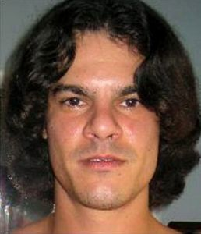
Albert Gonzalez
Led hacks against TJ Maxx, Heartland Payment Systems , 7-Eleven, BJ’s Wholesale Club, OfficeMax, Boston Market, Barnes & Noble and Sports Authority
TJX hack netted 94 million stolen credit cards
Caught and sentenced to 20 years in March 2010

Slide 11
Charges Against Gonzalez
Conspiracy
Wire fraud
Aggravated identity theft
Computer fraud
Access device fraud
CFAA

Slide 12
Marcus Hutchins, aka malwaretech
Anti-malware researcher
Accidentally stopped the WannaCry malware outbreak
Arrested in August 2017
Accused of writing, selling, and possibly operating the Kronos banking trojan

Slide 13
Charges Against malwaretech
Original charges
One count of conspiracy
One count of causing intentional damage to a protected computer
Four counts of illegal wiretapping
Bonus charges!
Lying to federal investigators
CFAA violations for writing malware
Contributory CFAA violations for selling malware
Wiretapping

Slide 14
Computer Fraud and Abuse Act of 1986
(Supposedly) written and enacted in response to the movie WarGames
Prohibits accessing a protected computer without authorization, or in excess of authorization
Provides civil and criminal penalties

Slide 15
CFAA Details
What is a “protected computer”?
“[Any computer] used in or affecting interstate or foreign commerce or communication”
Essentially, any computer connected to the internet
Criminal offenses
Unauthorized access to information on a protected computer
Leveraging unauthorized access to commit fraud for something of value worth >$5000
Causing damage or loss to a protected computer
Threatening to cause damage to or steal information from a protected computer without authorization
Covers worms, viruses, DDoS, computer trespass, computer fraud, computer espionage, password theft, etc.

Slide 16
Notable CFAA Prosecutions
Robert Morris for releasing the Morris worm
US v. Collins: against members of Anonymous for DDoSing Paypal
Albert Gonzalez for the TJX hack
Numerous cybercriminals, such as Severa

Slide 17
How Does the CFAA Impact Cybersecurity Researchers?

Slide 18
Infamous CFAA Prosecutions
US v Lori Drew: Drew created a fake MySpace account and used it to harass a young girl, who later committed suicide
Drew was charged under CFAA for violation MySpace’s Terms of Service
ToS said fake accounts were unauthorized
US v Nosal: Nosal stole a database from his former employer using credentials borrowed from a current employee
Account sharing violated the computer use policy for the corporate network

Slide 19
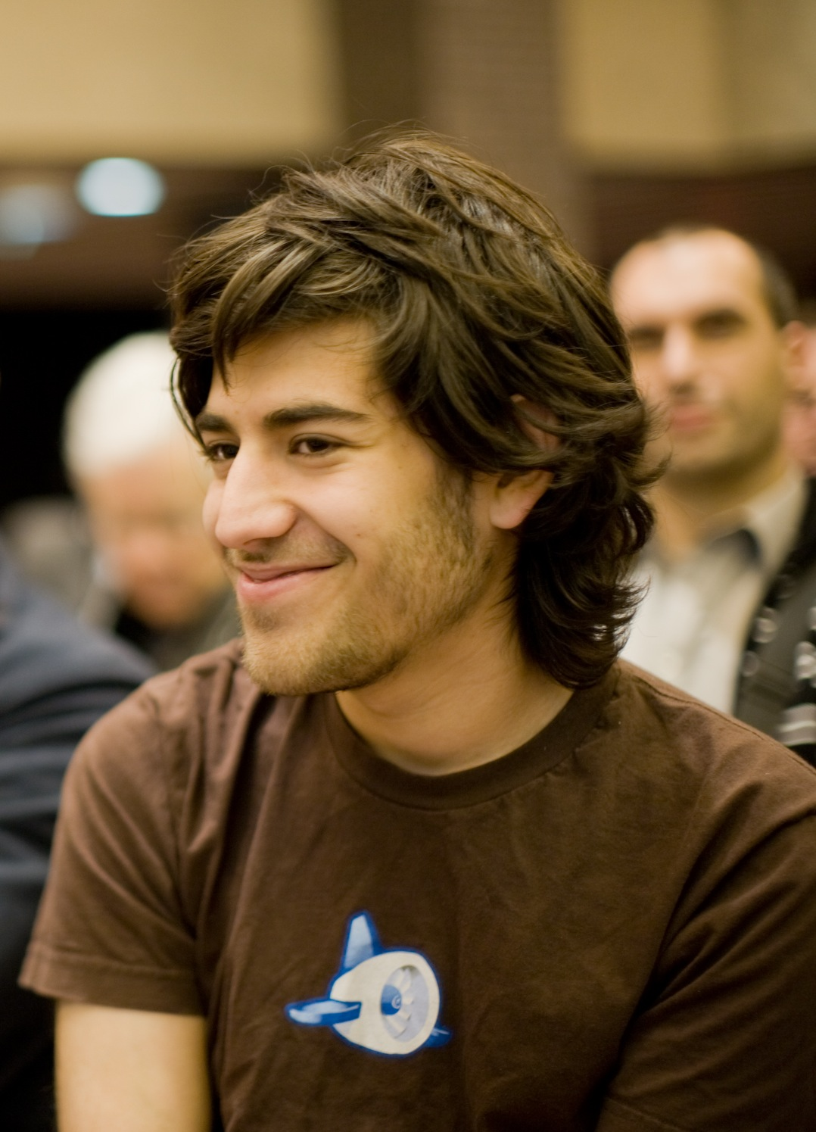
Aaron Swartz
Developer and internet activist
Co-developer of RSS and Markdown
Founder of Demand Progress
January 2011: Aaron was arrested for crawling papers from JSTOR
JSTOR is a for-profit publisher of academic papers
Aaron believed research results should be available to the public
Broke into a wiring closet at MIT and setup a laptop to download papers
U.S. Attorney for Massachusetts Carmen Ortiz charged Aaron with 13 counts under the CFAA
Even though MIT and JSTOR decline to press charges
35 years in prison and $1m max fine
Aaron committed suicide

Slide 20
The Problem of Authorization
Definition of “authorized” in the CFAA is ambiguous
Who decides what computers may be accessed or are “protected”?
Who decides how a computer may be accessed?
Different circuit courts have different interpretations
Authorization is defined by policy
Terms of Service, Computer Use Policy, etc.
Authorization is defined by mechanism
Access control systems
Firewalls
IP blockades

Slide 21
Access Versus Use
CFAA criminalizes access violations
But, CFAA threats have been brought for violating use policies
Example: LinkedIn vs. HiQ
HiQ scrapes data from LinkedIn and uses it for analytics
The data comes from public profiles
Anyone may access this data, even without a LinkedIn account
LinkedIn’s ToS says you may visit the website, but you may not record anything from the website
How you intend to use the data matters
Are use violations also CFAA violations?

Slide 22
Cautionary Tale
Kevin Finisterre identified several serious problems with DJI drones
Found SSL private keys and AES firmware encryption keys in DJI’s public GitHub
Gained access to DJI servers containing customer data and business records
DJI had a bug bounty program
Kevin disclosed his findings to DJI, did not go public
DJI agreed to $30k reward
However, DJI demanded an extremely restrictive NDA before paying the bounty
Threatened CFAA prosecution of Kevin did not comply
Ultimately, gave up the bounty and went public

Slide 23
Happy Ending?
DJI completely overhauled their bug bounty terms
Now one of the best in the industry
“By participating in this program and abiding by these terms, DJI grants you limited “authorized access” to its systems under the Computer Fraud and Abuse Act in accordance with the terms of the program and will waive any claims under the Digital Millennium Copyright Act (DCMA) and other relevant laws.”
-- https://security.dji.com/policy?lang=en_US

Slide 24
US Digital Millennium Copyright Act

Slide 25
Digital Millennium Copyright Act of 1998
Intended to criminalize circumvention of Digital Rights Management (DRM) software
Mechanisms used to prevent copyright infringement
Copy protection on videogames, software, digital media, etc.
Criminalizes circumvention of access controls
Regardless of whether you infringe copyrights
Criminalizes the distribution of circumvention tools
Regardless of whether you infringe copyrights
The Librarian of Congress may issue exemptions
Exemptions reviewed and changed every three years

Slide 26
Scope of the Law
What are copyright access control mechanisms?
Encryption on copyrighted works
CSS → DVD, AACS → Bluray, Apple FairPlay → eBooks and music
High-bandwidth Digital Content Protection (HDCP) encrypts HDMI connections
Copy protection software and mechanisms
SecuROM and SafeDisc for videogames
Mandatory USB dongles
Watermarks
Steganographic marker embedded in media or software
Unfortunately, scope of the DMCA is very broad
Any software can be copyrighted
Any encryption may be considered an access control mechanism
Authentication is also an access control mechanism

Slide 27
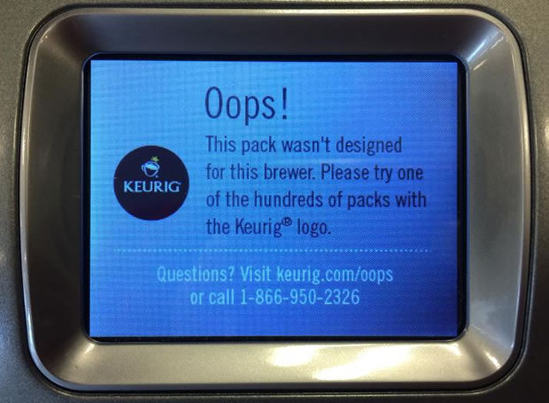

Slide 28
Chilling DRM Research
2000: SDMI issues a challenge to security researchers
Secure Digital Music Initiative
Asked researchers to crack a digital music watermarking scheme
Team from Princeton led by Ed Felten completes the challenge
SDMI threatens the team with DMCA claims to prevent publication
Team eventually publishes after suing SDMI
Similar fights have happened between Intel and researchers who found flaws in HDCP

Slide 29
Chilling Vulnerability Research
2002: proof-of-concept exploits for bugs in HP Unix
HP threatens researchers with DMCA violations
2003: vulnerabilities in Blackboard’s electronic ID cards
Blackboard uses DMCA to halt presentation of security research
2003: vulnerabilities in GameSpy’s online services
GameSpy’s lawyers threaten the researcher under DMCA
Researcher removes findings from the web

Slide 30
Getting Out of Hand
Sony sues George Hotz (geohot) for jailbreaking the Playstation 3
Required exploiting the PS3’s secure (encrypted) bootloader
Sony claimed the jailbreak allowed people to play pirated games
Craigslist sues companies that interface with their website
Provide tools for automating and managing posts
Circumvented CAPTCHA to enable this functionality
iPhones locked to the App Store and specific mobile carriers
Lexmark sues companies that sell aftermarket ink cartridges
Cartridges include authentication chips
Company sues former contractor for connecting to VPN
Argues that authorization to connect was withdrawn, therefor connecting was circumvention

Slide 31
Notable Exemptions
Current exemptions ratified by Library of Congress in 2018
Exemptions for good-faith research on:
Consumer electronics and IoT devices
Medical devices
Voting machines
Repped by Andrea Matwyshyn, former NEU Law Professor
Jailbreaking and unlocking phones and digital assistants (e.g. Amazon Echo)
Warning: exemptions are not permanent or all-inclusive
Must have legal access to the device or software
Cannot violate other laws, like the CFAA

Slide 32
Takeaways
If you are doing security research on a device you own, or software on a device in your possession
You need to be careful of the DMCA
If you are doing security research on a remote service via the internet
You need to be careful of the DMCA and the CFAA
Vulnerability research on companies that do not have bug bounty programs is very risky
However, bug bounty programs do not guarantee zero risk either!

Slide 33
Bug Bounty Programs
Most big tech companies have them
Google, Facebook, Amazon, Apple…
Bug bounty platforms
Manage bounty programs for hundreds of companies
Each company’s bounty program has different rules and terms
Read them before you start your research!

Slide 34
US Controlling the Assault of Non-Solicited Pornography And Marketing Act

Slide 35
CAN-SPAM Act of 2003
Controlling the Assault of Non-Solicited Pornography And Marketing Act
Main provisions:
Email headers cannot be spoofed
Email cannot be sent through open relays
Email must contain a working unsubscribe option
Email cannot be sent to a harvested email addresses
Emails with explicit content must be prominently labeled
Criminal and civil penalties
Federal Trade Commission enforces civil components

Slide 36
The Good
Legitimate marketing emails all contain opt-out links now
Many cases of civil and criminal enforcement
Months to years of jail time
Penalties ranging from $10k t0 $1.3m

Slide 37
The Bad
Often called the YOU-CAN-SPAM act
Enshrines an opt-out system, rather than opt-in
Superseded stricter state laws
Fails to effectively handle affiliate programs
Company claims “all the spam was sent by my affiliate partners”
Company’s affiliate agreement prohibits spam…
Even if the provision was never actually enforced
Law asked the FTC to study the creation of a Do-Not-Spam list
FTC completely rejected this idea
Most spam is sent by criminals
News flash: they don’t care about the law

Slide 38
Beware The Unsubscribe Link
To be CAN-SPAM compliant, legit marketing emails all contain an unsubscribe link
Actual spam also now contain unsubscribe links. Why?
The links are fake
Lead to drive-by download or scam sites
Clicking the link enables the spammer to determine that you saw their spam!
Prepare to get a lot more spam!!
Example of unintended consequences

Slide 39
So Much More to Learn
Things we haven’t covered:
International law
State law
Intellectual property law
Copyright
Patents
Trade secrets
Wiretap laws
Privacy laws
US: HIPAA, COPPA, FCRA
Europe: GDPR (and soon, Cal Privacy in California)
Mandatory breach notifications

Slide 40
Brief Intro to Ethics

Slide 41
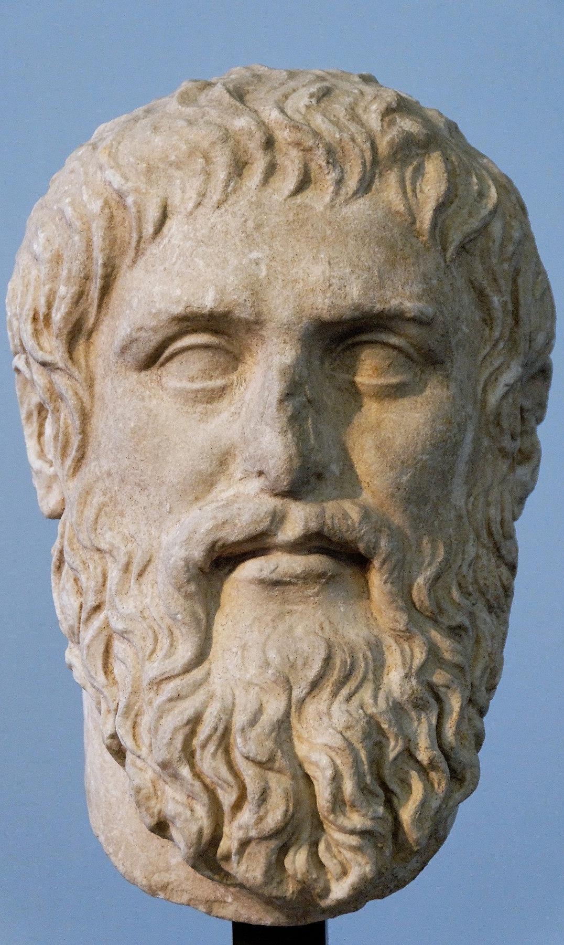
What is Ethics?
Science of the ideal human character
Speaks to some amorphous “perfect” person
Principles to help grapples with human values
Guiding force behind law
Moral principles of a particular tradition
Behavior that accords with social conventions
Cultural norms as baseline

Slide 42
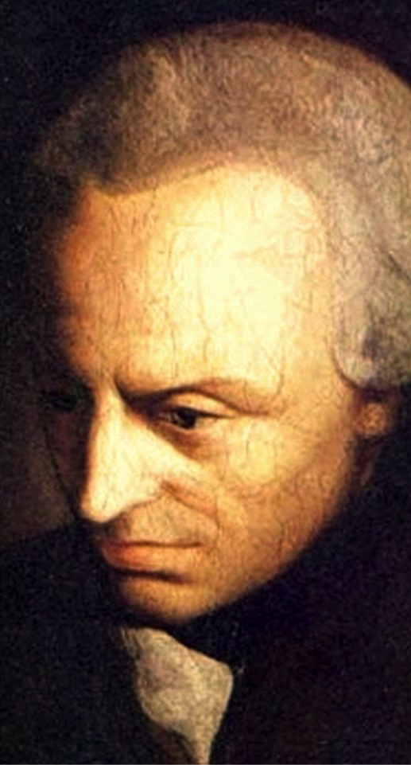
Many Schools of Thought
Virtue Ethics
What increases the common good, or “human flourishing”?
Deontological
Morality is based on compliance with normative rules (duties)
Actions themselves are more important than consequences
Consequentialism
Consequences of an act are the basis for moral judgment
“The ends justify the means”

Slide 43
Case Study: Forced Inoculation
Some researchers developed counter-worms to scan the Internet and patch vulnerable hosts
Normal worms infect and exploit victim machines
Counter-worm infects and patches victim machines
Is this sort of response justified?
Millions of vulnerable devices get enslaved in botnets
Botnets cause billions of dollars in damage (DDoS, spam, theft, etc.)
People often do not know how to disinfect and/or patch devices
Is it ethical?
Deontologists – No! Actions are risky and illegal
Consequentialists – Yes! Outcomes are mostly beneficial

Slide 44
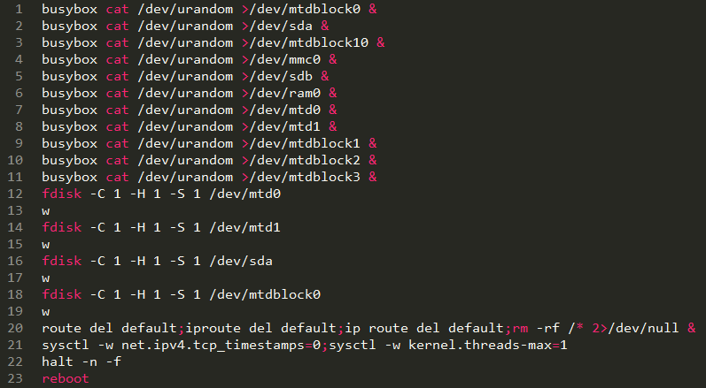
Extreme Example: Brickerbot
Worm that is based on the Mirai code
Infects and destroys vulnerable IoT devices

Slide 45
Case Study: Hacking Back
“Active Cyber Defense”
Idea that victims of attacks should be able to attack the perpetrator
Doesn’t a good defense require offense?
Active Cyber Defense Certainty Act (2017) would legalize hacking back
Victim must notify the FBI National Cyber Investigative Joint Task Force
May only destroy data that originally belonged to the victim
Is it ethical?
Deontologists – No! Actions are risky and illegal
Consider the implications of international law
Consequentialists – Maybe. Attack attribution is very hard
Attackers often hide by using (possibly hacked) intermediaries

Slide 46
Case Study: Data from Breaches
Hackers often steal and leak datasets
Underground forums
Business records from pharma affiliates and fake-AV scammers
Password datasets
“Found data” can be an extremely valuable resource
Pharmaleaks research led to better approaches for law enforcement
haveibeenpwned.com tests password strength vs. leaked datasets
Is it ethical?
Deontologists – Maybe. Does using stolen data encourage future breaches?
Consequentialists – Yes! Beneficial outcomes, little/no additional harm

Slide 47
Responsible Disclosure

Slide 48
Case Study: Vulnerability Disclosure
People find (exploitable) vulnerabilities in systems all the time
Who to disclose to, and when?
Never: sell the zero-day info and make $$$
Go public immediately
Warns the public immediately
Puts any attackers holding the vulnerability on notice
Forces the system developer to address the issue immediately
Non-public disclosure to the vendor
Enables the vendor to develop a patch

Slide 49
Case Study: Vulnerability Disclosure
People find (exploitable) vulnerabilities in systems all the time
Who to disclose to, and when?
Never, Sell the Zero-Day
Go Public Immediately
Just Disclose to the Vendor
Pros:
$$$
Three letter agencies may put the zero-day to “good use”
Cons:
Attackers may also discover and leverage the bug
Vulnerable population may be victimized
Pros:
Warns the public immediately
Forces the system developer to address the issue immediately
Cons:
Gives attackers a window of time to weaponize the bug
Pros:
Enables the vendor to develop a patch
Doesn’t give attackers any information
Cons:
Vendor may ignore the problem
Attackers may also discover and leverage the bug

Slide 50
Responsible Disclosure
Bedrock principle of the white-hat cybersecurity community
Disclose to the vendor
Provide full information, including proof-of-concept code if possible
Establish a timeline for full disclosure
Days? Weeks? Months?
Depends on the severity of the problem and difficulty of developing/deploying mitigations/patches
Coordinate response with third-parties
Law enforcement
Organizations like CERT
Severely impacted companies
Full disclosure to the public

Slide 51
Ethics of Responsible Disclosure
Considered a best practice, but still hotly contested
No or little (bug bounty) compensation for hackers
Does this achieve the greatest good?
Debates about the timing of full disclosure
How to balance pressure to patch with public awareness?
Example: Google’s Project Zero
Infamous for inflexible disclosure deadlines
Debates about coordinated response
Why do “privileged” parties get information ahead of time?
Example: HeartBleed, Meltdown, and Spectre
Google, Amazon, etc. were told before anyone else

Slide 52
Value Sensitive Design

Slide 53
How to Think About Ethics
There will never be universal and comprehensive answers
Cybersecurity professionals may have a duty of care to people who use technology
This is common with professionals
Doctors are expected to care for patients’ health
Lawyers are expected to care for clients’ legal needs
Teachers are expected to care for students’ education needs
Virtue ethics
What maximizes public good?
What minimizes harm to the public?
Need to find balance between the two

Slide 54
Value Sensitive Design
Identify stakeholders
Identify the values at stake for these stakeholders
Identify where value tradeoffs are necessary
Prioritize important values
Use this to define success

Slide 55
(1) Identify the Stakeholders
The public
Need secure systems, need protection from bad actors
System developer
Needs time to develop mitigations
Law enforcement and intelligence agencies
Use vulnerabilities to conduct information operations
Impacted companies and organizations
Entities that rely heavily on the impacted system
The bug hunter
Found the vulnerability

Slide 56
(2) Values at Stake
The bug hunter:
Altruism – desire to help people
Compensation – desire to be rewarded for the discovery
The public
Property, privacy, human welfare
System developer
Property, human welfare of their users
Reputational risk, share price, cost of developing fix, regulatory burden
Impacted companies and organizations
Property, privacy, human welfare of their users
Cost of deploying fix, regulatory burden
Law enforcement and intelligence agencies
Property, privacy, and human welfare of citizens
Ability to attack criminals and adversaries

Slide 57
(3) Value Tradeoffs, (4) Important Values
Areas of Agreement
Areas of Disagreement
Property, privacy, human welfare
Financial reward
Offensive capabilities
Reputational risk
Cost to develop mitigations
Duty of care: cybersecurity professionals must help people
Virtue ethics: Maximize public good, minimize public risk

Slide 58
(5) Define Success
Maximize likelihood that vulnerability will be mitigated
Minimize likelihood that adversaries will weaponize vulnerability
Responsible disclosure:
Disclose to the vendor
Coordinate response with third-parties
Full disclosure to the public

Slide 59
How to Think About Ethics
There may be not be a definitive right answer, but there are definitely wrong answers
Failing to consider the ethical and moral implications of cybersecurity is wrong
Value Sensitive Design is a tool to help you identify who is impacted and the values at stake
Committing to duty of care and virtue ethics means advocating for the security and privacy of people over competing interests

Slide 60
Sources
EFF:
Coders’ Rights Project Reverse Engineering FAQ, https://www.eff.org/issues/coders/reverse-engineering-faq
Coders’ Rights Project Vulnerability Reporting FAQ, https://www.eff.org/issues/coders/vulnerability-reporting-faq
A “Grey Hat” Guide, https://www.eff.org/pages/grey-hat-guide
Unintended Consequences: Sixteen Years under the DMCA, https://www.eff.org/files/2014/09/16/unintendedconsequences2014.pdf
US DOJ:
Leader of Hacking Ring Sentenced for Massive Identity Thefts from Payment Processor and U.S. Retail Networks, https://www.justice.gov/opa/pr/leader-hacking-ring-sentenced-massive-identity-thefts-payment-processor-and-us-retail
Russian National Indicted with Multiple Offenses in Connection with Kelihos Botnet, https://www.justice.gov/opa/pr/russian-national-indicted-multiple-offenses-connection-kelihos-botnet
Are Bug Bounty Program Safe for Whitehats?, https://www.usenix.org/node/208178

