Slide 1
CY 2550 Foundations of Cybersecurity
(Distributed) Denial of Service

Slide 2
Security Properties, Revisited
Confidentiality
Integrity
Authenticity
Availability
Data and resources must be accessible when required
Related to integrity, but more concerned with denial of service (DoS)
Resource exhaustion (e.g., CPU, memory, network bandwidth)
Usually easy to perform, and very difficult to defend against

Slide 3
Ping
Essential, low-level network utility
Sends a “ping” ICMP message to a host on the internet
$ ping 66.66.0.255
PING 66.66.0.255 (66.66.0.255) 56(84) bytes of data.
64 bytes from 66.66.0.255: icmp_seq=1 ttl=58 time=41.2 ms
Destination host is supposed to respond with a “pong”
Indicating that it can receive packets
By default, ping messages are 56 bytes long (+ some header bytes)
Maximum size 65535 bytes
What if you send a ping that is >65535 bytes long?

Slide 4
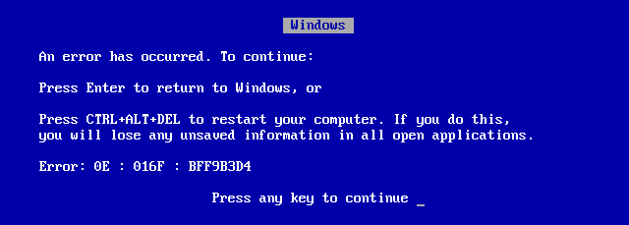
Ping of Death
$ ping –s 65535 66.66.0.255

Slide 5
iOS Telegu Unicode Bug
February 2018: iPhones and iPads crash if they receive text or email containing a specific symbol in Indian
In some cases, reboot doesn’t solve the issue
Apps reload bugged messages automatically on startup and crash again
Device wipe is sometimes the only fix

Slide 6
Denial of Service (DoS)
Prevent a person from being able to access a specific computer, service, or piece of data
In essence, an attack on availability
Possible vectors:
Exploit bugs that lead to crashes
Exhaust the resources of a target
Often very easy to perform…
… and fiendishly difficult to mitigate

Slide 7
Distributed Denial of Service

Slide 8
Attacker Goals and Threat Model
Goal is to reduce the availability of the victim
Active attacker who may send arbitrary packets
Resource exhaustion attack, not a bug or exploit
I wanna knock those servers offline… but how?
Internet
Servers
128.91.0.*
66.66.0.11

Slide 9
DoS Attack Parameters
Goal: exhaust the victim’s bandwidth
How much bandwidth is available to the attacker?
Can be increased by controlling more resources…
Or tricking others into participating in the attack
What kind of packets do you send to victim?
Minimize effort and risk of detection for the attacker…
While also maximizing damage to the victim

Slide 10
Exploiting Asymmetry
Example of a Distributed Denial of Service Attack (DDoS)
How to achieve scale?
Volunteers
Reflection and amplification
Botnet
Internet
1 Mbps
10 Mbps
Server
128.91.0.1
10 Mbps
1 Mbps
66.66.0.11

Slide 11
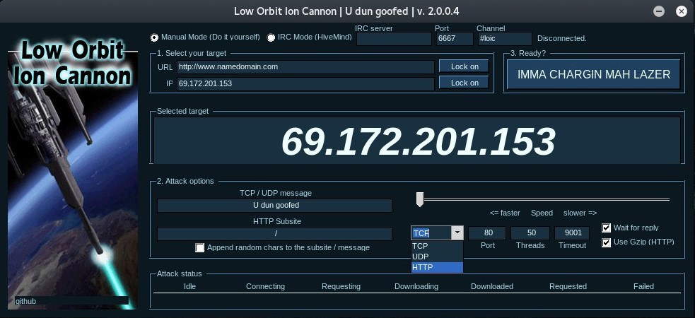
Dumbest tool ever: doesn’t spoof your IP address
Guarantees that you will be caught by law enforcement

Slide 12
The Smurf Attack
10.7.0.0
10.7.0.1
…
10.7.0.253
10.7.0.254
PING Request
Src: 128.91.0.1
Dst: 10.7.0.255
*.*.*.255 is a broadcast packet
Forwarded to all hosts in the /24
Internet
Server
128.91.0.1
66.66.0.11

Slide 13
Why Does Smurfing Work?
ICMP protocol does not include authentication
No connections
Receivers accept messages without verifying the source
Enables attackers to spoof the source of messages
Attacker benefits from an amplification factor
$$amp factor=\frac{total response size}{request size}$$
Smurf amp factor → [number of servers that respond to the broadcast]:1

Slide 14
Reflection/Amplification Attacks
Smurfing is an example of a reflection or amplification DDoS attack
Fraggle attack also relies on broadcasts for amplification
Send spoofed UDP packets to IP broadcast addresses on port 7 (echo) and 13 (chargen)
echo – 1500 bytes/pkt requests, equal size responses
chargen – 28 bytes/pkt request, 10K-100K bytes of ASCII in response
Amp factor
echo → [number of hosts responding to the broadcast]:1
chargen → [number of hosts responding to the broadcast]*360:1

Slide 15
DNS Reflection Attack
Spoof DNS requests to many open DNS resolvers
DNS is a UDP-based protocol, no authentication of requests
Open resolvers accept requests from any client
E.g. 8.8.8.8, 8.8.4.4, 1.1.1.1, 1.0.0.1
February 2014 – 25 million open DNS resolvers on the internet
64 byte DNS queries generate large responses
Old-school “A” record query → maximum 512 byte response
EDNS0 extension “ANY” record query → 1000-6000 byte response
E.g. $ dig ANY isc.org
Amp factor – 180:1
Attackers have been known to register their own domains and install very large records just to enable reflection attacks!

Slide 16
Reflection Example
DNS Request
Src: 128.91.0.1
Dst: whatever
Internet
50 Gbps
100 Gbps
5 Gbps
Server
128.91.0.1

Slide 17
NTP Reflection Attack
Spoof requests to open Network Time Protocol (NTP) servers
NTP is a UDP-based protocol, no authentication of requests
May 2014 – 2.2 million open NTP servers on the internet
234 byte queries generate large responses
monlist query: server returns a list of all recent connections
Other queries are possible, i.e. version and showpeers
Amp factor – from 10:1 to 560:1

Slide 18
memcached Reflection Attack
Spoof requests to open memcached servers
Popular <key:value> server used to cache web objects
memcached uses a UDP-based protocol, no authentication of requests
February 2018 – 50k open memcached servers on the internet
1460 byte queries generate large responses
A single query can request multiple 1MB <key:value> pairs from the database
Amp factor – up to 50000:1

Slide 19
Reflection Amplification
Protocol | Amplification Factor
memcached | 50000
NTP | 557
chargen | 359
DNS | 179
QOTD | 140
BitTorrent | 54
SSDP | 31
SNMPv2 | 6
Steam | 6
NetBIOS | 4

Slide 20
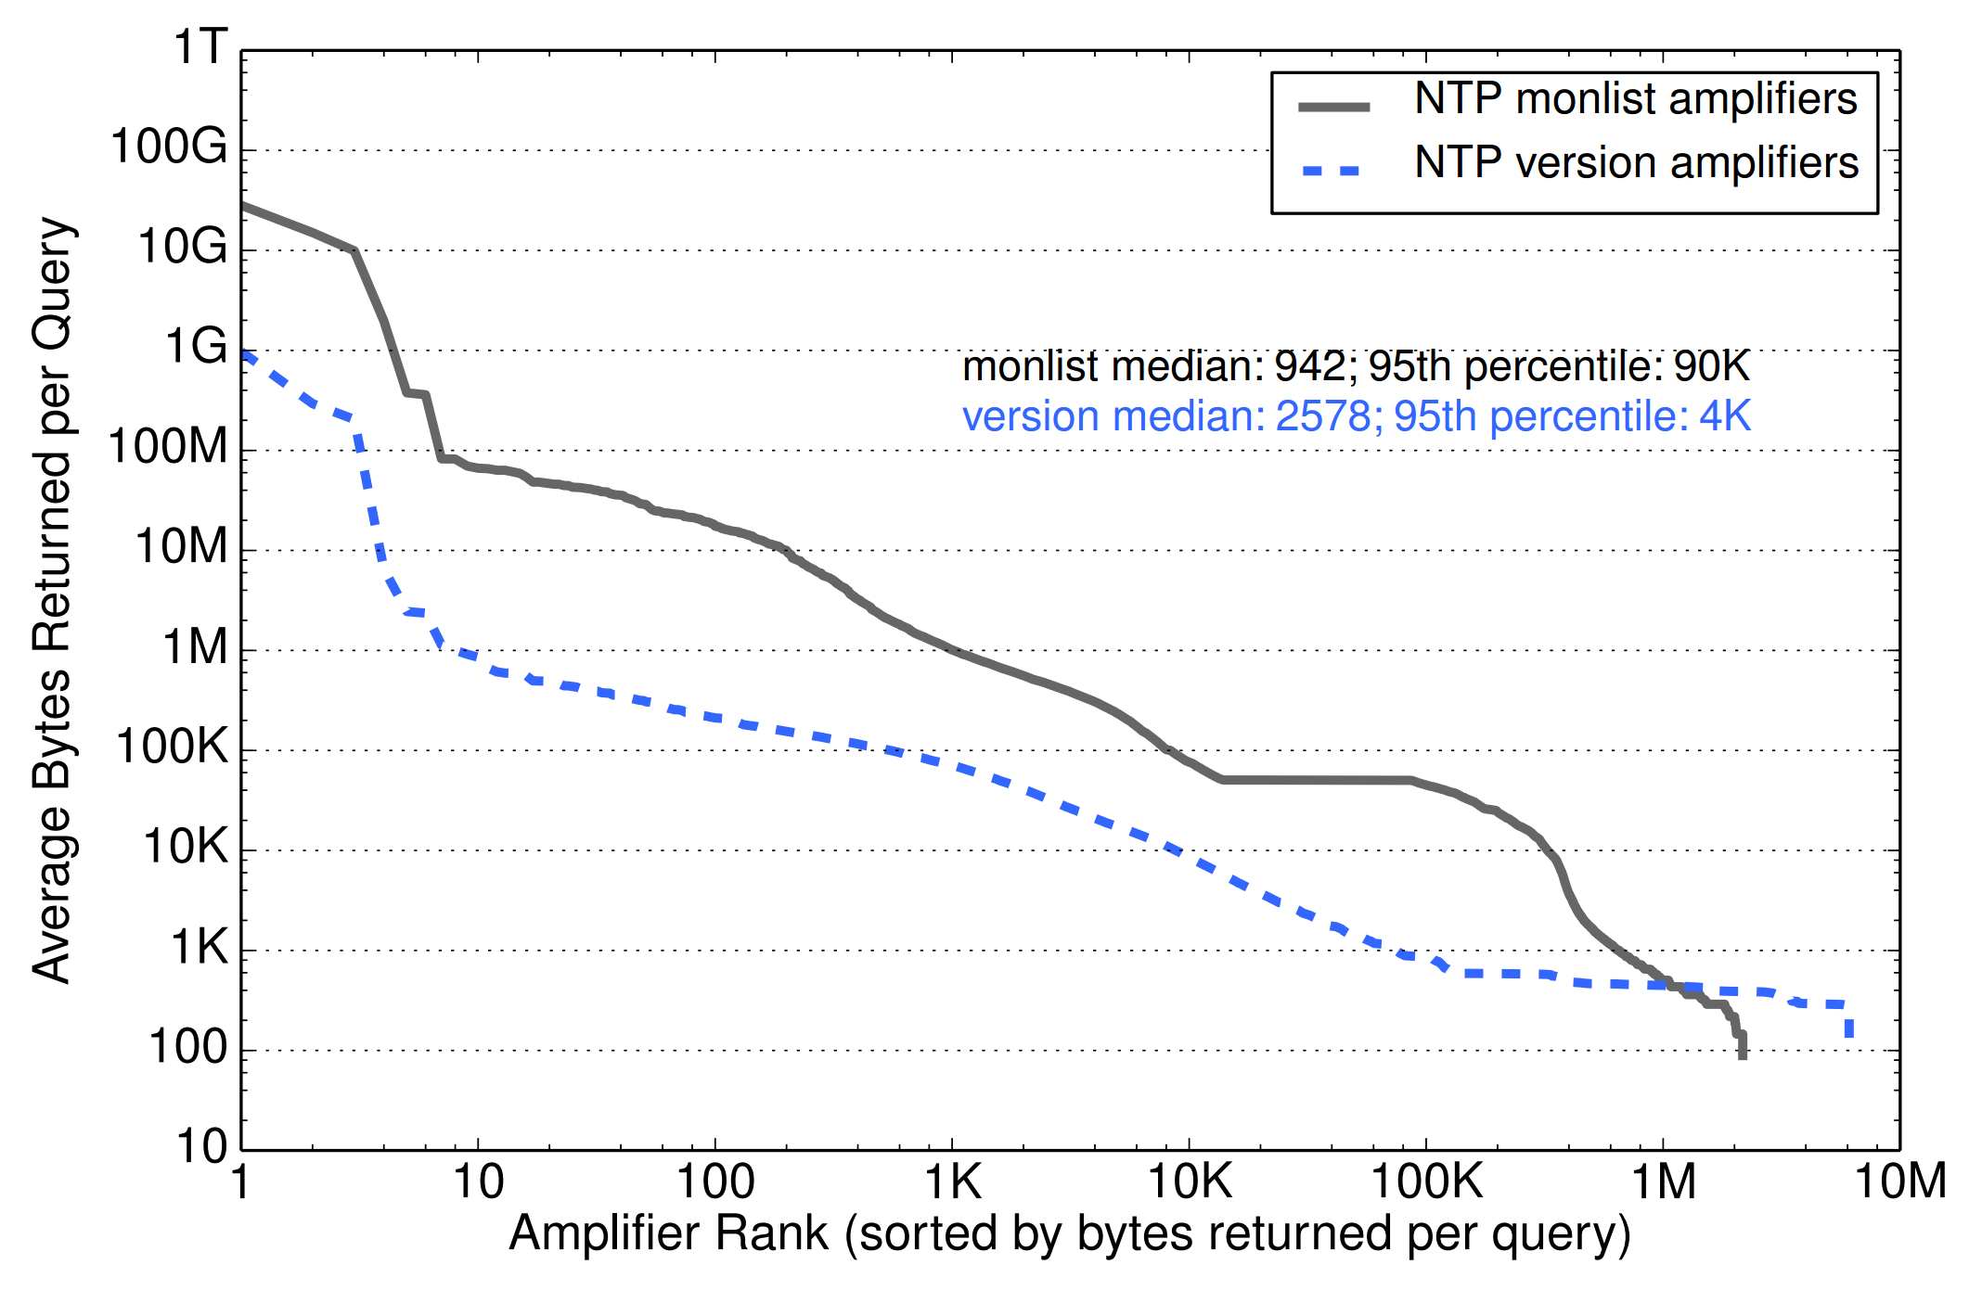
Taming the 800 Pound Gorilla: The Rise and Decline of NTP DDoS Attacks – https://dl.acm.org/citation.cfm?id=2663717

Slide 21
Infamous DDoS Attacks
When | Against Whom | Size | How
March 2013 | Spamhaus | 120 Gbps | Botnet + DNS reflection
February 2014 | Cloudflare | 400 Gbps | Botnet + NTP reflection
September 2016 | Krebs | 620 Gbps | Mirai
October 2016 | Dyn (major DNS provider) | 1.2 Tbps | Mirai
March 2018 | Github | 1.35 Tbps | Botnet + memcached refection

Slide 22
Denial of Service as a Service

Slide 23
Denial of Service as a Service
Booters and Stressors
Websites that claim to “test” a target for resilience against DDoS
Send huge amounts of traffic to a target for a fee
$10-$100 depending on the amount of traffic and duration of the “test”
Obvious front for criminal DDoS attacks
Users can “test”, i.e. attack, any website they want for a fee
Attack bandwidth drawn from botnets and bulletproof hosts
Many, many stressor services operating out in the open

Slide 24
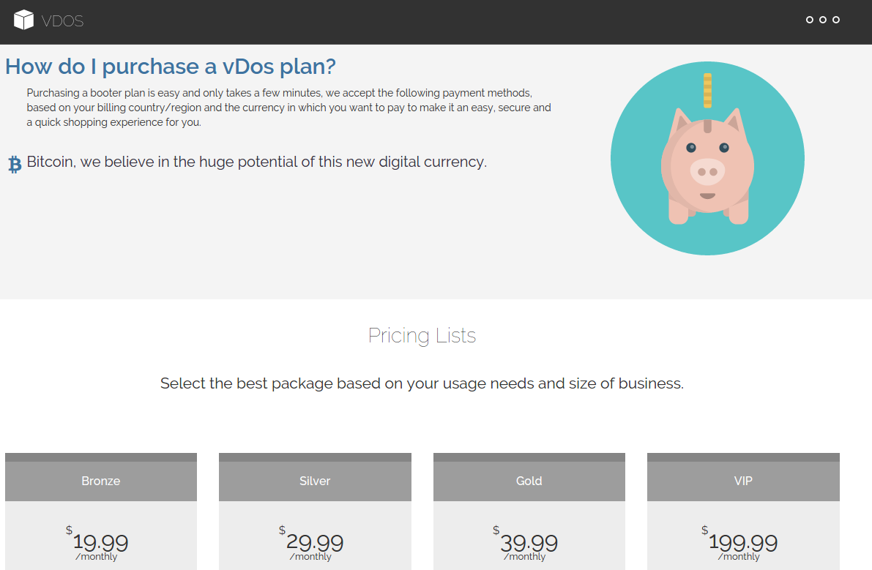

Slide 25
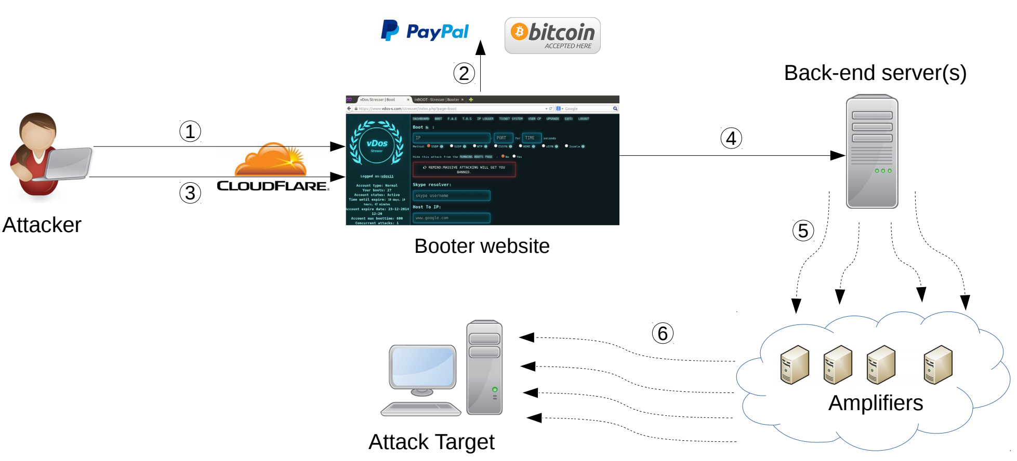
Might be bulletproof, might be a botnet

Slide 26
Hacked & Dumped Booter Services
99.4% via Paypal
Stress Testing the Booters: Understanding and Undermining the Business of DDoS Services – https://dl.acm.org/citation.cfm?id=2883004

Slide 27
Booter Attack Characteristics
Stress Testing the Booters: Understanding and Undermining the Business of DDoS Services – https://dl.acm.org/citation.cfm?id=2883004

Slide 28
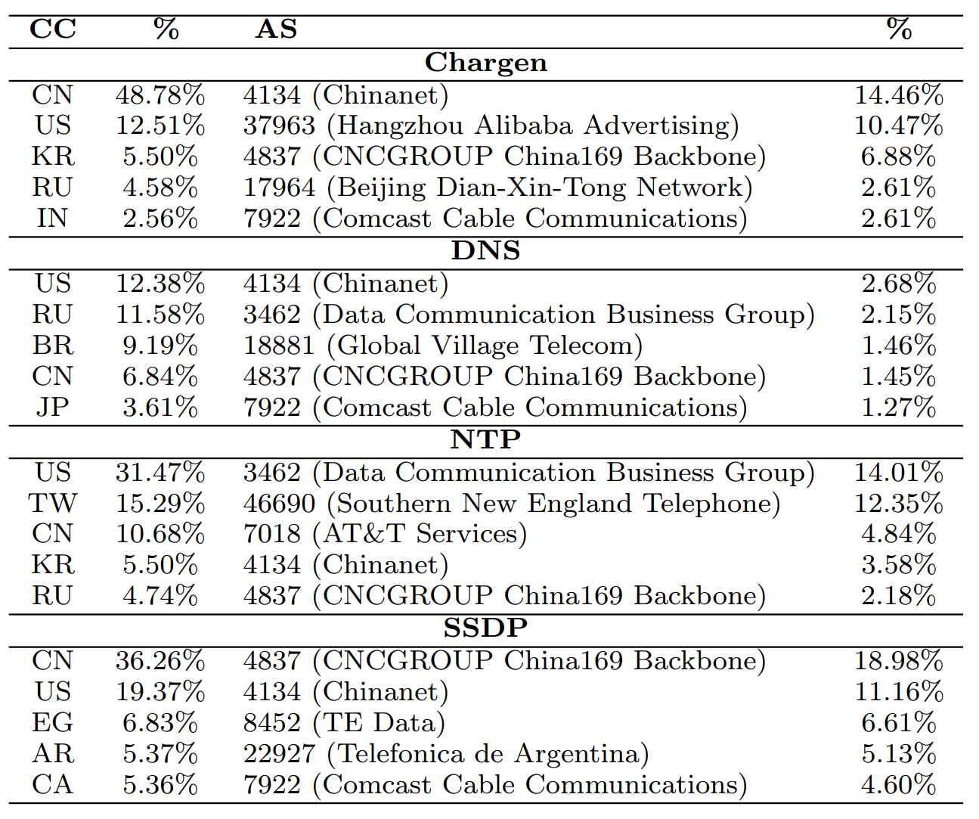
Amplifier Locations
Stress Testing the Booters: Understanding and Undermining the Business of DDoS Services – https://dl.acm.org/citation.cfm?id=2883004

Slide 29
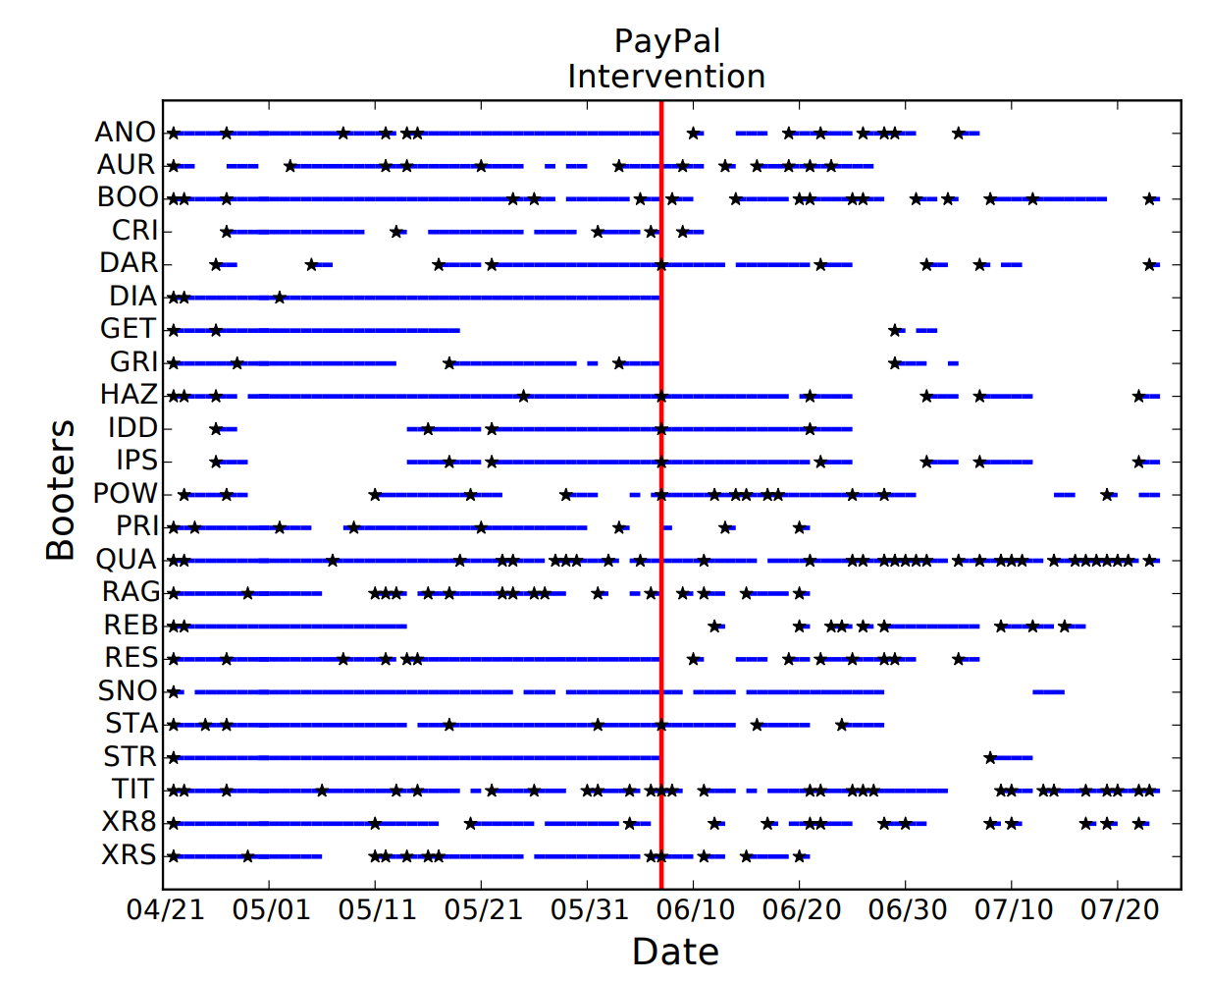
Payment Interventions
h
h
h
h
Stress Testing the Booters: Understanding and Undermining the Business of DDoS Services – https://dl.acm.org/citation.cfm?id=2883004

Slide 30
Mitigations
Anti-amplification
Filters
Anti-spoofing
CDNs

Slide 31
Potential Mitigations
Don’t become an amplifier, help shut down amplifiers
If resources aren’t available to attackers, DDoS is much harder
Network filters – traffic filtering and spoofing filters
Try to stop DDoS traffic from reaching your network
Content distribution Networks
Leverage a hosting service with a huge amount of capacity

Slide 32
Avoid Becoming an Amplifier
Don’t be part of the problem!
The behavior of your software and network impacts the well-being of others
Filter ingress IP broadcasts at the gateway router
i.e. drop anything destined to *.*.*.255
Disable non-essential services
echo, chargen, NTP, etc.
Configure services to only respond to requests from the local LAN
Firewall ports 53 (DNS), 123 (NTP), 11211 (memcached), etc.
If you write a UDP service, authenticate the sources of packets
TCP is connection-oriented, and thus much less vulnerable

Slide 33
Outreach
Researchers are trying to clean up amplifiers
Scan for servers with open services that are possible amplifiers
Manually contact server owners, ISPs, and ASs
Issue public advisories
Get vendors to issue patches that disable services or features by default

Slide 34
Example: NTP monlist Cleanup
Exit from Hell? Reducing the Impact of Amplification DDoS Attacks – https://www.usenix.org/system/files/conference/usenixsecurity14/sec14-paper-kuhrer.pdf

Slide 35
What About Filtering?
Problems:
Legitimate traffic is still blocked
How do you get Tier 1 ASs to install filters for you?
Problems:
The ingress links are still saturated
No idea where the attack is coming from
Stop
Stop
Stop
Stop
Web Server
Success! Some of the attack is halted

Slide 36
Problems With Filters
Packet filtering is not a viable solution
If you install a local filter:
Ingress links are still saturated
Very hard to distinguish DDoS packets from legitimate requests, since sources are spoofed
Remote filters work better, but:
You still need to track down the source of the attack
You have no ability to force ISPs and ASs to install filters on your behalf

Slide 37
In-Network Defenses
Why don’t ISPs/ASs drop spoofed packets?
Unicast Reverse Path Forwarding (uRPF)
Routers validate the source IP addresses against routing tables
“Unlikely” source addresses are dropped
uRPF modes:
Strict – may drop legitimate traffic (false positives)
Feasible – may accept spoofed traffic (false negatives)
Loose – only drops unroutable sources like 192.168.*.*
Most ISPs/ASs don’t implement uRPF
Unwilling to risk false positives from strict mode
No incentive to implement security measures

Slide 38
Content Delivery Networks (CDNs)
CDNs help companies scale-up their websites
Cache customer content on many replica servers
Users access the website via the replicas
Examples: Akamai, Cloudflare, Rackspace, Amazon Cloudfront, etc.
Side-benefit: DDoS protection
CDNs have many servers, and a huge amount of bandwidth
Difficult to knock all the replicas offline
Difficult to saturate all available bandwidth
No direct access to the master server
Cloudflare: 15 Tbps of bandwidth over 149 data centers

Slide 39
CDN Basics
Website content and database is here
Master
Users requests all go through the replicas
Most served from cache
Content is cached in the replicas

Slide 40
DDoS Defense via CDNs
Master
What if you DDoS the master replica?
Cached copies in the CDN still available
Easy to do ingress filtering at the master
What if you DDoS the replicas?
Difficult to kill them all
Dynamic DNS can redirect users to live replicas

Slide 41
Techniques for IP Traceback
The IP Protocol includes a Record Route option
If enabled by the sender (and supported by routers), each router inserts its IP into the packet payload
However, Record Route is off by default
No attacker would ever voluntarily enable it, since it would reveal their IP
Several proposals in the research literature for lightweight, on-by default record route systems
Practical Network Support for IP Traceback [Savage00]
Pi: A Path Identification Mechanism to Defend against DDoS Attacks [Yaar03]
These systems would be great, but require all Internet routers to be upgraded :(

Slide 42
Standard DDoS, Revisited
What kind of packets do you send to the victim?
Ideally, should be “connectionless”
Difficult to spoof TCP connections
Should maximize the resources used by the victim
SYN
Internet
Server
128.91.0.1
66.66.0.11
SYN

Slide 43
TCP SYN Flood
TCP stack keeps track of connection state in data structures called Transmission Control Blocks (TCBs)
New TCB allocated by the kernel whenever a listen socket receives a SYN
TCB must persist for at least one RTO
Attack: flood the victim with SYN packets
Exhaust available memory for TCBs, prevent legitimate clients from connecting
Crash the server OS by overflowing kernel memory
Advantages for the attacker
No connection – each SYN can be spoofed, no need to hear responses
Asymmetry – attacker does not need to allocate TCBs

Slide 44
Defending Against SYN Floods: SYN Cookies
Key idea: avoid storing TCB state on the server until after the three-way handshake is complete
What state in the TCB can be recovered from the client’s ACK?
Source IP and port
Destination IP and port
Maximum Segment Size (MSS) for the connection
Initial Acknowledgement Number from the source
Initial Sequence Number (ISN)
SYN cookie construction
Encode the MSS, a secret, and consistency check into the ISN in the SYN-ACK
Verify the secret and consistency check when the ACK is returned
Trivially known by the server
Guaranteed to be in the ACK

Slide 45
SYN Cookies
0
5
8
31
ISN:
Sequence Number
timestamp
MSS
hash(src_ip, src_port, timestamp, secret)
Maximum segment size (MSS)
Stated by the client during initial SYN, must be “remembered” by the server
Reflect the client’s value back through them
Limitation: 8-bit MSS must be encoded in 3-bits
Validation: did the client really send me a SYN recently?
Timestamp: freshness check, prevents replay attacks
Cryptographic hash w/ secret key: prevents spoofed packets

Slide 46
SYN Cookies in Practice
Advantages
Effective at mitigating SYN floods
Compatible with all TCP versions
Only need to modify the server, no need for client support
Disadvantages
MSS limited to 3 bits, may be smaller than clients actual MSS
Server forgets all other TCP options included with the client’s SYN
SACK support, window scaling, etc.

Slide 47
Sources
Stress Testing the Booters: Understanding and Undermining the Business of DDoS Services -- https://dl.acm.org/citation.cfm?id=2883004
Taming the 800 Pound Gorilla: The Rise and Decline of NTP DDoS Attacks -- https://dl.acm.org/citation.cfm?id=2663717
Exit from Hell? Reducing the Impact of Amplification DDoS Attacks -- https://www.usenix.org/system/files/conference/usenixsecurity14/sec14-paper-kuhrer.pdf

