Slide 1
CS 2550 Foundations of Cybersecurity
(Ancient) History

Slide 2
“Those who cannot remember the past are condemned to repeat it.” – George Santayana
Cybersecurity has changed immensely over the years
How did we get here?

Slide 3
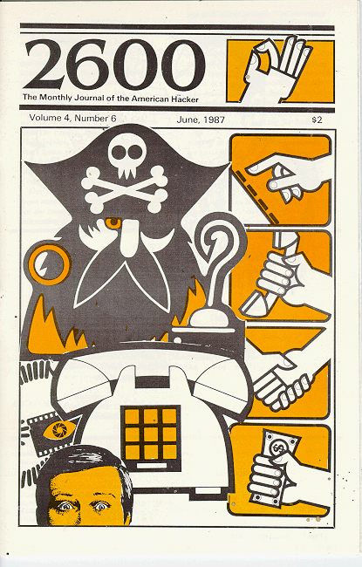
Modern Origins
Cybersecurity, arguably, traces its origins to the 1970s
Phone phreakers vs. the telephone networks
It’s hard to have cybersecurity without:
Ubiquitous computers
Ubiquitous connectivity
However, many fundamental concepts are much, much older

Slide 4
Information Assurance
IA is the practice of managing risks related to the use, processing, storage, and transmission of information
Desirable properties:
Confidentiality – no eavesdropping
Integrity – no unauthorized modifications
Authenticity – no spoofing or faking
Non-repudiation – no disclaiming of authorship
Properties are often achieved (assured) through cryptography

Slide 5
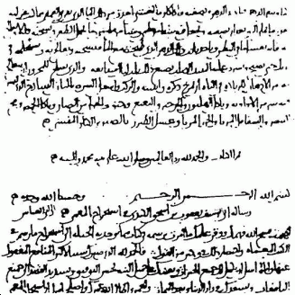
Ancient Origins
1500 BCE – Encrypted tablets from Mesopotamia
600 BCE – First use of monoalphabetic substitution ciphers
400 BCE – Kama Sutra describes cyphers for protecting communications between lovers
800 AD – Al-Kindi uses frequency-analysis to break monoalphabetic substitution ciphers

Slide 6
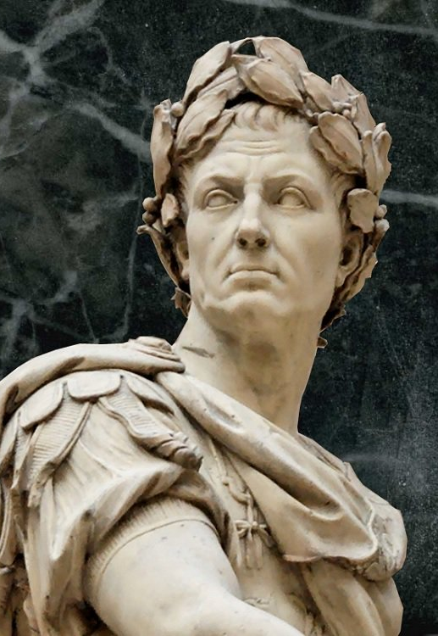
Caesar Shift
Simple symmetric monoalphabetic substitution cipher
Key is a number k
To encrypt, “shift” each letter by k positions
To decrypt, “shift” each letter back by k positions
HEY BRUTUS BRING A KNIFE TO THE PARTY
KHB EUXWXV EULQJ D NQLIH WR WKH SDUWB

Slide 7
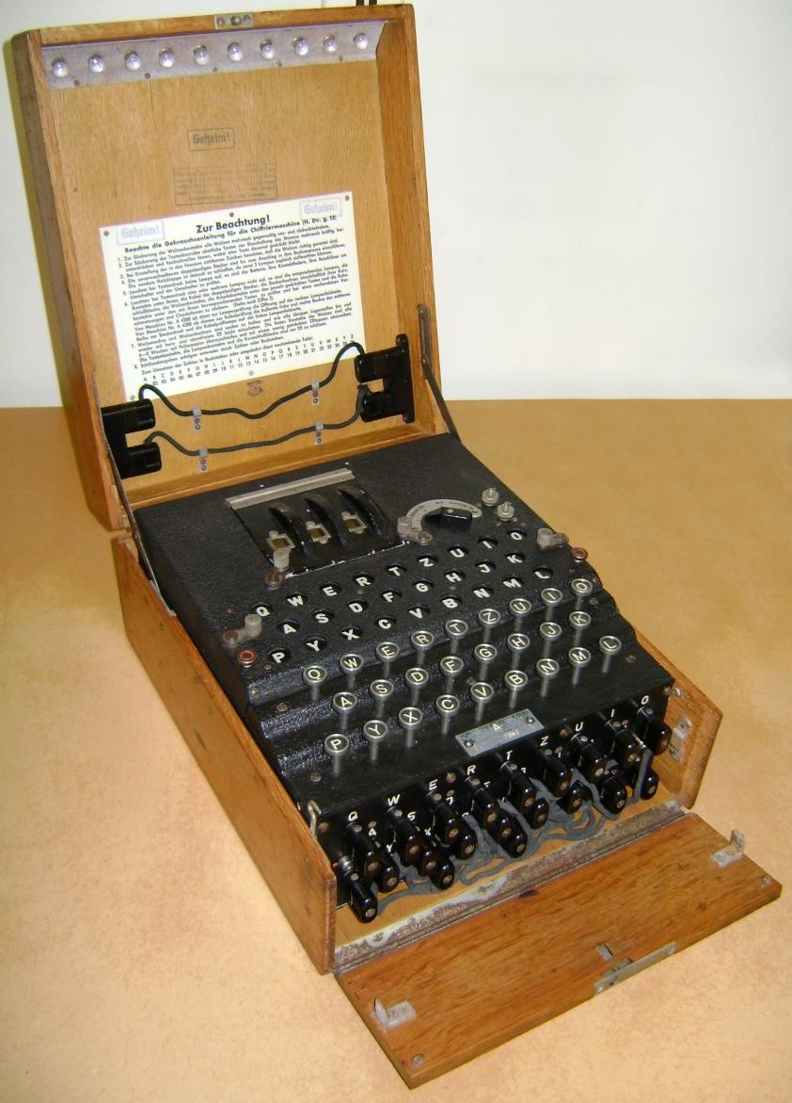
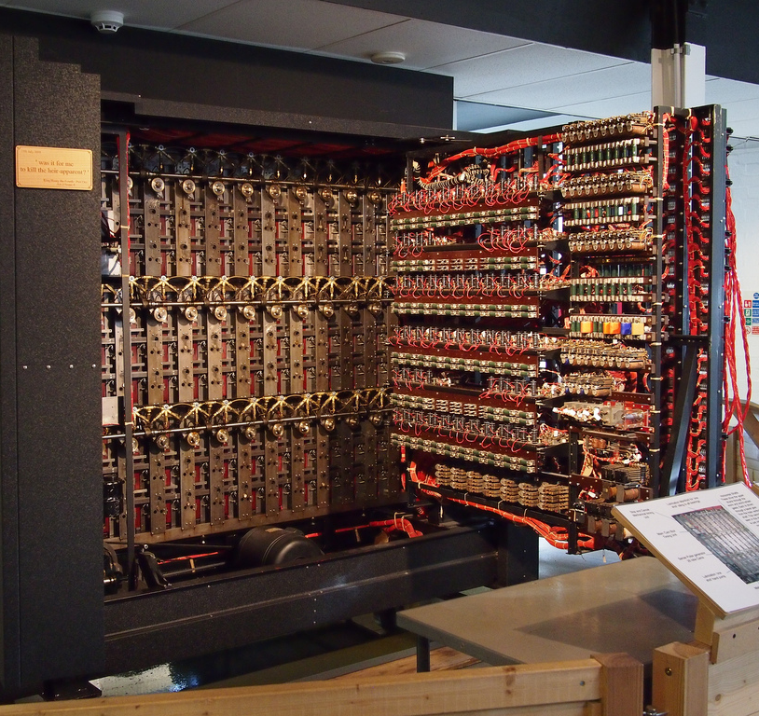

Slide 8
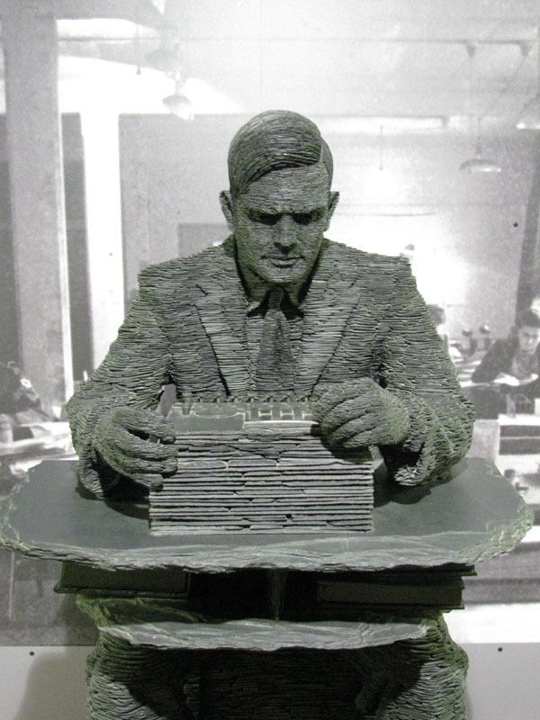
World War II as Catalyst
Ushers in modern cryptography and cryptanalysis
Never again will ad-hoc cryptography (like Enigma) be secure
Spurs the creation of the first digital computers
Turing’s Bombe
Leads to the birth of computer science

Slide 9
Phone Phreaking
1960-1970’s: golden age of phreaking
Curious nerds who explored the telephone network
The term hacker was introduced in a 1963 MIT student newspaper article about hacking the telephone system
Original meaning: somebody who enjoyed exploring, playing with, or learning about computers

Slide 10
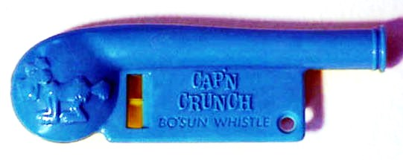
Changing Norms
Legal
The original phreaks were tinkerers and explorers
Looping calls around the planet
Setting up “party lines” for group chat
Locating strange corners of the phone system
Eventually, the culture and meaning of phreaking changed
Referred to using exploits to get free phone calls
Illegal

Slide 11
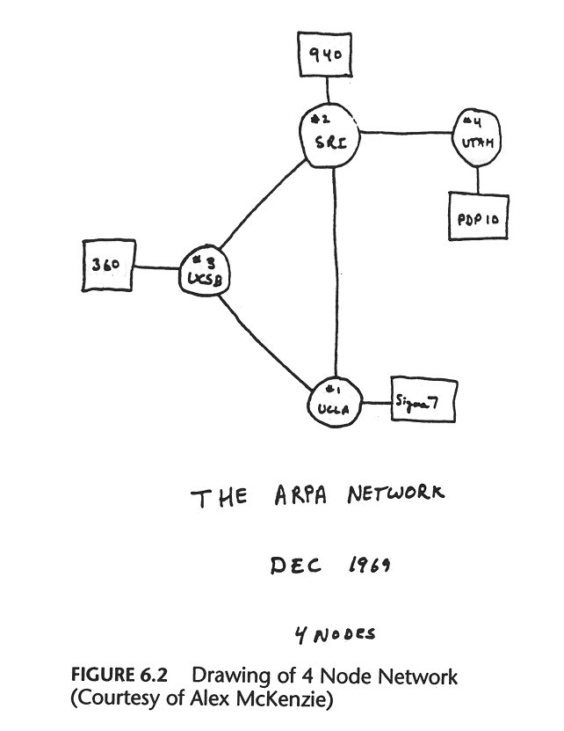
ARPANET
1969 – ARPANET comes online
1973 – Robert Metcalfe warns that ARPANET is insecure
High-school kids are poking around on the network
1983 – Fred Cohen invents the term computer virus
1983 – ARPANET adopts TCP/IP

Slide 12
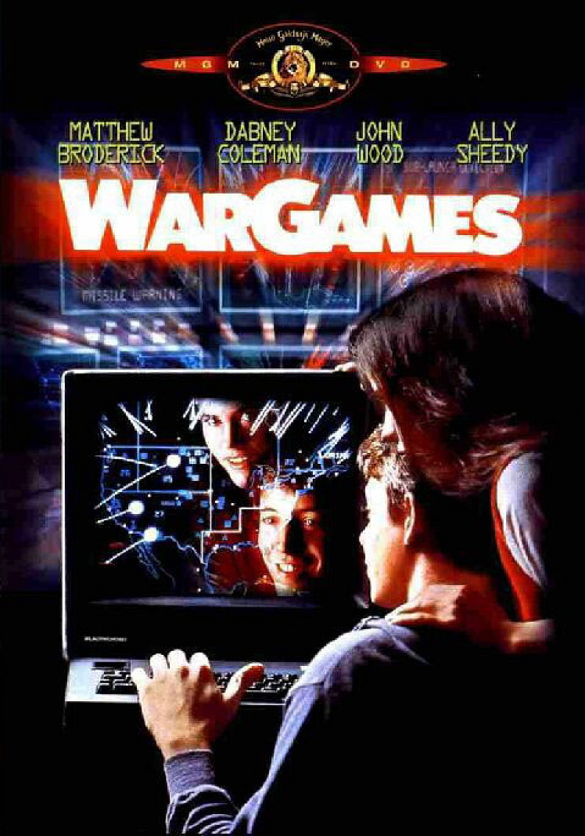
WarGames (1983)

Slide 13
Towards Cybercrime
1986 –Marcus Hess breaks into Arpanet
Breaks into 400 military computers, including mainframes at the Pentagon
Goal: sell secrets to the KGB
Caught by a honeypot
Machine set up to look like a tempting target…
… but in reality is a booby trap designed to surveille the intruder

Slide 14
CFAA
1986 – Congress passes the Computer Fraud and Abuse Act
First major anti-computer crime legislation
Criminalizes “unauthorized access” to “protected computer systems”
Some claim the law was passed in direct response to WarGames

Slide 15
Portents of Things to Come
1988 – Robert Morris inadvertently releases the first worm
Leveraged a bug in sendmail to remotely exploit vulnerable servers
Copied itself to the server
Released as a research experiment
A bug in Robert’s code caused the program to replicate out of control
Crashed 10% of the computers on the ARPANET
Morris was convicted under the CFAA, 3 years probation + $10k fine
First documented use of a buffer overflow exploit

Slide 16
From ARPANET to Internet
1993 – NCSA Mosaic is the first web browser
1994 – Internet becomes totally privatized
1999 – Beginning of the first .com bubble
2000 – Broadband internet starts becoming widely available
Widespread, always on internet connections become the norm
Problems
Software is wildly insecure, not designed for a connected world
People are unprepared to manage their own security

Slide 17
Havoc on the Internet
1999 – Melissa macro virus spreads via email attachments
2000 – ILOVEYOU virus released, infects millions of machines in hours
One of the first widespread uses of social engineering tactics
2000 – 15-year old “mafiaboy” invents the Denial of Service attack
Causes millions of damage to e-commerce websites
2001 – Code Red worm spreads via Microsoft IIS exploit
2003 – SQL Slammer and Blaster spread exponentially via exploits in Microsoft products

Slide 18
Defacement and Hacktivism
Culture of breaking into and “tagging” websites
Throughout the 1990s and early 2000s
Demonstration of 31337 skills
Hacktivism: defacement for political ends
2003 – Anonymous
2011 -- LulzSec

Slide 19
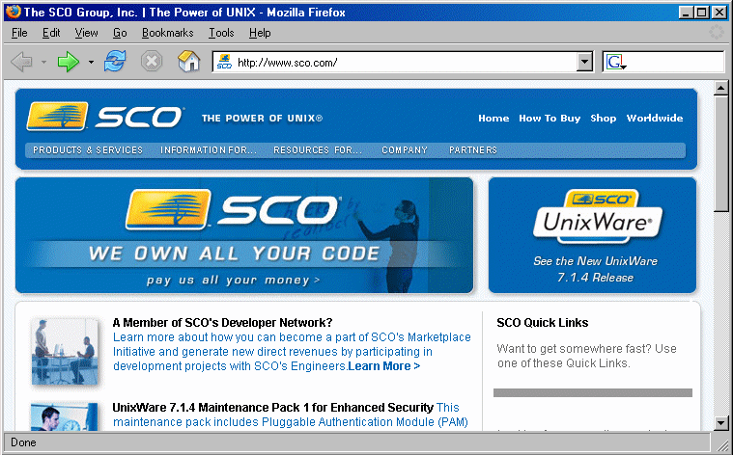

Slide 20
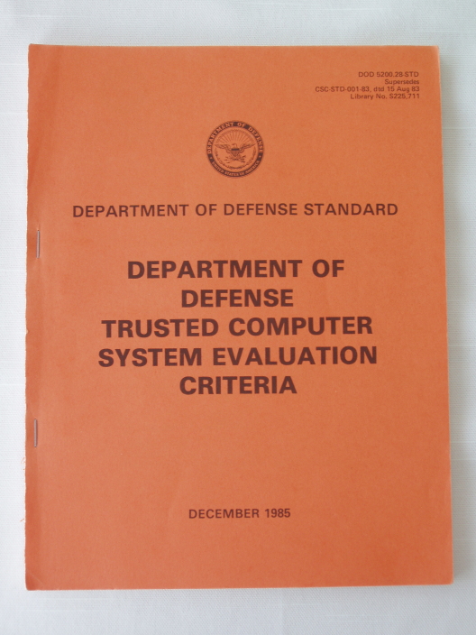
Reevaluating Cybersecurity
1983 – The Orange Book
Developed by NSA, published by DOD
Primarily concerned with specifying security models and access control
Designed to mitigate insider threats
Does not consider:
Vulnerabilities and exploits
Networked threats
Social engineering

Slide 21
Taking Cybersecurity Seriously
1987 – McAfee releases first version of VirusScan
1995 – Mozilla releases the Secure Socket Layer (SSL) protocol
2001 – NIST standardizes the Advanced Encryption Standard (AES)
2002 – Bill Gates launches Microsoft’s “Trustworthy Computing” initiative
Security, Privacy, Reliability, and Business Integrity
Watershed moment for secure software development

Slide 22
From 31337 |-|4x0rz to Organized Crime
Hacking culture throughout the 1990’s and early 2000’s was driven by the quest for respect
Virus writers, web hackers, etc. competed to be the most 31337
Destructive, unethical, and illegal…
… but still driven by a sense of technological exploration
By late 2000’s, hacking culture was largely dead
In its place was organized cybercrime

Slide 23
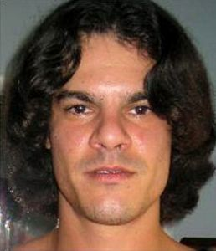
The Modern Criminal
2005 – Albert Gonzalez steals 46 million credit cards from TJ Maxx
2006 – The Russian Business Network (RBN) comes online
Offered bulletproof hosting for criminal enterprises
2007 – Storm worm turns infected machines into a botnet
2007 – First version of Zeus banking trojan released

Slide 24
Inklings of Cyberwarfare
2009 – Chinese hackers from PLA Unit 61398 perform “Operation Aurora”
Serious of hacks against US government and industry targets
2010 – US and Israel attack nuclear centrifuges in Iran with the Stuxnet worm
Designed to jump over air-gapped networks
Causes centrifuges to spin out of control, but report no anomalies
To this day, parts of the code are undeciphered
2014 – “Guardians of Peace” attack Sony Pictures
Destroy computers, leak confidential files and unreleased movies
Believed to be North Korean hackers

Slide 25
The Future?
Automated attacks carried out by adversarial AIs
Remote and deadly hacks of robots and autonomous cars
Cryptocurrency anarchy
Widespread social engineering via targeted propaganda
Actual warfare in cyberspace
Complete loss of individual privacy

