Slide 1
CY 2550 Foundations of Cybersecurity
Threat Modeling

Slide 2
Securing Your Phone
Add a password or passcode
Add biometric authentication (fingerprint, voice, or face)
Install an antivirus app
Encrypt the device
Subscribe to a Virtual Private Network (VPN) service
Fork the Linux kernel and develop your own version of Android from scratch
If you do all this, is your phone secure?
From whom?

Slide 3
Ad hoc Security Rarely Succeeds
Have you considered all possible attackers?
What do they want?
Why do they want it?
How hard are they willing to work to get it?
Have you considered all possible attack surfaces?
Is the network secure?
Is the OS secure?
Is the hardware secure?
Are you secure?
Have you weighed the tradeoffs of mitigations?
How much do they cost?
Do they introduce alternative forms of risk?
How much burden do they place on users?

Slide 4
Threat Modeling
Threat modeling is the process of systematically identifying the threats faced by a system
Identify things of value that you want to protect
Enumerate the attack surfaces
Hypothesize attackers and map them to
Things of value they want from (1)
Their ability to target vulnerable surfaces from (2)
Survey mitigations
Balance costs versus risks

Slide 5
Identify Things of Value
Data on the phone
Personally identifiable information (PII)
Address Book
Saved passwords
Pics, messages, browsing/search history (for blackmail)
Sensitive business documents
Data that gets sent over the network
Monetizable credentials (webmail, social networks) Credit card data (e.g. saved in the browser)
Access to bank accounts, paypal, venmo, or other financial services
Your personal security
Access to sensors (camera, mic, GPS)
network traffic (for surveillance)
The device itself ($$$)

Slide 6
Enumerate Attack Surfaces
Physical proximity
Steal the device and use it
Direct connection via USB
Close proximity radios (Bluetooth, NFC)
Social engineering
Trick the user into installing malicious app(s)
Network
Passive eavesdropping on the network
Active network attacks (e.g. man-in-the-middle, SMS of death)
The supply chain
Backdoor the OS (Google)
Backdoor the handset (e.g. OnePlus EngineeringMode)
Intercept and compromise the handset in transit

Slide 7
Key Factors for Attacks
When?
Before
During
After
Local
Remote
Where?
Passive
Active
How?

Slide 8
Hypothetical Attackers
Attacker | Capabilities | Goals
The Thief | Steal the phone Connect to USB or networks Disconnect the phone from the internet | The device itself Access to financial services
Law Enforcement | Everything the thief can do Legally compel you to do things Infect you with surveillance malware | Evidence from the device (pics, msgs, GPS logs)
The Eavesdropper | Passively observe network traffic | Steal PII, passwords, bank account numbers, etc.
Three Letter Agency (TLA) | Passively observe network traffic Active network attacks | Surveillance

Slide 9
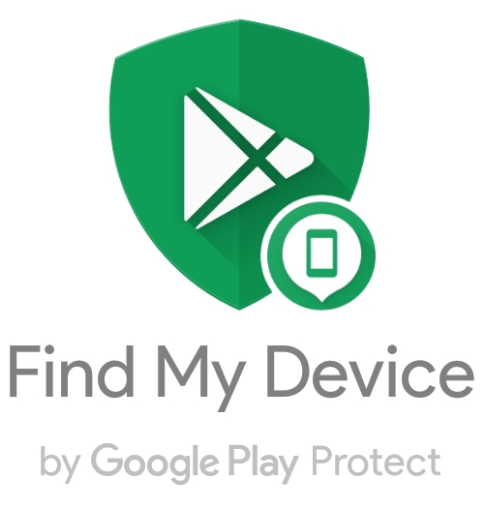
Mitigating The Thief
Mitigation
Issues?
Strong authentication
Strong password
Biometrics
Full device encryption
Remote tracking and wiping
Annoying to enter
Won’t work if the thief disconnects from the internet

Slide 10
Hypothetical Attackers
Attacker | Capabilities | Goals
The Thief | Steal the phone Connect to USB or networks Disconnect the phone from the internet | The device itself Access to financial services
Law Enforcement | Everything the thief can do Legally compel you to do things Infect you with surveillance malware | Evidence from the device (pics, msgs, GPS logs)
The Eavesdropper | Passively observe network traffic | Steal PII, passwords, bank account numbers, etc.
Three Letter Agency (TLA) | Passively observe network traffic Active network attacks | Surveillance

Slide 11
Mitigating Law Enforcement
Sort-of protected by the 5th amendment
Mitigation
Issues?
Strong authentication
Strong password
Biometrics
Full device encryption
Remote tracking and wiping
Patch the OS and apps
Use a Google Pixel
Avoid phishing attacks
Don’t use any cloud services
Annoying to enter
Can compel you to unlock
Will get you thrown in prison for obstruction of justice
Manufactures are slow to patch
Requires vigilance
Prevents you from using most modern apps

Slide 12
Hypothetical Attackers
Attacker | Capabilities | Goals
The Thief | Steal the phone Connect to USB or networks Disconnect the phone from the internet | The device itself Access to financial services
FBI | Everything the thief can do Legally compel you to do things Infect you with surveillance malware | Evidence from the device (pics, msgs, GPS logs)
The Eavesdropper | Passively observe network traffic | Steal PII, passwords, bank account numbers, etc.
Three Letter Agency (TLA) | Passively observe network traffic Active network attacks | Surveillance

Slide 13
Mitigating The Eavesdropper
Mitigation
Issues?
Strong authentication
Strong password
Full device encryption
Patch the OS and apps
Use a Nexus/Pixel
Avoid phishing attacks
Annoying to enter
Manufactures are slow to patch
Requires vigilance

Slide 14
Mitigating The Eavesdropper
Mitigation
Issues?
Use HTTPS everywhere
Use a Virtual Private Network (VPN)
Unclear which apps use HTTPS
No way to force HTTPS
Warning: free VPNs are scams!
May slow your connection

Slide 15
Hypothetical Attackers
Attacker | Capabilities | Goals
The Thief | Steal the phone Connect to USB or networks Disconnect the phone from the internet | The device itself Access to financial services
FBI | Everything the thief can do Legally compel you to do things Infect you with surveillance malware | Evidence from the device (pics, msgs, GPS logs)
The Eavesdropper | Passively observe network traffic | Steal PII, passwords, bank account numbers, etc.
Three Letter Agency (3LA) | Passively observe network traffic Active network attacks | Surveillance

Slide 16
Mitigating The 3LA
Mitigation
Issues?
Use a Virtual Private Network (VPN)
Use Tor
Patch the OS and apps
Disable JavaScript & plugins in web browser
No cloud services
Warning: free VPNs are scams!
May slow your connection
Does not provide anonymity
Very slow connection
Some websites will break

Slide 17
Balancing Cost and Risk
Assess the likelihood of different attacks
Purely subjective, will change based on context
Compare to the cost of mitigations
Sometimes, the risk/reward tradeoff is quite poor
Attacker | Likelihood? | Cost of Countermeasures
The Thief | High | Low (biometric login is okay)
Law Enforcement | Low | High (no biometrics or cloud services)
The Eavesdropper | Moderate | Medium (good VPNs are not free)
Three Letter Agency (3LA) | High | High (slow internet, no cloud, broken web)

Slide 18
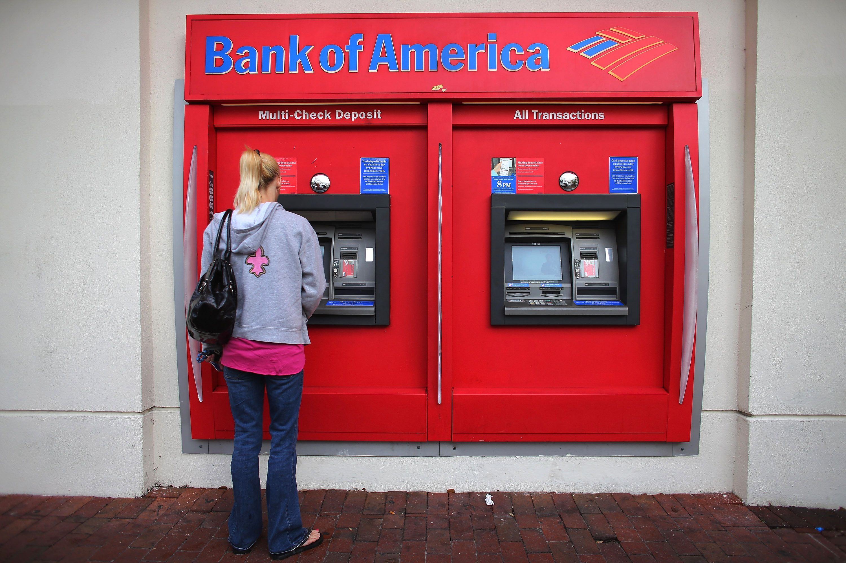

Slide 19
Threat Modeling
Threat modeling is the process of systematically identifying the threats faced by a system
Identify things of value that you want to protect
Enumerate the attack surfaces
Hypothesize attackers and map them to
Things of value they want from (1)
Their ability to target vulnerable surfaces from (2)
Survey mitigations
Balance costs versus risks

Slide 20
Identify Things of Value
Full of cash
People input sensitive info
Debit card numbers and PINs
Note: info is not stored locally…
… but it is sent over the network

Slide 21
Enumerate Attack Surfaces
Physical security
Open the box and steal the money
Local exploits
ATMs typically run Windows
Escape the ATM program and drop into Windows
Connect via external USB or Ethernet
Local network connection
Could be tapped
Remote exploits
Can be infected with a trojan

Slide 22
Hypothetical Attackers
Attacker | Capabilities | Goals
The Barbarian | Physical access + destructive force | Steal the money
The Insider | Physical access + authorization (keys) | Steal the money
The Eavesdropper | Physical access Passively observe network traffic | Steal debit card numbers and PINs
The Skimmer | Physical access | Steal debit card numbers and PINs
The Hacker | Remote access | Steal debit card numbers and PINs

Slide 23
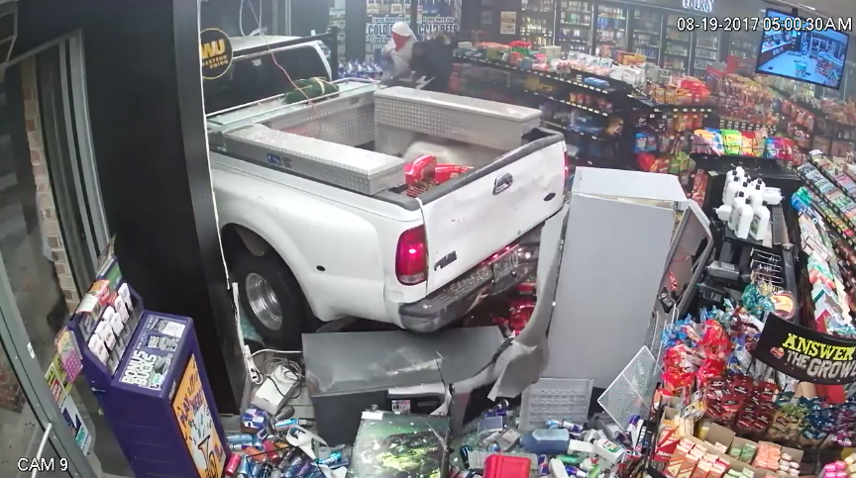

Slide 24
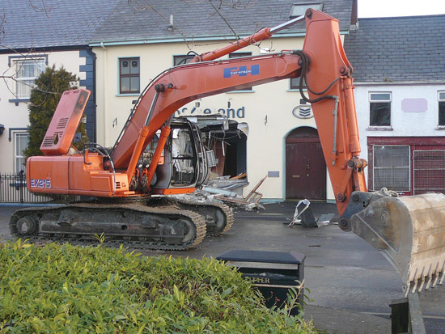
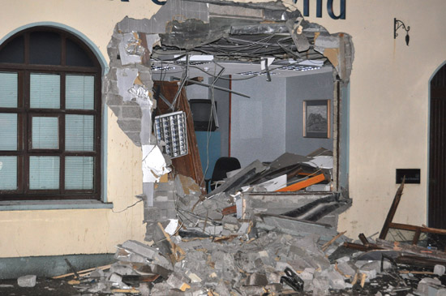

Slide 25
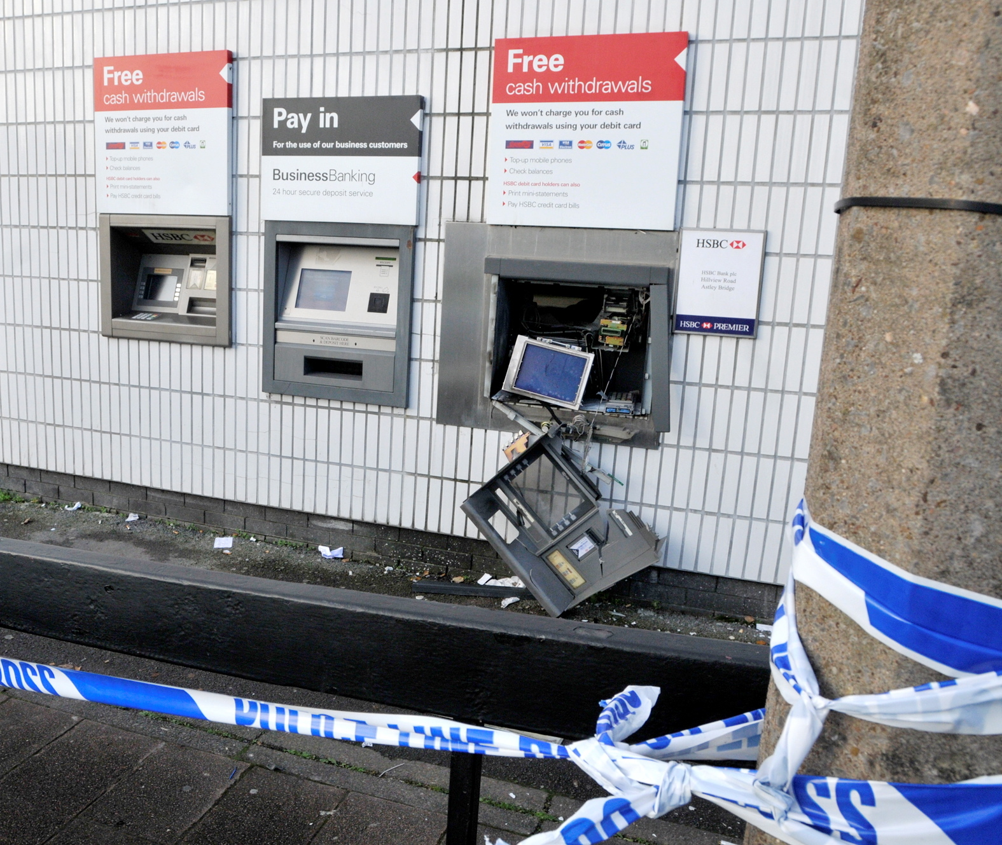
ATM Gas Attack
Insert a thin tube into the ATM
Use the tube to fill the ATM with explosive gas
Ignite
Profit

Slide 26
Hypothetical Attackers
Attacker | Capabilities | Goals
The Barbarian | Physical access + destructive force | Steal the money
The Insider | Physical access + authorization (keys) | Steal the money
The Eavesdropper | Physical access Passively observe network traffic | Steal debit card numbers and PINs
The Skimmer | Physical access | Steal debit card numbers and PINs
The Hacker | Remote access | Steal debit card numbers and PINs

Slide 27
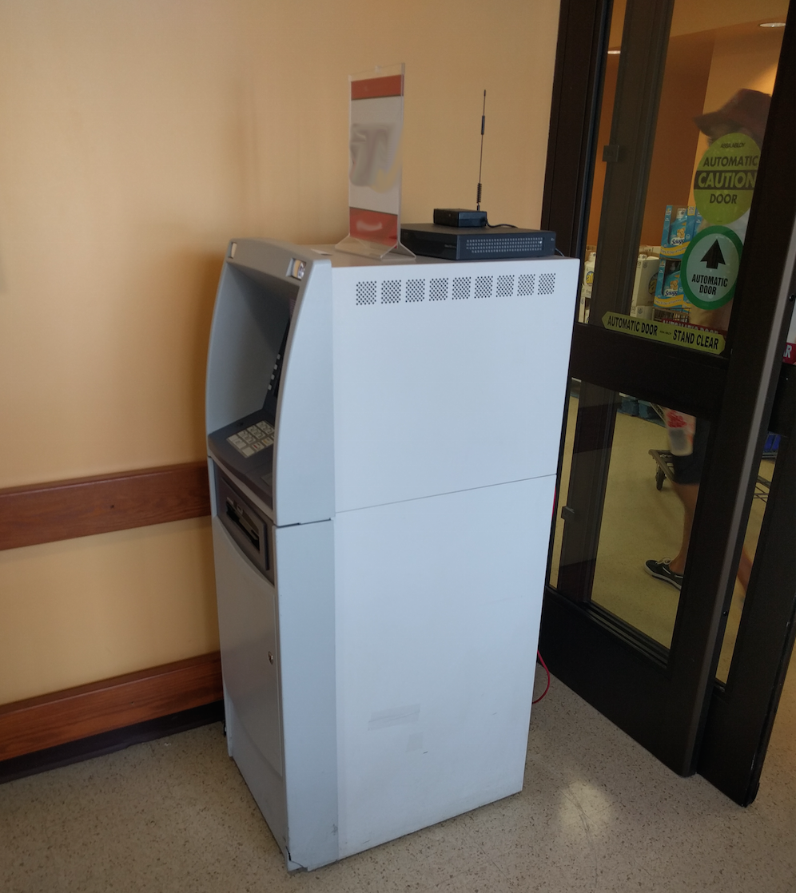
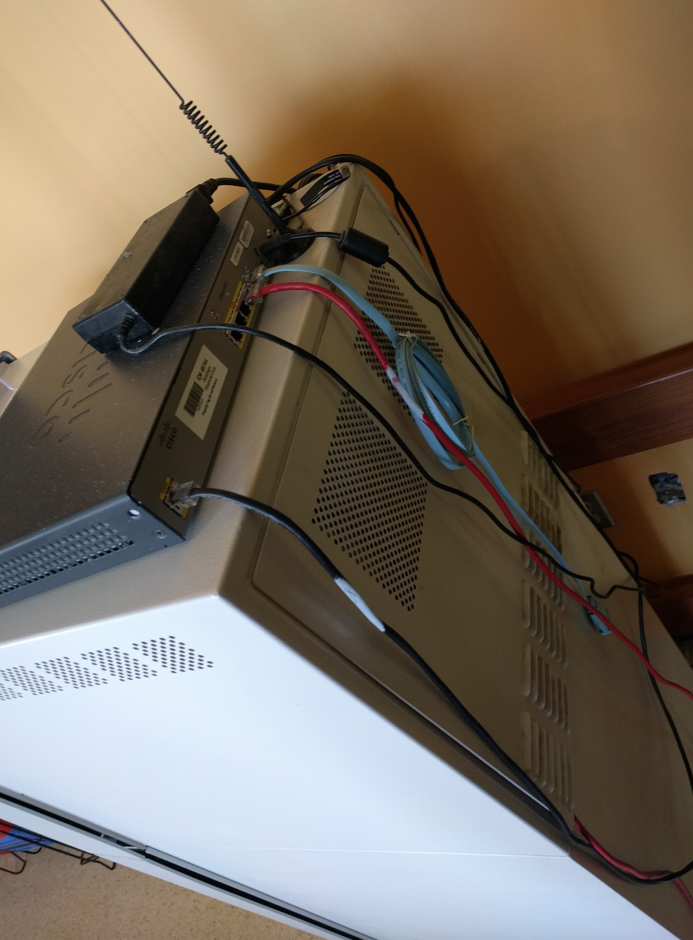

Slide 28
Hypothetical Attackers
Attacker | Capabilities | Goals
The Barbarian | Physical access + destructive force | Steal the money
The Insider | Physical access + authorization (keys) | Steal the money
The Eavesdropper | Physical access Passively observe network traffic | Steal debit card numbers and PINs
The Skimmer | Physical access | Steal debit card numbers and PINs
The Hacker | Remote access | Steal debit card numbers and PINs

Slide 29
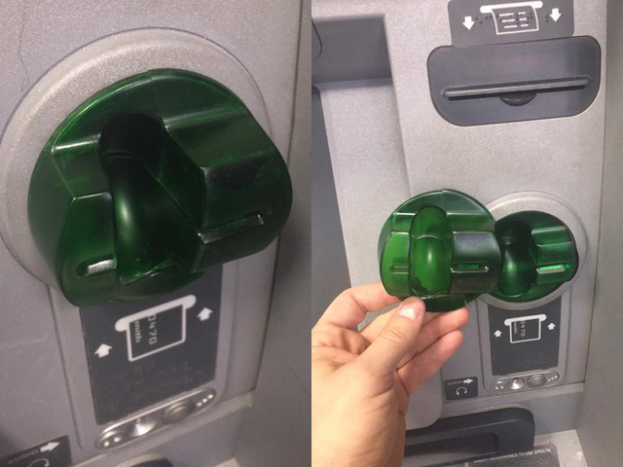

Slide 30
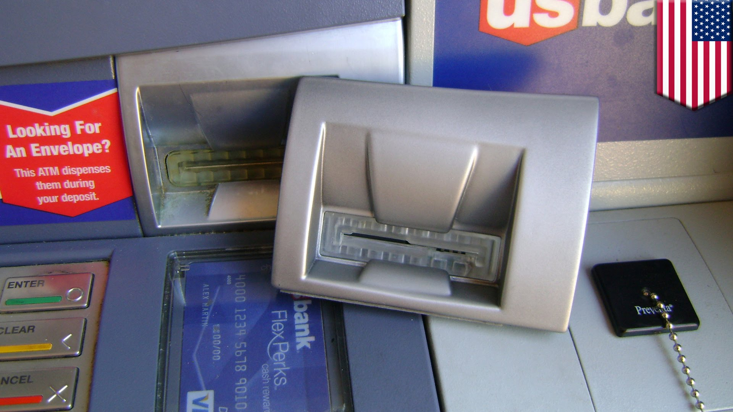

Slide 31
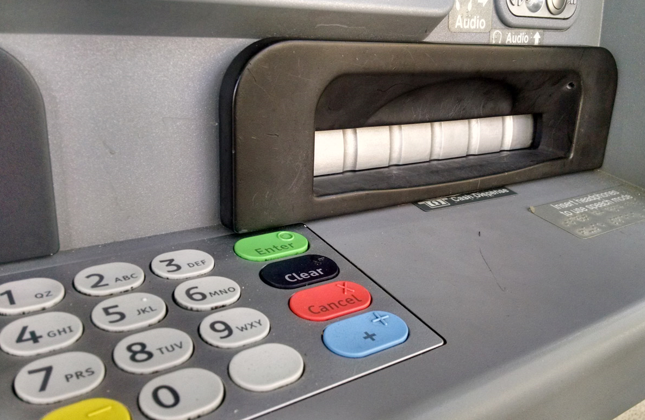
Pinhole camera for recording PIN numbers

Slide 32
Hypothetical Attackers
Attacker | Capabilities | Goals
The Barbarian | Physical access + destructive force | Steal the money
The Insider | Physical access + authorization (keys) | Steal the money
The Eavesdropper | Physical access Passively observe network traffic | Steal debit card numbers and PINs
The Skimmer | Physical access | Steal debit card numbers and PINs
The Hacker | Remote access | Steal debit card numbers and PINs

Slide 33
Mitigating Attacks
Physical security
Embed the ATM in a concrete wall
No access to network cables
Front and rear video surveillance
Oddly shaped card reader and PIN pad to hinder skimmers
Preventing insider threats
Dual physical access control
Two employees both with unique keys
Careful auditing
Stopping hackers
Frequent OS and software patches
Hardened operating system
Firewall and intrusion detection
Logging
Much more on this topic later

Slide 34
Threat Modeling in Practice
Important for all organizations to engage in
Multi-stakeholder process
Engineering and IT/DevOps
Legal Counsel
Executives
Various methodologies are available
STRIDE/DREAD – from Microsoft
Process for Attack Simulation and Threat Analysis (PASTA)
Trike
Visual, Agile, and Simple Threat (VAST) modeling
AS/NZS 4360:2004 Risk Management
OCTAVE

Slide 35
STRIDE
Designed to model and mitigate threats against software
Identify assets
Create an architecture overview
Diagrams that map out the target system
Decompose the application
Uncover vulnerabilities in design, implementation, or deployment
Identify the threats
Keep the goals of attackers in mind
Document the threats
Rate the threats
Prioritize and address the most significant threats first

Slide 36
DREAD
Method for calculating risk scores for threats
Damage potential: How great is the damage if the vulnerability is exploited?
Reproducibility: How easy is it to reproduce the attack?
Works every time → Very difficult to execute
Exploitability: How easy is it to launch an attack?
Novice → Requires deep knowledge and experience
Affected users: As a rough percentage, how many users are affected?
Discoverability: How easy is it to find the vulnerability?
Everybody already knows → Extremely obscure

Slide 37
Disambiguation
Formal threat models are often used in cryptography
Captures the capability of an attacker
Specifies the desired security property
All represented mathematically
Examples
Dolev-Yao
Attacker may observe and tamper with all messages
May also create new encrypted messages
Very powerful attack model
Indistinguishability under chosen plaintext attack (IND-CPA)
Attacker may encrypt messages and observe the output
Goal: two identical messages should be indistinguishable once encrypted
Indistinguishability under chosen ciphertext attack (IND-CCA)
Same as IND-CPA
Attacker may also decrypt some messages arbitrarily using an oracle

