Slide 1
CS 4700 / CS 5700 Network Fundamentals
Lecture 14: Datacenter Networks

Slide 2
“The Network is the Computer”
Network computing has been around forever
Grid computing
High-performance computing
Clusters (Beowulf)
Highly specialized
Nuclear simulation
Stock trading
Weather prediction
All of a sudden, datacenters/the cloud are HOT
Why?

Slide 3
The Internet Made Me Do It
Everyone wants to operate at Internet scale
Millions of users
Can your website survive a flash mob?
Zetabytes of data to analyze
Webserver logs
Advertisement clicks
Social networks, blogs, Twitter, video…
Not everyone has the expertise to build a cluster
The Internet is the symptom and the cure
Let someone else do it for you!

Slide 4
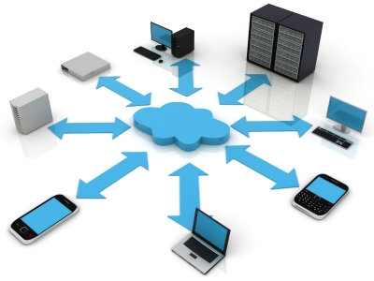
The Nebulous Cloud
What is “the cloud”?
Everything as a service
Hardware
Storage
Platform
Software
Anyone can rent computing resources
Cheaply
At large scale
On demand

Slide 5
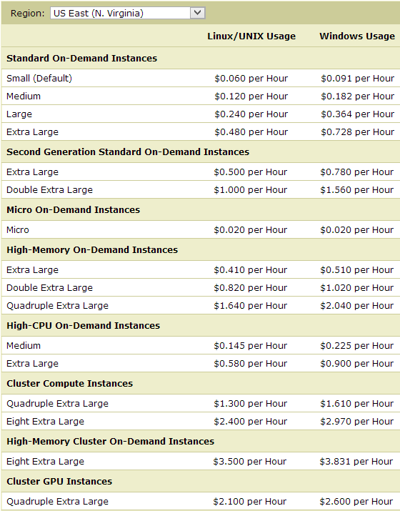
Example: Amazon EC2
Amazon’s Elastic Compute Cloud
Rent any number of virtual machines
For as long as you want
Hardware and storage as a service

Slide 6
Example: Google App Engine
Platform for deploying applications
From the developers perspective:
Write an application
Use Google’s Java/Python APIs
Deploy app to App Engine
From Google’s perspective:
Manage a datacenter full of machines and storage
All machines execute the App Engine runtime
Deploy apps from customers
Load balance incoming requests
Scale up customer apps as needed
Execute multiple instances of the app

Slide 7
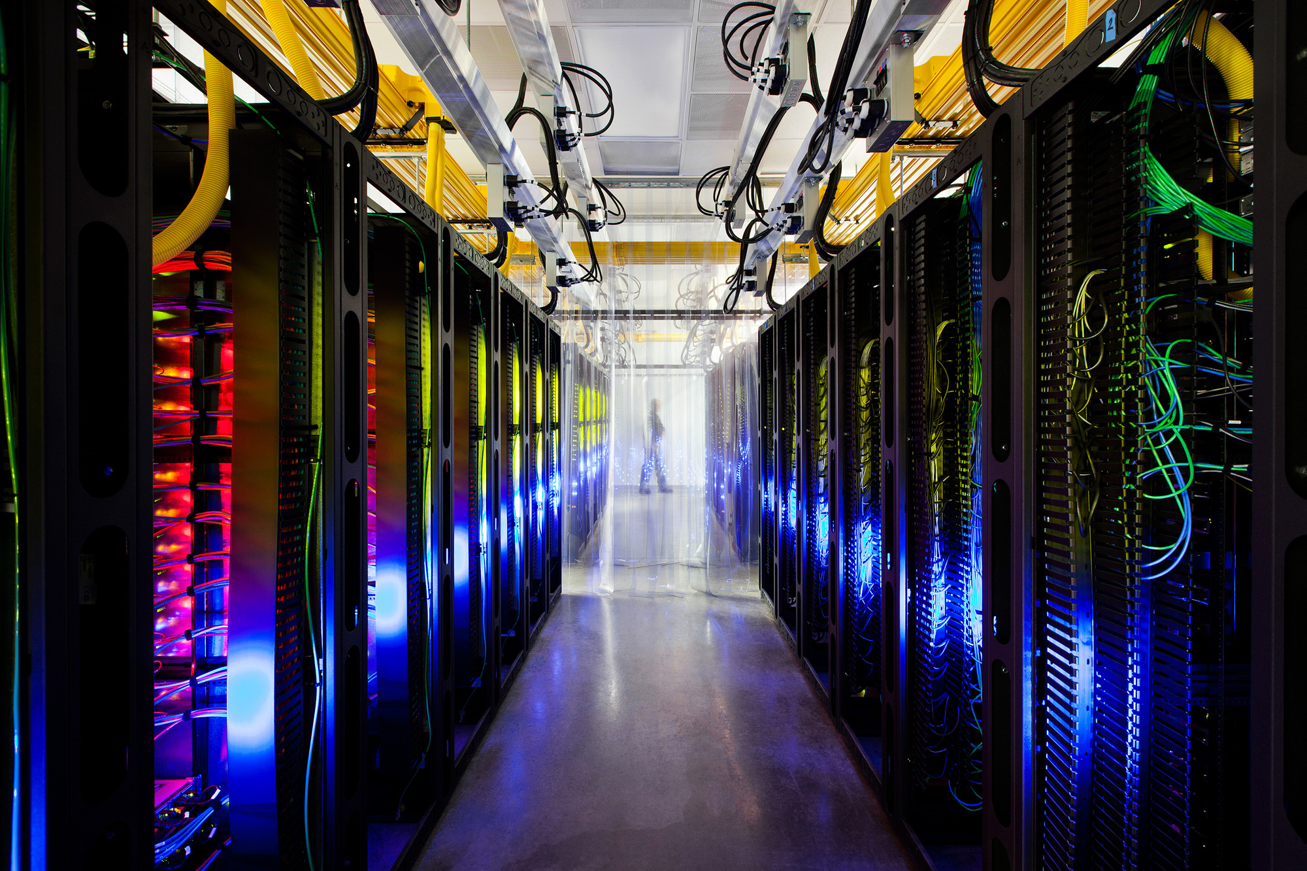

Slide 8
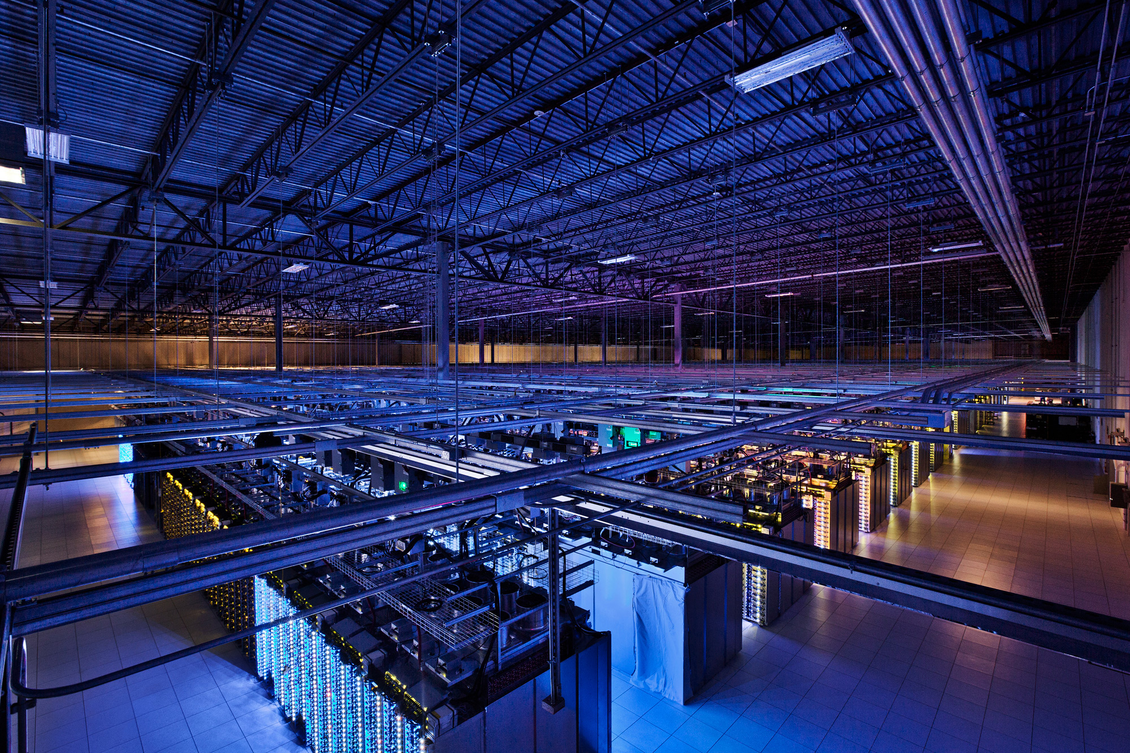

Slide 9
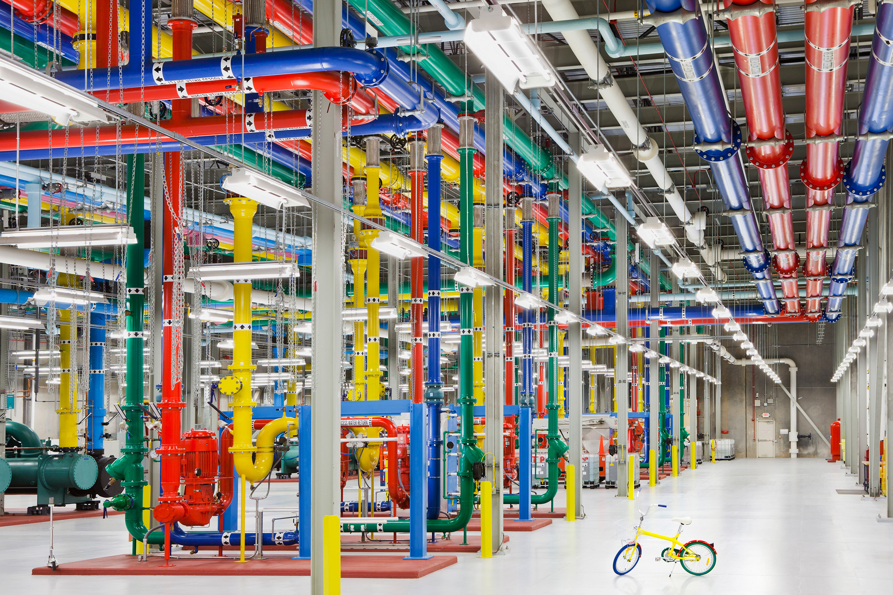

Slide 10
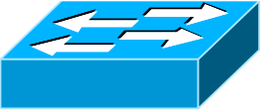
Typical Datacenter Topology
The Internet
Core Routers
Link Redundancy
Aggregation Routers
10 Gbps Ethernet
Top of Rack (ToR) Switches
1 Gbps Ethernet
20-40 Machines Per Rack

Slide 11
Advantages of Current Designs
Cheap, off the shelf, commodity parts
No need for custom servers or networking kit
(Sort of) easy to scale horizontally
Runs standard software
No need for “clusters” or “grid” OSs
Stock networking protocols
Ideal for VMs
Highly redundant
Homogeneous

Slide 12
Lots of Problems
Datacenters mix customers and applications
Heterogeneous, unpredictable traffic patterns
Competition over resources
How to achieve high-reliability?
Privacy
Heat and Power
30 billion watts per year, worldwide
May cost more than the machines
Not environmentally friendly
All actively being researched

Slide 13
Today’s Topic : Network Problems
Datacenters are data intensive
Most hardware can handle this
CPUs scale with Moore’s Law
RAM is fast and cheap
RAID and SSDs are pretty fast
Current networks cannot handle it
Slow, not keeping pace over time
Expensive
Wiring is a nightmare
Hard to manage
Non-optimal protocols

Slide 14
Outline
Intro
Network Topology and Routing
Fat Tree
60Ghz Wireless
Helios
Cam Cube
Transport Protocols

Slide 15
Problem: Oversubscription
#Racksx40x1 Gbps → 1x10 Gbps
1:80-240
40x1Gbps → 1x10 Gbps
1:4
Bandwidth gets scarce as you move up the tree
Locality is key to performance
All-to-all communication is a very bad idea
40x1 Gbps Ports
1:1
40 Machines
1 Gbps Each

Slide 16
Problem: Routing
In a typical datacenter…
Multiple customers
Multiple applications
VM allocation on demand
How do we place them?
Performance
Scalability
Load-balancing
Fragmentation
VLAN Routing
is a problem
10.0.0.*
10.0.0.*
13.0.0.*

Slide 17
Virtual Layer-2 (VL2)
Idea: insert a layer 2.5 into the network stack
Translate virtual IPs to actual IPs
Mapping maintained
using directory servers
128.0.0.1
129.0.0.1
164.0.0.1
10.0.0.1
10.0.0.2

Slide 18
VL2 at a Glance
Benefits
No more VLANs
Easy VM migration
Multi-path load balancing
OSPF in the core (as opposed to spanning tree)
Equal cost multipath (ECMP)
Semi-easy to deploy
No modifications to applications, protocols
Leverage existing switch/router features
No additional wires
Issues
Must modify host OSs
Need directory servers (and they need to scale)

Slide 19
Consequences of Oversubscription
Oversubscription cripples your datacenter
Limits application scalability
Bounds the size of your network
Problem is about to get worse
10 GigE servers are becoming more affordable
128 port 10 GigE routers are not
Oversubscription is a core router issue
Bottlenecking racks of GigE into 10 GigE links
What if we get rid of the core routers?
Only use cheap switches
Maintain 1:1 oversubscription ratio

Slide 20
Fat Tree Topology
To build a K-ary fat tree
K-port switches
K³/4 servers
(K/2)² core switches
K pods, each with K switches
In this example K=4
4-port switches
K³/4 = 16 servers
(K/2)² = 4 core switches
4 pods, each with 4 switches
Pod

Slide 21
Fat Tree at a Glance
The good
Full bisection bandwidth
Lots of redundancy for failover
The bad
Need custom routing
Paper uses NetFPGA
Cost → 3K²/2 switches
48 port switches = 3456
The ugly
OMG THE WIRES!!!! → (K³+2K²)/4
48 port switches = 28800

Slide 22
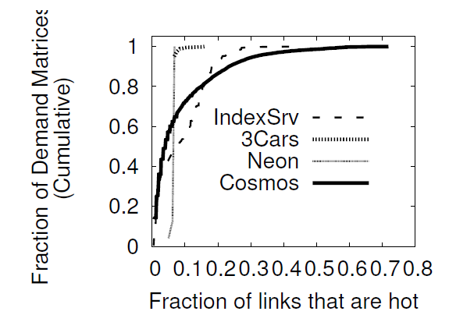
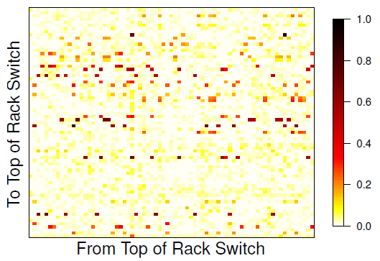
Is Oversubscription so Bad?
Oversubscription is a worst-case scenario
If traffic is localized, or short, there is no problem
How bad is the problem?

Slide 23
Idea: Flyways
Challenges
Additional wiring
Route switching

Slide 24
Wireless Flyways
Why use wires at all?
Connect ToR servers wirelessly
Why can’t we use Wifi?
Massive interference
Key issue: Wifi is not directed

Slide 25
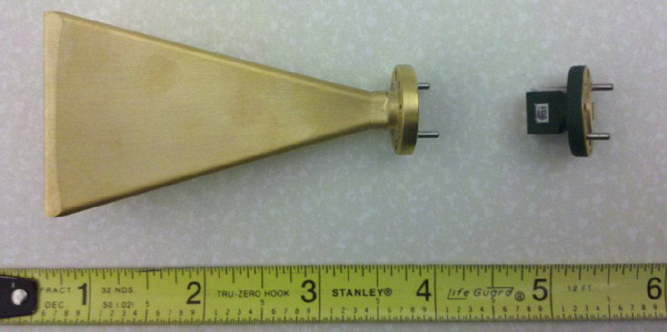
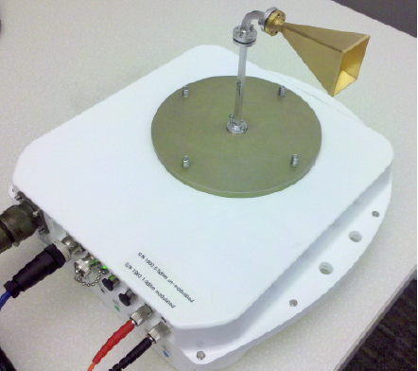
Direction 60 GHz Wireless

Slide 26
Implementing 60 GHz Flyways
Pre-compute routes
Measure the point-to-point bandwidth/interference
Calculate antenna angles
Measure traffic
Instrument the network stack per host
Leverage existing schedulers
Reroute
Encapsulate (tunnel) packets via the flyway
No need to modify static routes

Slide 27
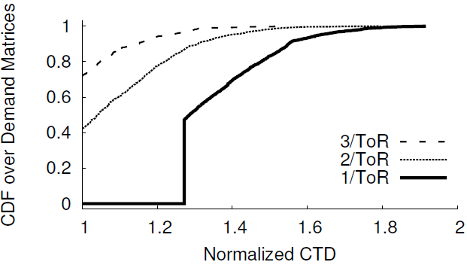
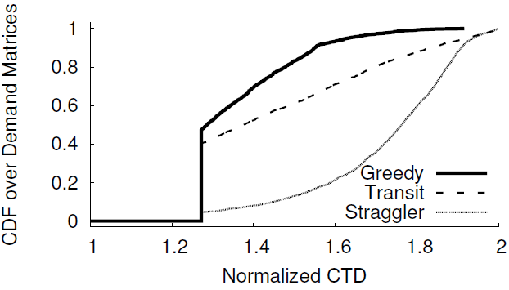
Results for 60 GHz Flyways
Hotspot fan-out is low
You don’t need that many antennas per rack
Prediction/scheduling is super important
Better schedulers could show more improvement
Traffic aware schedulers?

Slide 28
Random Thoughts
Getting radical ideas published is not easy
Especially at top conferences
This is a good example of paper that almost didn’t make it
Section 7 (Discussion) and Appendix A are all about fighting fires
The authors still got tons of flack at SIGCOMM
Takeaways
Don’t be afraid to be ‘out there’
But always think defensively!

Slide 29
Problems with Wireless Flyways
Problems
Directed antennas still cause directed interference
Objects may block the point-to-point signal

Slide 30
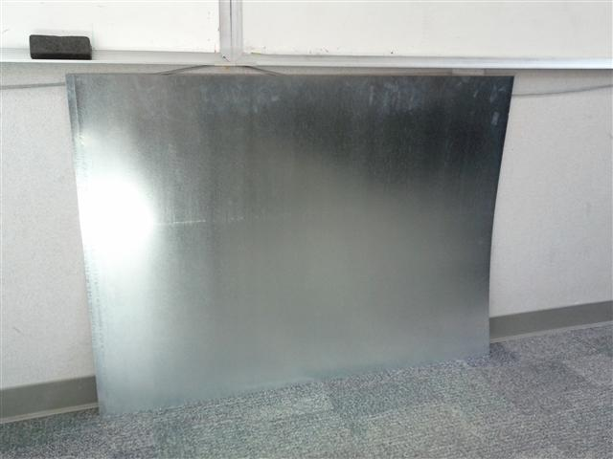
3D Wireless Flyways
Prior work assumes 2D wireless topology
Reduce interference by using 3D beams
Bounce the signal off the ceiling!
Stainless Steel Mirrors
60 GHz Directional Wireless

Slide 31
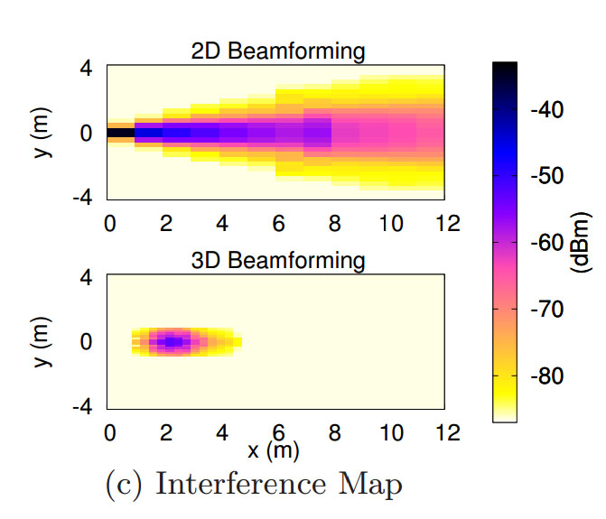
Comparing Interference
2D beam expands as it travels
Creates a cone of interference
3D beam focuses into a parabola
Short distances = small footprint
Long distances = longer footprint

Slide 32
Scheduling Wireless Flyways
Problem: connections are point-to-point
Antennas must be mechanically angled to form connection
Each rack can only talk to one other rack at a time
How to schedule the links?
Proposed solution
Centralized scheduler that monitors traffic
Based on demand (i.e. hotspots), choose links that:
Minimizes interference
Minimizes antenna rotations (i.e. prefer smaller angles)
Maximizes throughput (i.e. prefer heavily loaded links)
NP-Hard scheduling problem
Greedy algorithm for approximate solution

Slide 33
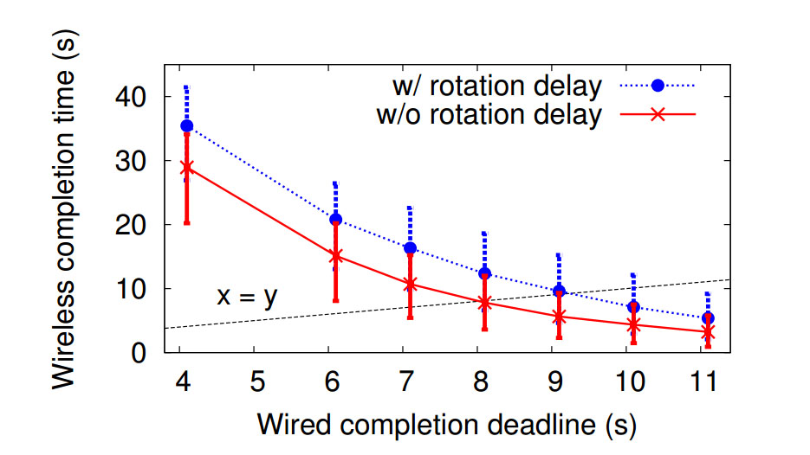
Other issues
Ceiling height
Antenna targeting errors
Antenna rotational delay

Slide 34
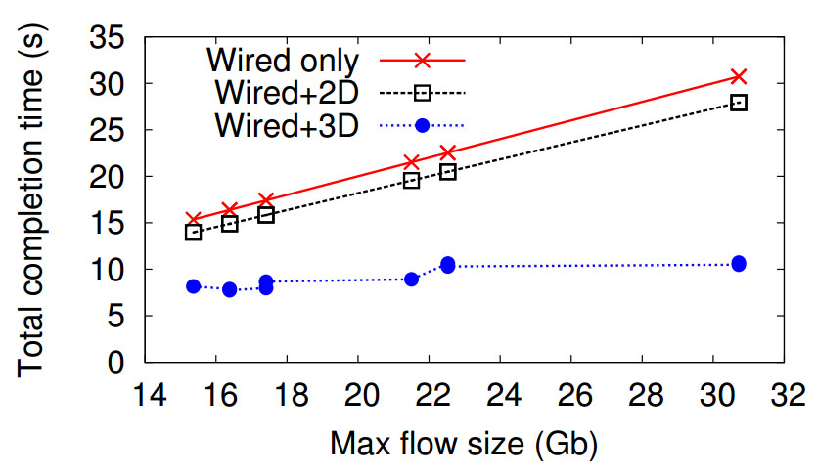
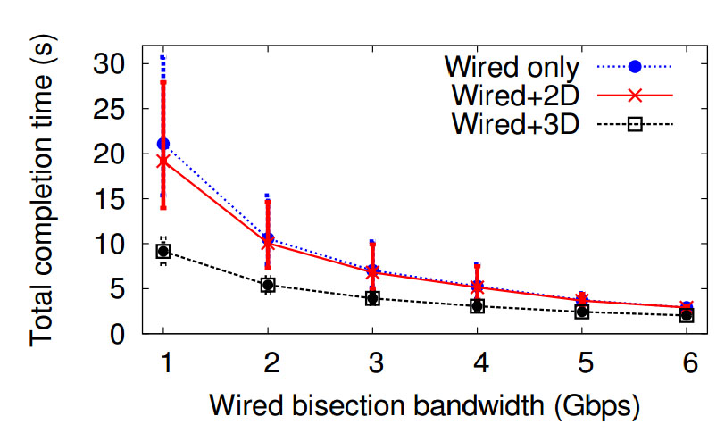
3D Flyway Performance

Slide 35
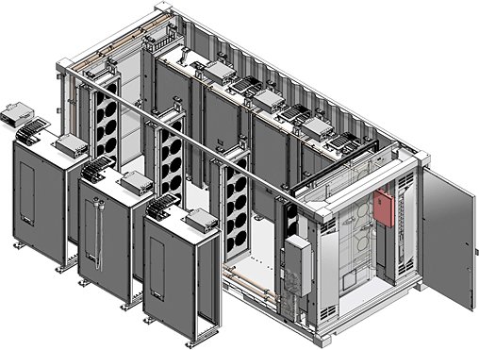
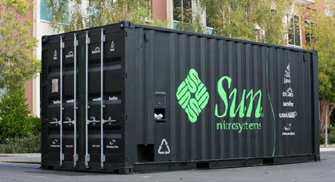
Modular Datacenters
Shipping container “datacenter in a box”
1,204 hosts per container
However many containers you want
How do you connect the containers?
Oversubscription, power, heat…
Physical distance matters (10 GigE → 10 meters)

Slide 36
Possible Solution: Optical Networks
Idea: connect containers using optical networks
Distance is irrelevant
Extremely high bandwidth
Optical routers are expensive
Each port needs a transceiver (light → packet)
Cost per port: $10 for 10 GigE, $200 for optical

Slide 37
Helios: Datacenters at Light Speed
Idea: use optical circuit switches, not routers
Uses mirrors to bounce light from port to port
No decoding!
Mirror
Optical
Router
Optical
Switch
Transceiver
Transceiver
In Port
Out Port
In Port
Out Port
Tradeoffs
Router can forward from any port to any other port
Switch is point to point
Mirror must be mechanically angled to make connection

Slide 38
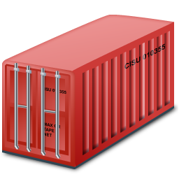
Dual Optical Networks
Typical, packet switch network
Connects all containers
Oversubscribed
Optical routers
Fiber optic flyway
Optical circuit switch
Direct container-to-container links, on demand

Slide 39
Circuit Scheduling and Performance
Centralized topology manager
Receives traffic measurements from containers
Analyzes traffic matrix
Reconfigures circuit switch
Notifies in-container routers to change routes
Circuit switching speed
~100ms for analysis
~200ms to move the mirrors

Slide 40
Datacenters in 4D
Why do datacenters have to be trees?
Cam Cube
3x3x3 hyper-cube of servers
Each host directly connects to 6 neighbors
Routing is now hop-by-hop
No monolithic routers
Borrows P2P techniques
New opportunities for applications

Slide 41
Outline
Intro
Network Topology and Routing
Transport Protocols
Google and Facebook
DCTCP
D3
Actually Deployed
Never Gonna Happen

Slide 42
Transport on the Internet
TCP is optimized for the WAN
Fairness
Slow-start
AIMD convergence
Defense against network failures
Three-way handshake
Reordering
Zero knowledge congestion control
Self-induces congestion
Loss always equals congestion
Delay tolerance
Ethernet, fiber, Wi-Fi, cellular, satellite, etc.

Slide 43
Datacenter is not the Internet
The good:
Possibility to make unilateral changes
Homogeneous hardware/software
Single administrative domain
Low error rates
The bad:
Latencies are very small (250µs)
Agility is key!
Little statistical multiplexing
One long flow may dominate a path
Cheap switches have queuing issues
Incast

Slide 44
Partition/Aggregate Pattern
User Request
Response
Common pattern for web applications
Search
E-mail
Responses are under a deadline
~250ms
Web Server
Aggregators
Workers

Slide 45
Problem: Incast
Aggregator sends out queries to a rack of workers
1 Aggregator
39 Workers
Each query takes the same time to complete
All workers answer at the same time
39 Flows→ 1 Port
Limited switch memory
Limited buffer at aggregator
Packet losses :(
Aggregator
Workers

Slide 46
Problem: Buffer Pressure
In theory, each port on a switch should have its own dedicated memory buffer
Cheap switches share buffer memory across ports
The fat flow can congest
the thin flow!

Slide 47
Problem: Queue Buildup
Long TCP flows congest the network
Ramp up, past slow start
Don’t stop until they induce queuing + loss
Oscillate around max utilization
Short flows can’t compete
Never get out of slow start
Deadline sensitive!
But there is queuing on arrival

Slide 48
Industry Solutions Hacks
Limits search worker responses to one TCP packet
Uses heavy compression to maximize data
Largest memcached instance on the planet
Custom engineered to use UDP
Connectionless responses
Connection pooling, one packet queries

Slide 49
Dirty Slate Approach: DCTCP
Goals
Alter TCP to achieve low latency, no queue buildup
Work with shallow buffered switches
Do not modify applications, switches, or routers
Idea
Scale window in proportion to congestion
Use existing ECN functionality
Turn single-bit scheme into multi-bit

Slide 50
Explicit Congestion Notification
Use TCP/IP headers to send ECN signals
Router sets ECN bit in header if there is congestion
Host TCP treats ECN marked packets the same as packet drops (i.e. congestion signal)
But no packets are dropped :)
Sender receives feedback
No Congestion
Congestion
ECN-bit set in ACK

Slide 51
ECN and ECN++
Problem with ECN: feedback is binary
No concept of proportionality
Things are either fine, or disasterous
DCTCP scheme
Receiver echoes the actual EC bits
Sender estimates congestion (0 ≤ α ≤ 1) each RTT based on fraction of marked packets
cwnd = cwnd * (1 – α/2)

Slide 52
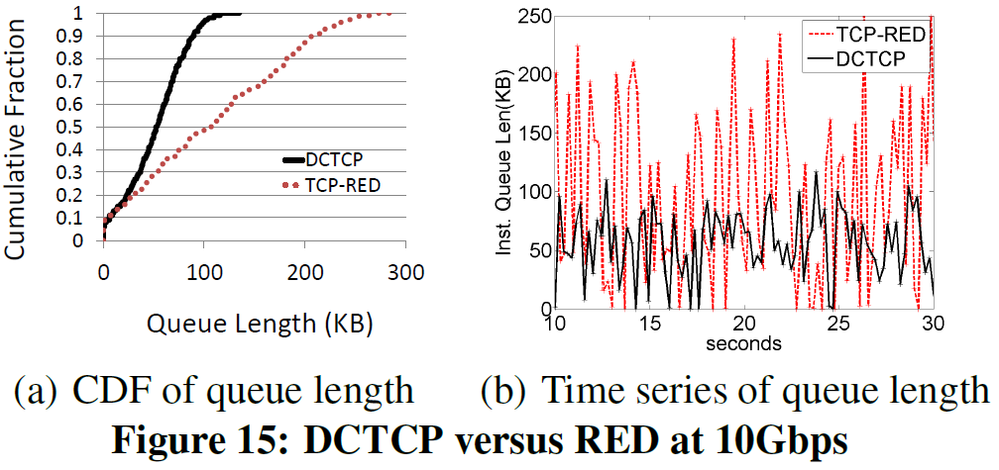
DCTCP vs. TCP+RED

Slide 53
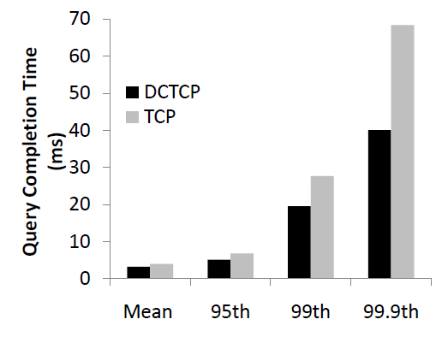
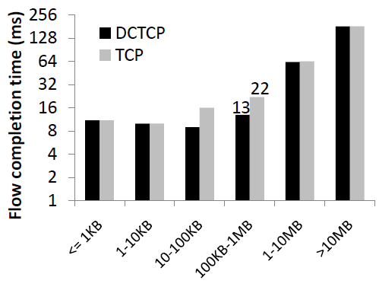
Flow/Query Completion Times

Slide 54
Shortcomings of DCTCP
Benefits of DCTCP
Better performance than TCP
Alleviates losses due to buffer pressure
Actually deployable
But…
No scheduling, cannot solve incast
Competition between mice and elephants
Queries may still miss deadlines
Network throughput is not the right metric
Application goodput is
Flows don’t help if they miss the deadline
Zombie flows actually hurt performance!

Slide 55
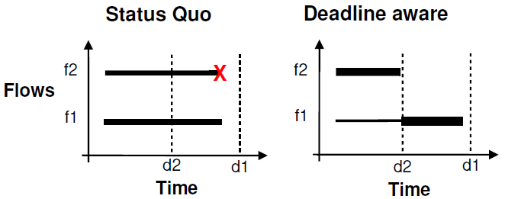
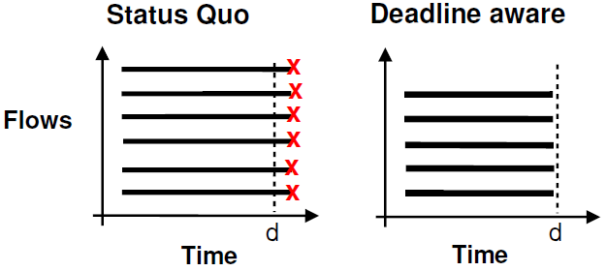
Poor Decision Making
Two flows, two deadlines
Fair share causes both to fail
Unfairness enables both to succeed
Many flows, untenable deadline
If they all go, they all fail
Quenching one flow results in higher goodput

Slide 56
Clean Slate Approach: D³
Combine XCP with deadline information
Hosts use flow size and deadline to request bandwidth
Routers measure utilization and make soft-reservations
RCP ensures low queuing, almost zero drops
Guaranteed to perform better than DCTCP
High-utilization
Use soft state for rate reservations
IntServe/DiffServe to slow/heavy weight
Deadline flows are small, < 10 packets, w/ 250µs RTT
rate = flow_size / deadline
Routers greedily assign bandwidth

Slide 57
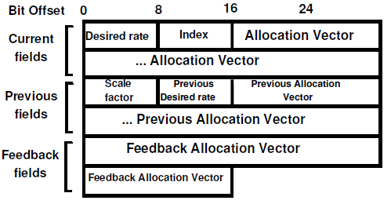
Soft Rate Reservations
Motivation
Don’t want per flow state in the router
Use a malloc/free approach
Once per RTT, hosts send RRQ packets
Include desired rate
Routers insert feedback into packet header
Vector Fields
Previous feedback
Vector of new feedback
ACKed feedback

Slide 58
Soft Rate Reservations (cont.)
Router keeps track of
Number of active flows
Available capacity
At each hop, router…
Frees the bandwidth already in use
Adjust available capacity based on new rate request
If no deadline, give fair share
If deadline, give fair share + requested rate
If bandwidth isn’t available, go into header-only mode
Insert new feedback, increment index
Why give fair share + requested rate?
You want rate requests to be falling
Failsafe against future changes in demand

Slide 59
D³ Example
Previous Rates
Previous Rates
Feedback copied into ACK
Previous Rates
cwnd = cwnd + feedback
30 Mbps | 45 Mbps | 40 Mbps
30 Mbps | 45 Mbps | 40 Mbps
30 Mbps | 45 Mbps | 40 Mbps
Desired Rate = 20 Mbps
Desired Rate = 20 Mbps
Desired Rate = 20 Mbps
28 Mbps
28 Mbps | 23 Mbps
D³ Header
This example is for a deadline flow
Non-deadline flows have desired rate = 0
This process occurs every RTT

Slide 60
Router Internals
Desired Rate = 10 Mbps
10 Mbps
Desired Rate = 10 Mbps
Desired Rate = 10 Mbps
Separate capacity from demand
Demand increases irrespective of utilization
Fair share rate is based on demand
As deadline flows arrive, even if all bandwidth is used, demand increases
During the next RTT, fair share is reduced
Frees bandwidth for satisfying deadlines
Capacity is virtual
Like XCP, multi-hop bottleneck scenarios

Slide 61
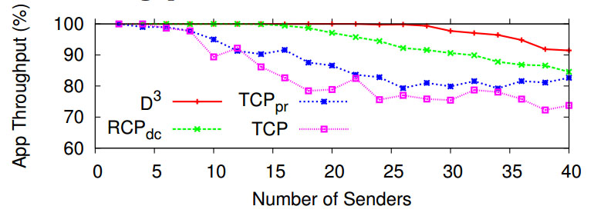
D³ vs. TCP
Flows that make 99% of deadlines

Slide 62
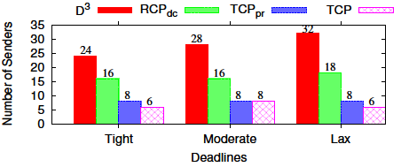
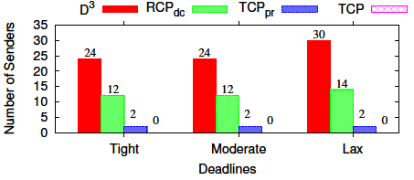
Results Under Heavy Load
With just short flows, 4x as many flows with 99% goodput
With background flows, results are even better

Slide 63
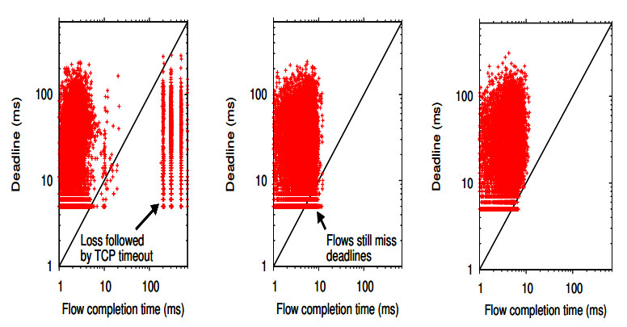
Flow Level Behavior
TCP
RCP
D³

Slide 64
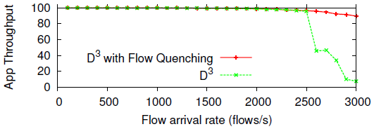
Flow Quenching
Idea: kill useless flows rather
Deadline is missed
Needed rate exceeds capacity
Prevents performance drop-off under insane load

Slide 65
Benefits of D³
Higher goodput under heavy load
TCP can not operate at 99% utilization
Network provisioning can be tighter
More freedom for application designers
Recall Google and Facebook
Current networks can barely support tight deadlines
Deadline-bound apps can:
Send more packets
Operate under tighter constraints

Slide 66
Challenges with D³
All-or-nothing deployment
Not designed for incremental deployment
May not play nice with TCP
Significant complexity in the switch?
XCP ran in an FPGA 2005
NetFPGAs are still expensive
Application level changes
For most apps, just switch socket type
For deadline aware, need to know the flow size
Current deadline apps do this!
Periodic state flushes at the router

Slide 67
Conclusions
Datacenters are a super hot topic right now
Lots of angles for research/improvement
Heat, power
Topology, routing
Network stack
VM migration, management
Applications: NoSQL, Hadoop, Cassandra, Dynamo
Space is getting crowded
Tough to bootstrap research
All but one of today’s papers were from Microsoft
Who else has the hardware to do the research?

Slide 68
Big Open Problem
Measurement data
Real datacenter traces are very hard to get
Are they representative?
Really, what is a ‘canonical’ datacenter?
Application dependent
Makes results very hard to quantify
Cross-paper comparisons
Reproducibility

Slide 69
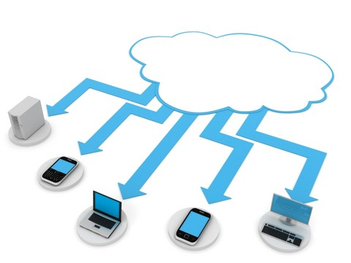
And we’re done.

