Slide 1
CS 4700 / CS 5700
Network Fundamentals
Lecture 20: Malware, Botnets, Spam
(Wanna buy some v14gr4?)
Slides stolen from Vern Paxson (ICSI) and Stefan Savage (UCSD)

Slide 2
Motivation
Internet currently used for important services
  Financial transactions, medical records
Increasingly used for critical services
  911, surgical operations, water/electrical system control, remote controlled drones, etc.
Networks more open than ever before
  Global, ubiquitous Internet, wireless
Notes:
script kiddies
foreign governments
domestic government
competitors
criminals

Slide 3
Malicious Users
Miscreants, e.g. LulzSec
  In it for thrills, street cred, or just to learn
  Defacing web pages, spreading viruses, etc.
Hacktivists, e.g. Anonymous
  Online political protests
  Stealing and revealing classified information
Organized Crime
  Profit driven, online criminals
  Well organized, divisions of labor, highly motivated

Slide 4
Network Security Problems
Host Compromise
  Attacker gains control of a host
  Can then be used to try and compromise others
Denial-of-Service
  Attacker prevents legitimate users from gaining service
Attack can be both
  E.g., host compromise that provides resources for denial-of-service

Slide 5
Definitions
Virus
  Program that attaches itself to another program
Worm
  Replicates itself over the network
  Usually relies on remote exploit (e.g. buffer overflow)
Rootkit
  Program that infects the operating system (or even lower)
  Used for privilege elevation, and to hide files/processes
Trojan horse
  Program that opens “back doors” on an infected host
  Gives the attacker remote access to machines
Botnet
  A large group of Trojaned machines, controlled en-mass
  Used for sending spam, DDoS, click-fraud, etc.

Slide 6
Outline
Worms
  Basics
  Detection
Botnets
  Basics
  Torpig – fast flux and phishing
  Storm – P2P and spam

Slide 7
Host Compromise
One of earliest major Internet security incidents
  Internet Worm (1988): compromised almost every BSD-derived machine on Internet
Today: estimated that a single worm could compromise 10M hosts in < 5 min
Attacker gains control of a host
  Read data
  Erase data
  Compromise another host
  Launch denial-of-service attacks on another host

Slide 8
Host Compromise: Stack Overflow
Typical code has many bugs because those bugs are not triggered by common input
Network code is vulnerable because it accepts input from the network
Network code that runs with high privileges (i.e., as root) is especially dangerous
  E.g., web server

Slide 9
Example
What is wrong with this code?
// Copy a variable length user name from a packet
#define MAXNAMELEN 64
int offset = OFFSET_USERNAME;
char username[MAXNAMELEN];
int name_len;
name_len = packet[offset];
memcpy(&username, packet[offset + 1], name_len);
0
3
4
Packet
name_len
name

Slide 10
Example
0
3
4
Packet
name_len
name
Stack
void foo(packet) {
#define MAXNAMELEN 64
int offset = OFFSET_USERNAME;
char username[MAXNAMELEN];
int name_len;
name_len = packet[offset];
memcpy(&username,
packet[offset + 1],name_len);
…
}
X
Address: X-72
“foo” return address
X-4
[Malicious assembly instructions]
int offset
X-8
Christo Wilson
char username[]
X-72
15
72 (MAXNAMELEN + 8)
int name_len
X-76

Slide 11
Effect of Stack Overflow
Write into part of the stack or heap
  Write arbitrary code to part of memory
  Cause program execution to jump to arbitrary code
Worm
  Probes host for vulnerable software
  Sends bogus input
  Attacker can do anything that the privileges of the buggy program allows
    Launches copy of itself on compromised host
  Spread at exponential rate
  10M hosts in < 5 minutes

Slide 12
Worm Spreading
f = (e ^{K(t-T)} – 1) / (1+ e ^{K(t-T)} )
f – fraction of hosts infected
K – rate at which one host can compromise others
T – start time of the attack
1
f
T
t

Slide 13
Worm Examples
Morris worm (1988)
Code Red (2001)
MS Slammer (January 2003)
MS Blaster (August 2003)

Slide 14
Morris Worm (1988)
Infect multiple types of machines (Sun 3 and VAX)
  Spread using a Sendmail bug
Attack multiple security holes including
  Buffer overflow in fingerd
  Debugging routines in Sendmail
  Password cracking
Intend to be benign but it had a bug
  Fixed chance the worm wouldn’t quit when reinfecting a machine → number of worm on a host built up rendering the machine unusable

Slide 15
Code Red Worm (2001)
Attempts to connect to TCP port 80 on a randomly chosen host
If successful, the attacking host sends a crafted HTTP GET request to the victim, attempting to exploit a buffer overflow
Worm “bug”: all copies of the worm use the same random seed to scanning new hosts
  DoS attack on those hosts
  Slow to infect new hosts
2nd generation of Code Red fixed the bug!
  It spread much faster

Slide 16
MS SQL Slammer (January 2003)
Uses UDP port 1434 to exploit a buffer overflow in MS SQL server
  Generate massive amounts of network packets
  Brought down as many as 5 of the 13 internet root name servers
Stealth Feature
  The worm only spreads as an in-memory process: it never writes itself to the hard drive
    Solution: close UDP port on firewall and reboot

Slide 17
MS SQL Slammer (January 2003)
Slammer exploited a connectionless UDP service, rather than connection-oriented TCP.
  Entire worm fit in a single packet!
  When scanning, worm could “fire and forget”.
Worm infected 75,000+ hosts in 10 minutes (despite broken random number generator).
  At its peak, doubled every 8.5 seconds
Progress limited by the Internet’s carrying capacity!

Slide 18
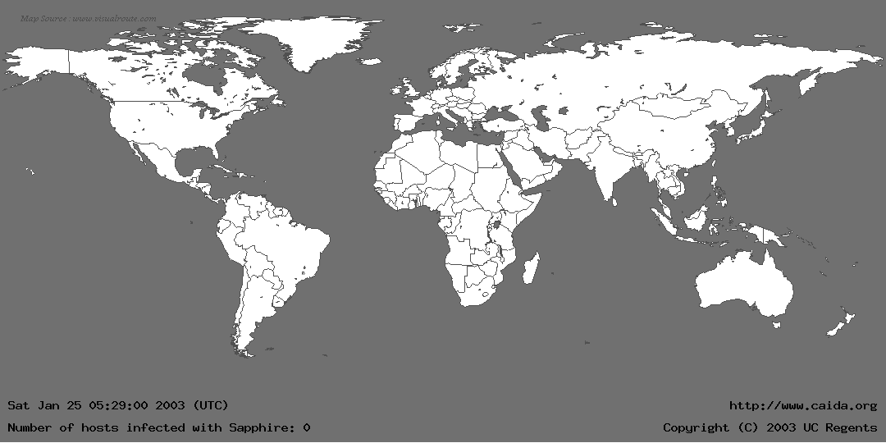
Life Just Before Slammer

Slide 19
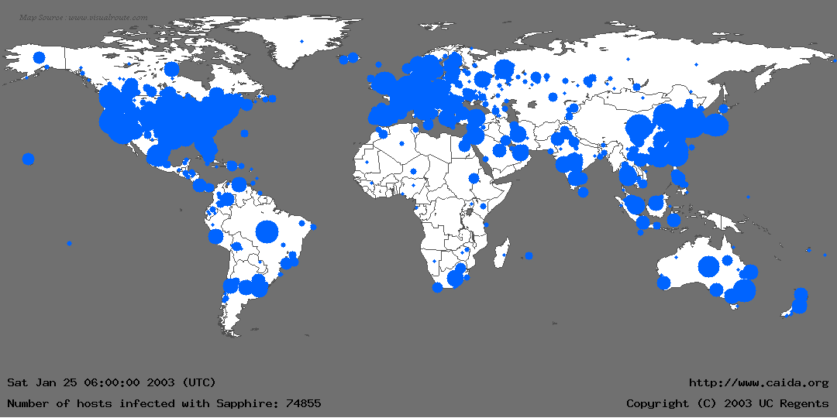
Life Just After Slammer

Slide 20
MS Blaster (August 2003)
Exploits a buffer overflow vulnerability of the RPC (Remote Procedure Call) service in Win 200 and XP
Scans a random IP range to look for vulnerable systems on TCP port 135
Opens TCP port 4444, which could allow an attacker to execute commands on the system
DDoS windowsupdate.com on certain versions of Windows

Slide 21
Spreading Faster
Idea 1: Reduce Redundant Scanning
  Construct permutation of address space.
  Each new worm instance starts at random point
  Worm instance that “encounters” another instance re-randomizes
Idea 2: Reduce Slow Startup Phase
  Construct a “hit-list” of vulnerable servers in advance
  Assume 1M vulnerable hosts, 10K hit-list, 100 scans/worm/sec, 1 sec to infect
    99% infection rate in 5 minutes

Slide 22
Spreading Even Faster — Flash Worms
Idea: use an Internet-sized hit list.
  Initial copy of the worm has the entire hit list
  Each generation…
    Infect n hosts from the list
    Give each new infection 1/n of the list
  Need to engineer for locality, failure & redundancy
  ~10 seconds to infect the whole Internet

Slide 23
Contagion worms
Suppose you have two exploits: Es (Web server) and Ec (Web client)
You infect a server (or client) with Es (Ec)
Then you . . . wait (Perhaps you bait, e.g., host porn)
When vulnerable client arrives, infect it
You send over both Es and Ec
As client happens to visit other vulnerable servers, infect

Slide 24
Incidental Damage … Today
Today’s worms have significant real-world impact:
  Code Red disrupted routing
  Slammer disrupted root DNS, elections, ATMs, airlines, operations at an off-line nuclear power plant …
  Blaster possibly contributed to Great Blackout of Aug. 2003 … ?
  Plus major clean-up costs
But most worms are amateurish
  Unimaginative payloads

Slide 25
Where are the Nastier Worms??
Botched propagation the norm
Doesn’t anyone read the literature?
  e.g. permutation scanning, flash worms, metaserver worms, topological, contagion
Botched payloads the norm
  e.g. Flooding-attack fizzles
Some worm authors are in it for kicks …
  No arms race.

Slide 26
Next-Generation Worm Authors
Military (e.g. Stuxnet)
  Worm spread in 2010 (courtesy of US/Israel)
  Targets Siemens industrial (SCADA) systems
  Target: Iranian uranium enrichment infrastructure
Crooks:
  Very worrisome onset of blended threats
    Worms + viruses + spamming + phishing + DOS-for-hire + botnets + spyware
  Money on the table → arms race
    (market price for spam proxies: 3-10¢/host/week)

Slide 27
Witty
Released March 19, 2004
Single UDP packet exploits flaw in the passive analysis of Internet Security Systems products
“Bandwidth-limited” UDP worm ala’ Slammer
Vulnerable pop. (12K) attained in 75 minutes
Payload: slowly corrupt random disk blocks

Slide 28
Witty, con’t
Flaw had been announced the previous day
Telescope analysis reveals:
  Initial spread seeded via a hit-list
  In fact, targeted a U.S. military base
  Analysis also reveals “Patient Zero”, a European retail ISP
Written by a Pro

Slide 29
Shamoon
Found August 16, 2012
Targeted computers from Saudi Aramco
  Largest company/oil producer in the world
Infected 30,000 desktop machines
  Took one week to clean and restore
Could have been much worse
  Attack was not stealthy
    Stolen data slowly over time
    Slowly corrupt random disk blocks, spreadsheets, etc.
  Did not target SCADA or production control systems

Slide 30
Some Cheery Thoughts
Imagine the following species:
  Poor genetic diversity; heavily inbred
  Lives in “hot zone”; thriving ecosystem of infectious pathogens
  Instantaneous transmission of disease
  Immune response 10-1M times slower
  Poor hygiene practices
What if diseases were…
  Trivial to create
  Highly profitable to create and spread
  What would its long-term prognosis be?

Slide 31
Outline
Worms
  Basics
  Detection
Botnets
  Basics
  Torpig – fast flux and phishing
  Storm – P2P and spam

Slide 32
Threat Detection
Both defense and deterrence are predicated on getting good intelligence
  Need to detect, characterize and analyze new malware threats
  Need to be do it quickly across a very large number of events
Classes of monitors
  Network-based
  Host/Endpoint-based
Monitoring environments
  In-situ: real activity as it happens
    Network/host IDS
  Ex-situ: “canary in the coal mine”
    HoneyNets/Honeypots

Slide 33
Worm Signature Inference
Challenge: need to automatically learn a content “signature” for each new worm – in less than a second!
Approach: Monitor network and look for strings common to traffic with worm-like behavior
Signatures can then be used for content filtering
PACKET HEADER
SRC: 11.12.13.14.3920 DST: 132.239.13.24.5000 PROT: TCP
00F0 90 90 90 90 90 90 90 90 90 90 90 90 90 90 90 90 ................
0100 90 90 90 90 90 90 90 90 90 90 90 90 4D 3F E3 77 ............M?.w
0110 90 90 90 90 FF 63 64 90 90 90 90 90 90 90 90 90 .....cd.........
0120 90 90 90 90 90 90 90 90 90 90 90 90 90 90 90 90 ................
0130 90 90 90 90 90 90 90 90 EB 10 5A 4A 33 C9 66 B9 ..........ZJ3.f.
0140 66 01 80 34 0A 99 E2 FA EB 05 E8 EB FF FF FF 70 f..4...........p
. . .
PACKET PAYLOAD (CONTENT)
Kibvu.B signature captured by Earlybird on May 14th, 2004

Slide 34
Content Sifting
Assume there exists some (relatively) unique invariant bitstring W across all instances of a particular worm
Two consequences
  Content Prevalence: W will be more common in traffic than other bitstrings of the same length
  Address Dispersion: the set of packets containing W will address a disproportionate number of distinct sources and destinations
Content sifting: find W’s with high content prevalence and high address dispersion and drop that traffic

Slide 35


The Basic Algorithm
Detector in network
A
B
C
cnn.com
E
D
Address Dispersion Table
Sources Destinations
Prevalence Table
3 (A, B, D)
3 (B, D, E)
1
2 (A, B)
1 (B, D)
1 (A)
1 (B)
1
1 (C)
1 (A)

Slide 36
Challenges
Computation
  To support a 1Gbps line rate we have 12us to process each packet, at 10Gbps 1.2us, at 40Gbps…
    Dominated by memory references; state expensive
  Content sifting requires looking at every byte in a packet
State
  On a fully-loaded 1Gbps link a naïve implementation can easily consume 100MB/sec for table
  Computation/memory duality: on high-speed (ASIC) implementation, latency requirements may limit state to
  on-chip SRAM

Slide 37
Which substrings to index?
Approach 1: Index all substrings
  Way too many substrings → too much computation → too much state
Approach 2: Index whole packet
  Very fast but trivially evadable (e.g. shift a string by one byte…)
Approach 3: Index all contiguous substrings of a fixed length ‘S’
  Can capture all signatures of length ‘S’ and larger
A B C D E F G H I J K

Slide 38
How to represent substrings?
Store hash instead of literal to reduce state
Incremental hash to reduce computation
Rabin fingerprint is one such efficient incremental hash function [Rabin81,Manber94]
  One multiplication, addition and mask per byte
P1
R A N D A B C D O M
Fingerprint = 11000000
P2
R A B C D A N D O M
Fingerprint = 11000000

Slide 39
How to subsample?
Approach 1: index all strings, but sample packets
  If we chose 1 in N, detection will be slowed by N
Approach 2: sample at particular byte offsets
  Susceptible to simple evasion attacks
  No guarantee that we will sample same sub-string in every packet
Approach 3: sample based on the hash of the substring
  i.e. a probabilistic approach

Slide 40
Value sampling [Manber ’94]
Sample hash if last N bits of the hash are equal to the value V
  The number of bits N can be dynamically set
  The value V can be randomized for resiliency
P_{track} → Probability of selecting >=1 substring of length S in a L byte invariant
  For 1/64 sampling (last 6 bits equal to 0), and 40 byte substrings
  P_{track} = 99.64% for a 400 byte invariant
A B C D E F G H I J K
Fingerprint = 11000000
SAMPLE
Fingerprint = 11000001
IGNORE
Fingerprint = 11000010
IGNORE
Fingerprint = 10000000
SAMPLE

Slide 41
High-prevalence strings are rare
If you graph all signatures, and show a CDF of how often they repeat…
Only 0.6% of the 40 byte substrings repeat more than 3 times in a minute
Only want to keep state for prevalent substrings
Chicken vs. egg: how to count strings without maintaining state for them?

Slide 42
Efficient high-pass filters for content
Multi Stage Filters: randomized technique for counting “heavy hitter” network flows with low state and few false positives [Estan02]
  Instead of using flow id, use content hash
    Rabin Fingerprints with Manber’s Value sampling
  Three orders of magnitude memory savings
Very similar to a Counting Bloom Filter

Slide 43
Finding “heavy hitters”
Hash 1
Increment
Counter Array 1
Content Hash
(Rabin
Fingerprint)
Hash 2
Counter Array 2
ALERT! If
all counters
above threshold
Hash 3
Counter Array 3

Slide 44
Multistage filters in action
Counters
. . .
Threshold
Grey = other hashes
Counters 1
Yellow = rare hash
Green = common hash
Counters 2
Counters 3

Slide 45
High address dispersion is rare
Naïve implementation might maintain a list of sources (or destinations) for each string hash
But dispersion only matters if its over threshold
  Approximate counting may suffice
  Trades accuracy for state in data structure
Scalable Bitmap Counters
  Similar to multi-resolution bitmaps [Estan03]
  Reduce memory by 5x for modest accuracy error
  (Also similar to a Counting Bloom Filter)

Slide 46
Content sifting summary
Index fixed-length substrings using incremental hashes
Subsample hashes as function of hash value
Multi-stage filters to filter out uncommon strings
Scalable bitmaps to tell if number of distinct addresses per hash crosses threshold
Now its fast enough to implement

Slide 47
Software prototype: Earlybird
To other sensors and
blocking devices
TAP
EB Sensor code (using C)
Apache + PHP
Libpcap
Summary
data
Mysql + rrdtools
Linux 2.6
EB Aggregator (using C)
Setup 1: Large fraction of the UCSD campus traffic, Traffic mix: approximately 5000 end-hosts, dedicated servers for campus wide services (DNS, Email, NFS etc.)
Line-rate of traffic varies between 100 & 500Mbps.
Setup 2: Fraction of local ISP Traffic,
Traffic mix: dialup customers, leased-line customers
Line-rate of traffic is roughly 100Mbps.
AMD Opteron 242 (1.6Ghz)
Linux 2.6
EarlyBird Sensor
EarlyBird Aggregator
Reporting & Control

Slide 48
Content sifting overhead
Mean per-byte processing cost
  0.409 microseconds, without value sampling
  0.042 microseconds, with 1/64 value sampling
  (~60 microseconds for a 1500 byte packet,
  can keep up with 200Mbps)
Additional overhead in per-byte processing cost for flow-state maintenance (if enabled):
  0.042 microseconds

Slide 49
Experience
Detected and automatically generated signatures for every known worm outbreak over eight months
  Code Red, Nimda, WebDav, Slammer, Opaserv, …
Can produce a precise signature for a new worm in a fraction of a second
  MsBlaster, Bagle, Sasser, Kibvu, …
Software implementation keeps up with 200Mbps

Slide 50
False Negatives
Easy to prove presence, impossible to prove absence
Live evaluation: over 8 months detected every worm outbreak reported on popular security mailing lists
Offline evaluation: several traffic traces run against both Earlybird and Snort IDS (w/all worm-related signatures)
  Worms not detected by Snort, but detected by Earlybird
  The converse never true

Slide 51
False Positives
Common protocol headers
  Mainly HTTP and SMTP headers
  Distributed (P2P) system protocol headers
  Can be fixed with a whitelist
    Small number of popular protocols
Non-worm epidemic Activity
  SPAM
  BitTorrent
GNUTELLA.CONNECT
/0.6..X-Max-TTL:
.3..X-Dynamic-Qu
erying:.0.1..X-V
ersion:.4.0.4..X
-Query-Routing:.
0.1..User-Agent:
.LimeWire/4.0.6.
.Vendor-Message:
.0.1..X-Ultrapee
r-Query-Routing:

Slide 52
Challenges
What are the limitations to this approach?
  Variable content
  polymorphic worms, per-session encryption, …
  Attacking the filter
  embedding common signatures
  Network level polymorphism
  overlapping IP or TCP fragments
  Slow growth worms (e.g. contagion…)

Slide 53
More Defensive Strategies
Code reviews (Red team, Tiger team)
  Widely used now
  But very expensive
    ~$200M to review Windows Server 2003
Host-based security
  Tools for hardening software
    Static and dynamic analysis, taint tracking
    Address space layout randomization
    Sandboxing and virtualization
  Software behavioral analysis
  Create artificial software heterogeneity
    Binary rewriting/dynamic compilation

Slide 54
Outline
Worms
  Basics
  Detection
Botnets
  Basics
  Torpig – fast flux and phishing
  Storm – P2P and spam

Slide 55
Worms to Botnets
Ultimate goal of most Internet worms
  Compromise machine, install rootkit, then trojan
  One of many in army of remote controlled machines
Used by online criminals to make money
  Extortion
    “Pay use $100K or we will DDoS your website”
  Spam and click-fraud
  Phishing and theft of personal information
    Credit card numbers, bank login information, etc.

Slide 56
Botnet Attacks
Truly effective as an online weapon for terrorism
  i.e. perform targeted attacks on governments and infrastructure
Recent events: massive DoS on Estonia
  April 27, 2007 – Mid-May, 2007
  Closed off most government and business websites
  Attack hosts from US, Canada, Brazil, Vietnam, …
  Web posts indicate attacks controlled by Russians
  All because Estonia moved a memorial of WWII soldier
Is this a glimpse of the future?

Slide 57
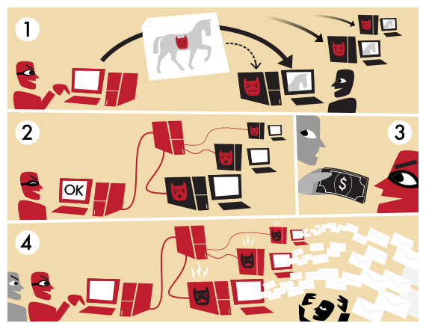

Slide 58
Detecting / Deterring Botnets
Bots controlled via C&C channels
  Potential weakness to disrupt botnet operation
  Traditionally relied on IRC channels run by ephemeral servers
    Can rotate single DNS name to different IPs on minute-basis
  Can be found by mimicing bots (using honeypots)
Bots also identified via DNS blacklist requests
A constant cat and mouse game
  Attackers evolving to decentralized C&C structures
  Peer to peer model, encrypted traffic
  Storm botnet, estimated 1-50 million members in 9/2007

Slide 59



Old-School C&C: IRC Channels
snd spam: <subject> <msg>
Botmaster
snd spam: <subject> <msg>
snd spam: <subject> <msg>
IRC Servers
Problem: single point of failure
Easy to locate and take down

Slide 60


P2P Botnets
Insert commands into the DHT
Structured P2P DHT
Botmaster
Master Servers
Get commands from the DHT

Slide 61
Fast Flux DNS
Botmaster
HTTP Servers
But: ISPs can blacklist the rendezvous domain
12.34.56.78
6.4.2.0
31.64.7.22
245.9.1.43
98.102.8.1
www.my-botnet.com
Change DNS→IP mapping every 10 seconds

Slide 62
Random Domain Generation
…But the Botmaster only needs to register a few
Botmaster
HTTP Servers
www.sb39fwn.com
www.17-cjbq0n.com
www.xx8h4d9n.com
Bots generate many possible domains each day
Can be combined with fast flux

Slide 63
Outline
Worms
  Basics
  Detection
Botnets
  Basics
  Torpig – fast flux and phishing
  Storm – P2P and spam

Slide 64
“Your Botnet is My Botnet”
Takeover of the Torpig botnet
  Random domain generation + fast flux
  Team reverse engineered domain generation algorithm
  Registered 30 days of domains before the botmaster!
  Full control of the botnet for 10 days
Goal of the botnet: theft and phishing
  Steals credit card numbers, bank accounts, etc.
  Researchers gathered all this data
Other novel point: accurate estimation of botnet size

Slide 65
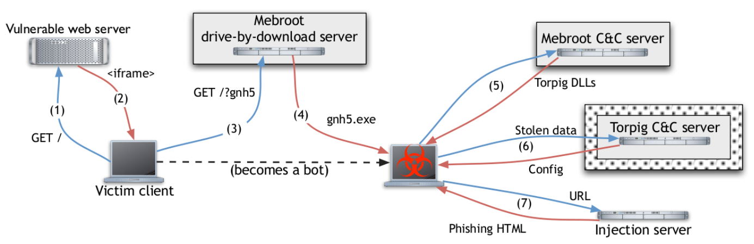
Torpig Architecture
Host gets infected via drive-by-download
Rootkit installation
Trojan installation
Collect stolen data
Researchers Infiltrated Here
Capture banking passwords

Slide 66
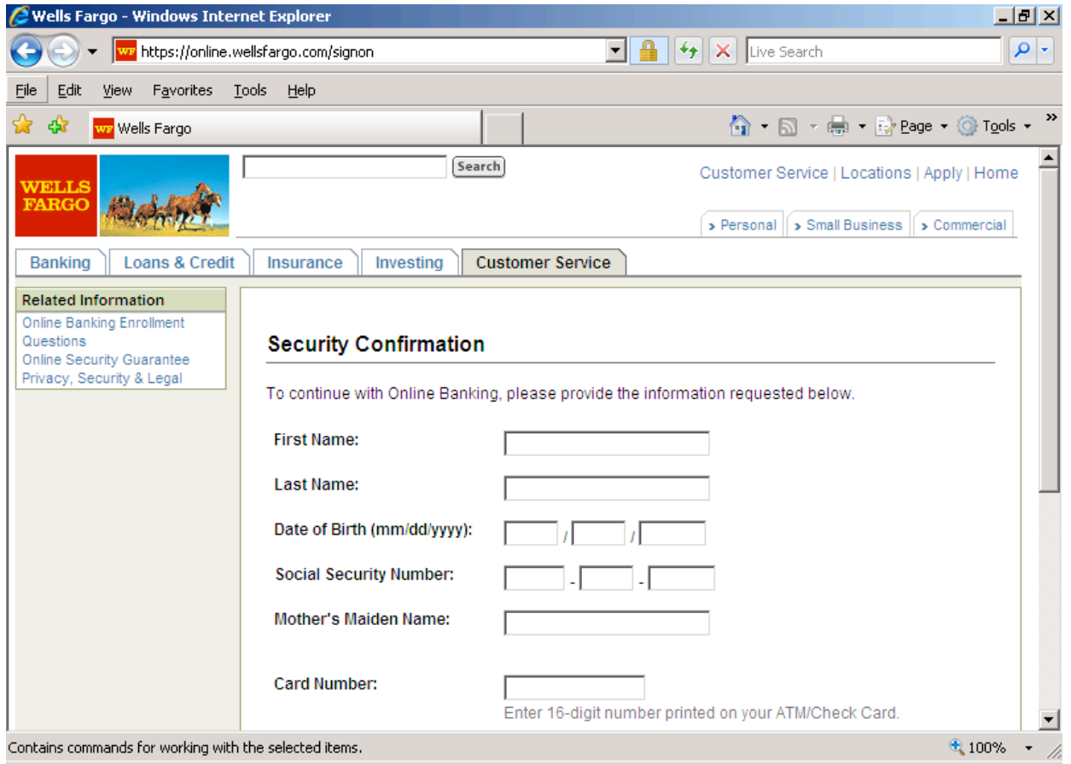
Man-in-the-Browser Attack

Slide 67
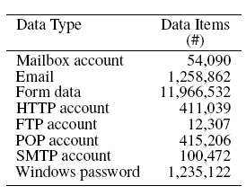
Stolen Information
Data gathered from Jan 25-Feb 4 2009
User Accounts
Banks Accounts
How much is this data worth?
  Credit cards: $0.10-$25 Banks accounts: $10-$1000
  $83K-$8.3M

Slide 68
How to Estimate Botnet Size?
Passive data collection methodologies
  Honeypots
    Infect your own machines with Trojans
    Observe network traffic
  Look at DNS traffic
    Domains linked to fast flux C&C
  Networks flows
    Analyze all packets from a large ISP and use heuristics to identify botnet traffic
None of these methods give a complete picture

Slide 69
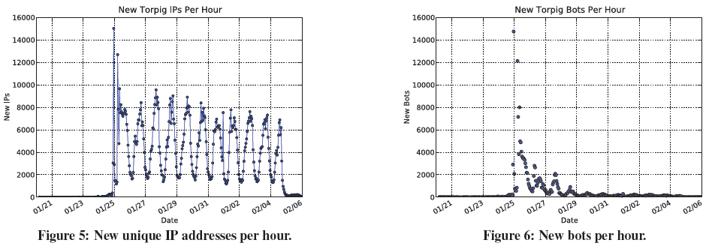
Size of the Torpig Botnet
Why the disconnect between IPs and bots?
  Dynamic IPs, short DHCP leases
Casts doubt on prior studies, enables more realistic estimates of botnet size

Slide 70
Outline
Worms
  Basics
  Detection
Botnets
  Basics
  Torpig – fast flux and phishing
  Storm – P2P and spam

Slide 71
“Spamalytics”
Measurement of “conversion rate” of spam campaigns
  Probability that an unsolicited email will elicit a “sale”
  Methodology using Botnet infiltration
Analyze two spam campaigns
  Trojan propagation
  Online pharmaceutical marketing
For more than 469M spam emails, authors identified
  Number that pass thru anti-spam filters
  Number that elicit visits to advertised sites (response rate)
  Number of “sales” and “infections” produced (conversion rate)

Slide 72
Spam Conversion
Big question
  Why do spammers continue to send spam?
  Spam filters eliminate >99% of spam
More questions
  How many messages get past spam filters?
  How much money does each successful “txn” make?
Key
  Infiltrate the spam generation/monetizing process and find out answers
Notes:
Therearenoapparentmethodsforindirectly measuring spam conversion
– Best way is to be a spammer
• Authorsconductedstudyby“sidesteppingthe obvious legal and ethical problems associated with sending spam”
– Ensuring neutral actions so users never are worse off due to researchers activities
– Reducing harm for cases in which user property is at risk
• Method:infiltrateexistingspammingbotnet, modifying sent spam and directing recipients to authors’ websites

Slide 73
Storm Botnet
Disadvantage: not complete coverage
Structured P2P DHT
Botmaster
Advantage: easy to infiltrate
Master Servers
Get commands from the DHT
Researchers Infiltrated Here

Slide 74
Methodology
Infiltrate Storm at proxy level
  Rewrite spam instructions to use own URLs
  URLs point to sites controlled by researchers
  Observe activity at each stage
Get rates for SMTP delivery, spam filtering, click-through, and final conversion
Did this to ~470M emails generated by the Storm botnet, over a period of a month

Slide 75
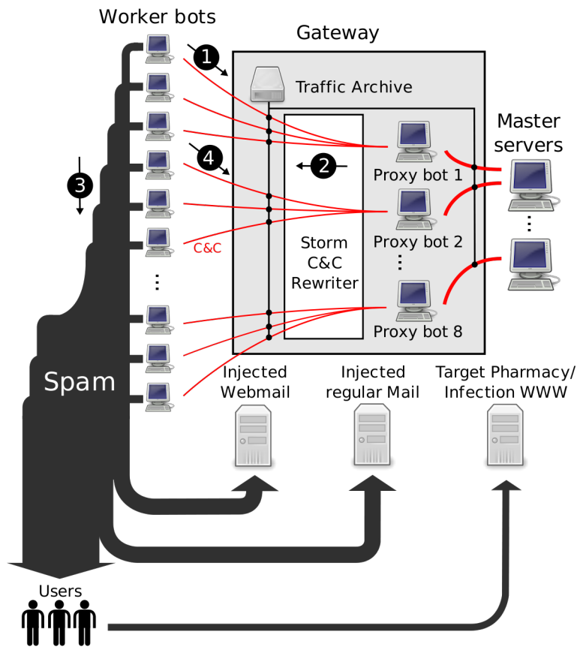

Slide 76
Focus on Two Spam Campaigns
Pharmaceuticals and self-propagating malware
Ran fake, harmless websites that look like the real ones
Conversion signals
  For pharma, a click on “purchase” button
  For self-prop, execution of downloaded binary that phones home and exits

Slide 77
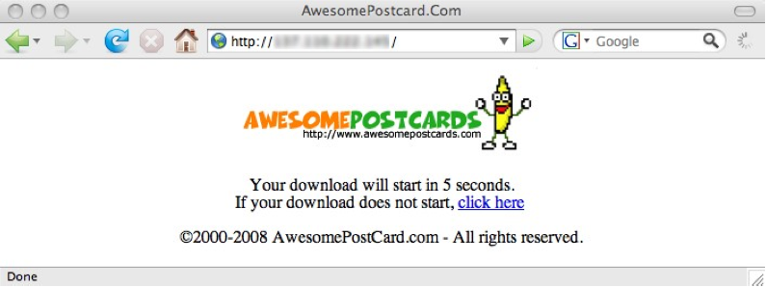

Slide 78


Slide 79
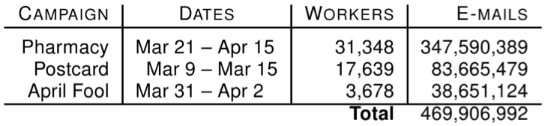
Results: Campaign Volumes

Slide 80
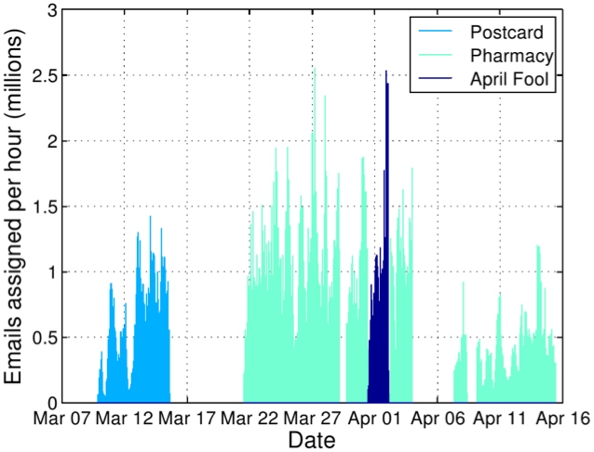
Rewritten Spams per Hour

Slide 81
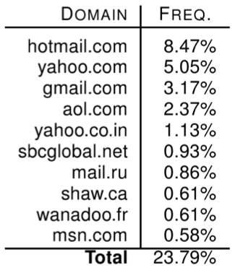
Spam Delivery: Top Domains

Slide 82
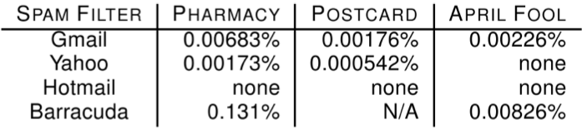
Spam Filter Effectiveness
What percentage of spam got through the filters?
Average: 0.014%
  1 in 7,142 attempted spams got through

Slide 83
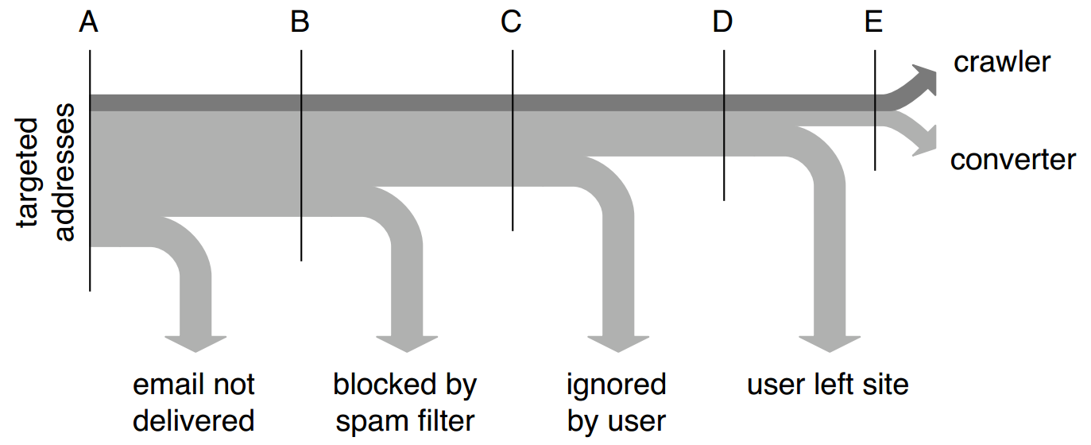
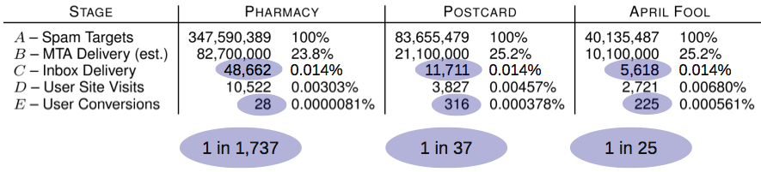
Conversion Tracking

Slide 84
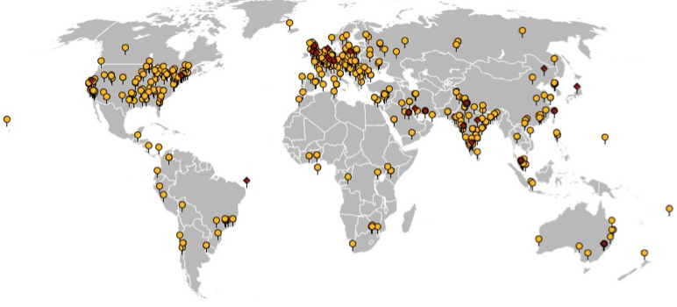
Geographic View of Conversions
541 binary executions, 28 purchases

Slide 85
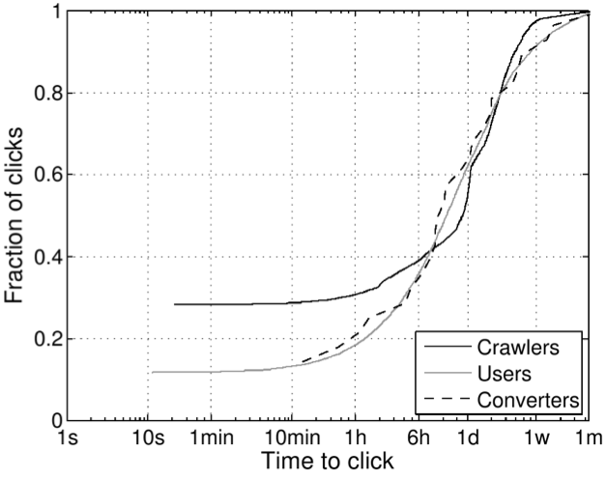
Time-to-click Distribution

Slide 86
Pharmaceutical Revenue
28 purchases in 26 days, average price ~$100
  Total: $2,731.88, $140/day
But: only controlled ~1.5% of workers!
  $9500/day (and 8500 new bot infections per day)
  $3.5M/year
Storm: service provider or integrated operation?
  Retail price of spam ~$80 per million
  Suggests integrated operation to be profitable
  In fact: 40% cut for Storm operators via Glavmed

Slide 87
Thoughts / Questions?
How much of these results are representative?
Legal implications of research?
Based on results, what’s the future of spam likely to be?
What does the spam battle teach us about incentives and misbehavior on the Internet?

