Slide 1
CS 4740/6740 Network Security
Lecture 2: Fundamentals and Definitions

Slide 2
Definitions
Models
Approaches
Principals
Ethics
Notes:
Ask for definitions of security

Slide 3
Defining "Security"
Policies and mechanisms for preserving desirable protection properties over data and resources.
We reason about security in terms of properties
Policies specify what we want to enforce
Mechanisms are the means by which we enforce policies
Always in the context of an attacker

Slide 4
Security Properties
Let's consider an example where a general wants to give the order "Attack at dawn."
In a network, messages must be distributed from one principal to various other principals.
What are the properties we would like to enforce on messages?
Alternatively, what are the bad things that could be done to this message?
Notes:
What are some of the basic properties we're interested in enforcing? Let's consider an example.
What kinds of things could go wrong with the order?

Slide 5
Confidentiality
"Hey, we're attacking at dawn!"
Data must only be released to authorized principals
Cryptography has historically focused on providing confidentiality
But, there are other mechanisms
Can have a temporal aspect

Slide 6
Integrity
"Retreat at dawn."
Data must not be modified (in an undetectable manner)
What constitutes a modification?
Corruption
Dropped, replayed, or reordered messages
Cryptography has also historically provided this
e.g, (cryptographic) hash functions, HMAC

Slide 7
Authenticity
Enemy commander: "Attack at dawn."
Establishment of identity
Or, verification of "genuineness"
Again, cryptography has long considered this
e.g., HMAC, signatures

Slide 8
Availability
“Xfk3^#M3mf a __ q3rf” – jamming results in garbled message
Data and resources must be accessible when required
Related to integrity, but more concerned with denial of service (DoS) attacks
Resource exhaustion (e.g., CPU, memory, network bandwidth)
Usually easy to perform, can be difficult to defend

Slide 9
Non-repudiation
"I never said to attack at dawn!"
Data must be bound to identity
Prevents denial of message transmission or receipt
Cryptographic techniques
e.g., HMAC, certificates

Slide 10
Access Control
Policy specifying how entities can interact with resources
i.e., Who can access what?
Requires authentication and authorization
Access control primitives
Principal | Users of a system
Subject | Entity that acts on behalf of principals
Object | Resource acted upon by subjects

Slide 11
Authentication
Verification of identity claim made by a subject on behalf of a principal
Involves examination of factors, or credentials
Something you have – e.g., a badge
Something you know – e.g., a password
Something you are – e.g., your fingerprint
Desirable properties include being unforgeable, unguessable, and revocable

Slide 12
Authorization
Authorization follows authentication
If asking what someone can do, you must know who they are
Usually represented as a policy specification of what resources can be accessed by a given subject
Can also include the nature of the access

Slide 13
Types of Access Control
Discretionary Access Control (DAC)
Owners of objects specify policy
Mandatory Access Control (MAC)
Policy based on sensitivity levels – e.g., clearance
Owners do not specify their own policies
Role-based Access Control (RBAC)
Central authority defines policy in terms of roles
Roles ≈ permission sets

Slide 14
Access Control Matrices
Given subjects si ∈S, objects oj ∈O, rights {R,W,X},
 | o1 | o2 | o3
s1 | RW | RX
s2 | R | RWX | RW
s3 |  | RWX
Introduced by Lampson in 1971
Static description of system protection state
Abstract model of concrete systems

Slide 15
Definitions
Models
Approaches
Principals
Ethics
Notes:
Ask for definitions of security

Slide 16
Abstract Security Models
Access control lists
Capabilities
Bell-LaPadula
Biba Integrity
Clark-Wilson
Brewer-Nash
Non-interference
Information flow

Slide 17
Practical Security Models
UNIX permissions
Windows access control
Java permissions
Web (same-origin policy)
Android permissions
iOS (MAC model)

Slide 18
Limitations of Access Matrices
The Unix model is very simple
Users and groups, read/write/execute
Not all possible policies can be encoded
 | file 1 | file 2
user 1 | --- | rw-
user 2 | r-- | r--
user 3 | rw- | rwx
user 4 | rw- | ---
file 1: two users have high privileges
If user 3 and user 4 are in a group, how to give user 2 read and user 1 nothing?
file 2: four distinct privilege levels
Maximum of three levels (user, group, other)

Slide 19
Access Control List (ACL)
⟨object, subject, operation⟩
Authorization verified for each request by checking list of tuples
Instantiation of access control matrices with update
Used pervasively in filesystems and networks
"Users a, b, and c and read file x."
"Hosts a and b can listen on port x."
Drawbacks?

Slide 20
Capabilities
In this model, authorization is synonymous with possession of a capability
Capabilities represented as transferable, unforgeable tokens
Many implementations
Hardware
Systems (EROS, Capsicum)
Languages (E, Caja, Joe-E)
Drawbacks?

Slide 21
Capabilities
public class ReadOnlyFileToken extends FileToken {
protected ReadOnlyFileToken(String path) { ... }
public void close() { ... }
public void seek(int pos) { ... }
public void read(byte[] buf, int off, int len) { ... }
public void write(byte[] buf, int off, int len) {
throw new CapabilityException("writes unauthorized");
}
}

Slide 22
Bell-LaPadula (BLP)
Concerned with enforcing confidentiality
Subjects have clearances
e.g., Confidential, Secret, Top-Secret, TS/SCI
Objects have classifications
State-transition model specifies system evolution

Slide 23
Bell-LaPadula
"No read up, no write down"
Simple security property
A subject at a given level cannot read an object at a higher level
★-property (confinement)
A subject at a higher level cannot write to an object at a lower level
Discretionary security property
Additional DAC – e.g., ACLs
Notes:
BLP clearances describe a lattice, where clearances form a partially-ordered set
What about integrity?

Slide 24
Biba Integrity
"No read down, no write up"
Simple integrity axiom
Subjects at a higher level cannot read objects at a lower level
★-integrity axiom
Subjects at a lower level cannot write to objects at a higher level
Notes:
Response to lack of integrity of BLP
Why is both simple and star integrity needed?

Slide 25
Covert Channels
Access control is defined over "legitimate" channels
e.g., shared memory, pipes, sockets, files
However, isolation in real systems is imperfect
External observations can be used to create covert channels
Requires collusion with an insider
Can be extremely difficult to detect
Difficulty is proportionate to channel bandwidth
Notes:
What do we mean by a channel?
Can anyone given an example of a covert channel?

Slide 26
Non-interference
Any sequence of low inputs produces the same low outputs regardless of high inputs
System modeled as machine with low (unprivileged) and high (privileged) inputs and outputs
Property guarantees that regardless of high inputs, no externally observable effects occur in the low outputs
Guarantees no covert channels
Very strict and virtually unrealizable property

Slide 27
Information Flow
Traditional access control is coarse-grained
Access control specifies how information is released
Information flow policies specify how information is propagated
Objects classified by levels
Policies denote allowable flows between subjects
Distinction between explicit flows and implicit flows
Notes:
Examples of objects? Programs, variables.
What about distributed information flow (between systems)?

Slide 28
Explicit Flows
Given program variables h: high, l: low,
l = h; // Explicit flow of all bits of h
l = h % 2; // Explicit flow of LSB of h
l ^= h >> 3; // Explicit flow of high bits of h
Explicit information flows involve a direct transfer of information from high to low objects

Slide 29
Implicit Flows
Given program variables h: high, l: low,
l = 0;
h = h % 2;
if (h == 1) {
l = 1;
}
Implicit flows leak information from high to low objects via an indirect mechanism (e.g., control flow)
Notes:
Can you characterize the leak here?

Slide 30
Information Flow Control
Information flow control (IFC) makes it theoretically possible to verify non-interference
Within a given model of a system...
However, realistic programs require declassification
i.e., most systems require flows from high to low
Numerous implementations of IFC
Systems – e.g., Asbestos, Hi-Star
Languages – e.g., Jif, Sif

Slide 31
Side Channels
Side channels result from inadvertent information leakage
Timing – e.g., password recovery by timing keystrokes
Power – e.g., crypto key recovery by power fluctuations
RF emissions – e.g., video signal recovery from video cable EM leakage
Virtually any shared resource can be used
Countermeasures?
Remove access to shared resource
Introduce noise (chaff) or blind the resource
Notes:
Other examples? (Sound, cache, reflections)
Are countermeasures always possible or desirable?

Slide 32
Definitions
Models
Approaches
Principals
Ethics
Notes:
Ask for definitions of security

Slide 33
Approaches to Security
There are four basic approaches to security systems:
Avoidance
Detection
Prevention
Recovery

Slide 34
Avoidance
Prevent the introduction of vulnerabilities during design and development
Integration of security models into system design
Secure development practices
Preemptively identifying and removing vulnerabilities
Static analysis
Dynamic analysis – e.g., fuzzing
Source code audits
Penetration tests

Slide 35
Prevention
Interdict attacks at runtime
Related to avoidance, but refers to runtime measures
Often focused on mitigating specific classes of attacks
Stack, heap-based buffer overflows
Cross-site scripting

Slide 36
Detection
Monitor deployed systems to identify attacks at runtime
Generically, intrusion detection systems (IDS)
Encompasses anti-virus, anti-malware, intrusion prevention
Detection domains
Network, host, application
Approaches
Signature vs. anomaly-based

Slide 37
Recovery
Continuity of service after exploitation
Approach concedes that some attacks will likely succeed
Two forms
Discontinue service while recovery is performed
Continue limited service
Focuses on integrity
Restoration from backups
Isolation and rollback of malicious operations
Reverting to previous program states

Slide 38
Definitions
Models
Approaches
Principals
Ethics
Notes:
Ask for definitions of security

Slide 39
Security Principles
We've seen some basic properties, policies, mechanisms, models, and approaches to security
But, designing secure systems (and breaking them) remains an art
Security principles help bridge the gap between art and science
Let's look at a few

Slide 40
Economy of Mechanism
Would you depend on a defense designed like this?

Slide 41
Economy of Mechanism
Simplicity of design implies a smaller attack surface
Correctness of protection mechanisms is critical
"Who watches the watcher?"
We need to be able to trust our security mechanisms
(Or, at least quantify their efficacy)
Essentially the KISS principle

Slide 42
Defense in Depth
Don't depend on a single protection mechanism, since they are apt to fail
Even very simple or formally verified defenses fail
Layering defenses increases the difficulty for attackers
Defenses should be complementary!
Notes:
Real-world examples: drawbridge and moat, belt and suspenders
At the risk of trouble: non-complementary defense example, doubled condoms

Slide 43
Fail-safe Defaults
The absence of explicit permission is equivalent to no permission
Systems should be secure "out-of-the-box"
Most users stick with defaults
Security should be easy
Users should "opt-in" to less-secure configurations
Notes:
Examples? Lawnmower switches, services turned off by default

Slide 44
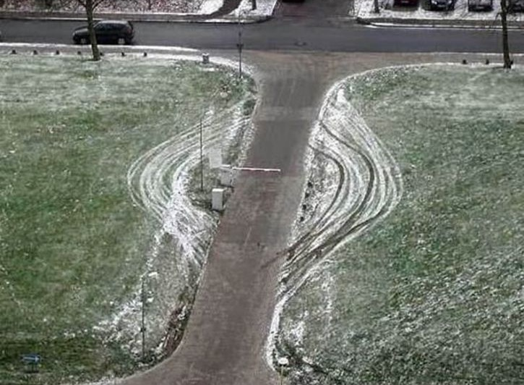
Complete Mediation

Slide 45
Complete Mediation
Every access to every object must be checked for authorization
Incomplete mediation implies that a path exists to bypass a security mechanism
Required property of reference monitors

Slide 46
Open Design
Kerckhoff's Principle: A cryptosystem should be secure even if everything about the system, except the key, is public knowledge
Generalization: A system should be secure even if the adversary knows everything about its design
Design does not include runtime parameters
Contrast with "security through obscurity"

Slide 47
Separation of Privilege
Privilege, or authority, should only be distributed to subjects that require it
Some components of a system should be less privileged than others
Not every subject needs the ability to do everything
Not every subject is deserving of full trust
Contrast with "ambient authority"

Slide 48
Least Privilege
Subjects should possess only that authority that is required to operate successfully
Closely related to separation of privilege
Not only should privilege be separated, but subjects should have the least amount necessary to perform a task

Slide 49
Work Factor

Slide 50
Work Factor
Increase the difficulty of mounting attacks
Often entails the introduction of non-determinism
Related to the idea of adaptive defense
Notes:
In cryptography, e.g., increasing key size
Systems example: increasing entropy used in ASLR

Slide 51
Compromise Recording
Concede that attacks will occur, but record the fact
Auditing approach to security
Detection and recovery
"Tamper-evident" vs. "tamper-proof"
Notes:
Example? Food seals, voting equipment seals

Slide 52
Threat Models
When analyzing a system's security, we often speak of a threat model
Threat models bound the capabilities of an attacker
Many formal examples from cryptography (Dolev-Yao, IND-CPA, IND-CCA)
Also important for systems
Passive network attacker, active network attacker, privileged local user

Slide 53
Trust
We also often speak of trust in the context of security
Trust implies an assumption that a component works correctly, is benign, or some other desirable property
Trusted computing base (TCB) refers to the trusted components of a system
Usually critical, highly privileged, and makes security decisions (e.g., a reference monitor)
Trust relationships describe which users/subjects trust others
Too much trust is a bad thing!

Slide 54
Security vs. Usability
Security often comes with a trade-off between the level of protection provided and ease-of-use
Systems that try to provide very strong security guarantees tend to be unusable in practice
Completely insecure systems are usually easy to use
Pragmatic security follows the Pareto principle, or 80/20 rule

Slide 55
Definitions
Models
Approaches
Principals
Ethics
Notes:
Ask for definitions of security

Slide 56
Ethics
Security research is, by its very nature, a sensitive endeavor
As the "good guys," should we be focused solely on defense?
Can attacks ever be used for good?
Many ethical frameworks could be applied
Utilitarianism (John Stuart Mill)
Individual rights (Immanuel Kant)
Common good (Plato, Aristotle)

Slide 57
Case Study: Forced Inoculation
Internet worms were a major problem in the early- to mid-2000s
Huge populations of vulnerable machines
Services on by default, few firewalls
Notes:
Code Red, Nimda, Slammer
What would philosophies say about forced inoculation?

Slide 58
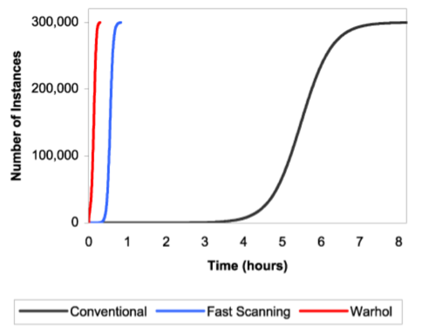
Flash Worms
T – start time of contagion
t – current time
K – rate of infection
a – fraction of vulnerable population that is infected
Notes:
a: # of infections
t: time
T: start time
K: rate

Slide 59
Case Study: Forced Inoculation
Some researchers developed counter-worms to scan the Internet and patch vulnerable hosts
Is this sort of response justified?
Is it ethical?
Notes:
Code Red, Nimda, Slammer
What would philosophies say about forced inoculation?
We've done it in the biological realm (vaccination)

Slide 60
Case Study: Disclosure
What options exist when a vulnerability is discovered?
Full disclosure
Responsible disclosure
No disclosure

Slide 61
Full Disclosure
Immediately release details of the vulnerability
Often includes proof-of-concept exploit code
Classic response
Fits into old world of hacking as proof of skill
Forcing function on vendor response
Criticized as irresponsible (is it?)
Notes:
What would different philosophies say about this?

Slide 62
Responsible Disclosure
Confidentially notify vendors and CERTs prior to public release
e.g., HeartBleed OpenSSL vulnerability
Has largely supplanted full disclosure among industrial researchers
However, criticized as too lax on vendors by some
Notes:
What would philosophies say about this?

Slide 63
No Disclosure
Discovered vulnerabilities are not released to the general public
Can be used for criminal purposes
Can be sold on exploit markets
Reflects monetization of hacking
Exploits are valuable
Burning 0-days = burning money

Slide 64
Conclusion
We've looked at basic definitions, security models, approaches, principles, some ethics
But, we've only scratched the surface
Next: Network-layer security
Notes:
The devil is in the details, it turns out

