Slide 1
CS 4740/6740
Network Security
Lecture 3: Hijacking, Denial of Service, and IDS
(Low-level Attacks and Defenses)

Slide 2
Today’s Topics
Spying and Hijacking
  How to eavesdrop on other people’s packets
  How to inject your own packets into someone else’s stream
Denial of Service
  Availability attacks using layer 3, 4, and 5 protocols
  Defenses?
Firewalls and IDS
  Preventing and detecting attacks on the network
  Stateless, stateful, and adaptive methods

Slide 3
Spying and Hijacking
ARP Cache Poisoning
MAC Flooding
TCP Connection Hijacking

Slide 4





Attacker Goals and Threat Model
Internet
Switched Ethernet network
Local attacker on the LAN
Attacker may send arbitrary packets
Router
192.168.0.1
00:AA:BB:CC:00:11
192.168.0.10
01:02:03:04:05:06
I wanna spy on those packets… but how?
Switch
192.168.0.2
00:11:22:33:44:55
192.168.0.11
1A:2B:3C:4D:5E:6F
192.168.0.255
FF:00:FF:00:FF:FF

Slide 5
The Link Layer
Application
Presentation
Session
Functions:
  Send blocks of data (frames) between physical devices
  Perform media access control (MAC)
  Detecting/recovering from collisions and bit errors
Layer 2.5 feature
  Mapping from network addresses to hardware addresses
Transport
Network
Data Link
Physical

Slide 6
Address Resolution Protocol
A mapping is needed between IP and physical (MAC) address
Dynamically established using the Address Resolution Protocol (ARP)
  Broadcast protocol implemented at the link layer
  Considered to be a layer 2.5 protocol
  Used by Ethernet, 802.11, many other link layer protocols with IPv4
Message types:
  who-has requests – “Who has IP 192.168.0.2?”
  is-at replies – “00:01:2D:00:5F:CC has IP 192.168.0.2”
Problem:
  No binding between ARP messages and sender identity
  In other words, no authentication

Slide 7
ARP Example
Internet
192.168.0.10 is-at
01:02:03:04:05:06
Router
192.168.0.1
00:AA:BB:CC:00:11
192.168.0.10
01:02:03:04:05:06
Src: 192.168.0.11
Dst: 192.168.0.10
IP
192.168.0.11
1A:2B:3C:4D:5E:6F
Src: 1A:2B:3C:4D:5E:6F
Dst: 01:02:03:04:05:06
Src: 1A:2B:3C:4D:5E:6F
Dst: ???
who-has 192.168.0.10?
Eth.
Eth.

Slide 8

ARP Example
8.8.8.8
Internet
192.168.0.1 is-at
00:AA:BB:CC:00:11
Router
192.168.0.1
00:AA:BB:CC:00:11
192.168.0.10
01:02:03:04:05:06
Src: 192.168.0.11
Dst: 8.8.8.8
IP
192.168.0.11
1A:2B:3C:4D:5E:6F
Src: 1A:2B:3C:4D:5E:6F
Dst: 00:AA:BB:CC:00:11
Src: 1A:2B:3C:4D:5E:6F
Dst: ???
who-has 192.168.0.1?
Eth.
Eth.

Slide 9
ARP Cache Poisoning
Each host on the LAN maintains a cache of IP→MAC mappings
An attacker can poison ARP caches by spoofing ARP packets
  Poisoning – injecting false information into a data store
  Spoofing – forging the source of a packet
Possible attacks:
  Confidentiality – attacker can inspect packets before forwarding them on
  Integrity – attacker may be able to modify packets in-flight
  Availability – attacker can simply drop packets

Slide 10

ARP Poisoning Example
8.8.8.8
Internet
192.168.0.1 is-at
00:AA:BB:CC:00:11
Router
192.168.0.1
00:AA:BB:CC:00:11
Attacker can now observe, modify, or drop packets generated by the target
192.168.0.10
01:02:03:04:05:06
192.168.0.1 is-at
FF:00:FF:00:FF:FF
192.168.0.11
1A:2B:3C:4D:5E:6F
192.168.0.255
FF:00:FF:00:FF:FF
who-has 192.168.0.1?

Slide 11

Gratuitous ARP
Internet
Common optimization
Preemptively send is-at replies to set the caches of neighboring machines
No need to wait for who-has requests
OK.
Thanks :)
192.168.0.13 is-at
10:11:2F:00:00:FF
Great!

Slide 12
Abusing Gratuitous ARP
Internet
Router
192.168.0.1
00:AA:BB:CC:00:11
192.168.0.1 is-at
FF:00:FF:00:FF:FF
192.168.0.255
FF:00:FF:00:FF:FF

Slide 13
Key Issues
Why does the ARP cache poisoning vulnerability exist?
  Lack of authentication
  Any host on the LAN can claim to own any IP address
Data race
  Attacker tries to “outrun” to legitimate response and poison the target

Slide 14

DHCP Poisoning
Internet
DHCP Offer
Src: 192.168.0.1
Dst: 255.255.255.255
Attacker can become the gateway and DNS for the target
DHCP Offer
Src: 192.168.0.255
Dst: 255.255.255.255
Router
192.168.0.1
00:AA:BB:CC:00:11
DHCP Server
192.168.0.10
01:02:03:04:05:06
192.168.0.255
FF:00:FF:00:FF:FF
192.168.0.11
1A:2B:3C:4D:5E:6F
DHCP Discover
Src: 0.0.0.0
Dst: 255.255.255.255

Slide 15
Tools and Defenses
Many link layer attack tools exist
  arping – basic tool for generating ARP messages (analogous to ping)
  arpspoof (dsniff) – $ arpspoof -t [victim’s IP] [gateway’s IP]
    Combine with sslstrip to implement SSL MITM attacks
  ettercap – “comprehensive package for MITM attacks”
Defending against link layer attacks
  Monitoring
    arpwatch – passively monitors observed IP→MAC pairings and generates alerts
    DHCP snooping
  Static/sticky ARP cache entries
  Compartmentalization, e.g. VLANs

Slide 16
DHCP Snooping
DHCP Discover
Snoop Table
IP | MAC
192.168.0.10 | 01:02:03:04:05:06
192.168.0.1 | 00:AA:BB:CC:00:11
192.168.0.11 | 1A:2B:3C:4D:5E:6F
Router
192.168.0.1
00:AA:BB:CC:00:11
DHCP Offer
DHCP Server
192.168.0.10
01:02:03:04:05:06
192.168.0.1 is-at
FF:00:FF:00:FF:FF
Stop
192.168.0.11
1A:2B:3C:4D:5E:6F
192.168.0.255
FF:00:FF:00:FF:FF
DHCP Discover

Slide 17
Virtual LANs
Virtual Local Area Networks (VLANs) partition a physical network into separate broadcast domains
  Port-based configuration
    Ports 1-4 → VLAN 1
    Ports 5-16 → VLAN 2
  Tagging
    MAC:1, MAC:2, MAC3 → VLAN 1
    * → VLAN 2
Compartmentalization enforced at the switch
  Old approach – manually configure switches
  New approach – Software Defined Networks (SDN)

Slide 18
What About IPv6?
ARP and DHCP designed for IPv4 networks
IPv6/ICMPv6/DHCPv6 should fix these poisoning attacks… right?
  Wrong :(
ICMPv6 includes a Neighbor Discovery Protocol (NDP)
  Almost exactly the same as ARP
  By default, no authentication :(
ICMPv6 also includes a Router Redirect messages
  Used to tell hosts about more efficient routes to the gateway
  May be spoofed to redirect a victim towards an attacker
Mitigations:
  Secure Neighbor Discovery Protocol (SEND) extension to IPv6 protocol suite
  Uses Cryptographically Generated Addresses (CGAs) instead of MAC
  Relies on an RPKI to validate CGAs

Slide 19
MAC Flooding
Modern Ethernet switches make attacks more difficult
  Passive interception is no longer possible (vs. Ethernet hubs)
  DHCP Snooping binds IP→MAC
However, switches have limited resources
  Content Addressable Memory (CAM) stores MAC→port binding
  Size of the CAM is limited
Attack: flood the network with is-at replies, overflow the MAC
  How do switches typically respond to this?
  Revert to old-school broadcast model

Slide 20
Towards Connection-Oriented Protocols
ARP and DHCP are broadcast protocols
  No authentication of sources or destinations
  As we’ll see, other ICMP and UDP-based protocols are also vulnerable
Connection-oriented protocols are supposed to fix this
  Connections include some notion of message authenticity
  E.g. TCP has random sequence numbers and a three-way handshake
Question: do TCP connections solve the authentication problem?

Slide 21
The Transport Layer
Application
Function:
  Demultiplexing of data streams (port numbers)
Optional functions:
  Creating long lived connections
  Authenticating packets in the stream
  Reliable, in-order packet delivery
  Error detection
  Flow and congestion control
  Fairly sharing resources between hosts
Presentation
Session
Transport
Network
Data Link
Physical

Slide 22
Transmission Control Protocol
Reliable, in-order, bi-directional byte streams
  Port numbers for demultiplexing
  Virtual circuits (connections)
  Flow control
  Congestion control, approximate fairness
0
4
16
31
Source Port
Destination Port
Sequence Number
Acknowledgement Number
HLen
Flags
Advertised Window
Checksum
Urgent Pointer
Options

Slide 23
Connection Setup and Flags
Why do we need connection setup?
  To establish state on both hosts
  Most important state: sequence numbers
    Count the number of bytes that have been sent
    Initial value chosen at random
  Random initial sequence numbers are a form of authentication
Important TCP flags (1 bit each)
  SYN – synchronization, used for connection setup
  ACK – acknowledge received data
  FIN – finish, used to tear down connection
  RST – unrecoverable error, immediately terminate the connection

Slide 24
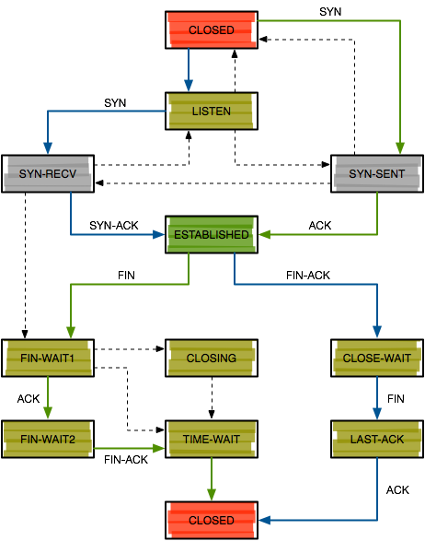
Three Way Handshake
Choose SeqC at random
Choose SeqS at random
Client
Server
SYN <SeqC, 0>
SYN/ACK <SeqS, SeqC+1>
At this point, only the client and server should know SeqC and SeqS
ACK <SeqC+1, SeqS+1>

Slide 25
Attacker Goals and Threat Model
TCP/IP Internet
Attacker is off-path
  Cannot observe traffic
Active attacker
  May send arbitrary packets
Assume the attacker knows IP addresses of targets
TCP/IP Connection
Server
84.79.0.1:80
I wanna send commands to that server…
Internet
193.54.34.101:8641
72.80.02.01

Slide 26
Attack Strategies
Send a FIN packet?
  Triggers a multi-packet, graceful shutdown
Send a RST packet?
  Only works if you can guess both ports and the seq/ack numbers
???
Server
84.79.0.1:80
RST seq=? ack=?
Src: 84.79.0.1:80
Dst: 193.54.34.101:?
I wanna kill that connection!
FIN/ACK
Internet
FIN
???
193.54.34.101:8641
72.80.02.01

Slide 27
Guessing Sequence Numbers
The security of TCP connections relies on the randomness of the initial sequence numbers (ISNs)
  If an attacker knows the sequence numbers, they can spoof packets
Problem: many OSs used to have low-entropy ISN generators
  Typically seeded by the current time
  RFC793 – “increase the ISN by 1 every 4 microseconds”
  Windows NT 4.0 – ISN = ms * 10 % 2^32
Attacker can measure the victim’s ISN generators
  NTP query
  Repeatedly open connections to known services like HTTP, FTP, echo, etc.

Slide 28
TCP RST Attack
Server port is typically known, client port must be guessed
Older OSs accepted a wide range of plausible seq/ack numbers with RST
Modern OSs are more conservative
  Seq. must be “reasonable”
  Ack. must be within the sender’s window
Server
84.79.0.1:80
Okay, connection closed.
RST
???
Internet
???
???
193.54.34.101:8641
72.80.02.01

Slide 29
TCP Connection Hijacking
RST attacks enable DoS, but not packet injection
Attackers can hijack TCP connections by:
  Silencing one participant (A)
  Sending spoofed packets to the other participant (B)
If B accepts a spoofed packet, the connection becomes desynchronized
Why is it useful to silence one participant?
  A may RST the connection if they observe a desynchronization or unsolicited packets

Slide 30
rsh Connection Hijacking Example
Remote shell (rsh) was the predecessor to ssh
Typically allowed connections from a preconfigured list of “trusted” hosts
Attacker goal: spoof a TCP connection from a trusted host
Finish login, redirect stdout/stderr to /dev/null, create a new account for the attacker, etc.
Server
84.79.0.1:514
SYN seq=1 ack=0
Src: 193.54.34.101:666
Dst: 193.54.34.101:514
ACK seq=2 ack=guess
Src: 193.54.34.101:666
Dst: 193.54.34.101:514
Make many TCP connections, measure initial sequence number distribution
Make sure the trusted host is offline, or DoS them
SYN/ACK
ACK
Internet
Trusted Host
193.54.34.101
72.80.02.01

Slide 31
Modern TCP
Modern OSs choose ISNs purely at random
  This makes off-path hijacking attacks extremely difficult
Does this mean TCP is now secure from spoofing and hijacking?
  No.
  On-path attackers still see everything, no guessing required
  May drop, modify, or inject packets at will
This is why we need IPSEC, TLS, etc.

Slide 32
Denial of Service
Reflection/Amplification: Smurf, NTP, DNS
SYN Floods
Application Floods

Slide 33
Attacker Goals and Threat Model
Off-path attacker on the Internet
Active attacker who may send arbitrary packets
Goal is to reduce the availability of the victim
I wanna knock those servers offline… but how?
Internet
Servers
128.91.0.*
192.168.0.255

Slide 34
DoS Attack Parameters
How much bandwidth is available to the attacker?
  Can be increased by controlling more resources…
  Or tricking others into participating in the attack
What kind of packets do you send to victim?
  Minimize effort and risk of detection for the attacker…
  While also maximizing damage to the victim

Slide 35

Exploiting Asymmetry
Example of a Distributed Denial of Service Attack (DDoS)
Most DDoS is fueled by botnets
  Networks of infected machines controlled by the attacker
Some DDoS is fueled by volunteers
  E.g. Anonymous and Low Orbit Ion Canon (LOIC)
Internet
1 Mbps
10 Mbps
Server
128.91.0.1
10 Mbps
1 Mbps
192.168.0.255

Slide 36

The Smurf Attack
10.7.0.0
10.7.0.0
…
10.7.0.253
10.7.0.254
Broadcast request is forwarded to all hosts in the /24
PING Request
Src: 128.91.0.1
Dst: 10.7.0.255
Internet
Server
128.91.0.1
192.168.0.255

Slide 37
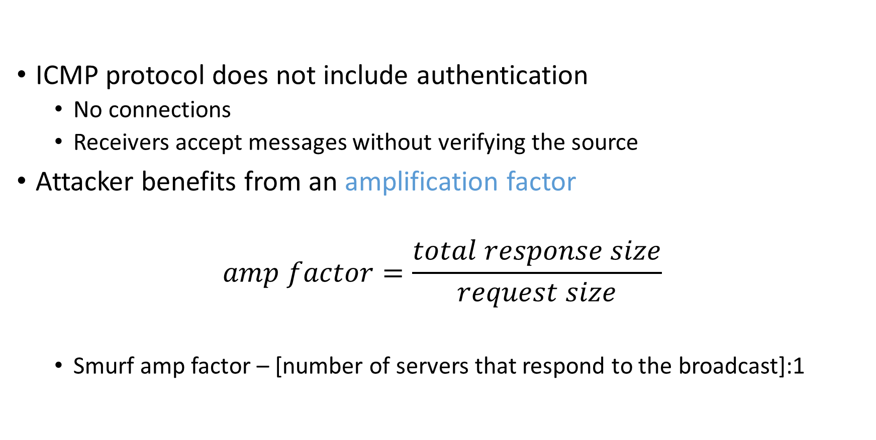
Why Does Smurfing Work?
ICMP protocol does not include authentication
  No connections
  Receivers accept messages without verifying the source
Attacker benefits from an amplification factor
$$amp factor=\frac{total response size}{request size}$$
  Smurf amp factor – [number of servers that respond to the broadcast]:1

Slide 38
Reflection/Amplification Attacks
Smurfing is an example of a reflection or amplification DDoS attack
Fraggle attack also relies on broadcasts for amplification
  Send spoofed UDP packets to IP broadcast addresses on port 7 (echo) and 13 (chargen)
    echo – 1500 bytes/pkt requests, equal size responses
    chargen -- 28 bytes/pkt request, 10K-100K bytes of ASCII in response
  Amp factor
    echo – [number of hosts responding to the broadcast]:1
    chargen – [number of hosts responding to the broadcast]*1000:1

Slide 39
DNS Reflection Attack
Spoof DNS requests to many open DNS resolvers
  DNS is a UDP-based protocol, not authentication of requests
  Open resolvers accept requests from any client
    E.g. 8.8.8.8 and 8.8.4.4
  February 2014 – 25 million open DNS resolvers on the Internet
64 byte queries generate large responses
  Old-school “A” record query → maximum 512 byte response
  EDNS0 extension “ANY” record query → 1000-6000 byte response
    E.g. $ dig ANY isc.org
  Amp factor – ~100:1
Attackers have been known to register their own domains and install very large records just to enable reflection attacks!
March 2013: Spamhaus DDoSed at 300 Gbps via DNS reflection

Slide 40
NTP Reflection Attack
Spoof requests to open Network Time Protocol (NTP) servers
  NTP is a UDP-based protocol, not authentication of requests
  May 2014 – 2.2 million open NTP servers on the Internet
234 byte queries generate large responses
  monlist query: server returns a list of all recent connections
  Other queries are possible, i.e. version and showpeers
  Amp factor – from 10:1 to 100:1
December 2013: various sites DDoSed at 400 Gbps via NTP reflection

Slide 41
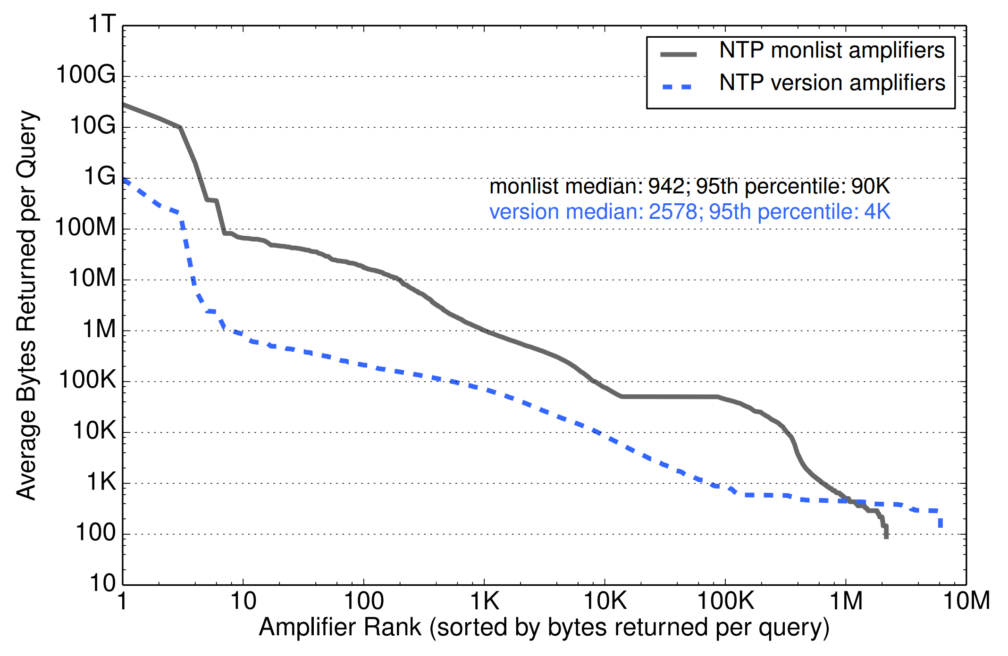

Slide 42
Mitigating Amplification Attacks
Filter ingress IP broadcasts at the gateway router
  i.e. drop anything destined to *.*.*.255
Disable non-essential services
  echo, chargen, NTP, etc.
Configure services to only respond to requests from the local LAN
If you write a UDP service, authenticate the sources of packets
Don’t be part of the problem!
  The behavior of your software and network impacts the well-being of others

Slide 43
DoS Attack Parameters
How much bandwidth is available to the attacker?
  Can be increased by controlling more resources…
  Or tricking others into participating in the attack
What kind of packets do you send to victim?
  Minimize effort and risk of detection for the attacker…
  While also maximizing damage to the victim

Slide 44
Standard DDoS, Revisited
What kind of packets do you send to the victim?
Ideally, should be “connectionless”
  Why?
  Difficult to spoof TCP connections
Should maximize the resources used by the victim
SYN
Internet
Server
128.91.0.1
192.168.0.255
SYN

Slide 45
TCP SYN Flood
TCP stack keeps track of connection state in data structures called Transmission Control Blocks (TCBs)
  New TCB allocated by the kernel whenever a listen socket receives a SYN
  TCB must persist for at least one RTO
Attack: flood the victim with SYN packets
  Exhaust available memory for TCBs, prevent legitimate clients from connecting
  Crash the server OS by overflowing kernel memory
Advantages for the attacker
  No connection – each SYN can be spoofed, no need to hear responses
  Asymmetry – attacker does not need to allocate TCBs

Slide 46
Defending Against SYN Floods: SYN Cookies
Key idea: avoid storing TCB state on the server until after the three-way handshake is complete
What state in the TCB can be recovered from the client’s ACK?
  Source IP and port
  Destination IP and port
  Maximum Segment Size (MSS) for the connection
  Initial Acknowledgement Number from the source
  Initial Sequence Number (ISN)
SYN cookie construction
  Encode the MSS, a secret, and consistency check into the ISN in the SYN-ACK
  Verify the secret and consistency check when the ACK is returned
Trivially known by the server
Guaranteed to be in the ACK

Slide 47
SYN Cookies
0
5
8
31
ISN:
Sequence Number
timestamp
MSS
hash(src_ip, src_port, timestamp, secret)
Maximum segment size (MSS)
  Stated by the client during initial SYN, must be “remembered” by the server
  Reflect the client’s value back through them
  Limitation: 8-bit MSS must be encoded in 3-bits
Validation: did the client really send me a SYN recently?
  Timestamp: freshness check, prevents replay attacks
  Cryptographic hash w/ secret key: prevents spoofed packets

Slide 48
SYN Cookies in Practice
Advantages
  Effective at mitigating SYN floods
  Compatible with all TCP versions
  Only need to modify the server, no need for client support
Disadvantages
  MSS limited to 3 bits, may be smaller than clients actual MSS
  Server forgets all other TCP options included with the client’s SYN
    SACK support, window scaling, etc.

Slide 49



What About Filtering?
Problems:
The ingress links are still saturated
No idea where the attack is coming from
Problems:
Legitimate traffic is still blocked
How do you get Tier 1 ASs to install filters for you?
Stop
Stop
Stop
Stop
Web Server
Success! Some of the attack is halted

Slide 50
Problems With Filters
Packet filtering is not a viable solution
If you install a local filter:
  Ingress links are still saturated
  Very hard to distinguish DDoS packets from legitimate requests, since sources are spoofed
Remote filters work better, but:
  You still need to track down the source of the attack
  You have no ability to force ISPs and ASs to install filters on your behalf

Slide 51
Techniques for IP Traceback
The IP Protocol includes a Record Route option
  If enabled by the sender (and supported by routers), each router inserts its IP into the packet payload
However, Record Route is off by default
  No attacker would ever voluntarily enable it, since it would reveal their IP
Several proposals in the research literature for lightweight, on-by default record route systems
  Practical Network Support for IP Traceback [Savage00]
  Pi: A Path Identification Mechanism to Defend against DDoS Attacks [Yaar03]
These systems would be great, but require all Internet routers to be upgraded :(

Slide 52
In-Network Defenses
Why don’t routers identify and drop spoofed packets?
Unicast Reverse Path Forwarding (uRPF)
  Routers validate the source IP addresses against routing tables
  “Unlikely” source addresses are dropped
uRPF modes:
  Strict – packet must be received on the interface with the best forward path to source
    Warning: may drop legitimate traffic if routes are asymmetric
  Feasible – packet must be received on an interface that has a valid forward path to the source
  Loose – Source IP can match any valid route, only drops unroutable sources like 192.168.*.*

Slide 53





DDoS Defense via CDNs (Cloudflare )
Master
What if you DDoS the master replica?
  Cached copies in the CDN still available
  Easy to do ingress filtering at the master
What if you DDoS the replicas?
  Difficult to kill them all
  Dynamic DNS can redirect users to live replicas

Slide 54
Intrusion Detection Systems
Firewalls
Stateless vs. Stateful Filters
Adaptive NIDS
Base Rate Fallacy

Slide 55
It’s the Wild West Out There
The Internet is a dangerous place
  Port scans
  Vulnerability scans and exploit attempts
  Password brute-forcing
  DDoS packets, reflection attempts, and backscatter
  Malware, worms, viruses, botnets
  Email spam
Administrators want to keep bad stuff out of their networks
Also want to prevent certain types of outgoing traffic
  Data exfiltration attempts
  Malware that calls home

Slide 56





Firewalls
Dev
Executive
Users
Internet
Canonical
Web Server
Database

Slide 57
Firewalls
Dev
Executive
Users
Internet
Canonical
Web Server
Database

Slide 58
Firewall Capabilities
Firewalls inspect traffic and filter/modify it according to predicates
  Based on IP addresses, protocols (ICMP/TCP/UDP), ports, packet sizes, TTLs, etc.
  Often coupled with logging capabilities
Types of firewalls
  Packet filtering – analyzes layer 3 and 4 headers of individual packets
  Stateful filtering – reconstructs and analyzes TCP connections
  Application-layer filtering – extends analysis capabilities to common application-level protocols

Slide 59
Scanning Past Firewalls
Firewalking is a technique for scanning past a firewall
  Similar to traceroute, increments TTL until firewall is discovered
  Once firewall is found, increment TTL once more and do a port scan
  ICMP errors reveal that a packet on a particular port made it past the firewall
Detecting firewalking is tricky
  Monitor needs to observe multiple events using different protocols and correlate them
  E.g. UDP packets with odd TTLs, ICMP errors, and TCP SYN port scan

Slide 60


Network Intrusion Detection Systems (NIDS)
Logical successor to firewalls
  Stateful monitoring of network events
  Logs flows to facilitate forensics
  Alerts admins of intrusion attempts, takes action
Complex rule-based processing
  Simple, firewall-like decisions based on layer 3 and 4 info
  Multi-packet/multi-flow correlation at layer 4 and 5
Signature matching
  Identify and drop packets containing known malicious code or exploits
Hot tech in the early 2000s, now considered “last gen”
Bro

Slide 61
NIDS
Bro Logs
Dev
Executive
!
Internet
Stop
Web Server
Database

Slide 62
Bro Architecture
Packets retrieved from the kernel
  Uses standard libpcap
  tcpdump filters may be used to remove uninteresting packets/events
libpcap

Slide 63
Bro Architecture
Event engine implements state tracking
Reconstructs high-level events
  Layer 4, e.g. connection created/finished
  App-level, e.g. FTP request, HTTP GET
  Activity-level, e.g. successful login
Includes a signature matching engine
  Easy to share patterns for common malware and exploits
Designed for high-speed
  Successfully tested at 1 Gbps line rates
libpcap
Event Engine

Slide 64
Bro Architecture
Domain specific scripting language
  Encodes the site’s policies
  Access to state from previous events
Scripts may take actions
  Record logs to disk
  Generate alerts via syslog, email, etc.
  Execute programs (i.e. update firewall)
libpcap
Event Engine
Policy Script Interpreter
Bro Logs

Slide 65
Limitations of Bro and Snort
Reliant on hard-coded rules and signatures
  Manually enumerating rules that match all possible attack patterns is next to impossible
  Signatures may be out of date, won’t include zero day threats
Motivates the need for adaptive NIDS
  Observe network data and build models of “normal” behavior
  Deviations from normal are anomalies
  Apply rules to log or filter out anomalies

Slide 66
Earlybird: Automatic Worm Identification
Goal: automatically identify new worms and build signatures to drop those packets in the future
Assume there exists some (relatively) unique invariant bitstring W across all instances of a particular worm
Two consequences
  Content Prevalence: W will be more common in traffic than other bitstrings of the same length
  Address Dispersion: the set of packets containing W will address a disproportionate number of distinct sources and destinations
Content sifting: find W’s with high content prevalence and high address dispersion and drop that traffic

Slide 67
The Earlybird Algorithm
Earlybird
A
B
C
cnn.com
E
D
Address Dispersion Table
Sources Destinations
Prevalence Table
1
(A, B)
3
(A, B, D)
2
(A)
(B, D)
(B)
(B, D, E)
1
(C)
(A)

Slide 68
Challenges
Computation
  To support a 1Gbps line rate we have 12us to process each packet, at 10Gbps 1.2us, at 40Gbps…
    Dominated by memory references; state expensive
  Content sifting requires looking at every byte in a packet
State
  On a fully-loaded 1Gbps link a naïve implementation can easily consume 100MB/sec for table lookups
  Computation/memory duality: on high-speed (ASIC) implementation, latency requirements may limit state to on-chip SRAM

Slide 69
Efficient Filters for Content
Multi Stage Filters: randomized technique for counting “heavy hitter” network flows with low state and few false positives
  Use content hashes to index frequency counts
  Calculate hashes of length S substrings using incremental Rabin Fingerprints
  Manber’s Value sampling: select and retain a deterministic subset of hashes
  Three orders of magnitude memory savings
Scalable Bitmap Counters to measure address dispersion
  Reduces memory by 5x but introduces a modest accuracy error
Both techniques are very similar to a Counting Bloom Filter

Slide 70
Does Earlybird Work?
Detected and automatically generated signatures for every known worm outbreak over eight months
  Code Red, Nimda, WebDav, Slammer, Opaserv, …
Produced precise signatures for new worms in a fraction of a second
  MsBlaster, Bagle, Sasser, Kibvu, …
Software implementation keeps up with 200Mbps

Slide 71
Shortcomings of NIDS
NIDS do not have complete visibility into end host states
  Insertion – NIDS may accept packets that an end host does not
  Evasion – NIDS may reject packets that an end host accepts
  Denial of Service – NIDS is stateful, thus it is susceptible to DoS
NIDS must be able to observe traffic
  Encryption prevents observation
  Polymorphism prevents signatures from matching exploits or malicious code
What is more important: false positive or false negative rate?
  False positive rate is much more important!
  Known as the Base Rate Fallacy

Slide 72
Sneaking Past Packet Filters
Split the payload over multiple packets
URI GET /cgi-bin/adm
URI GET /cgi-bin/admin.php?clear-db=1
URI GET /cgi-bin/admin.php?clear-db=1
in.php?clear-db=1
Web Server
Rule: drop packets containing
“URI GET /cgi-bin/admin.php?clear-db=1”

Slide 73
Sneaking Past Packet Filters
Split the payload over multiple packets
Split the payload over multiple IP fragments
IP Fragment: Bytes 0-21
URI GET /cgi-bin/admin.php?clear-db=1
IP Fragment: Bytes 22-38
Web Server
Rule: drop packets containing
“URI GET /cgi-bin/admin.php?clear-db=1”

Slide 74
NIDS Evasion
NIDS monitor data spanning multiple packets in a connection
But, they can still be deceived…
NIDS reconstructs [0-30]+[31-38]
Host reconstructs [0-14]+[15-38]
IP Fragment: Bytes 0-30
URI GET /cgi-bin/admin.php?clear-db=1
IP Fragment: Bytes 15-38
Web Server

Slide 75
Detection Theory
 | Event Occurred | Event Did Not Occur
Event Detected | True Positive | False Positive
Event Not Detected | False Negative | True Negative
Detection theory considers two Boolean variables
  Whether an event occurred
  Whether an event was detected

Slide 76
Analyzing the Efficacy of NIDS
Let A, I be two boolean random variables
  I – probability an event represents an intrusion
  A – probability an alert is raised
P(A|I) – probability an alert is raised if an intrusion occurs
P(A|¬I) – false positive
P(I|A) – if there is an intrusion, was there an alert?

Slide 77
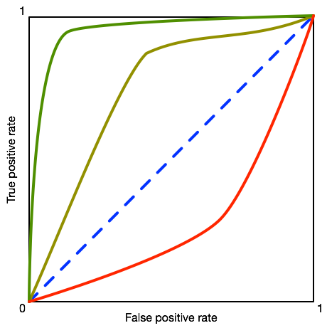
ROC Plots
Random Guessing
Perfect Detection
Perfect Inaccuracy

Slide 78
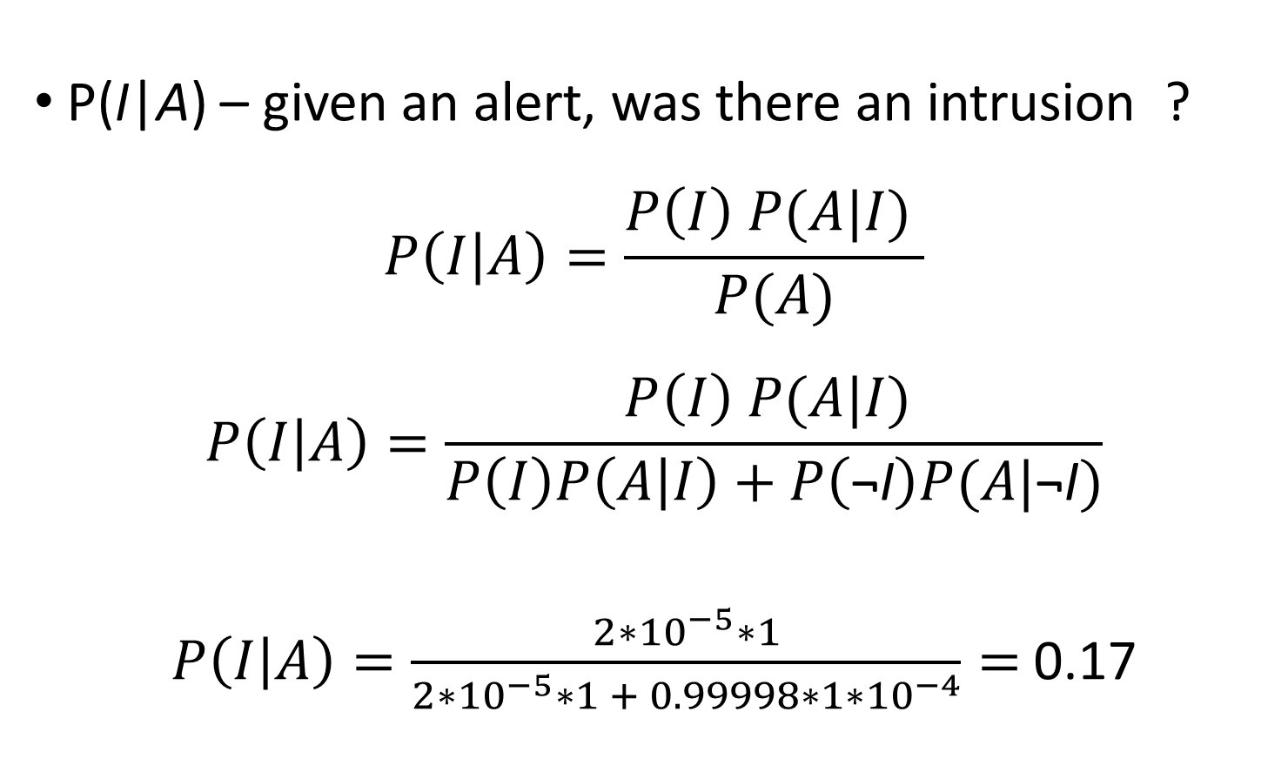
Analyzing NIDS Efficacy
P(I|A) – given an alert, was there an intrusion ?
$$P\left(I | A\right)=\frac{P\left(I\right) P(A|I) }{P(A)}$$
$$P\left(I | A\right)=\frac{P\left(I\right) P(A|I) }{P\left(I\right)P\left(A | I\right)+P\left(\text{¬}\text{I}\right)P(A|\text{¬}\text{I})}$$
$P\left(I | A\right)=\frac{2∗{10}^{−5}∗1}{2∗{10}^{−5}∗1 + 0.99998∗1∗{10}^{−4}}=$0.17
P(I) = 20 per million events
P(A|I) = 1 (perfect detection rate)
P(A|¬I) = 0.0001
Detection rate is dominated by false positives!

Slide 79
False Positives vs. Detection Accuracy
P(I) = 20 per million events P(A|I) = 1 (perfect detection rate)

Slide 80
The Base Rate Fallacy
False positives are the limiting factor with NIDS, not false negatives!
Base rate of attacks is very, very low in most environments
Class imbalance means that false positives are greatly magnified

Slide 81
Sources
Many slides courtesy of Wil Robertson: https://wkr.io
Analysis of NTP reflection attacks: http://conferences2.sigcomm.org/imc/2014/papers/p435.pdf
Analysis of DNS and DNSSEC reflection attacks: http://conferences2.sigcomm.org/imc/2014/papers/p449.pdf
TCP SYN Cookies: http://cr.yp.to/syncookies/archive
Practical Network Support for IP Traceback: http://cseweb.ucsd.edu/~savage/papers/Sigcomm00.pdf
Bro architecture courtesy of LBL: http://crd-legacy.lbl.gov/DOEresources/SC04/Tierney_Bro_SC04.pdf
Bro paper: https://www.usenix.org/legacy/publications/library/proceedings/sec98/full_papers/paxson/paxson.pdf
Earlybird paper: http://www.cs.unc.edu/~jeffay/courses/nidsS05/signatures/savage-earlybird03.pdf
NIDS Insertion, Denial, and Evasion paper: https://sparrow.ece.cmu.edu/group/731-s08/readings/ptacek-newsham.pdf

