Slide 1
CS 2550 Foundations of Cybersecurity
Cybercrime Underground

Slide 2
Attack Mechanisms vs. Attackers
Understanding vulnerabilities and exploits is useful for understanding the mechanisms and tools available to attackers
However, thus far we haven’t talked about the attackers themselves
Who are they? What are their motivations?
“Hacking” used to be about street cred
31337 hackers vs. script-kiddies and n00bs
Virus writing, website defacement
Today, “hacking” is primarily about money
Organized crime
Diverse set of actors with different skills (some technical, some not)
Marketplace with specialization and its own economy

Slide 3
Structure of the Underground
Zero-day Development
Crimeware Development
Botnets
Credit Card and Bank Account Theft
Carders, Cashiers, and Money Mules
DDoS and Ransomware Extortion
Spam
Bitcoin Mining
Phishing
Counterfeit Goods
Malware Attachments
Pharma
Blackhat SEO
Pay-per-Install and Exploit-as-a-Service
Stolen Account Credentials
Click Fraud and Ad Injection
Fake Anti-virus
Bulletproof Hosting

Slide 4
Actors in the Underground
Exploit developers
Very smart people who reverse-engineer software
Develop and sell exploits
Crimeware developers
Create banking trojans, botnets, Remote Access Trojans (RATs), exploit kits
“Bulletproof” Hosting Providers
Offer dedicated servers to other actors
Hosted in lawless parts of the Internet
Botnet masters
Develop software and control vast numbers of zombie machines
Rent out their botnet to other actors
Spammers
Advertise links for other actors
Phishers
Setup scam sites to steal information
Work with spammers to spread the attack
Pharma, Counterfeiters, Fake AV
Run illegal e-commerce websites
Must be able to clear credit cards
Carders, Cashiers, and Mules
Turn stolen bank accounts and credit cards into cash
Help launder money

Slide 5
Outline
Underground Forums
Spam
Counterfeit Goods: Pharma, Fake AV, and Knockoffs
Exploit-as-a-Service
Botnets

Slide 6
Underground Forums
Where everything is for sale

Slide 7
eBay for the Underground
The underground includes many types of illicit actors
Exploit developers
Botnet operators
Email and SEO spammers
Carders and cashiers
Just like any other economy, these participants need places to buy and sell their goods
IRC chatrooms
Underground forums
Often obfuscated using Tor Hidden Services
“The Deep Web”

Slide 8
“An Inquiry into the Nature and Causes of the Wealth of Internet Miscreants”
Study examined 7 months of logs from an underground IRC chatroom
Data collected in 2007
13 million messages
Populated by buyers, sellers, and rippers
Administrators verify trustworthy sellers
Rippers steal from naïve buyers or sell fraudulent goods
Most messages are advertisements
The actual deal making is done via private messages

Slide 9
Advertisements
Some participants ask for good or services
i have boa wells and barclays bank logins....
have hacked hosts, mail lists, php mailer send to all inbox
i need 1 mastercard i give 1 linux hacked root
i have verified paypal accounts with good balance...and i can cashout paypals
Others offer samples to prove they have specific data
Name: Phil Phished
Address: 100 Scammed Lane, Pittsburgh, PA
Phone: 555-687-5309
Card Number: 4123 4567 8901 2345
Exp: 10/09 CVV: 123
SSN: 123-45-6789
CHECKING 123-456-XXXX $51,337.31
SAVINGS 987-654-XXXX $75,299.64

Slide 10
Sensitive Data in Ads

Slide 11
Are Credit Cards Valid?
The rightmost digit of every credit card number is the Luhn Digit
Luhn algorithm is a simple checksum algorithm
Enables you to quickly check of a credit card number is possibly valid
However, just because a card number passes the Luhn algorithm…
Doesn’t mean it’s a valid card number, it hasn’t been cancelled, or the credit limit hasn’t been reached

Slide 12
Where do Credit Cards Come From?

Slide 13
Goods
Mechanisms for charging credit cards and transferring cash
Email lists, mail proxies, and scam sites for spamming
Accounts and personal information, a.k.a. dumps
Hacked Servers
Exploits
Botnets

Slide 14
Services
Confirmer: Performs in-person confirmation of money transfer (e.g. Western Union)
Carder: Uses dumps to print fake credit cards and buy high-value items from stores for resale later
Cashier: Cashes out bank accounts and keeps some of the money as a reward

Slide 15
Prices for Hacked Hosts
Prices for hacked hosts over time

Slide 16
Prices for packs of dumps (bundles of credit cards) circa 2014

Slide 17
Treachery
These commands are scams! They return false information, and they record the CC/bank info for the administrators ;)
IRC room includes many bots that offer basic services to users

Slide 18
“An Analysis of Underground Forums”
Buy
Sell
Buy
Sell
Prepaid cash cards, used to launder money
Categories and quantities of merchandise on the Carders forum (2008-2010)

Slide 19
Underground Forums Wrap-up
Today, underground forums are ubiquitous
Many operate in plain site; they’re just a Google search away
Large volume of illicit goods and services are available
Law enforcement often targets forums/IRC rooms
In some cases, forums have been law enforcement sting operations
However, new venues always rise to fill the void
Black market forums are hugely valuable for security professionals
Give researchers a view into the underworld
Allow white-hats to observe trends and detect unfolding attacks

Slide 20
Spam and “Affiliates”
Advertising by another name

Slide 21
Structure of the Underground
Zero-day Development
Crimeware Development
Botnets
Credit Card and Bank Account Theft
Carders, Cashiers, and Money Mules
DDoS and Ransomware Extortion
Spam
Bitcoin Mining
Phishing
Counterfeit Goods
Malware Attachments
Pharma
Blackhat SEO
Pay-per-Install and Exploit-as-a-Service
Stolen Account Credentials
Click Fraud and Ad Injection
Fake Anti-virus
Bulletproof Hosting

Slide 22
On the Origins of Spam
It is estimated that >90% of all email sent each day is spam
Hundreds of billions of spam messages per day
Spammers are key players in the cybercrime underground
Build, curate, buy, and sell lists of email addresses
Send mail on behalf of other actors for a fee
Pay Per Install services looking to acquire traffic and infections
Phishers looking to steal personal information
Spammers rent access to botnets to send bulk email
Need a large number of IP addresses to circumvent spam filters

Slide 23
Affiliate Marketing
Huge amounts of spam are related to affiliate marketing schemes
Scammers set up websites selling illegal/counterfeit goods
Pharma: Viagra, Cialis, Vicoden, etc.
Knockoffs: Rolex, Gucci, Louis Vuitton, Nike, Microsoft, Adobe, etc.
Fake Anti-Virus: “Warning, your computer is infected! Pay $49.99…”
Scammers are responsible for delivering products and collecting payments
As we will see, access to credit card processing infrastructure is crucial
Many scams have legitimate customer service departments!
Spammers sign-up as “affiliates” with scam campaigns
Spammers advertise the scams, and collect commission on successful sales
Commission is typically 30-50% of the final sale price

Slide 24
“Spamalytics: An Empirical Analysis of Spam Marketing Conversion”
Measurement of conversion rate of spam campaigns
Probability that an unsolicited email will elicit a sale
Methodology leveraged infiltration of the Storm botnet
Analyze two spam campaigns
Trojan propagation via fake e-cards
Online pharmaceutical marketing
For more than 469M spam emails, authors identified
Number that pass thru anti-spam filters
Number that elicit visits to advertised sites (response rate)
Number of “sales” and “infections” produced (conversion rate)

Slide 25
Spam Conversion
Big question
Why do spammers continue to send spam?
Spam filters eliminate >99% of spam
More questions
How many messages get past spam filters?
How much money does each successful “txn” (transaction) make?
Measurement technique
Infiltrate the spam generation/monetizing process and find out answers

Slide 26
Storm Botnet
Disadvantage: not complete coverage
Structured P2P DHT
Botmaster
Advantage: easy to infiltrate
Master Servers
Get commands from the DHT
Researchers Infiltrated Here

Slide 27
Methodology
Infiltrate Storm at proxy level
Rewrite spam instructions to use URLs specified by the researchers
URLs point to websites controlled by researchers
Look like clones of the actual scam sites, but are “defanged”
Observe activity at each stage
Record activity throughout the conversion funnel
How much spam is delivered? Look at SMTP delivery error rate
How much spam is filtered? Send spam to honeypots controlled by the researchers
What is the click-through rate? Observe visits to the URLs
How many people convert? Observe behavior on the clone sites
Modified ~470M emails generated by Storm over a period of a month

Slide 28
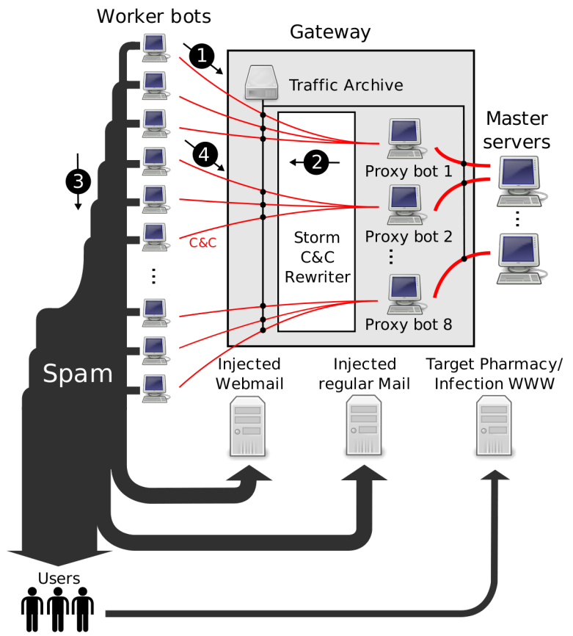
Researchers infiltrated here
Researchers injected additional target email addresses

Slide 29
Focus on Two Spam Campaigns
Pharmaceuticals and self-propagating malware
Ran fake, harmless websites that look like the real ones
Conversion signals
For pharma, a click on “purchase” button
For malware, download and execute a binary that phones home and exits

Slide 30
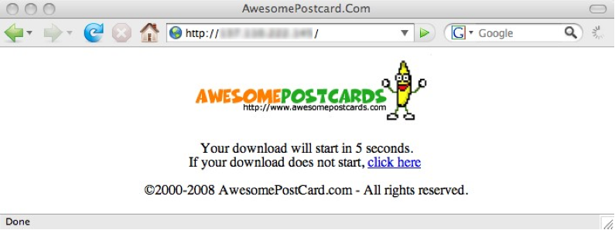

Slide 31
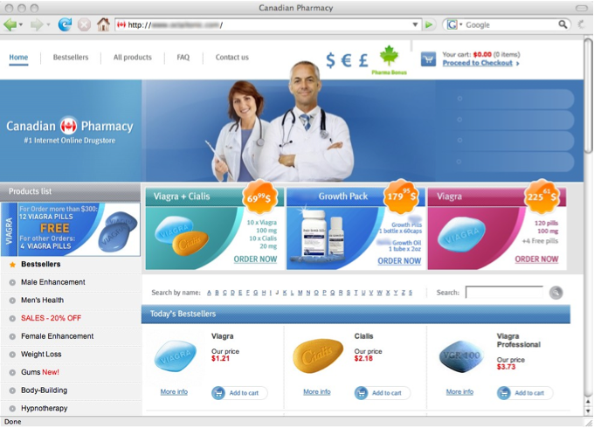

Slide 32
Results: Campaign Volumes

Slide 33
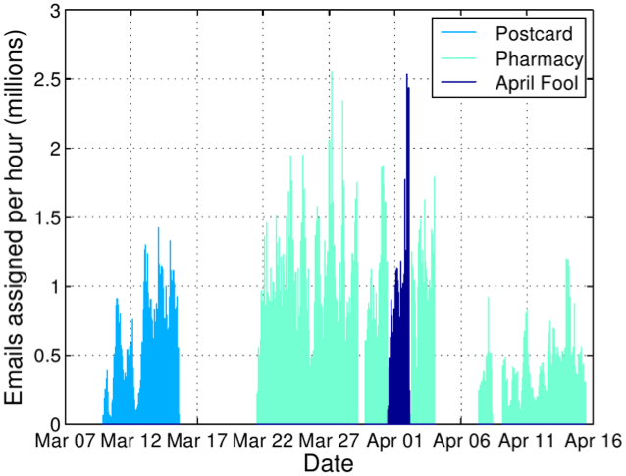
Rewritten Spam Emails per Hour

Slide 34
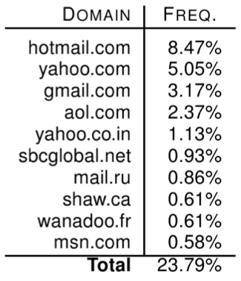
Spam Delivery: Top Domains

Slide 35
Spam Filter Effectiveness
What percentage of spam got through the filters?
Average: 0.014%
1 in 7,142 attempted spams got through

Slide 36
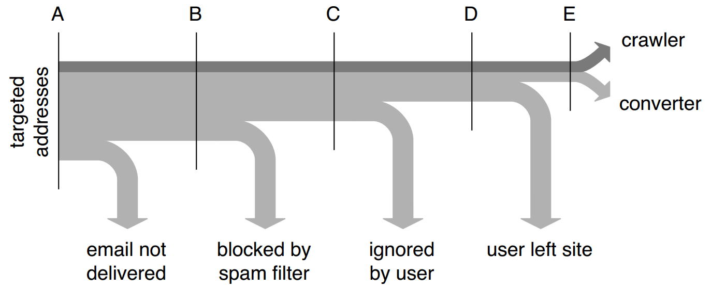
Conversion Tracking

Slide 37
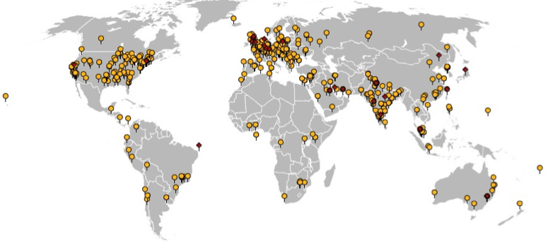
Geographic View of Conversions
541 binary executions, 28 purchases

Slide 38
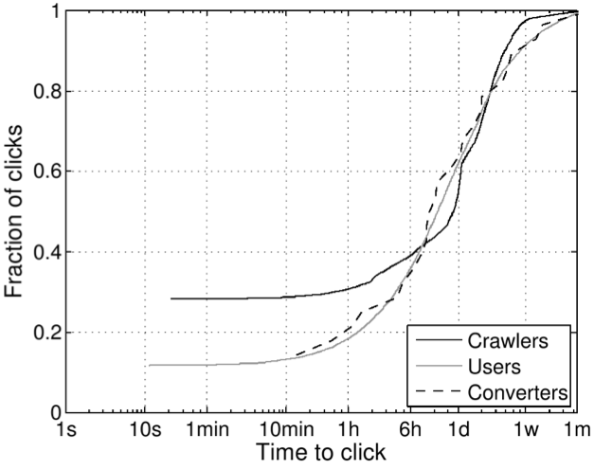
Time-to-click Distribution
10% of clicks occur after one week!?
60% of clicks occur within the first 24 hours

Slide 39
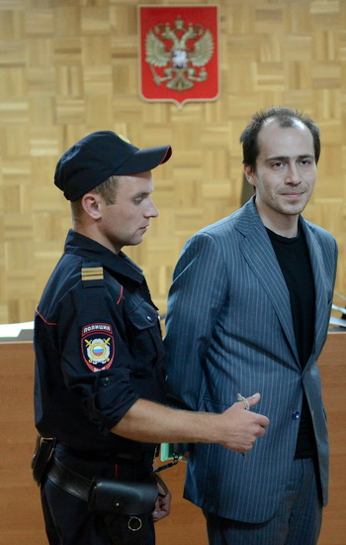
Pharmaceutical Revenue
Pavel Vrublevsky
28 purchases in 26 days, average price ~$100
Total: $2,731.88, $140/day
But: only controlled ~1.5% of workers!
$9500/day (and 8500 new bot infections per day)
$3.5M/year
However, this is split with the affiliate program
40% cut for Storm operators via Glavmed → $1.7M/year
Storm: service provider or integrated operation?
Retail price of spam ~$80 per million
350M emails → $25K
Suggests integrated operation to be profitable

Slide 40
“Spamcraft: An Inside Look At Spam Campaign Orchestration”
Paper takes a broader look at the activities of the Storm botnet

Slide 41
Duration and Size

Slide 42
Counterfeit Goods
Viagra, Cialis, Gucci, Rolex, and Anti-Virus?

Slide 43
Affiliate Scams, Revisited
Thus far, we have focused on spammers
This represents the advertising portion of affiliate schemes
What about the affiliate scammers themselves?
These schemes are complicated to host and maintain
Payment processing is crucial but also challenging
Order fulfillment and customer service

Slide 44
Scammers in the Spotlight
We’re going to look at data from four papers
Click Trajectories: End-to-End Analysis of the Spam Value Chain
PharmaLeaks: Understanding the Business of Online Pharmaceutical Affiliate Programs
The Underground Economy of Fake Antivirus Software
Priceless: The Role of Payments in Abuse-advertised Goods
These papers analyze the full breadth of the scamming ecosystem
Infrastructure and the key role of payment processors
Ground-truth data about large-scale pharmaceutical scams
Ground-truth data about large-scale fake anti-virus scams

Slide 45
Scammin’ Ain’t Easy
Suppose you want to setup www.canadianpharma.com.
What sort of hosting infrastructure do you need?
Domain name(s)
Problem: legit registrars will take down your name if they receive complaints
Some registrars are known to ignore complaints, but they charge more ;)
DNS servers
Problem: DNS servers are an obvious choke-point for law enforcement
“Bulletproof” DNS is available on the market, but its expensive ;)
Web servers
“Bulletproof” servers are available, but they’re expensive
Some services offer resilient hosting with distributed web servers
But obviously, it’s expensive

Slide 46
Scammin’ Ain’t Easy, Continued
Okay, you’ve set up www.canadianpharma.com... Now what?
To sell products, you need to be able to accept payments (realization)
Merchant bank account to deposit your payments
Relationship with a payment processing service
Handles credit card payments
Withdraws money from the buyers account via a card association network (e.g. Visa)
Obviously, most banks and processors won’t do business with scammers
Fulfilment
Scam sites almost always ship products to customers
Why?
Customer service
If too many customers complain to their credit card company, your payment processor will shut you down, and your bank account may be seized
Human operators to handle complaints and returns

Slide 47
Example: Pharmacy Express

Slide 48
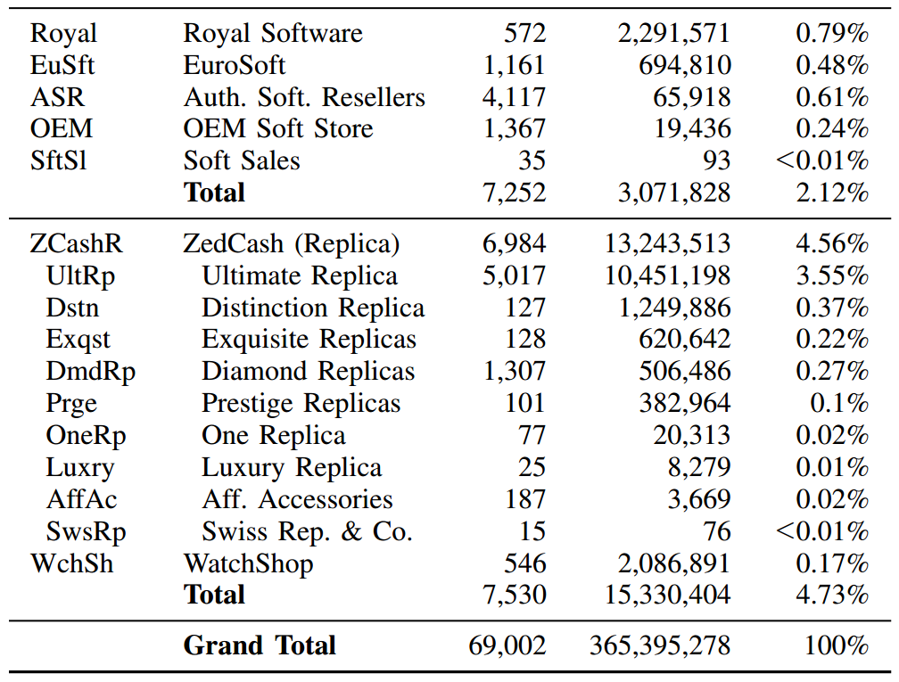
RX-Promotion and GlavMed account for around 35% of all affiliate scams
Remember them from Spam Nation? ;)
Data collected from spam feeds, botnet infiltration, and various types of honeypots in Fall 2010

Slide 49
Merchant Banks
Researchers made 76 purchases from different affiliate programs to observe where payment was delivered
Only 13 banks, i.e. banking infrastructure is shared across affiliates

Slide 50
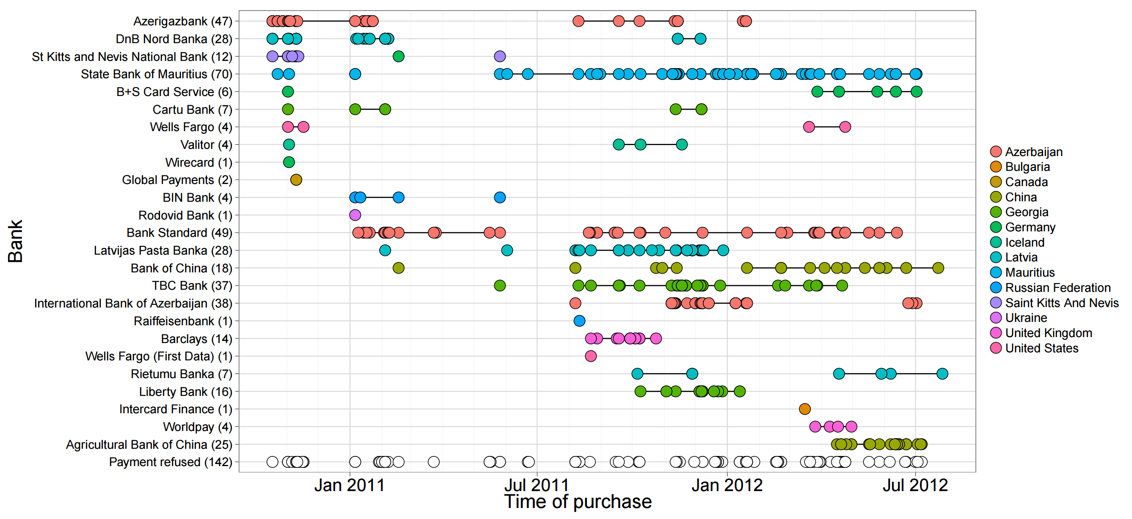

Slide 51
Suppliers
Goods were sourced from 13 different manufactures/suppliers

Slide 52
Pharmaleaks
In 2012, the databases for GlavMed, SpamIt, and RX-Promotion were breached, dumped, and publicly released
This is what happens when your competitors are criminals
Contain complete logs of sales, customers, and affiliate relationships
The Pharmaleaks paper analyzes this data to give us ground-truth understanding about this area of the underground economy

Slide 53
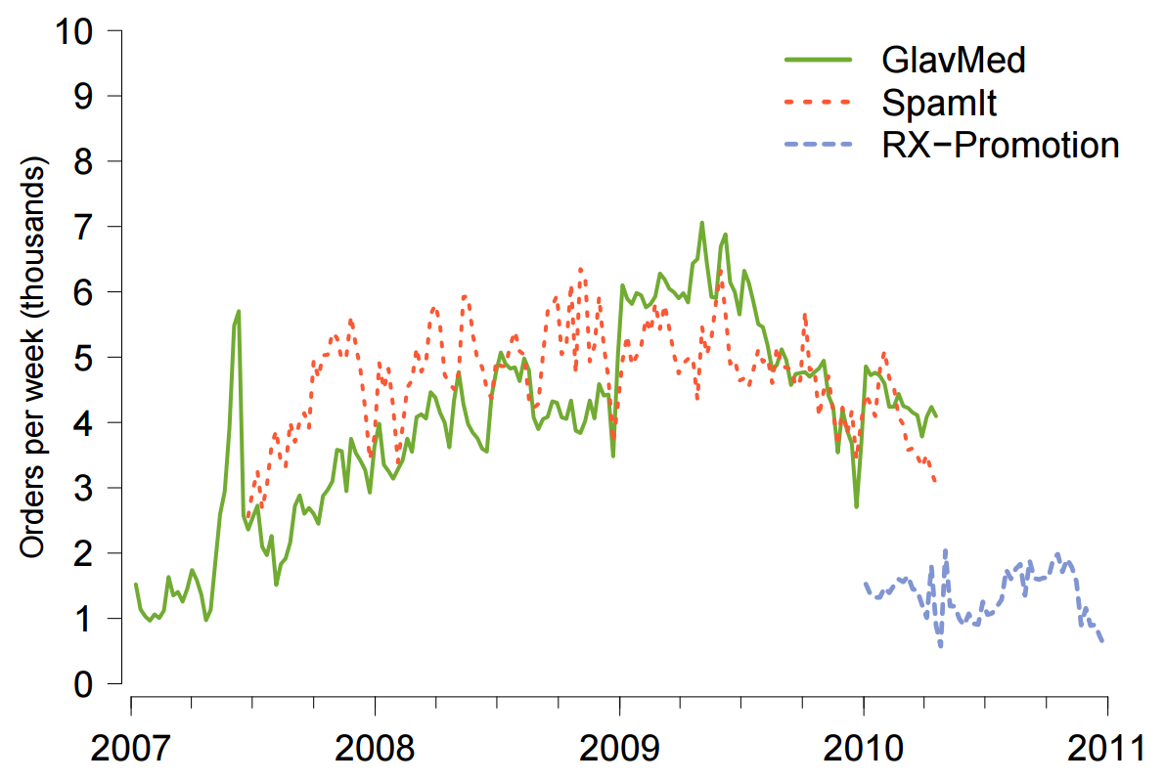
Transaction Volume

Slide 54
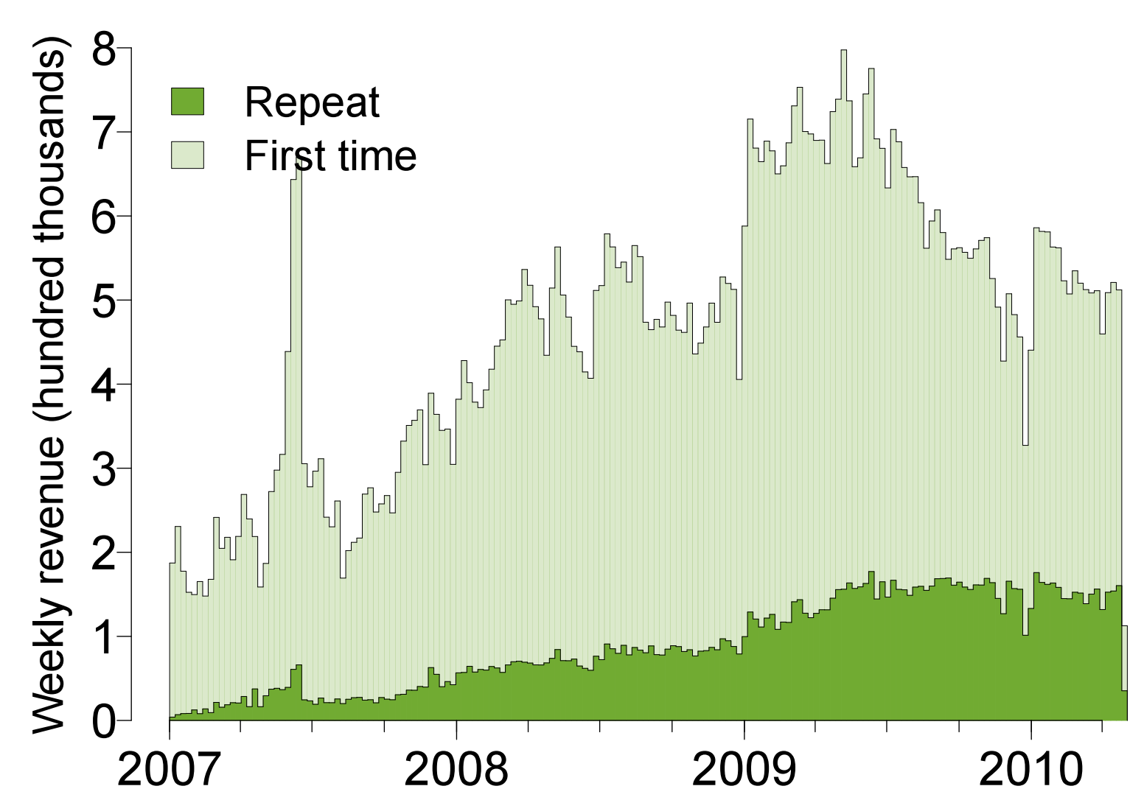
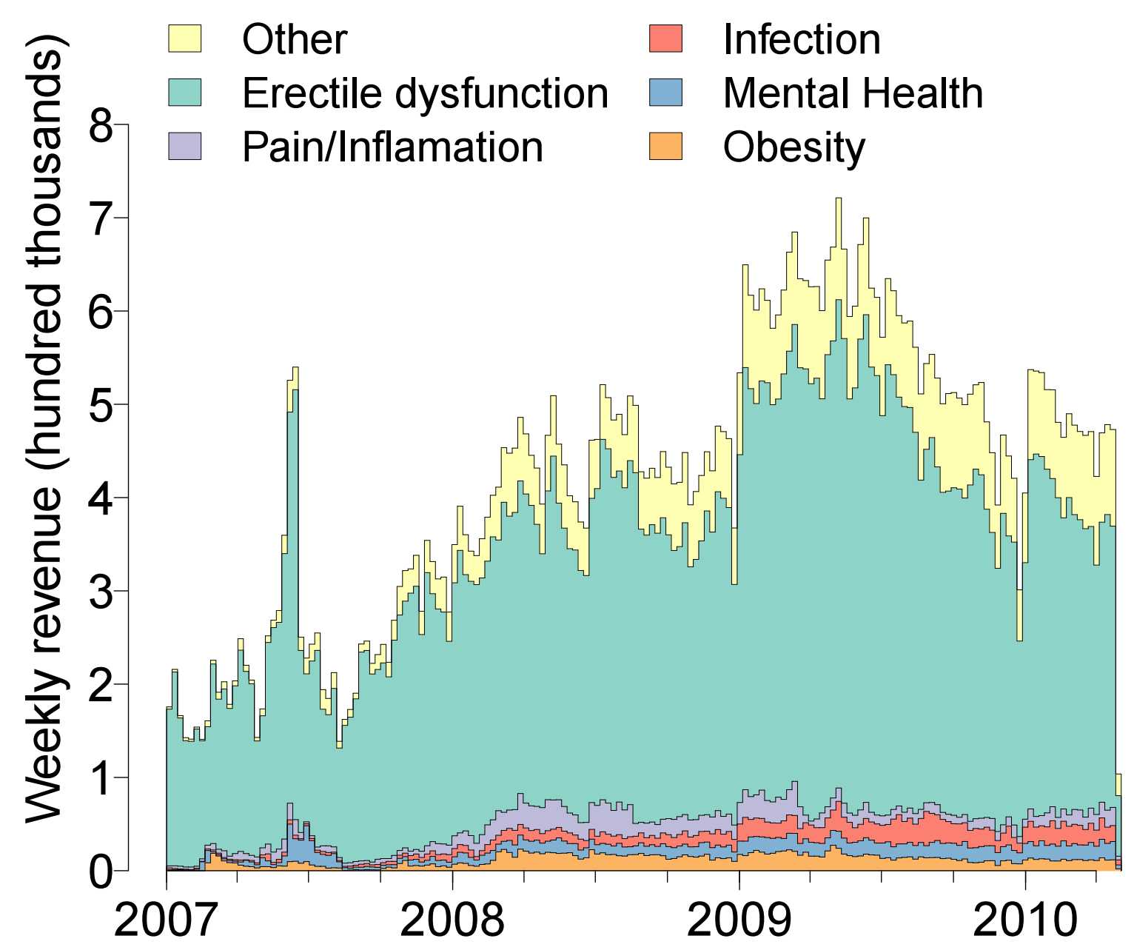
New vs. Repeat Customers
Types of Products

Slide 55
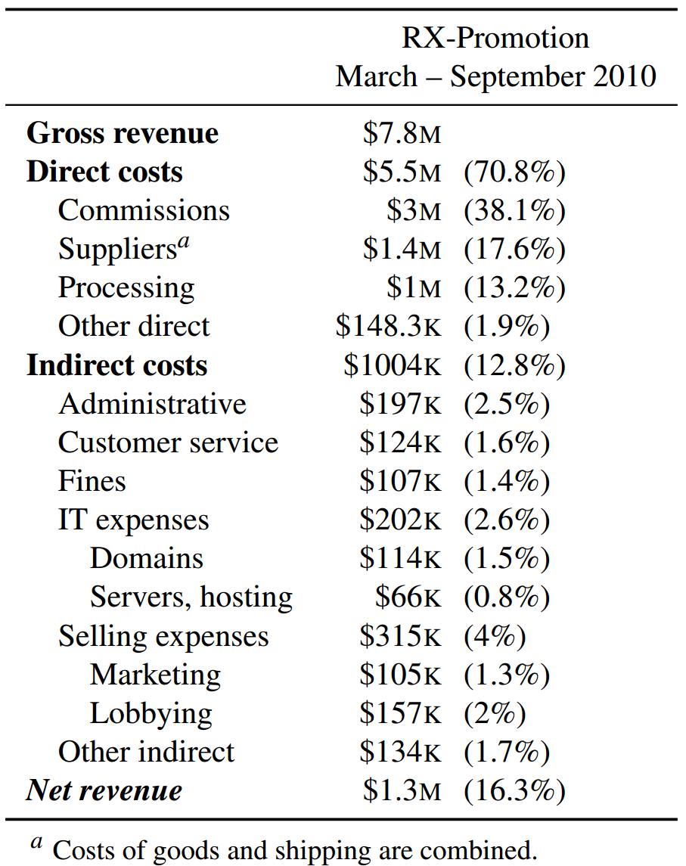
Profit
Payments to affiliates
Pharma scams bring in a lot of revenue
… but are they actually making a profit?
Bulletproof hosting
Spammers and botnet operators

Slide 56
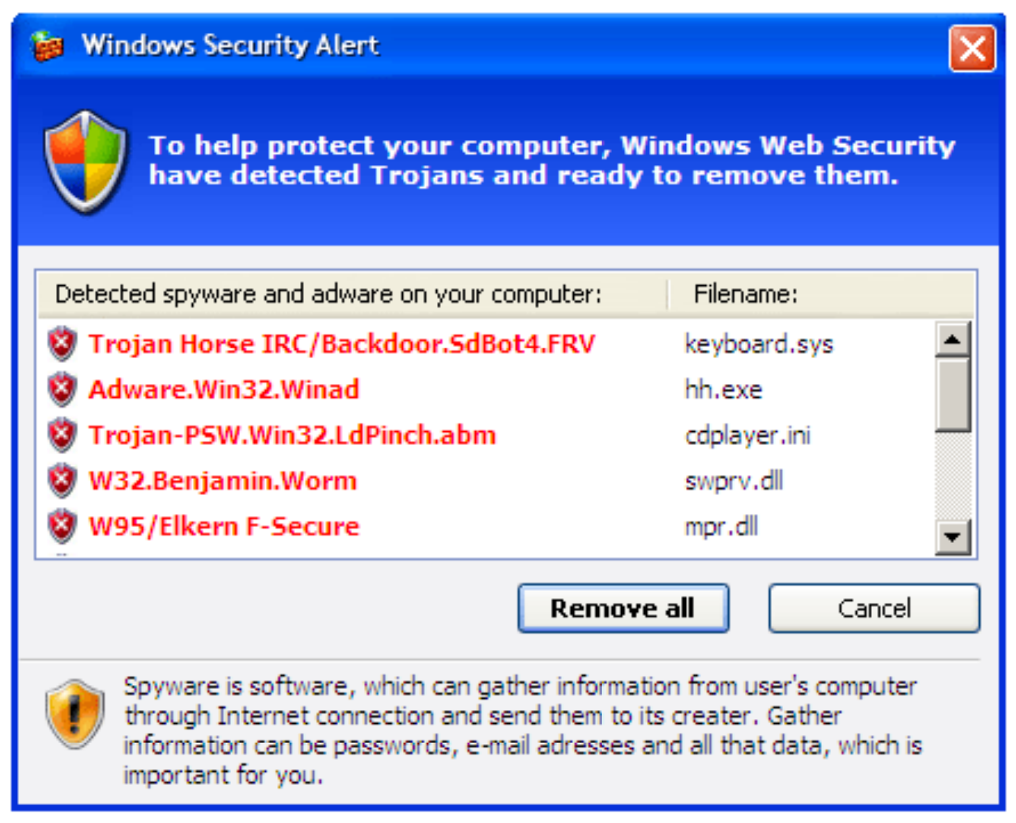
Fake Antivirus Software
Fake antivirus software is another common drop during drive-by attacks
Warning dialog looks legitimate at first glance…
OMG, look at all those nasty viruses!
Clicking here will prompt you to buy a subscription

Slide 57
Methodology
Researchers used dynamic analysis tools to identify URLs from fake AV software
Pointed to 21 unique servers hosting infrastructure for the scams
Researchers contacted the hosting providers and got them to take the servers down
Allowed researchers to image the hard drives :)
Data records purchases, returns, etc. for 3 fake AV campaigns
March 2008 – April 2010

Slide 58
Fake AV by the Numbers
Campaign | Subscriptions | Purchase Rate | Total Installs | Total Sales/ Conversion % | Revenue | Refunds/ Chargebacks | Net
AV1 (3 months) | 6 months - $49.95 | 34.8% | 8,403,008 | 189,342 (2.4%) | $11,303,494 | 5,669 1,544 | $10,862,492
 | 1 year – $59.95 | 32.9%
 | 2 year - $69.95 | 32.3%
AV2 (16 months) | 6 months - $49.95 | 61.9% | 6,624,508 | 137,209 (2.1%) | $5,046,508 | 11,681 3,024 | $4,103,735
 | 1 year - $69.95 | 13.5%
 | Lifetime - $89.95 | 24.6%
AV3 (30 months) | 1 year - $79.90 | 83.2% | 91,305,640 | 1,969,953 (2.2%) | $116,941,854 | 151,553 30,743 | $103,765,233
 | Lifetime - $99.90 | 16.8%
Each campaign paid out millions of dollars to affiliates (spammers) for acquiring traffic

Slide 59
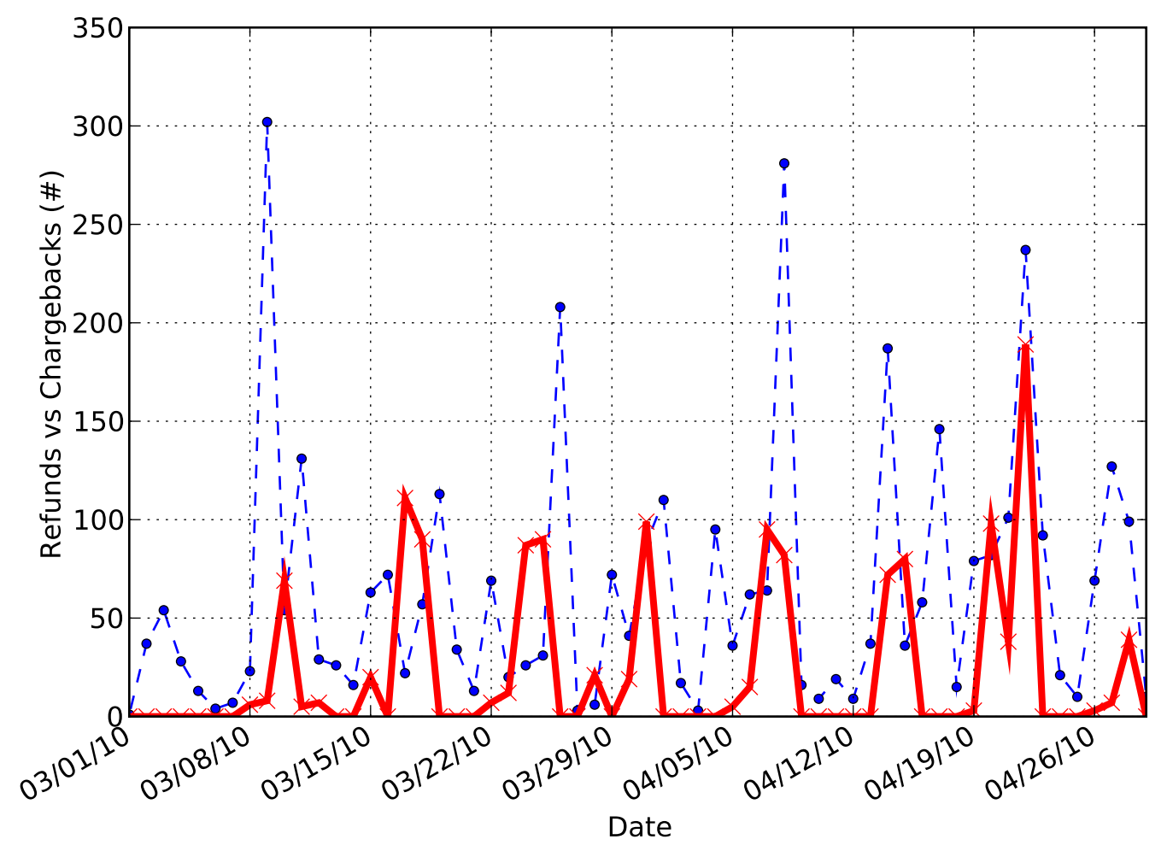
Refunds and Chargebacks
The peaks tend to alternate, meaning the scammer tries to prevent too many chargebacks while offering minimum refunds
A company with too many chargebacks will be suspended by their payment processor
Known as a “trigger-level”
Thus, the scammer must allow some refunds to prevent chargebacks
However, offering refunds reduces profits
Refunds
Chargebacks

Slide 60
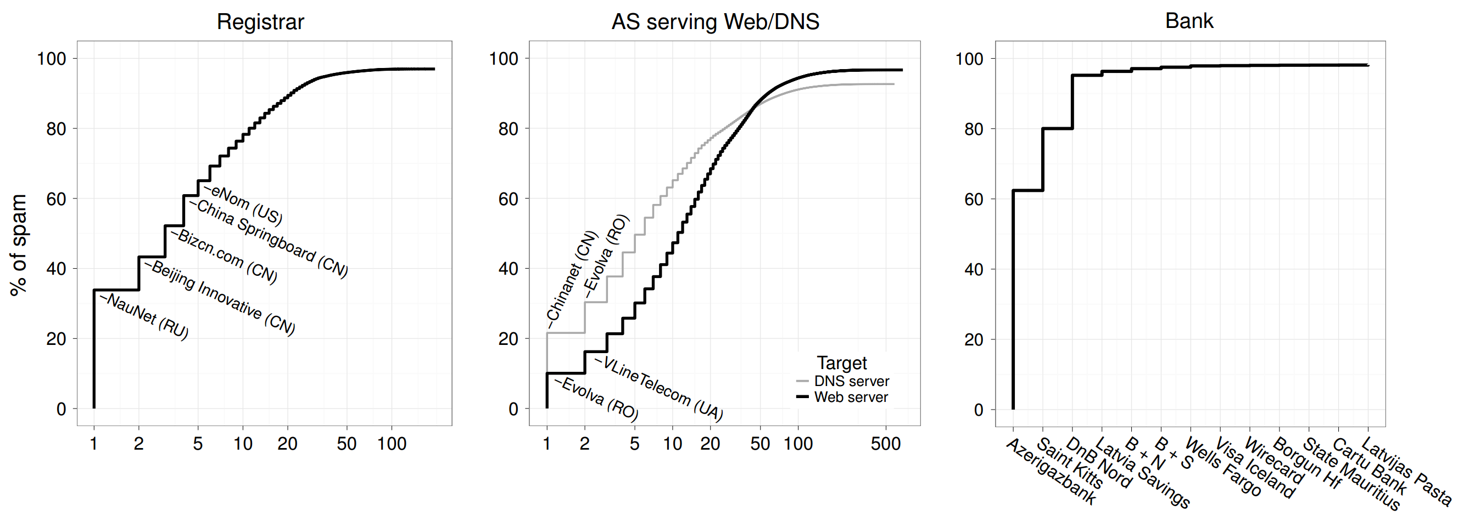
Intervention
What is the most effective infrastructure for law enforcement to go after in order to shut down affiliate scams?
Follow the money, shut down or blacklist merchant banks

Slide 61
Sources
An Inquiry into the Nature and Causes of the Wealth of Internet Miscreants - http://www.icir.org/vern/papers/miscreant-wealth.ccs07.pdf
Peek Inside A Professional Carding Shop, Brian Krebs - http://krebsonsecurity.com/2014/06/peek-inside-a-professional-carding-shop/
An Analysis of Underground Forums - http://cseweb.ucsd.edu/~voelker/pubs/forums-imc11.pdf
Spamalytics: An Empirical Analysis of Spam Marketing Conversion - http://cseweb.ucsd.edu/~savage/papers/CCS08Conversion.pdf
Spamcraft: An Inside Look At Spam Campaign Orchestration - http://cseweb.ucsd.edu/~savage/papers/LEET09.pdf
Click Trajectories: End-to-End Analysis of the Spam Value Chain - http://cseweb.ucsd.edu/~savage/papers/Oakland11.pdf
PharmaLeaks: Understanding the Business of Online Pharmaceutical Affiliate Programs - http://cseweb.ucsd.edu/~savage/papers/UsenixSec12.pdf
The Underground Economy of Fake Antivirus Software - https://www.cs.ucsb.edu/~vigna/publications/2011_stone_abman_kemmerer_kruegel_steigerwald_vigna_FakeAV.pdf

Slide 62
More Sources
Priceless: The Role of Payments in Abuse-advertised Goods - http://cseweb.ucsd.edu/~savage/papers/CCS12Priceless.pdf
Characterizing Large-Scale Click Fraud in ZeroAccess - http://cseweb.ucsd.edu/~voelker/pubs/za-ccs14.pdf
Serf and Turf: Crowdturfing for Fun and Profit - http://www.ccs.neu.edu/home/cbw/pdf/crowdturfing-www12.pdf
Dirty Jobs: The Role of Freelance Labor in Web Service Abuse - http://cseweb.ucsd.edu/~savage/papers/UsenixSec11-DJ.pdf
Follow the Green: Growth and Dynamics in Twitter Follower Markets - http://www.cs.ucsb.edu/~gangw/twitter_imc13.pdf
Dialing Back Abuse on Phone Verified Accounts - http://www.inwyrd.com/blog/wp-content/uploads/2014/08/ccs2014dialing.pdf

