Slide 1
Building Bridges
CS 3700 Project 2

Slide 2
Goals
You will write a program that implements a simple Ethernet bridge
The bridge must forward packets from hosts
Thus, you’ll need to maintain a forwarding table
The network may have loops
Thus, you must implement the spanning tree protocol
Bridges may be added to or removed from the network over time
Your bridge must be resilient to network dynamics and failures
Grade based on correctness and performance
People say that this is the hardest project in the class
Start early
We have a milestone to force you to start early

Slide 3
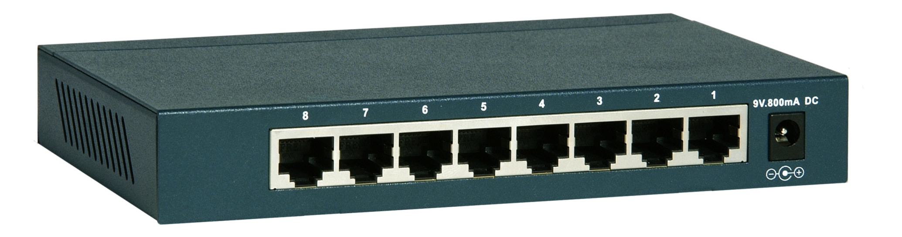
Command Line Syntax
$ ./3700bridge <ID> <LAN ID 1> [LAN ID 2] … [LAN ID n]
ID is the unique ID for this bridge
The LAN IDs are names of the LANs the bridge is connected to
You will open a socket() for each LAN
Conceptually, each LAN connects to port on your bridge
Note: you will never execute this command yourself!
LAN 2
LAN 1

Slide 4
The Simulator
A network with only one bridge is boring
We will use a simulator that runs multiple copies of your bridge in parallel to create a network with many bridges
Simulator takes care of setting up all LANs
Simulator also creates hosts on the LANs that will send packets to each other
$ ./run <config file>
You will never run your bridge directly on the command line, you will always use the simulator
Thus, this project is multi-socket and multi-process
Each bridge will have multiple open sockets
And, there will be multiple copies of your bridge running in parallel

Slide 5
Simple Config File Example
One bridge, connected to one LAN
{
"lifetime": 4,
"bridges": [{"id": "08ad", "lans": [1]}],
"hosts": 2,
"packets": 10,
"seed": 1
}
Simulator
Two hosts
One copy of your program, with one socket

Slide 6
Intermediate Config File Example
Four bridges
One copy of your program, with three sockets
Simulator
{
"lifetime": 10,
"bridges": [{"id": "f8ad", "lans": [1, 2]},
{"id": "aa09", "lans": [2, 3]},
{"id": "9e3a", "lans": [1, 2], "start": 5},
{"id": "1000", "lans": [1, 2, 3], "start": 7}],
"hosts": 10,
"packets": 70,
"seed": 1
}
LAN 1
1000
f8ad
9e3a
LAN 2
LAN 3
Bridges may be added (or removed) over time
aa09
Four copies of your bridge

Slide 7
The Protocol
Uses JSON formatted packets:
{"source":"<source>", "dest":"<destination>", "type":"<type>", "message":{<message>}}
Example BPDU:
{"source":"02a1", "dest":"ffff", "type": "bpdu", "message":{"id":"92b4", "root":"02a1", "cost":3}}
Example packet from a host:
{"source":"28aa", "dest":"97bf", "type": "data", "message":{"id": 17}}

Slide 8
Suggested Approach
Before you start writing any code, practice the spanning tree protocol
Draw the networks in the test cases on a piece of paper
Manually determine which ports should be active, and why
Implement the spanning tree protocol using BPDU packets
Get all bridges to agree on who is the root
Work on enabling/disabling all ports correctly
Initially, don’t worry about forwarding packets from hosts, just drop them
Don’t worry about timeouts or error recovery
Work on the forwarding table
Work on error recovery
Implement periodic BPDU broadcasts, timeout old BPDUs and forwarding table entries
After a timeout, the state of all of your ports should go back to default, and the forwarding table must be flushed

Slide 9
Performance Testing
We provide a script that runs all test cases
$ ./test
In addition to passing all tests (correctness), we will also be grading you based on performance
What fraction of packets were successfully delivered? Higher is better.
How much overhead (broadcasts) did you generate? Lower is better.
Leaderboard showing everyone’s performance on the test cases
$ /course/cs3700f16/bin/project2/printstats

Slide 10
Turning in Your Project
Register your group
All group members must run the script!
Create a directory for your files
All of your (well documented) code
Makefile
README
Run the turn-in script
Note: you will register for the milestone and the full project separately

Slide 11
Grading
14% of your total grade
1% for the milestone, due Wednesday September 28
Turn in a bridge that passes test cases simple-[1, …, 6]
Points based on how many cases you pass
13% for the full project, due Friday October 7
75% for program correctness, i.e. passing all test cases
10% for performance
15% for style and documentation

Slide 12
A Note On Cheating
It is possible to pass all the test cases without implementing the spanning tree protocol
Have your bridge store copies of all received messages
Examine each received message to determine if it is a duplicate
Drop duplicates
Although this solves the network loop problem, you are not allowed to do this
This is a blatant violation of the spirit of the assignment
We will be performing code reviews
If we see that you are doing this, you get a zero on the project
No exceptions

