Slide 1
CS 4700 / CS 5700 Network Fundamentals
Lecture 10: Inter Domain Routing
(It’s all about the Money)
Revised 9/25/2013

Slide 2
Network Layer, Control Plane
Function:
Set up routes between networks
Key challenges:
Implementing provider policies
Creating stable paths
Data Plane
Application
Presentation
Session
Transport
Network
RIP
OSPF
BGP
Control Plane
Data Link
Physical

Slide 3
Outline
BGP Basics
Stable Paths Problem
BGP in the Real World
Next-gen Routing: HLP

Slide 4
ASs, Revisited
AS-1
AS-3
Interior Routers
AS-2
BGP Routers

Slide 5
AS Numbers
Each AS identified by an ASN number
16-bit values
64512 – 65535 are reserved
Currently, there are > 20000 ASNs
AT&T: 5074, 6341, 7018, …
Sprint: 1239, 1240, 6211, 6242, …
Northeastern: 156
North America ASs → ftp://ftp.arin.net/info/asn.txt

Slide 6
Inter-Domain Routing
Global connectivity is at stake!
Thus, all ASs must use the same protocol
Contrast with intra-domain routing
What are the requirements?
Scalability
Flexibility in choosing routes
Cost
Routing around failures
Question: link state or distance vector?
Trick question: BGP is a path vector protocol

Slide 7
BGP
Border Gateway Protocol
De facto inter-domain protocol of the Internet
Policy based routing protocol
Uses a Bellman-Ford path vector protocol
Relatively simple protocol, but…
Complex, manual configuration
Entire world sees advertisements
Errors can screw up traffic globally
Policies driven by economics
How much $$$ does it cost to route along a given path?
Not by performance (e.g. shortest paths)

Slide 8
BGP Relationships
Provider
Peer 2 has no incentive to route 1→ 3
Peers do not pay each other
Customer
Provider
Customer
Peer 1
Peer 2
Peer 3
Customer pays provider
Customer

Slide 9
Tier-1 ISP Peering
Inteliquent
Centurylink
Verizon Business
AT&T
Level 3
Sprint
XO Communications

Slide 10
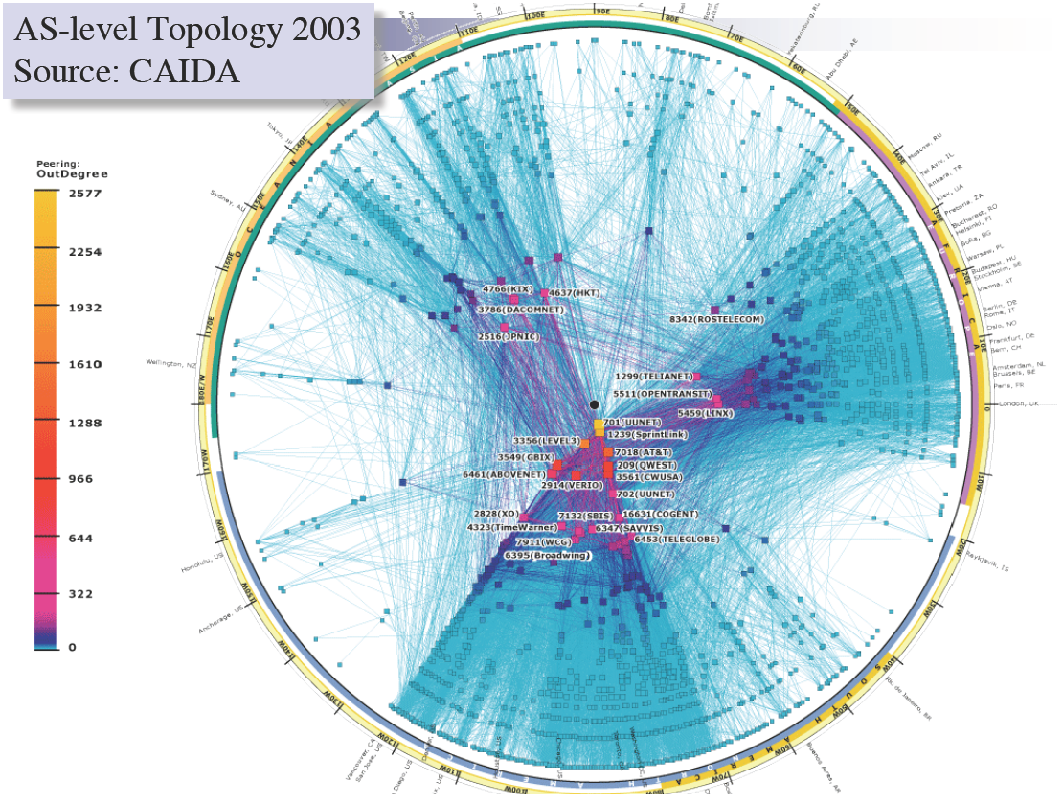

Slide 11
Peering Wars
Peer
Don’t Peer
Reduce upstream costs
Improve end-to-end performance
May be the only way to connect to parts of the Internet
You would rather have customers
Peers are often competitors
Peering agreements require periodic renegotiation
Peering struggles in the ISP world are extremely contentions, agreements are usually confidential

Slide 12
Two Types of BGP Neighbors
Exterior routers also speak IGP
IGP
eBGP
eBGP
iBGP
iBGP

Slide 13
Full iBGP Meshes
Question: why do we need iBGP?
OSPF does not include BGP policy info
Prevents routing loops within the AS
iBGP updates do not trigger announcements
eBGP
iBGP

Slide 14
Path Vector Protocol
AS-path: sequence of ASs a route traverses
Like distance vector, plus additional information
Used for loop detection and to apply policy
Default choice: route with fewest # of ASs
AS 4
120.10.0.0/16
AS 3
130.10.0.0/16
AS 5
AS 2
110.10.0.0/16
120.10.0.0/16: AS 2 → AS 3 → AS 4
130.10.0.0/16: AS 2 → AS 3
110.10.0.0/16: AS 2 → AS 5
AS 1

Slide 15
BGP Operations (Simplified)
Establish session on TCP port 179
AS-1
Exchange active routes
BGP Session
AS-2
Exchange incremental updates

Slide 16
Four Types of BGP Messages
Open: Establish a peering session.
Keep Alive: Handshake at regular intervals.
Notification: Shuts down a peering session.
Update: Announce new routes or withdraw previously announced routes.
announcement = IP prefix + attributes values

Slide 17
BGP Attributes
Attributes used to select “best” path
LocalPREF
Local preference policy to choose most preferred route
Overrides default fewest AS behavior
Multi-exit Discriminator (MED)
Specifies path for external traffic destined for an internal network
Chooses peering point for your network
Import Rules
What route advertisements do I accept?
Export Rules
Which routes do I forward to whom?

Slide 18
Route Selection Summary
Highest Local Preference
Enforce relationships
Shortest AS Path
Lowest MED
Traffic engineering
Lowest IGP Cost to BGP Egress
When all else fails,
break ties
Lowest Router ID

Slide 19
Shortest AS Path != Shortest Path
4 hops
4 ASs
9 hops
2 ASs
Source
?
?
Destination

Slide 20
Hot Potato Routing
5 hops total, 2 hops cost
Source
3 hops total,
3 hops cost
?
?
Destination

Slide 21
Importing Routes
From Provider
ISP Routes
From Peer
From Peer
From Customer

Slide 22
Exporting Routes
$$$ generating routes
Customer and ISP routes only
To Provider
To Peer
To Peer
To Customer
Customers get all routes

Slide 23
Outline
BGP Basics
Stable Paths Problem
BGP in the Real World
Next-gen Routing: HLP

Slide 24
What Problem is BGP Solving?
Underlying Problem | Distributed Solution
Shortest Paths | RIP, OSPF, IS-IS, etc.
??? | BGP
Knowing ??? can:
Aid in the analysis of BGP policy
Aid in the design of BGP extensions
Help explain BGP routing anomalies
Give us a deeper understanding of the protocol

Slide 25
The Stable Paths Problem
An instance of the SPP:
Graph of nodes and edges
Node 0, called the origin
A set of permitted paths from each node to the origin
Each set contains the null path
Each set of paths is ranked
Null path is always least preferred
2 1 0
2 0
5
5 2 1 0
2
2
4 2 0
4 3 0
4
0
1
3
3 0
1 3 0
1 0

Slide 26
A Solution to the SPP
A solution is an assignment of permitted paths to each node such that:
Node u’s path is either null or uwP, where path uw is assigned to node w and edge u → w exists
Each node is assigned the higest ranked path that is consistent with their neighbors
2 1 0
2 0
5
5 2 1 0
2
Solutions need not use the shortest paths, or form a spanning tree
2
4 2 0
4 3 0
4
0
1
3
3 0
1 3 0
1 0

Slide 27
Simple SPP Example
1 0
1 3 0
2 0
2 1 0
1
2
2
Each node gets its preferred route
Totally stable topology
0
3
4
3 0
4 3 0
4 2 0
4 2 0
4 3 0

Slide 28
Good Gadget
1 3 0
1 0
2 1 0
2 0
1
2
2
Not every node gets preferred route
Topology is still stable
Only one stable configuration
No matter which router chooses first!
0
3
4
3 0
4 3 0
4 2 0

Slide 29
SPP May Have Multiple Solutions
1 2 0
1 0
1 2 0
1 0
1 2 0
1 0
1
1
1
0
0
0
2
2
2
2 1 0
2 0
2 1 0
2 0
2 1 0
2 0

Slide 30
Bad Gadget
1 3 0
1 0
2 1 0
2 0
That was only one round of oscillation!
This keeps going, infinitely
Problem stems from:
Local (not global) decisions
Ability of one node to improve its path selection
1
2
2
0
3
4
3 4 2 0
3 0
4 2 0
4 3 0

Slide 31
SPP Explains BGP Divergence
BGP is not guaranteed to converge to stable routing
Policy inconsistencies may lead to “livelock”
Protocol oscillation
Solvable
Can Diverge
Good Gadgets
Bad Gadgets
Must
Converge
Must
Diverge
Naughty Gadgets

Slide 32
Beware of Backup Policies
1 3 0
1 0
2 1 0
2 0
1
2
2
BGP is not robust
It may not recover from link failure
0
3
4
3 4 2 0
3 0
4 0
4 2 0
4 3 0

Slide 33
BGP is Precarious
If node 1 uses path 1 → 0, this is solvable
4 3 1 0
4 5 3 1 2 0
4 3 1 2 0
1 2 0
1 0
4
1
3 1 0
3 1 2 0
3
No longer stable
0
5
6
2
5 3 1 0
5 6 3 1 2 0
5 3 1 2 0
6 3 1 0
6 4 3 1 2 0
6 3 1 2 0
2 1 0
2 0

Slide 34
Can BGP Be Fixed?
Unfortunately, SPP is NP-complete
Possible Solutions
Static Approach
Dynamic Approach
Extend BGP to
detecting and suppress
policy-based oscillations?
Automated Analysis
of Routing Policies
(This is very hard)
Inter-AS
coordination
These approaches are complementary

Slide 35
Outline
BGP Basics
Stable Paths Problem
BGP in the Real World
Next-gen Routing: HLP

Slide 36
Motivation
Routing reliability/fault-tolerance on small time scales (minutes) not previously a priority
Transaction oriented and interactive applications (e.g. Internet Telephony) will require higher levels of end-to-end network reliability
How well does the Internet routing infrastructure tolerate faults?
Notes:
Motivation → why we should care about convergence

Slide 37
Conventional Wisdom
Internet routing is robust under faults
Supports path re-routing
Path restoration on the order of seconds
BGP has good convergence properties
Does not exhibit looping/bouncing problems of RIP
Internet fail-over will improve with faster routers and faster links
More redundant connections (multi-homing) will always improve fault-tolerance

Slide 38
Delayed Routing Convergence
Conventional wisdom about routing convergence is not accurate
Measurement of BGP convergence in the Internet
Analysis/intuition behind delayed BGP routing convergence
Modifications to BGP implementations which would improve convergence times

Slide 39
Open Question
After a fault in a path to multi-homed site, how long does it take for majority of Internet routers to fail-over to secondary path?
Route Withdrawn
Routing table convergence
Stable end-to-end paths
Primary ISP
Customer
Backup ISP
Traffic

Slide 40
Bad News
With unconstrained policies:
Divergence
Possible create unsatisfiable policies
NP-complete to identify these policies
Happening today?
With constrained policies (e.g. shortest path first)
Transient oscillations
BGP usually converges
It may take a very long time…
This paper is about constrained policies

Slide 41
16 Month Study of Convergence
Instrument the Internet
Inject BGP faults (announcements/withdrawals) of varied prefix and AS path length into topologically and geographically diverse ISP peering sessions
Monitor impact faults through
Recording BGP peering sessions with 20 tier1/tier2 ISPs
Active ICMP measurements (512 byte/second to 100 random web sites)
Wait two years (and 250,000 faults)

Slide 42
Measurement Architecture
Researchers pretending to be an AS
Researchers pretending to be an AS

Slide 43
Announcement Scenarios
Tup – a new route is advertised
Tdown – A route is withdrawn
i.e. single-homed failure
Tshort – Advertise a shorter/better AS path
i.e. primary path repaired
Tlong – Advertise a longer/worse AS path
i.e. primary path fails

Slide 44
Major Convergence Results
Routing convergence requires an order of magnitude longer than expected
10s of minutes
Routes converge more quickly following Tup/Repair than Tdown/Failure events
Bad news travels more slowly
Withdrawals (Tdown) generate several more announcements than new routes (Tup)

Slide 45
Example
BGP log of updates from AS2117 for route via AS2129
One withdrawal triggers 6 announcements and one withdrawal from 2117
Increasing AS path length until final withdrawal

Slide 46
Why So Many Announcements?
Events from AS 2177
Route Fails: AS 2129
Announce: 5696 2129
Announce: 1 5696 2129
Announce: 2041 3508 2129
Announce: 1 2041 3508 2129
Route Withdrawn: 2129
AS 2041
AS 3508
AS 1
AS 5696
AS 2129
AS 2117

Slide 47
How Many Announcements Does it Take For an AS to Withdraw a Route?
Answer: up to 19

Slide 48
BGP Routing Table Convergence Times
New Route
Long->Short Fail-over
Short->Long Fail-Over
Failure
Less than half of Tdown events converge within two minutes
Tup/Tshort and Tdown/Tlong form equivalence classes
Long tailed distribution (up to 15 minutes)

Slide 49
Failures, Fail-overs and Repairs
Bad news does not travel fast…
Repairs (Tup) exhibit similar convergence as long-short AS path fail-over
Failures (Tdown) and short-long fail-overs (e.g. primary to secondary path) also similar
Slower than Tup (e.g. a repair)
80% take longer than two minutes
Fail-over times degrade the greater the degree of multi-homing

Slide 50
Intuition for Delayed Convergence
There exists possible ordering of messages such that BGP will explore ALL possible AS paths of ALL possible lengths
BGP is O(N!), where N number of default-free BGP routers in a complete graph with default policy

Slide 51
Impact of Delayed Convergence
Why do we care about routing table convergence?
It deleteriously impacts end-to-end Internet paths
ICMP experiment results
Loss of connectivity, packet loss, latency, and packet re-ordering for an average of 3-5 minutes after a fault
Why?
Routers drop packets when next hop is unknown
Path switching spikes latency/delay
Multi-pathing causes reordering

Slide 52
In real life …
Discussed worst case BGP behavior
In practice, BGP policy prevents worst case from happening
BGP timers also provide synchronization and limits possible orderings of messages

Slide 53
Outline
BGP Basics
Stable Paths Problem
BGP in the Real World
Next-gen Routing: HLP

Slide 54
Inter-Domain Routing
BGP4 is the only inter-domain routing protocol currently in use world-wide
Issues?
Lack of security
Ease of misconfiguration
Poorly understood interaction between local policies
Poor convergence
Lack of appropriate information hiding
Non-determinism
Poor overload behavior

Slide 55
Policy, policy, and policy
An ISP’s routing policy is a commercial secret
Don’t want to tell anyone else what the policy is
BGP does policy entirely through local filtering of the set of possible alternative routes
However, you need path information to set a useful range of policies
But path information inherently reveals information about routing adjacencies…

Slide 56
Does Policy Hiding Even Work?
It is practical to hide many private peering relationships
It’s not practical to hide most customer/provider routing relationships when using BGP
Customer pays provider to advertise their route to the rest of the world
95% of the “peerings” visible in route-views and RIPE appear to function as customer/provider links
Note that the flow of $ is not revealed by routing protocols

Slide 57
Problems with Local Filtering
Doing policy entirely through local filtering is the root cause of many of BGP’s problems
Manual configuration of what not to accept → prone to misconfiguration
No semantics describing why a route is used → hard to discover errors or attacks
No information about alternative routes → BGP must do a lengthy path exploration to find feasible alternatives
No information about which alternatives will work for whom → BGP can’t do effective information hiding
Small changes in one part of the world are frequently globally visible

Slide 58
Towards a New Routing Framework
Given that:
Most links function as customer/provider
Customer/provider links are inherently visible to the world
Additional semantics visible in the routing protocol would allow:
More informed route calculation
Permit better information hiding
Thus, it seems logical to design a routing protocol that uses this information explicitly

Slide 59
Routing Hierarchy
Customer / Provider Links
Peering Links
Customer / Provider Hierarchy

Slide 60
Multiple Routing Hierarchies
Within the hierarchy:
No need to hide policy information
More information → easier to make robust routing decisions
Peer relationships:
Want to hide policy information
No need to export low-level path changes
Use different routing protocols for inside and outside the hierarchy!

Slide 61
Routing Protocol Styles
Link State
Path Vector
E.g. OSPF
Great convergence properties
Scales fairly well
Can’t easily hide policy information
E.g. BGP
Poor convergence properties
Scales well
Can hide policy information
Inside the Hierarchy (Customer / Provider Links)
Outside the Hierarchy
(Peering Links)

Slide 62
Hybrid Link State/Path Vector (HLP)
Path Vector
Path Vector
Link State
Link State
Link State

Slide 63
Link State HLP
Within customer/provider link state tree:
Good convergence
More information
e.g. alternative route pre-computation
Explicit representation of backup links for multi-homing
Default policy is simple and robust
Reduces misconfiguration errors
Improved default security
Need to be a tier-1 provider to do much damage

Slide 64
Path Vector HLP
Between customer/provider trees (peering links):
Use fragmented path-vector (FPV), rather than full path-vector used by BGP
Number of links routed using FPV decreased drastically
Reduces path-exploration space
Degrade gracefully from link-state towards path-vector if ISPs need to use more non-default policies
Worst case looks pretty much like BGP

Slide 65
New Route Announcements
FPV: A→E
Cost = 2
A
LSA: C→E
Cost = 1
B
LSA: C→E
Cost = 1
FPV: B→A→E
Cost = 3
D
G
LSA: C→E
Cost = 1
FPV: B→A→E
Cost = 4
C
F
H
LSA: C→E
Cost = 1
LSA: C→E
Cost = 1
E

Slide 66
Route Withdrawl
FPV: A→E
Cost = 3
A
LSA: C→E
Cost = ∞
B
LSA: C→E
Cost = ∞
FPV: B→A→E
Cost = 4
D
G
LSA: C→E
Cost = ∞
FPV: B→A→E
Cost = 5
C
F
H
LSA: C→E
Cost = ∞
E

Slide 67
Isolation and Information Hiding
Lots of information within a Customer-Provider tree
Don’t need to convey all changes into FPV
Local changes that aren’t too critical can be hidden from the wider world
Only large-scale changes need to be pushed via FPV
Significantly reduce global routing table churn

Slide 68
Exceptions
Not all policies conform strictly to the hierarchy
Export-policy exception
Prefer-customer exception
Dealt with in HLP by using FPV rather than Link-state
Fortunately this is rare
Frequency of export-policy exceptions:

Slide 69
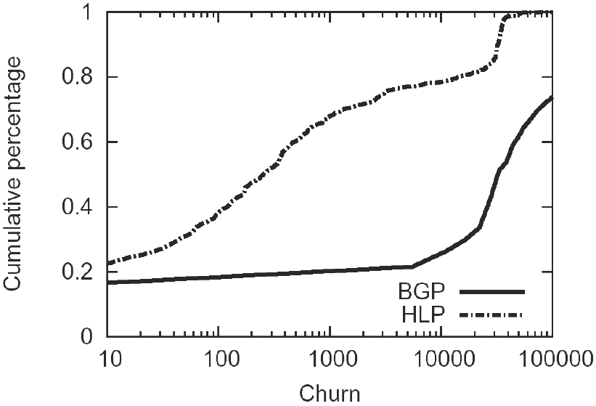
Performance: Routing Table Churn
Churn: # of updates generated by single event

Slide 70
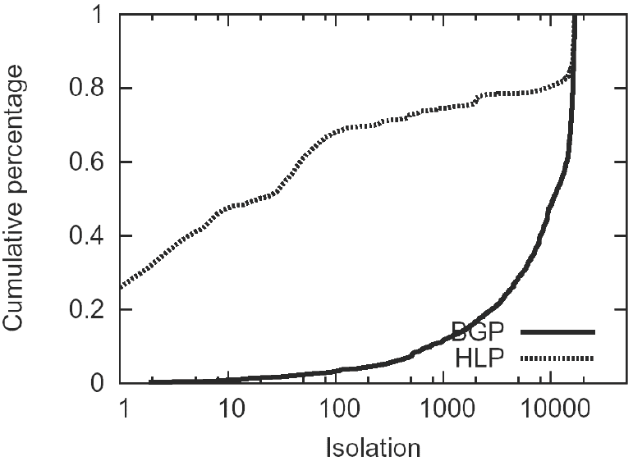
Performance: Fault isolation
Isolation: # of AS’s affected by a single event

Slide 71
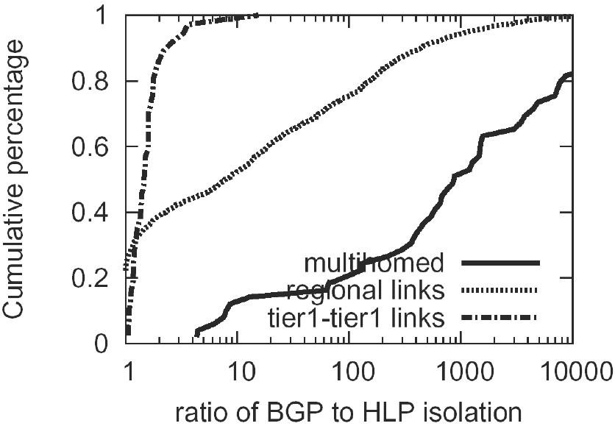
Fault Isolation and Multihoming
Ratio of BGP to HLP isolation improvement

Slide 72
Convergence
BGP: Worst case is fully connected n-node graph:
Convergence time is O((n-1)!)
HLP: In the absence of exceptions, worst case is:
Convergence time is O(nk(D))
k(D) is number of peering links on path to D
In the current Internet:
k ≤ 1 for 90% of Internet routes
k ≤ 2 for 99% of Internet routes
k ≤ 4 for all Internet routes

Slide 73
HLP Advantages
Scalability: route churn is the issue
Information hiding
Separation of prefix distribution from routing
Convergence:
Link-State converges fast
FPV converges faster than Path-Vector because there are fewer infeasible alternates
Security:
Structure adds security
Secure prefix distribution separately from dynamic routing
Robustness:
Harder to misconfigure, easier to figure out the intent behind a route

Slide 74
HLP Summary
A really nice paper
Great execution from a number of perspectives
Detailed need-driven system design
Identify and isolate fundamental issues and tradeoffs: isolation versus reachability
Decouple conflicting policies
Sheds light on inner workings of complex system
Extremely well-written paper
Clear logical reasoning
Exceptional introduction
Complete: from high-level design to protocol analysis to router implementation and microbenchmarks

