Slide 1
CS 4700 / CS 5700 Network Fundamentals
Lecture 22: Anonymous Communications
(Wave Hi to the NSA)

Slide 2
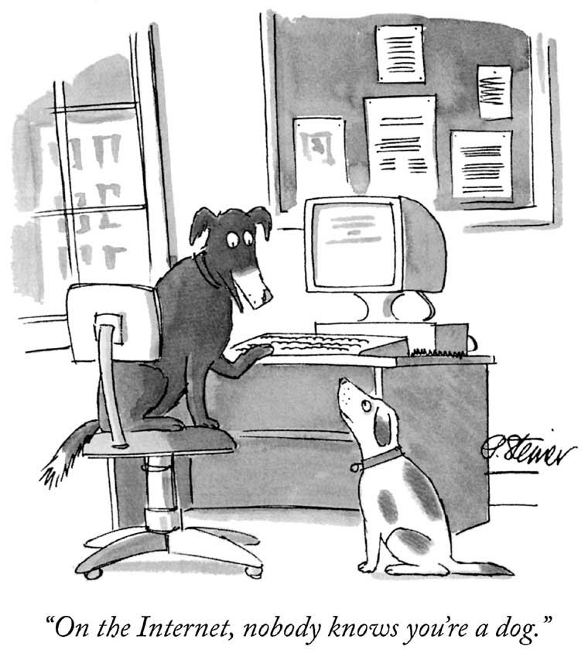

Slide 3
You Are Not Anonymous
Your IP address can be linked directly to you
ISPs store communications records
Usually for several years (Data Retention Laws)
Law enforcement can subpoena these records
Your browser is being tracked
Cookies, Flash cookies, E-Tags, HTML5 Storage
Browser fingerprinting
Your activities can be used to identify you
Unique websites and apps that you use
Types of links that you click

Slide 4
Wiretapping is Ubiquitous
Wireless traffic can be trivially intercepted
Airsnort, Firesheep, etc.
Wifi and Cellular traffic!
Encryption helps, if it’s strong
WEP and WPA are both vulnerable!
Tier 1 ASs and IXPs are compromised
NSA, GCHQ, “5 Eyes”
~1% of all Internet traffic
Focus on encrypted traffic

Slide 5
Who Uses Anonymity Systems?
“If you’re not doing anything wrong, you shouldn’t have anything to hide.”
Implies that anonymous communication is for criminals
The truth: who uses Tor?
Journalists
Law enforcement
Human rights activists
Normal people
Fact: Tor was/is developed by the Navy
Business executives
Military/intelligence personnel
Abuse victims

Slide 6
Why Do We Want Anonymity?
To protect privacy
Avoid tracking by advertising companies
Viewing sensitive content
Information on medical conditions
Advice on bankruptcy
Protection from prosecution
Not every country guarantees free speech
Downloading copyrighted material
To prevent chilling-effects
It’s easier to voice unpopular or controversial opinions if you are anonymous

Slide 7
Anonymity Layer
Application
Function:
Hide the source, destination, and content of Internet flows from eavesdroppers
Key challenge:
Defining and quantifying anonymity
Building systems that are resilient to deanonymization
Maintaining performance
Anonymity
Presentation
Session
Transport
Network
Data Link
Physical

Slide 8
Outline
Definitions and Examples
Crowds
Chaum Mix / Mix Networks
Tor

Slide 9
Quantifying Anonymity
How can we calculate how anonymous we are?
Anonymity Sets
Suspects (Anonymity Set)
Who sent this message?
Larger anonymity set = stronger anonymity

Slide 11
Other Definitions
Unlinkability
From the adversaries perspective, the inability the link two or more items of interest
E.g. packets, events, people, actions, etc.
Three parts:
Sender anonymity (who sent this?)
Receiver anonymity (who is the destination?)
Relationship anonymity (are sender A and receiver B linked?)
Unobservability
From the adversaries perspective, items of interest are indistinguishable from all other items

Slide 12
Crypto (SSL)
Data Traffic
Content is unobservable
Due to encryption
Source and destination are trivially linkable
No anonymity!

Slide 13
Anonymizing Proxies
HTTPS Proxy
No anonymity!
Source is known
Destination anonymity
Destination is known
Source anonymity

Slide 14
Anonymizing VPNs
VPN Gateway
No anonymity!
Source is known
Destination anonymity
Destination is known
Source anonymity

Slide 15
Using Content to Deanonymize
HTTPS Proxy
Reading Gmail
Looking up directions to home
Updating your G+ profile
Etc…
No anonymity!
Fact: the NSA leverages common cookies from ad networks, social networks, etc. to track users

Slide 16
Data To Protect
Personally Identifiable Information (PII)
Name, address, phone number, etc.
OS and browser information
Cookies, etc.
Language information
IP address
Amount of data sent and received
Traffic timing

Slide 17
Outline
Definitions and Examples
Crowds
Chaum Mix / Mix Networks
Tor

Slide 18
Crypto Algorithms
Symmetric algorithms
Conventional algorithms
Encryption and decryption keys are the same
Examples: DES, 3DES, AES, Blowfish
Asymmetric algorithms
Commonly known as Public Key algorithms
Encryption key and decryption key are different
Examples: Diffie-Hellman, RSA, Elliptic curve

Slide 19
Symmetric Key Crypto
Let’s say we have a plaintext message M
… a symmetric encryption algorithm E
… and a key K
M → E(K, M) = C → E(K, C) = M
Advantages:
Fast and easy to use
Disadvantages
How to securely communicate the key?
Cyphertext C
Symmetric encryption is reversible

Slide 20
Public Key Crypto
Let’s say we have plaintext message M
… a public key algorithm F
… and two keys K_{P} (public) and K_{S} (private)
M → F(K_{P}, M) = C → F(K_{S}, C) = M
M → F(K_{S}, M) = C → F(K_{P}, C) = M
Encrypt with the public key…
Decrypt with the private key

Slide 21
Public Key Crypto in Action
K_{P}
<K_{P}, K_{S}>
K_{P}
Safe to distribute the public key K_{P}
Can only decrypt with the private key K_{S}
Computationally infeasible to derive K_{S} from K_{P}

Slide 22
Crowds
Key idea
Users’ traffic blends into a crowd of users
Eavesdroppers and end-hosts don’t know which user originated what traffic
High-level implementation
Every user runs a proxy on their system
Proxy is called a jondo
From “John Doe,” i.e. an unknown person
When a message is received, select x $ε$[0, 1]
If x > p_{f}: forward the message to a random jondo
Else: deliver the message to the actual receiver

Slide 23
Crowds Example
Links between users use public key crypto
Users may appear on the path multiple times
Final Destination

Slide 24
Anonymity in Crowds
No source anonymity
Target receives m incoming messages (m may = 0)
Target sends m + 1 outgoing messages
Thus, the target is sending something
Destination anonymity is maintained
If the source isn’t sending directly to the receiver

Slide 25
Anonymity in Crowds
Source and destination are anonymous
Source and destination are jondo proxies
Destination is hidden by encryption

Slide 26
Anonymity in Crowds
Destination is known
Obviously
Source is anonymous
O(n) possible sources, where n is the number of jondos

Slide 27
Anonymity in Crowds
Destination is known
Evil jondo is able to decrypt the message
Source is somewhat anonymous
Suppose there are c evil jondos in the system
If p_{f} > 0.5, and n > 3(c + 1), then the source cannot be inferred with probability > 0.5

Slide 28
Other Implementation Details
Crowds requires a central server called a Blender
Keep track of who is running jondos
Kind of like a BitTorrent tracker
Broadcasts new jondos to existing jondos
Facilitates exchanges of public keys

Slide 29
Summary of Crowds
The good:
Crowds has excellent scalability
Each user helps forward messages and handle load
More users = better anonymity for everyone
Strong source anonymity guarantees
The bad:
Very weak destination anonymity
Evil jondos can always see the destination
Weak unlinkability guarantees

Slide 30
Outline
Definitions and Examples
Crowds
Chaum Mix / Mix Networks
Tor

Slide 31
Mix Networks
A different approach to anonymity than Crowds
Originally designed for anonymous email
David Chaum, 1981
Concept has since been generalized for TCP traffic
Hugely influential ideas
Onion routing
Traffic mixing
Dummy traffic (a.k.a. cover traffic)

Slide 32
Mix Proxies and Onion Routing
Encrypted Tunnels
Mix
[K_{P} , K_{P} , K_{P}]
<K_{P}, K_{S}>
<K_{P}, K_{S}>
<K_{P}, K_{S}>
<K_{P}, K_{S}>
<K_{P}, K_{S}>
<K_{P}, K_{S}>
<K_{P}, K_{S}>
<K_{P}, K_{S}>
E(K_{P} , E(K_{P} , E(K_{P} , M))) = C
Non-encrypted data
Mixes form a cascade of anonymous proxies
All traffic is protected with layers of encryption

Slide 33
Another View of Encrypted Paths
<K_{P}, K_{S}>
<K_{P}, K_{S}>
<K_{P}, K_{S}>

Slide 34
Return Traffic
In a mix network, how can the destination respond to the sender?
During path establishment, the sender places keys at each mix along the path
Data is re-encrypted as it travels the reverse path
<K_{P1} , K_{S1}>
K_{P1}
K_{P2}
K_{P3}
<K_{P2} , K_{S2}>
<K_{P3} , K_{S3}>

Slide 35
Traffic Mixing
Mix collects messages for t seconds
Messages are randomly shuffled and sent in a different order
Hinders timing attacks
Messages may be artificially delayed
Temporal correlation is warped
Problems:
Requires lots of traffic
Adds latency to network flows
Arrival Order
Send Order
1
1
4
2
2
3
3
4

Slide 36
Dummy / Cover Traffic
Simple idea:
Send useless traffic to help obfuscate real traffic

Slide 37
Outline
Definitions and Examples
Crowds
Chaum Mix / Mix Networks
Tor

Slide 38
Tor: The 2nd Generation Onion Router
Basic design: a mix network with improvements
Perfect forward secrecy
Introduces guards to improve source anonymity
Takes bandwidth into account when selecting relays
Mixes in Tor are called relays
Introduces hidden services
Servers that are only accessible via the Tor overlay

Slide 39
Deployment and Statistics
Largest, most well deployed anonymity preserving service on the Internet
Publicly available since 2002
Continues to be developed and improved
Currently, ~5000 Tor relays around the world
All relays are run by volunteers
It is suspected that some are controlled by intelligence agencies
500K – 900K daily users
Numbers are likely larger now, thanks to Snowden

Slide 40
Celebrities Use Tor

Slide 41
How Do You Use Tor?
Download, install, and execute the Tor client
The client acts as a SOCKS proxy
The client builds and maintains circuits of relays
Configure your browser to use the Tor client as a proxy
Any app that supports SOCKS proxies will work with Tor
All traffic from the browser will now be routed through the Tor overlay

Slide 42
Selecting Relays
How do clients locate the Tor relays?
Tor Consensus File
Hosted by trusted directory servers
Lists all known relays
IP address, uptime, measured bandwidth, etc.
Not all relays are created equal
Entry/guard and exit relays are specially labelled
Why?
Tor does not select relays randomly
Chance of selection is proportional to bandwidth
Why? Is this a good idea?

Slide 43
Attacks Against Tor Circuits
Source: known
Dest: known
Source: known
Dest: unknown
Source: unknown
Dest: unknown
Source: unknown
Dest: known
Entry/
Guard
Middle
Exit
Tor users can choose any number of relays
Default configuration is 3
Why would higher or lower number be better or worse?

Slide 44
Predecessor Attack
Assumptions:
N total relays
M of which are controlled by an attacker
Attacker goal: control the first and last relay
M/N chance for first relay
(M-1)/(N-1) chance for the last relay
Roughly (M/N)² chance overall, for a single circuit
However, client periodically builds new circuits
Over time, the chances for the attacker to be in the correct positions improves!
This is the predecessor attack
Attacker controls the first and last relay
Probability of being in the right positions increases over time

Slide 45
Guard Relays
Guard relays help prevent attackers from becoming the first relay
Tor selects 3 guard relays and uses them for 3 months
After 3 months, 3 new guards are selected
Only relays that:
Have long and consistent uptimes…
Have high bandwidth…
And are manually vetted may become guards
Problem: what happens if you choose an evil guard?
M/N chance of full compromise

Slide 46
Hidden Services
Tor is very good at hiding the source of traffic
But the destination is often an exposed website
What if we want to run an anonymous service?
i.e. a website, where nobody knows the IP address?
Tor supports Hidden Services
Allows you to run a server and have people connect
… without disclosing the IP or DNS name
Many hidden services
Tor Mail, Tor Char
DuckDuckGo
Wikileaks
The Pirate Bay
Silk Road (2.0)

Slide 47
Hidden Service Example
Introduction Points
https://go2ndkjdf8whfanf4o.onion
Hidden
Service
Rendezvous Point
Onion URL is a hash, allows any Tor user to find the introduction points

Slide 48
Perfect Forward Secrecy
In traditional mix networks, all traffic is encrypted using public/private keypairs
Problem: what happens if a private key is stolen?
All future traffic can be observed and decrypted
If past traffic has been logged, it can also be decrypted
Tor implements Perfect Forward Secrecy (PFC)
The client negotiates a new public key pair with each relay
Original keypairs are only used for signatures
i.e. to verify the authenticity of messages
An attacker who compromises a private key can still eavesdrop on future traffic
… but past traffic is encrypted with ephemeral keypairs that are not stored

Slide 49
Tor Bridges
Anyone can look up the IP addresses of Tor relays
Public information in the consensus file
Many countries block traffic to these IPs
Essentially a denial-of-service against Tor
Solution: Tor Bridges
Essentially, Tor proxies that are not publicly known
Used to connect clients in censored areas to the rest of the Tor network
Tor maintains bridges in many countries

Slide 50
Obfuscating Tor Traffic
Bridges alone may be insufficient to get around all types of censorship
DPI can be used to locate and drop Tor frames
Iran blocked all encrypted packets for some time
Tor adopts a pluggable transport design
Tor traffic is forwarded to an obfuscation program
Obfuscator transforms the Tor traffic to look like some other protocol
BitTorrent, HTTP, streaming audio, etc.
Deobfuscator on the receiver side extracts the Tor data from the encoding

Slide 51
Conclusions
Presented a brief overview of popular anonymity systems
How do they work?
What are the anonymity guarantees?
Introduced Tor
Lots more work in anonymous communications
Dozens of other proposed systems
Tarzan, Bluemoon, etc.
Many offer much stronger anonymity than Tor
… however, performance is often a problem

Slide 52
Anonymous P2P Networks
Goal: enable censorship resistant, anonymous communication and file storage
Content is generated anonymously
Content is stored anonymously
Content is highly distributed and replicated, making it difficult to destroy
Examples
FreeNet
GNUnet

