Slide 1
CS 4740/6740 Network Security
Lecture 12: The Cybercrime Underground
(Exploits-as-a-Service, Botnets, Spam Affiliates,
Pharma/Fake AV/Knockoffs)

Slide 2
Learning About Security
In this class, we have discussed many offensive security techniques
Network and protocol level vulnerabilities (DDoS, ARP and DNS poisoning)
Memory corruption exploits (buffer overflows, return-to-libc)
Why did I teach you these skills?
Because they’re fun ;)
So that you can think like an attacker
Why is it valuable to understand the adversaries capabilities?
To help you engineer secure software and avoid common exploitable bugs
To motivate the adoption of technologies and best-practices that secure your software and systems

Slide 3
Attack Mechanisms vs. Attackers
Understanding vulnerabilities and exploits is useful for understanding the mechanisms and tools available to attackers
However, thus far we haven’t talked about the attackers themselves
Who are they? What are their motivations?
“Hacking” used to be about street cred
31337 hackers vs. script-kiddies and n00bs
Virus writing, website defacement
Today, “hacking” is primarily about money
Organized crime
Diverse set of actors with different skills (some technical, some not)
Marketplace with specialization and its own economy

Slide 4
Actors in the Underground
Exploit developers
Very smart people who reverse-engineer software
Develop and sell exploits packs and kits
Botnet masters
Develop software and control vast numbers of zombie machines
Rent out their botnet to other actors
Spammers
Advertise links for other actors
Phishers
Setup scam sites to steal information
Work with spammers to spread the attack
Counterfeiters
Run websites selling fake goods
Must be able to clear credit cards
“Bulletproof” Hosting Providers
Offer dedicated servers to other actors
Hosted in lawless parts of the Internet
Carders, Cashiers, and Mules
Turn stolen bank accounts and credit cards into cash
Help launder money
Crowdturfers
Create, verify, and manage fake accounts
Solve CAPTCHAS for a fee

Slide 5
Structure of the Underground
Botnets
Credit Card and Bank Account Theft
Carders and Cashiers
DDoS and Ransomware Extortion
Click Fraud and Ad Injection
Spam
Bitcoin Mining
Pay-per-Install and Exploit-as-a-Service
Phishing
Counterfeit Goods
Malware Attachments

Slide 6
Outline
Underground forums
Exploit-as-a-Service
Botnets
Spam
Counterfeit Goods: Pharma, Fake AV, and Knockoffs

Slide 7
Underground Forums
Where everything is for sale

Slide 8
eBay for the Underground
The underground includes many types of illicit actors
Exploit developers
Botnet operators
Email and SEO spammers
Carders and cashiers
Just like any other economy, these participants need places to buy and sell their goods
IRC chatrooms
Underground forums
Often obfuscated using Tor Hidden Services

Slide 9
“An Inquiry into the Nature and Causes of the Wealth of Internet Miscreants”
Study examined 7 months of logs from an underground IRC chatroom
Data collected in 2007
13 million messages
Populated by buyers, sellers, and rippers
Administrators verify trustworthy buyers
Rippers steal from naïve buyers or sell fraudulent goods
Most messages are advertisements
The actual deal making is done via private messages

Slide 10
Advertisements
Some participants ask for good or services
i have boa wells and barclays bank logins....
have hacked hosts, mail lists, php mailer send to all inbox
i need 1 mastercard i give 1 linux hacked root
i have verified paypal accounts with good balance...and i can cashout paypals
Others offer samples to prove they have specific data
Name: Phil Phished
Address: 100 Scammed Lane, Pittsburgh, PA
Phone: 555-687-5309
Card Number: 4123 4567 8901 2345
Exp: 10/09 CVV: 123
SSN: 123-45-6789
CHECKING 123-456-XXXX $51,337.31
SAVINGS 987-654-XXXX $75,299.64

Slide 11
Sensitive Data

Slide 12
Are Credit Cards Valid?
The rightmost digit of every credit card is the Luhn Digit
Luhn algorithm is a simple checksum algorithm
Enables you to quickly check of a credit card number is possibly valid
However, just because a card number passes the Luhn algorithm…
Doesn’t mean it’s a valid card number, it hasn’t been cancelled, or the credit limit hasn’t been reached

Slide 13
Where do Credit Cards Come From?

Slide 14
Goods
Mechanisms for charging credit cards and transferring cash
Email lists, mail proxies, and scam sites for spamming
Accounts and personal information, a.k.a. dumps
Hacked Servers
Exploits
Botnets

Slide 15
Services
Confirmer: Performs in-person confirmation of money transfer (e.g. Western Union)
Carder: Uses dumps to print fake credit cards and buy high-value items from stores for resale later
Cashier: Cashes out bank accounts and keeps some of the money as a reward

Slide 16
Prices
Prices for hacked hosts over time

Slide 17
Prices for packs of dumps (bundles of credit cards) circa 2014

Slide 18
Treachery
These commands are scams! They return false information, and they record the CC/bank info for the administrators ;)
IRC room includes many bots that offer basic services to users

Slide 19
“An Analysis of Underground Forums”
Buy
Sell
Buy
Sell
Prepaid cash cards, used to launder money
Categories and quantities of merchandise the Carders forum (2008-2010)

Slide 20
Underground Forums Wrap-up
Today, underground forums are ubiquitous
Many operate in plain site; they’re just a Google search away
Large volume of illicit goods and services are available
Law enforcement often targets forums/IRC rooms
In some cases, forums have been law enforcement sting operations
However, new venues always rise to fill the void
Black market forums are hugely valuable for security professionals
Give researchers a view into the underworld
Allow white-hats to observe trends and detect unfolding attacks

Slide 21
Exploits-as-a-Service
For all your cloud-based exploitation needs

Slide 22
Decoupling and Specialization
In the old days, compromise and monetization were coupled
Criminals would develop exploits, use them to launch attacks, and then use the hacked machines to make money
Today, these two facets of the criminal underground are decoupled
Exploit developers sell exploits kits or packs
Other actors leverage the kits to attack hosts
Often via spam and/or compromised web servers
Compromised hosts are then sold on the black market
Pay-per-install model of malware

Slide 23
“Manufacturing Compromise: The Emergence of Exploit-as-a-Service”
Authors identify the exploit-as-a-service malware distribution model
Relies on drive-by-download attacks against browsers
Blackhole, MPack, and other exploit kits
Two styles of attacks
A miscreant can buy an exploit kit and deploy it themselves
A miscreant can rent access to an exploit server that hosts an exploit kit
Miscreants are responsible for acquiring traffic
Direct victims to the exploit kits using spam or phishing
Traffic-PPI (Pay-per-install) services simplify this process
Bundle a traffic acquisition mechanism and an exploit server
Attacker supplies a binary (typically a Trojan) and purchases “installs”

Slide 24
Exploit Kits and Traffic-PPI Services
MPack dates back to 2006
Many others: Blackhole, Incognito, Eleonore, Phoenix
Exploit kit pricing:
Buying a Phoenix license cost $400 in 2009, $2200 in 2012
Renting a Blackhole server costs $50/hour or $500/month
Traffic-PPI pricing:
SellMeYourTraffic – between $0.80-$3.00 per thousand visits
Traffbiz – $1.60 per thousand visits
Only 9-14% of visits will results in a successful infection

Slide 25
Traffic-PPI Example

Slide 26
Measurement Methodology
Question: how do you study drive-by downloads at scale?
Collect feeds of suspicious URLs
Google Safe Browsing API
Spam traps
Crowdsourcing (manual identification of drive-by sites)
Live network traffic from Arbor Networks (a large security appliance vendor)
Visit drive-by sites/execute malware in a virtualized environment
Identify and classify exploit kits
Identify and classify droppers, Trojans, and other software installed by the kit
Dataset collected between Fall 2011 – Spring 2012

Slide 27
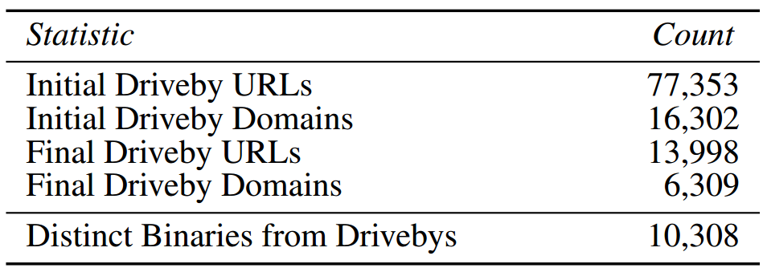
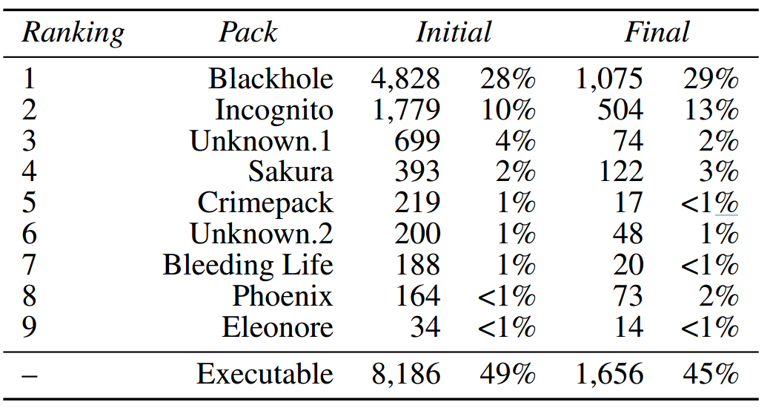
The Funnel

Slide 28
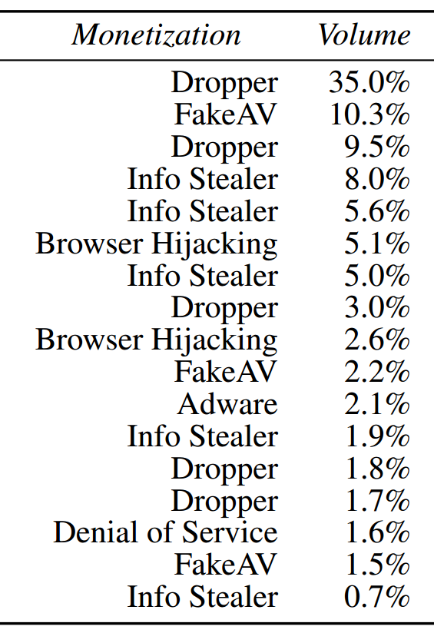
Malware and Monetization
Dropper: malware that is used to install other malware
Remember Zero Access, we’ll see it again shortly…
Volume of DNS requests linked to each malware family

Slide 29
Exploit-as-a-Service Wrapup
The market for compromised hosts is complex, highly specialized, and well-developed
Some actors specialize in writing exploits and packaging them into kits
Other actors specialize in hosting exploit kits on hacked or bulletproof infrastructure
Finally, some actors specialize in acquiring traffic
Exploit-as-a-service allows “customers” to choose their payloads
Diverse relationships between exploit kits and malware payloads
Customers exhibit a range of monetization strategies

Slide 30
Botnets
The backbone of the underground

Slide 31
From Malware to Botnets
Some malware monetizes through theft and extortion
Stealing personal information from users
Browser hijacking, a.k.a. man-in-the-browser attacks
Ransomware
Installation of adware or ransomware
However, infected machines have many other valuable resources
Unique IP addresses and bandwidth
Spare CPU cycles
Botnets allow criminals to aggregate and control infected machines
Command and Control (C&C) infrastructure for controlling bots
Swaths of bots are often rented out to other actors for various purposes

Slide 32
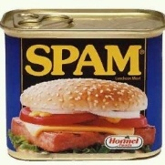
Old-School C&C: IRC Channels
snd spam: <subject> <msg>
Botmaster
snd spam: <subject> <msg>
snd spam: <subject> <msg>
IRC Servers
Problem: single point of failure
Easy to locate and take down

Slide 33
P2P Botnets
Insert commands into the DHT
Botmaster
Structured P2P DHT
Master Servers
Get commands from the DHT

Slide 34
Fast Flux DNS
Botmaster
HTTP Servers
But: ISPs can blacklist the rendezvous domain
12.34.56.78
6.4.2.0
31.64.7.22
245.9.1.43
98.102.8.1
www.my-botnet.com
Change DNS→IP mapping every 10 seconds

Slide 35
Random Domain Generation
…But the Botmaster only needs to register a few
Botmaster
HTTP Servers
www.sb39fwn.com
www.17-cjbq0n.com
www.xx8h4d9n.com
Bots generate many possible domains each day
Can be combined with fast flux

Slide 36
“Your Botnet is My Botnet”
Takeover of the Torpig botnet
Random domain generation + fast flux
Team reverse engineered domain generation algorithm
Registered 30 days of domains before the botmaster!
Full control of the botnet for 10 days
Goal of the botnet: theft and sending phishing emails
Steals credit card numbers, bank accounts, etc.
Researchers gathered all this data
Other novel point: accurate estimation of botnet size

Slide 37
Torpig Architecture
Researchers Infiltrated Here
Attacker places a redirect on the vulnerable server
Rootkit installation
Trojan installation
Collect stolen data
Capture banking passwords

Slide 38
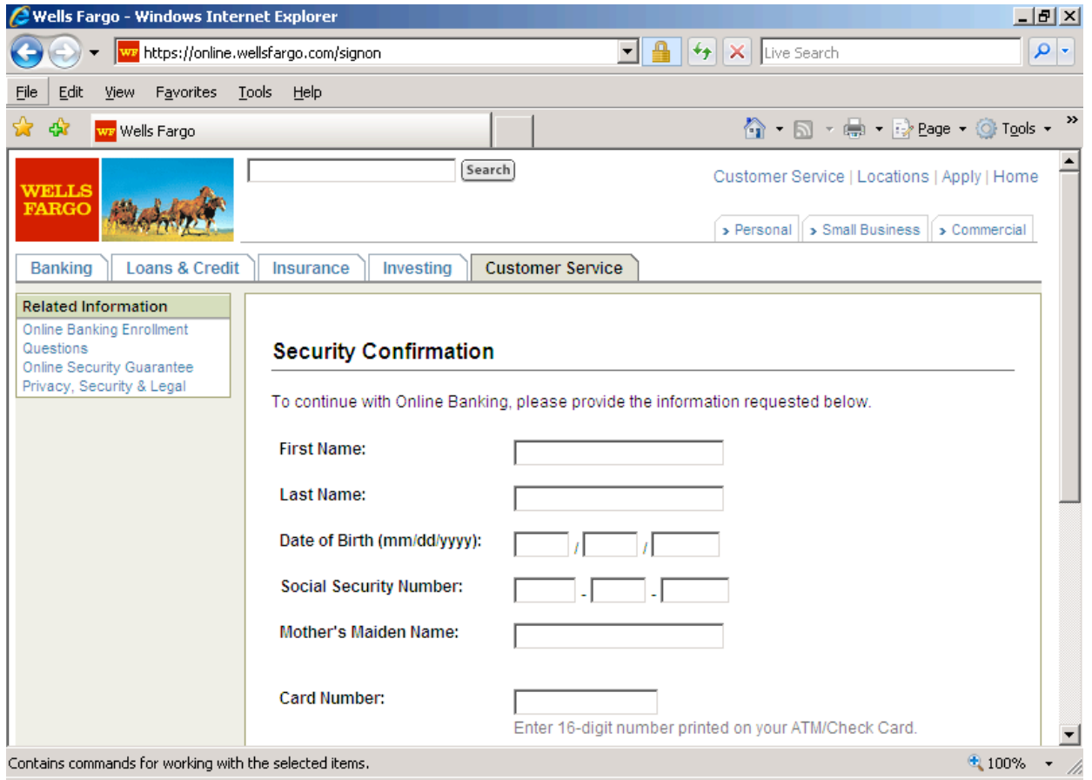
Man-in-the-Browser Attack
Injected DLL steals information entered into forms

Slide 39
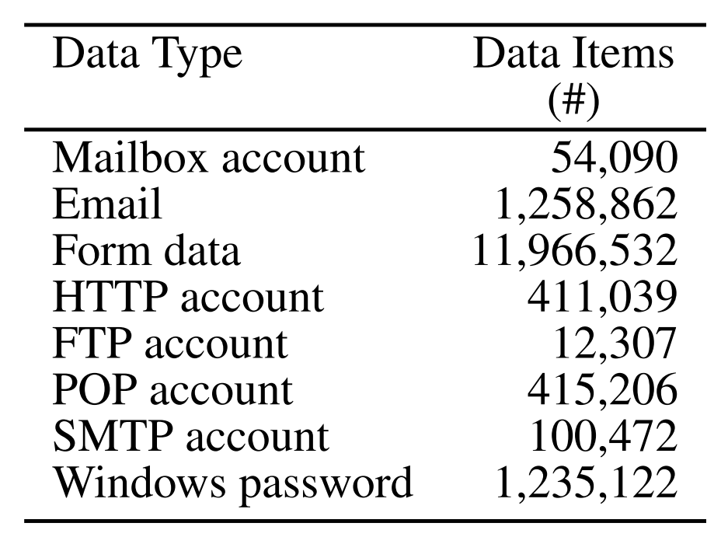
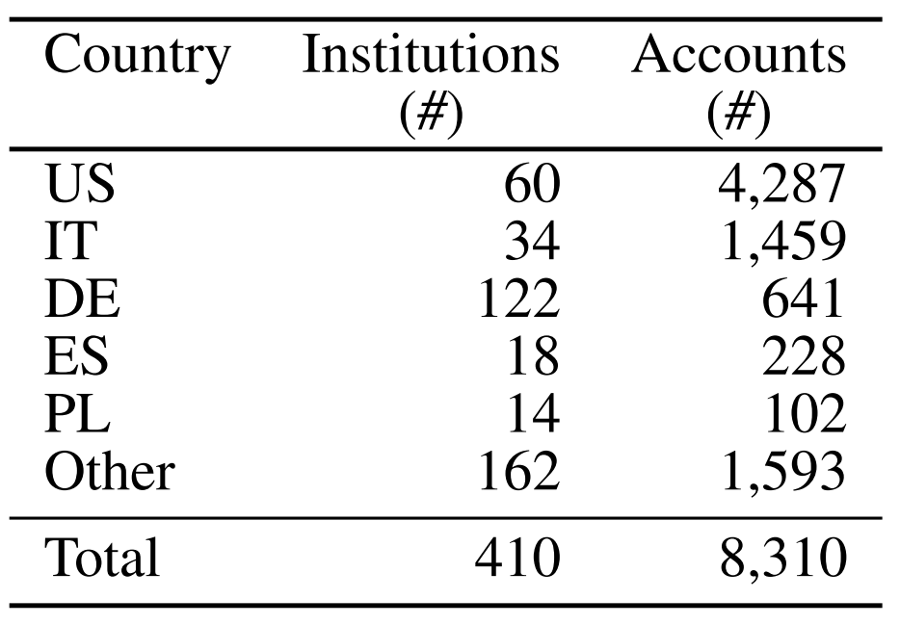
Stolen Information
Data gathered from Jan 25-Feb 4 2009
User Accounts
Bank Accounts
How much is this data worth?
Credit cards: $0.10-$25 each, banks accounts: $10-$1000 each
Estimated total: $83K-$8.3M

Slide 40
How to Estimate Botnet Size?
Passive data collection methodologies
Honeypots
Infect your own machines with Trojans
Observe network traffic
Look at DNS traffic
Domains linked to fast flux C&C
Networks flows
Analyze all packets from a large ISP and use heuristics to identify botnet traffic
None of these methods give a complete picture

Slide 41
Size of the Torpig Botnet
Why the disconnect between IPs and bots?
Dynamic IPs, short DHCP leases
Casts doubt on prior studies, enables more realistic estimates of botnet size

Slide 42
Uses for Botnets
Torpig was only used for two purposes
Theft of user accounts, credit cards, and bank accounts
Phishing
Many other ways to monetize botnets
Extortion
Demand payment from a victim, otherwise you DDoS them
Ransomware – encrypt the victim’s files and demand that they buy the key from you
Spam – use the bots as mail servers
Click fraud and ad-injection – steal money from advertisers
Bitcoin mining – use stolen CPU cycles to mint Bitcoins

Slide 43
Spam and “Affiliates”
Advertising by another name

Slide 44
On the Origins of Spam
It is estimated that >90% of all email sent each day is spam
Hundreds of billions of spam messages per day
Spammers are key players in the cybercrime underground
Build, curate, buy, and sell lists of email addresses
Send mail on behalf of other actors for a fee
Traffic-PPI services looking to acquire traffic and infections
Phishers looking to steal personal information
Spammers rent access to botnets to send bulk email
Need a large number of IP addresses to circumvent spam filters

Slide 45
Affiliate Marketing
Huge amounts of spam are related to affiliate marketing schemes
Scammers set up websites selling counterfeit goods
Pharma: Viagra, Cialis, Vicoden, etc.
Knockoffs: Rolex, Gucci, Louis Vuitton, Nike, Microsoft, Adobe, etc.
Fake Anti-Virus: “Warning, your computer is infected! Pay $49.99…”
Scammers are responsible for delivering products and collecting payments
As we will see, access to credit card processing infrastructure is crucial
Many scams have legitimate customer service departments!
Spammers sign-up as “affiliates” with scam campaigns
Spammers advertise the scams, and collect commission on successful sales
Commission is typically 30-50% of the final sale price

Slide 46
“Spamalytics: An Empirical Analysis of Spam Marketing Conversion”
Measurement of “conversion rate” of spam campaigns
Probability that an unsolicited email will elicit a “sale”
Methodology used infiltration of the Storm botnet
Analyze two spam campaigns
Trojan propagation via fake e-cards
Online pharmaceutical marketing
For more than 469M spam emails, authors identified
Number that pass thru anti-spam filters
Number that elicit visits to advertised sites (response rate)
Number of “sales” and “infections” produced (conversion rate)

Slide 47
Spam Conversion
Big question
Why do spammers continue to send spam?
Spam filters eliminate >99% of spam
More questions
How many messages get past spam filters?
How much money does each successful “txn” (transaction) make?
Measurement technique
Infiltrate the spam generation/monetizing process and find out answers

Slide 48
Storm Botnet
Disadvantage: not complete coverage
Structured P2P DHT
Botmaster
Advantage: easy to infiltrate
Master Servers
Get commands from the DHT
Researchers Infiltrated Here

Slide 49
Methodology
Infiltrate Storm at proxy level
Rewrite spam instructions to use URLs specified by the researchers
URLs point to websites controlled by researchers
Look like clones of the actual scam sites, but are “defanged”
Observe activity at each stage
Recording activity throughout the conversion funnel
How much spam is delivered? Look at SMTP delivery error rate
How much spam is filtered? Send spam to honeypots controlled by the researchers
What is the click-through rate? Observe visits to the URLs
How many people convert? Observe behavior on the clone sites
Modified ~470M emails generated by Storm over a period of a month

Slide 50
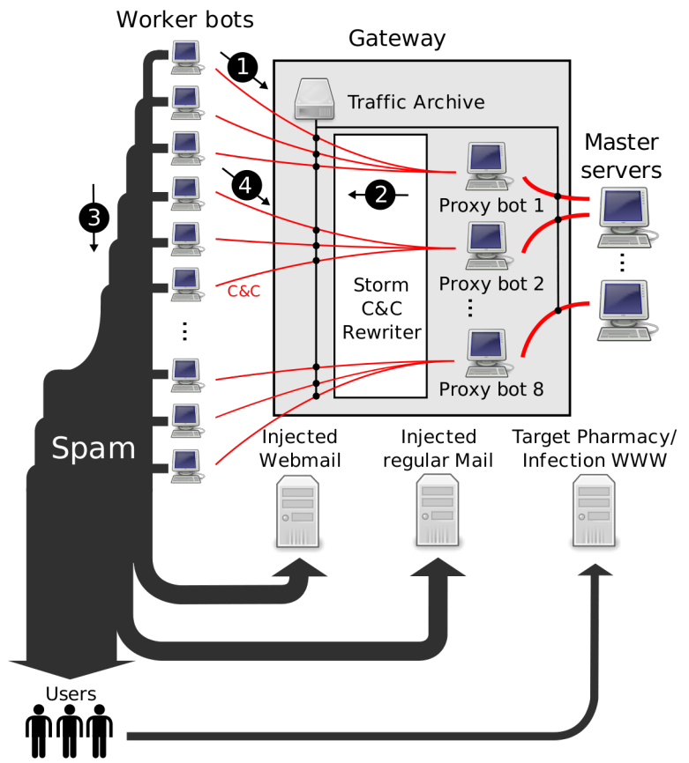
Researchers infiltrated here
Researchers injected additional target email addresses

Slide 51
Focus on Two Spam Campaigns
Pharmaceuticals and self-propagating malware
Ran fake, harmless websites that look like the real ones
Conversion signals
For pharma, a click on “purchase” button
For malware, download and execute a binary that phones home and exits

Slide 52
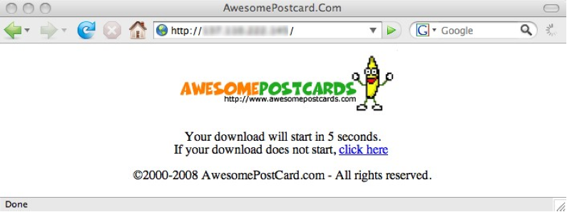

Slide 53
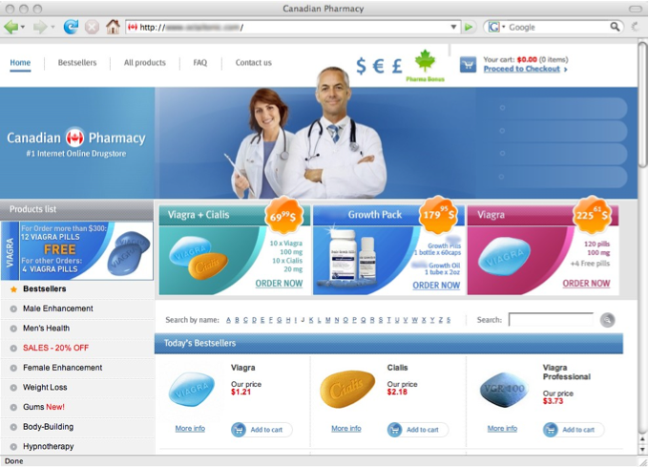

Slide 54
Results: Campaign Volumes

Slide 55
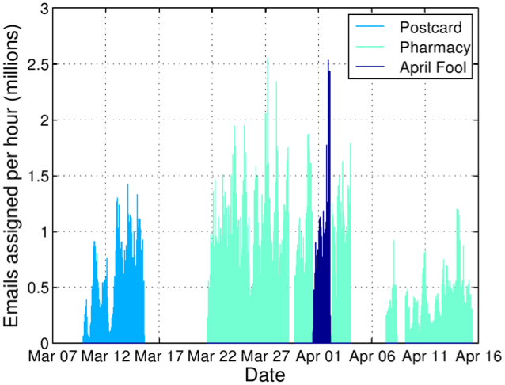
Rewritten Spam Emails per Hour

Slide 56
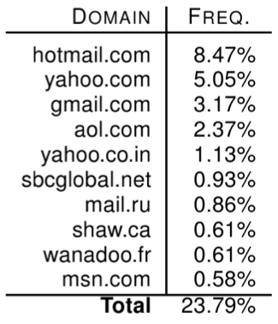
Spam Delivery: Top Domains

Slide 57
Spam Filter Effectiveness
What percentage of spam got through the filters?
Average: 0.014%
1 in 7,142 attempted spams got through

Slide 58
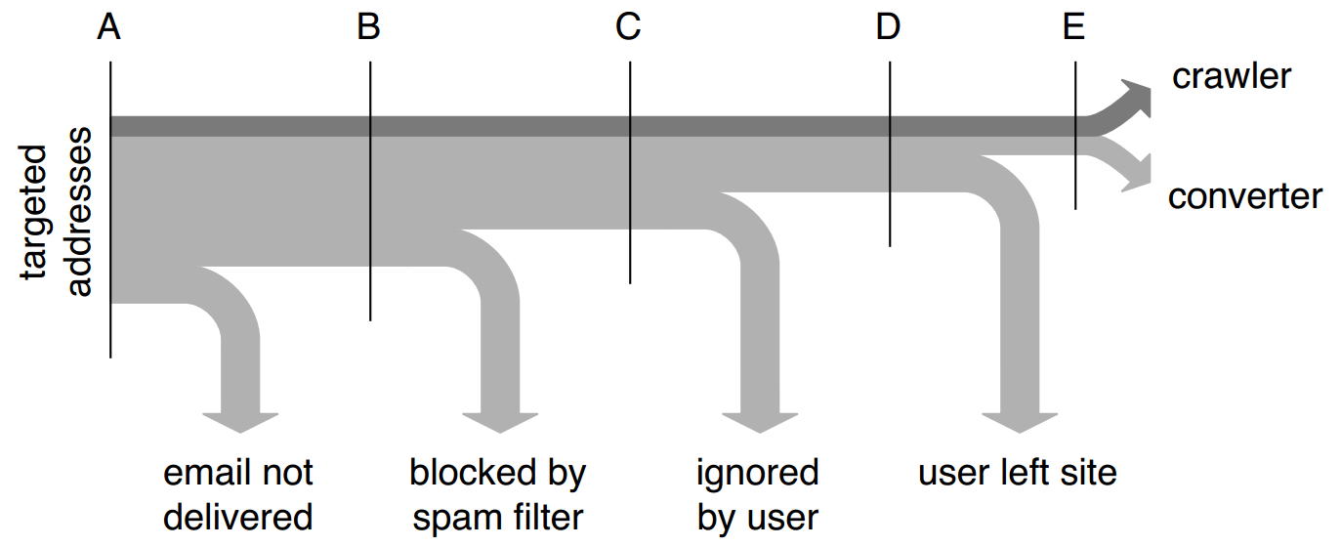
Conversion Tracking

Slide 59
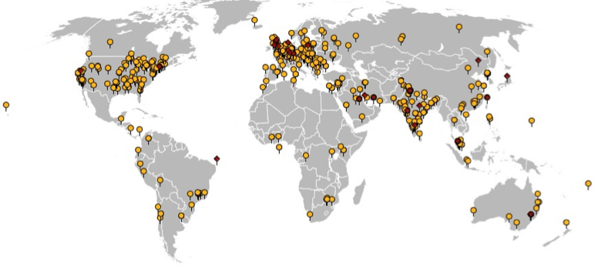
Geographic View of Conversions
541 binary executions, 28 purchases

Slide 60
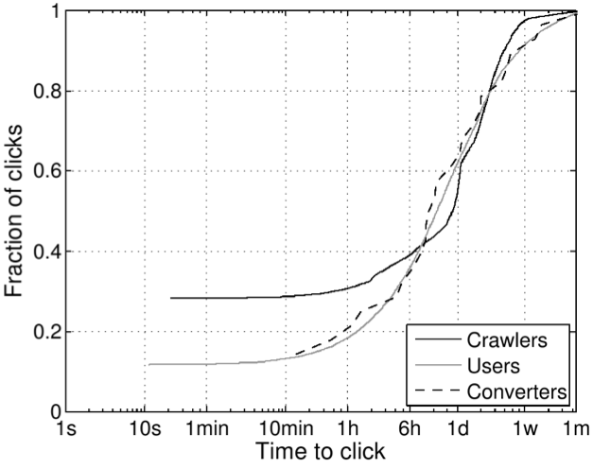
Time-to-click Distribution

Slide 61
Pharmaceutical Revenue
28 purchases in 26 days, average price ~$100
Total: $2,731.88, $140/day
But: only controlled ~1.5% of workers!
$9500/day (and 8500 new bot infections per day)
$3.5M/year
However, this is split with the affiliate program
40% cut for Storm operators via Glavmed → $1.7M/year
Storm: service provider or integrated operation?
Retail price of spam ~$80 per million; 350M emails → $25K
Suggests integrated operation to be profitable

Slide 62
“Spamcraft: An Inside Look At Spam Campaign Orchestration”
Paper takes a broader look at the activities of the Storm botnet

Slide 63
Duration and Size

Slide 64
Campaigns Over Time

Slide 65
Counterfeit Goods
Viagra, Cialis, Gucci, Rolex, and Anti-Virus?

Slide 66
Affiliate Scams, Revisited
Thus far, we have focused on botnets and spammers
This represents the advertising portion of affiliate schemes
What about the affiliate scammers themselves?
These schemes are complicated to host and maintain
Payment processing is crucial but also challenging
Order fulfillment and customer service

Slide 67
Scammers in the Spotlight
We’re going to look at data from four papers
Click Trajectories: End-to-End Analysis of the Spam Value Chain
PharmaLeaks: Understanding the Business of Online Pharmaceutical Affiliate Programs
The Underground Economy of Fake Antivirus Software
Priceless: The Role of Payments in Abuse-advertised Goods
These papers analyze the full breadth of the scamming ecosystem
Infrastructure and the key role of payment processors
Ground-truth data about large-scale pharmaceutical scams
Ground-truth data about large-scale fake anti-virus scams

Slide 68
Scammin’ Ain’t Easy
Suppose you want to setup www.canadianpharma.com
What sort of hosting infrastructure do you need?
Domain name(s)
Problem: legit registrars will take down your name if they receive complaints
Some registrars are known to ignore complaints, but they charge more ;)
DNS servers
Problem: DNS servers are an obvious choke-point for law enforcement
“Bulletproof” DNS is available on the market, but its expensive ;)
Web servers
“Bulletproof” servers are available, but they’re expensive
Some services offer resilient hosting with distributed web servers, domain randomization, and DNS fast-flux
But obviously, it’s expensive

Slide 69
Scammin’ Ain’t Easy, Continued
Okay, you’ve set up www.canadianpharma.com... Now what?
To sell products, you need to be able to accept payments (realization)
Merchant bank account to deposit your payments
Relationship with a payment processing service
Handles credit card payments
Withdraws money from the buyers account via a card association network (e.g. Visa)
Obviously, most banks and processors won’t do business with scammers
Fulfilment
Scam sites almost always ship products to customers
Why?
Customer service
If too many customers complain to their credit card company, your payment processor will shut you down, and your bank account may be seized
Human operators to handle complaints and returns

Slide 70
Example: Pharmacy Express

Slide 71
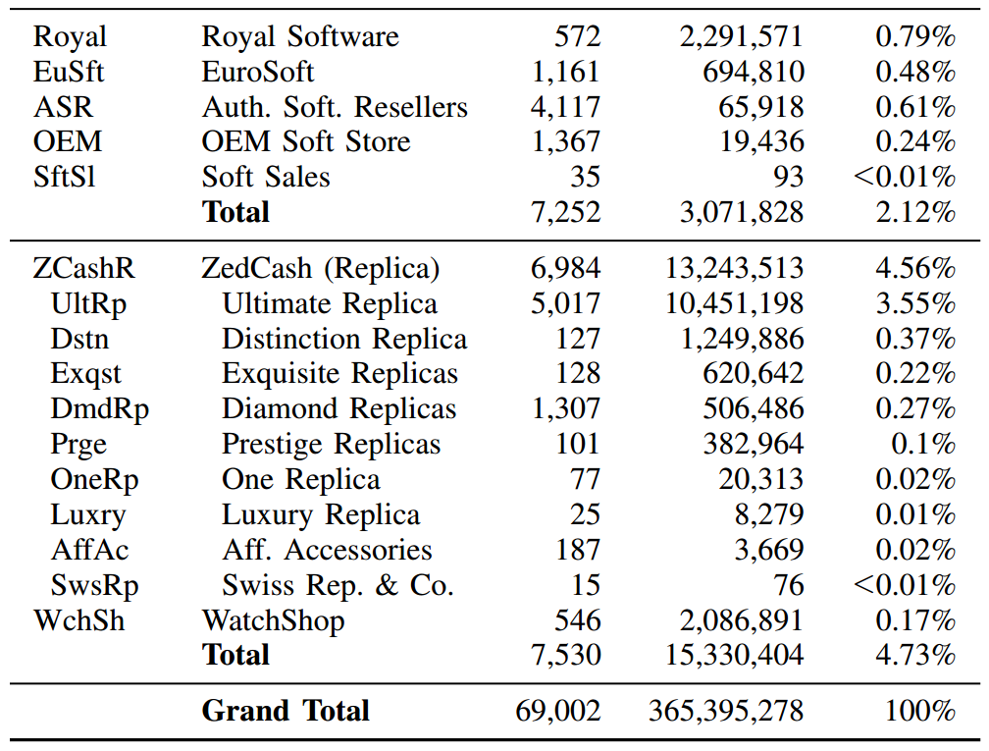
RX-Promotion and GlavMed account for around 35% of all affiliate scams
Remember them, we’ll see them again :)
Data collected from spam feeds, botnet infiltration, and various types of honeypots in Fall 2010

Slide 72
Merchant Banks
Researchers made 76 purchases from different affiliate programs to observe where payment was delivered
Only 13 banks, i.e. banking infrastructure is shared across affiliates

Slide 73
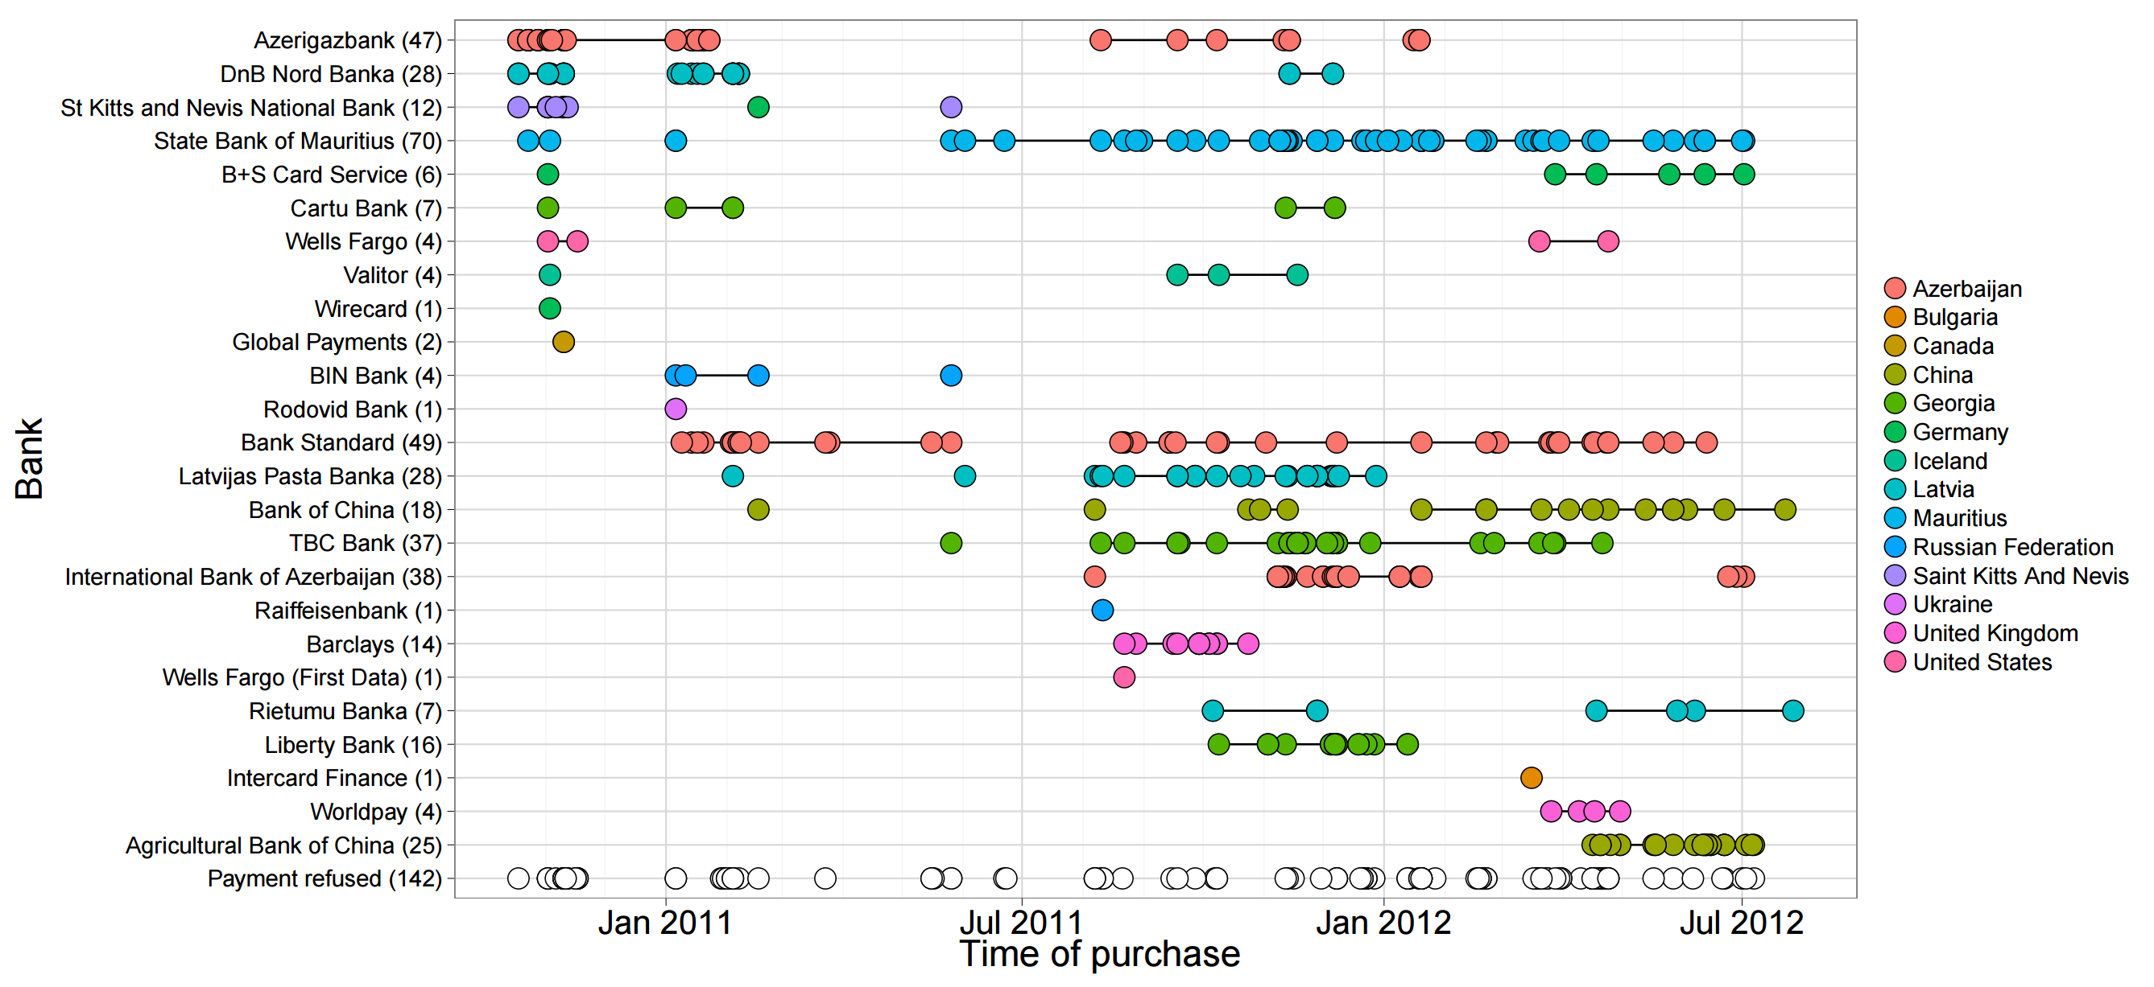

Slide 74
Suppliers
Goods were sourced from 13 different manufactures/suppliers

Slide 75
Pharmaleaks
In 2012, the databases for GlavMed, SpamIt, and RX-Promotion were breached, dumped, and publicly released
This is what happens when your competitors are criminals
Contain complete logs of sales, customers, and affiliate relationships
The Pharmaleaks paper analyzes this data to give us ground-truth understanding about this area of the underground economy

Slide 76
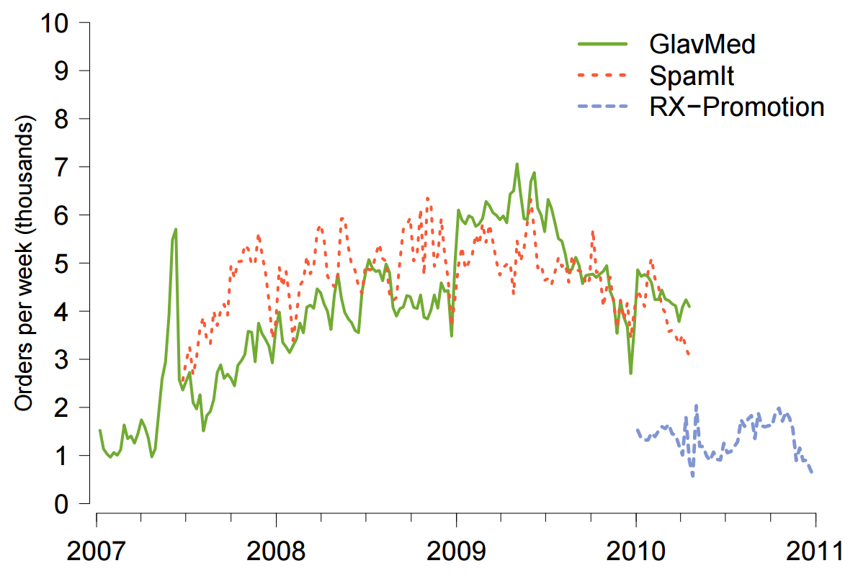
Transaction Volume

Slide 77
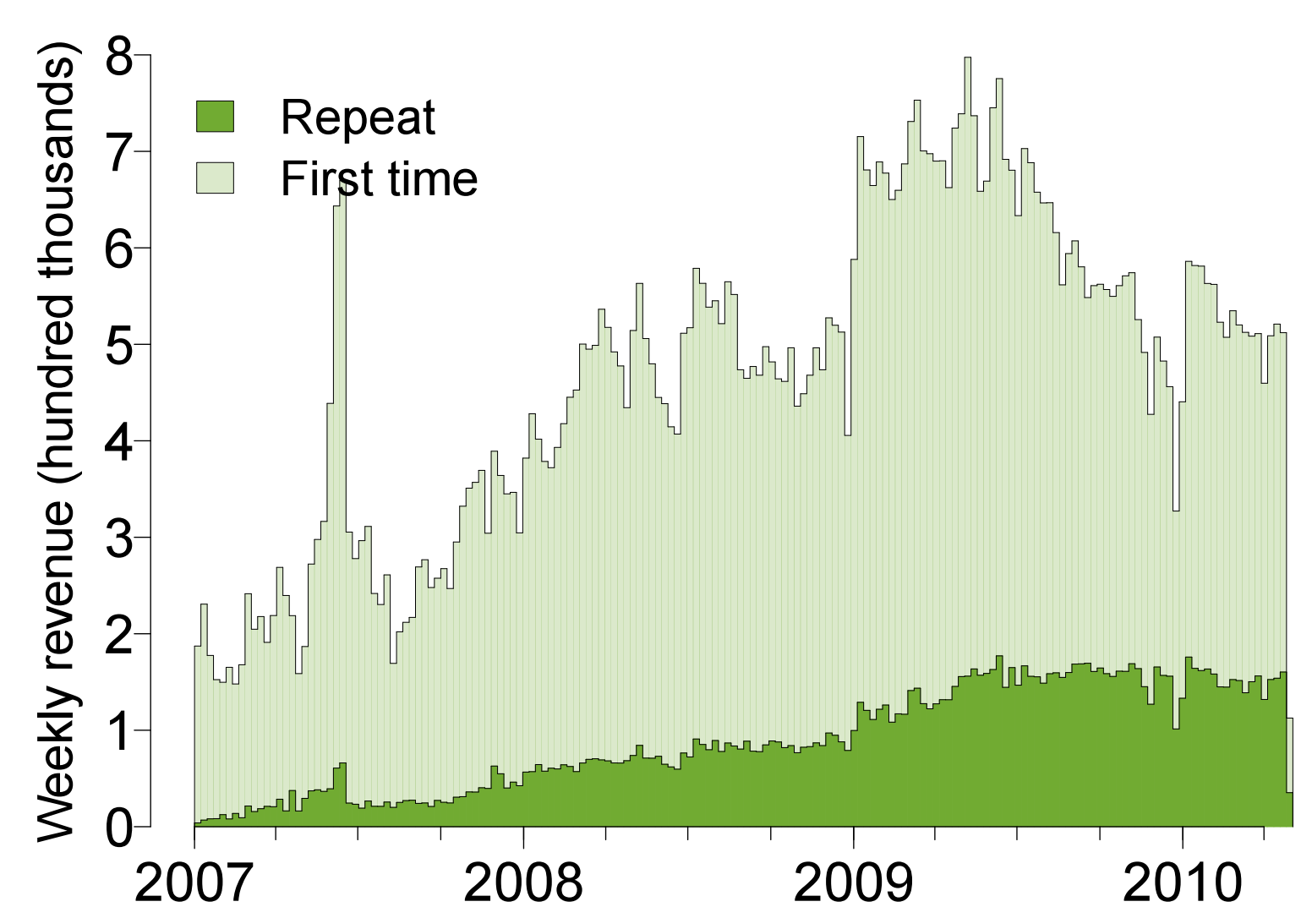
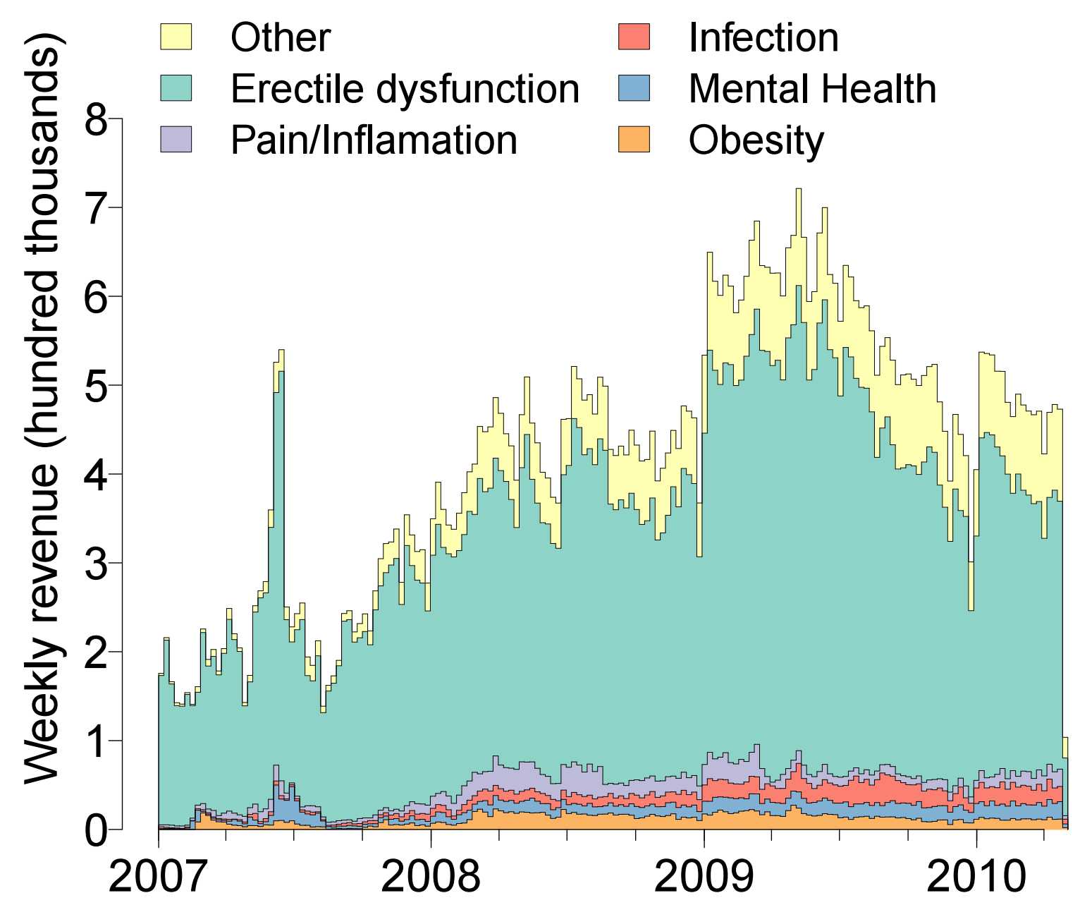
New vs. Repeat Customers
Types of Products

Slide 78
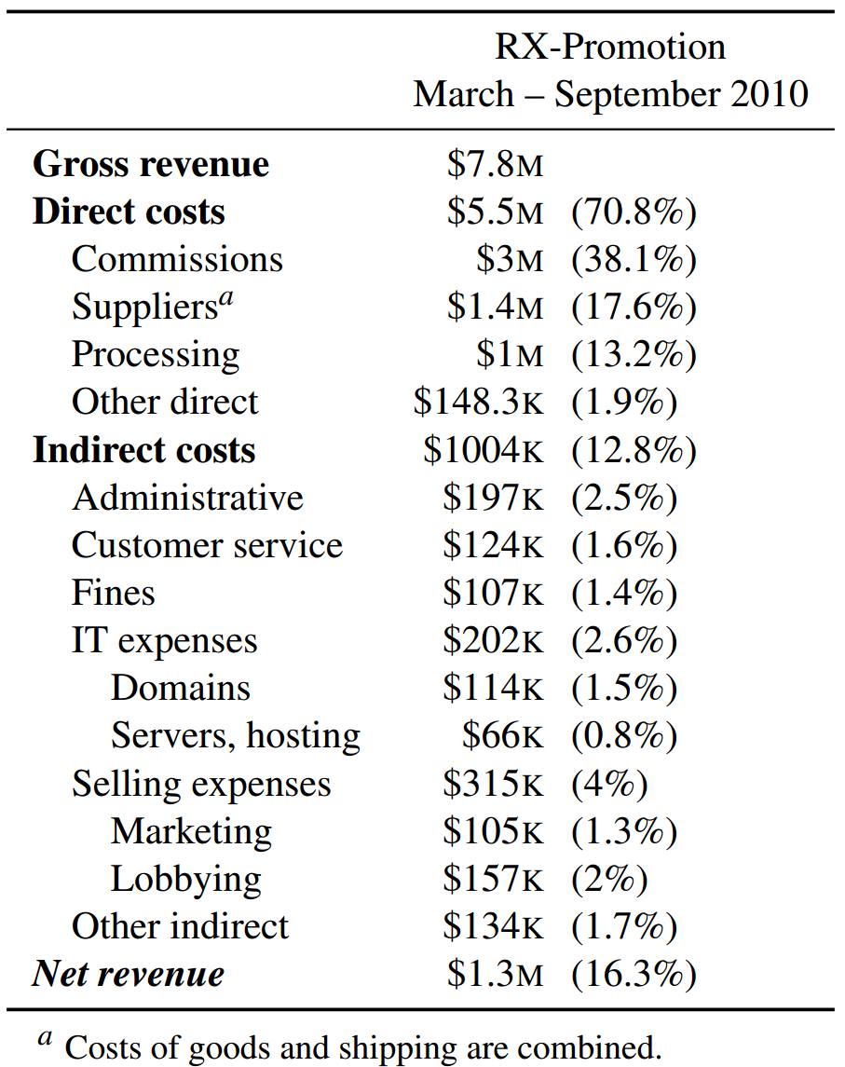
Profit
Payments to affiliates
Pharma scams bring in a lot of revenue
… but are they actually making a profit?
Bulletproof hosting
Spammers and botnet operators

Slide 79
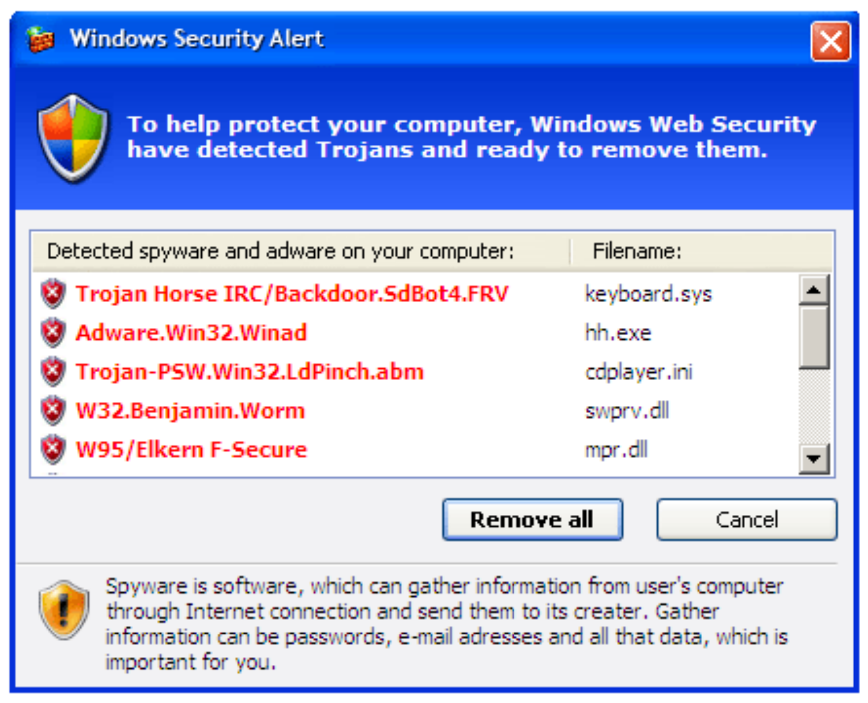
Fake Antivirus Software
Fake antivirus software is another common drop during drive-by attacks
Warning dialog looks legitimate at first glance…
OMG, look at all those nasty viruses!
Clicking here will prompt you to buy a subscription

Slide 80
Methodology
Researchers used dynamic analysis tools to identify URLs from fake AV software
Pointed to 21 unique servers hosting infrastructure for the scams
Researchers contacted the hosting providers and got them to take the servers down
Allowed researchers to image the hard drives :)
Data records purchases, returns, etc. for 3 fake AV campaigns
March 2008 – April 2010

Slide 81
Fake AV by the Numbers
Campaign | Subscriptions | Purchase Rate | Total Installs | Total Sales/ Conversion % | Revenue | Refunds/ Chargebacks | Net
AV1 (3 months) | 6 months - $49.95 | 34.8% | 8,403,008 | 189,342 (2.4%) | $11,303,494 | 5,669 1,544 | $10,862,492
 | 1 year – $59.95 | 32.9%
 | 2 year - $69.95 | 32.3%
AV2 (16 months) | 6 months - $49.95 | 61.9% | 6,624,508 | 137,209 (2.1%) | $5,046,508 | 11,681 3,024 | $4,103,735
 | 1 year - $69.95 | 13.5%
 | Lifetime - $89.95 | 24.6%
AV3 (30 months) | 1 year - $79.90 | 83.2% | 91,305,640 | 1,969,953 (2.2%) | $116,941,854 | 151,553 30,743 | $103,765,233
 | Lifetime - $99.90 | 16.8%
Each campaign paid out millions of dollars to affiliates (spammers) for acquiring traffic

Slide 82
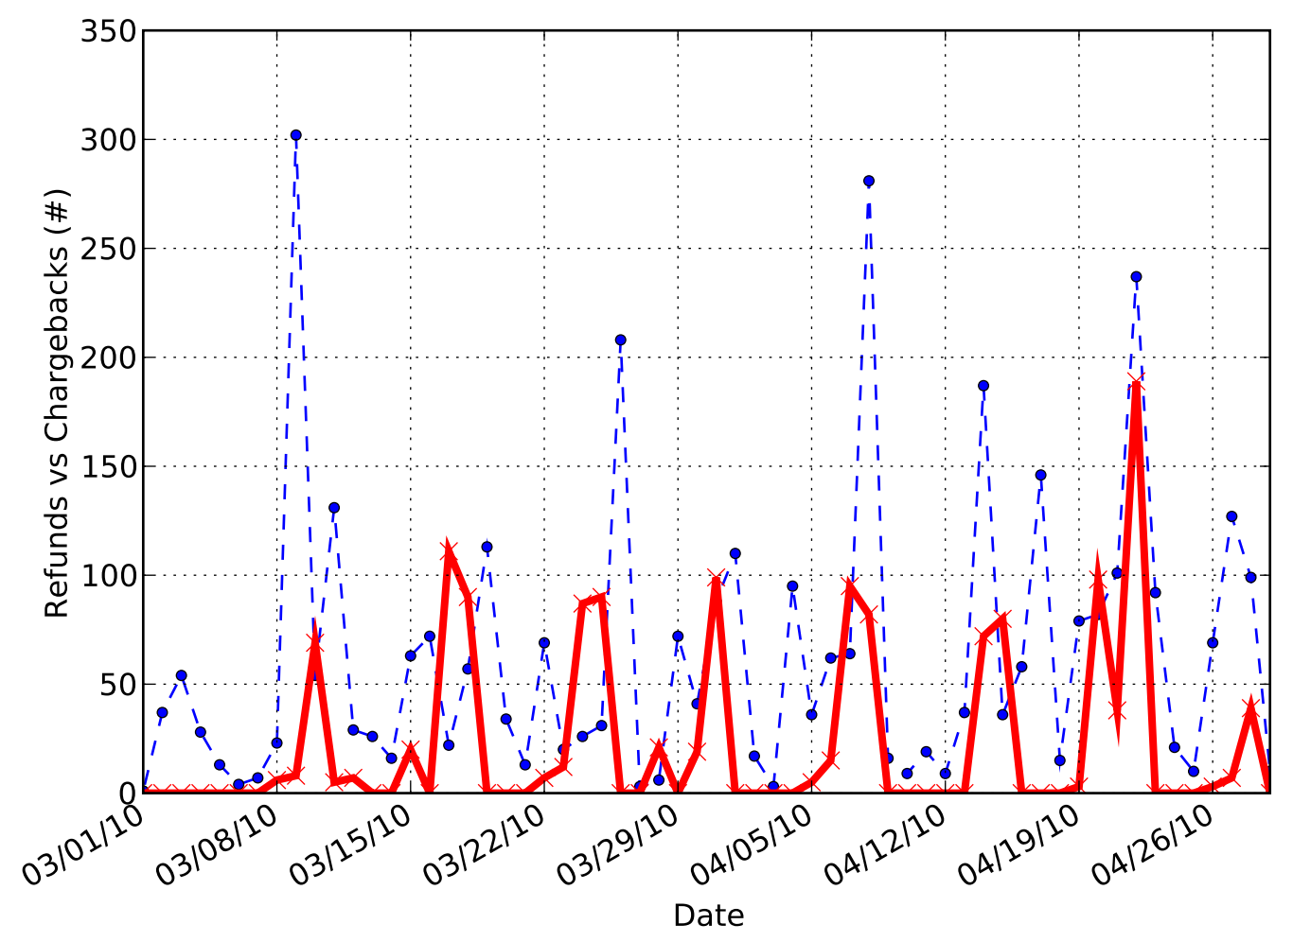
Refunds and Chargebacks
The peaks tend to alternate, meaning the scammer tries to prevent too many chargebacks while offering minimum refunds
A company with too many chargebacks will be suspended by their payment processor
Known as a “trigger-level”
Thus, the scammer must allow some refunds to prevent chargebacks
However, offering refunds reduces profits
Refunds
Chargebacks

Slide 83
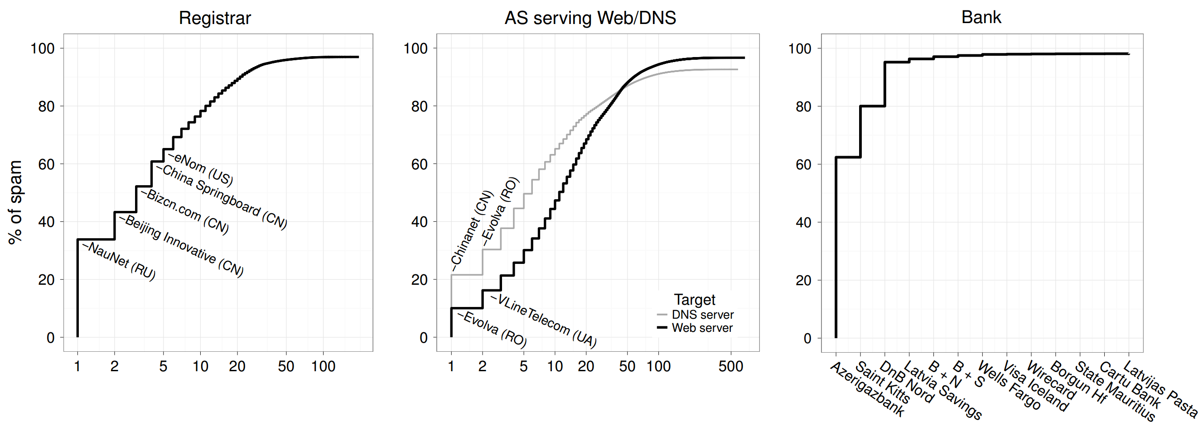
Intervention
What is the most effective infrastructure for law enforcement to go after in order to shut down affiliate scams?

Slide 84
Final Words

Slide 85
Scratching the Surface of the Underground
Zero-days
The competitive market for fresh exploits
Search Engine Optimization (SEO)
Attempt to push garbage results to the top of Google search
Click fraud and ad injection
Steal money from legitimate advertisers
Bitcoin mining (Botcoin)
Steal CPU cycles from infected hosts to mint currency
CATPCHA-solving services
Employ real people to solve CAPTCHAs for a small fee
Crowdturfing
Employ real people to create fake accounts (Sybils or sock puppets)
Perform phone and email verification so accounts look legitimate

Slide 86
Don’t Believe the Hype
Evidence shows that the cybercrime market is large and profitable
However, its not as bad as some breathless commentators claim
The cybercrime underground is not a billion dollar industry
Botnets don’t control tens of millions of hosts
Regardless of size, cybercrime is a huge problem due to asymmetry
Example: spam
Criminals may spend millions of dollars sending spam per year
Industry spends billions of dollars per year on spam defense mechanisms
An attacker can strike anywhere around the globe at any time
Barriers to entry are low, costs are easily offset by profits

Slide 87
Criminals vs. State-Sponsored Attackers
Our discussion today focused on the criminal underground
The goal of criminals is to make as much money as possible, as quickly and easily as possible
Thus, criminals tend to go after targets of opportunity
Poorly educated, gullible Internet users
Websites setup by novices
Small companies with limit IT resources
State-sponsored attacks are a completely different beast
Unlimited resources and time
Much higher level of technical skill
Patience to slowly and carefully penetrate hardened targets
Phishing → Spear phishing
Fake AV and Ransomware → Stealthy rootkits and BIOS-level attacks

Slide 88
Advanced Persistent Threat
Defending against APT is currently the forefront of security research
APT examples:
US and Isreali Stuxnet attack against Iranian nuclear centrifuges
Highly specialized malware that leveraged multiple zero-days, a stolen SSL cert, and could jump over air-gaps by infecting USB thumb drives
People’s Liberation Army Unit 61398
Allegedly the source of long running espionage campaigns against large companies (Google, NYT) and government agencies

Slide 89
Sources
An Inquiry into the Nature and Causes of the Wealth of Internet Miscreants - http://www.icir.org/vern/papers/miscreant-wealth.ccs07.pdf
Peek Inside A Professional Carding Shop, Brian Krebs - http://krebsonsecurity.com/2014/06/peek-inside-a-professional-carding-shop/
An Analysis of Underground Forums - http://cseweb.ucsd.edu/~voelker/pubs/forums-imc11.pdf
Manufacturing Compromise: The Emergence of Exploit-as-a-Service - http://cseweb.ucsd.edu/~savage/papers/CCS12Exploit.pdf
Your Botnet is My Botnet: Analysis of a Botnet Takeover - https://www.cs.ucsb.edu/~vigna/publications/2009_stone-gross_cova_cavallaro_gilbert_szydlowski_kemmerer_kruegel_vigna_Torpig.pdf
Analysis of a Botnet Takeover - https://www.cs.ucsb.edu/~vigna/publications/2011_stone_cova_gilbert_kemmerer_kruegel_vigna_torpig.pdf
Spamalytics: An Empirical Analysis of Spam Marketing Conversion - http://cseweb.ucsd.edu/~savage/papers/CCS08Conversion.pdf
Spamcraft: An Inside Look At Spam Campaign Orchestration - http://cseweb.ucsd.edu/~savage/papers/LEET09.pdf
Click Trajectories: End-to-End Analysis of the Spam Value Chain - http://cseweb.ucsd.edu/~savage/papers/Oakland11.pdf

Slide 90
More Sources
PharmaLeaks: Understanding the Business of Online Pharmaceutical Affiliate Programs - http://cseweb.ucsd.edu/~savage/papers/UsenixSec12.pdf
The Underground Economy of Fake Antivirus Software - https://www.cs.ucsb.edu/~vigna/publications/2011_stone_abman_kemmerer_kruegel_steigerwald_vigna_FakeAV.pdf
Priceless: The Role of Payments in Abuse-advertised Goods - http://cseweb.ucsd.edu/~savage/papers/CCS12Priceless.pdf
Characterizing Large-Scale Click Fraud in ZeroAccess - http://cseweb.ucsd.edu/~voelker/pubs/za-ccs14.pdf
Botcoin: Monetizing Stolen Cycles - http://cseweb.ucsd.edu/~snoeren/papers/botcoin-ndss14.pdf
Serf and Turf: Crowdturfing for Fun and Profit - http://www.ccs.neu.edu/home/cbw/pdf/crowdturfing-www12.pdf
Dirty Jobs: The Role of Freelance Labor in Web Service Abuse - http://cseweb.ucsd.edu/~savage/papers/UsenixSec11-DJ.pdf
Follow the Green: Growth and Dynamics in Twitter Follower Markets - http://www.cs.ucsb.edu/~gangw/twitter_imc13.pdf
Dialing Back Abuse on Phone Verified Accounts - http://www.inwyrd.com/blog/wp-content/uploads/2014/08/ccs2014dialing.pdf

