Slide 1
CS 4740/6740 Network Security
Lecture 6: Naming and Routing
(DNS→DNSSEC, BGP→RPKI)

Slide 2
Trust on the Internet
http://www.bofa.com
When you visit www.bofa.com you assume a few things
The name www.bofa.com will resolve to the correct IP of BofA’s server
Packets sent to BofA’s IP will be successfully delivered to the right machine
Technology underlies these assumptions
DNS binds names to IP addresses
BGP distributes the routes necessary to reach all IPs on the Internet
If these assumptions are violated, an attacker can wreak havoc

Slide 3
Today’s Topics
DNS
What is it, why do we need it, and why is it a security-critical service?
Three attacks: injection, spoofing, and Kaminsky
Securing DNS with DNSSEC
BGP
What is it, why do we need it, and why is it a security critical service?
BGP hijacking
S-BGP and why it failed
Securing BGP with RPKI

Slide 4
DNS
Authorities and Records
Cache Poisoning
DNSSEC

Slide 5
DNS at a High-Level
Domain Name System
Distributed database
No centralization
Simple client/server architecture
UDP port 53, some implementations also use TCP
Hierarchical namespace
As opposed to original, flat namespace
e.g. .com → google.com → mail.google.com

Slide 6
Naming Hierarchy
Root
net
edu
com
gov
mil
org
uk
fr
etc.
Top Level Domains (TLDs) are at the top
Each Domain Name is a subtree
.edu → neu.edu → ccs.neu.edu → www.ccs.neu.edu
Maximum tree depth: 128
Name collisions are avoided
neu.com vs. neu.edu
neu
mit
ccs
ece
husky
www
login
mail

Slide 7
Hierarchical Administration
Verisign
Root
ICANN
net
edu
com
gov
mil
org
uk
fr
etc.
Tree is divided into zones
Each zone has an administrator
Responsible for the part of the hierarchy
Example:
CCIS controls *.ccs.neu.edu
NEU controls *.neu.edu
neu
mit
ccs
www
login
mail

Slide 8
Server Hierarchy
Functions of each DNS server:
Authority over a portion of the hierarchy
No need to store all DNS names
Store all the records for hosts/domains in its zone
May be replicated for robustness
Know the addresses of the root servers
Resolve queries for unknown names
Root servers know about all TLDs
The buck stops at the root servers

Slide 9
Root Name Servers
Responsible for the Root Zone File
Lists the TLDs and who controls them
~272KB in size
com. 172800 IN NS a.gtld-servers.net.
com. 172800 IN NS b.gtld-servers.net.
com. 172800 IN NS c.gtld-servers.net.
Administered by ICANN
13 root servers, labeled A→M
6 are anycasted, i.e. they are globally replicated
Contacted when names cannot be resolved
In practice, most systems cache this information

Slide 10
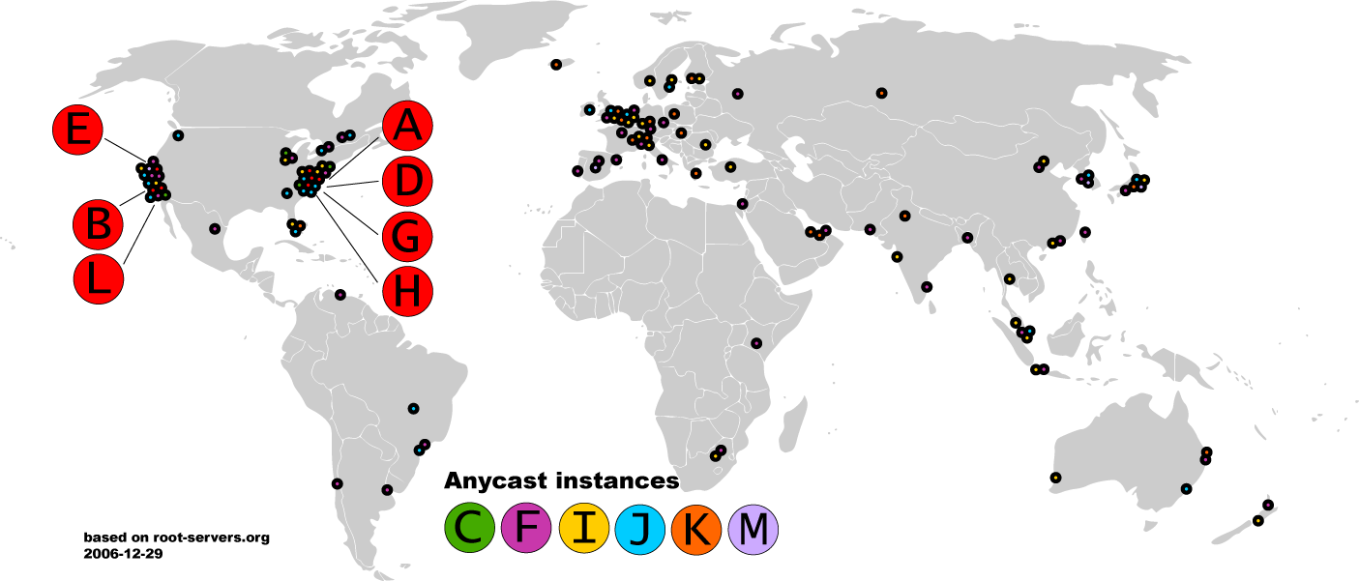
Map of the Roots

Slide 11
Local Nameserver and Authorities
www.google.com
Where is www.google.com?
Local nameserver
Authority for *google.com
Local nameserver handles queries on behalf of clients
Authoritative nameservers know the zone mappings for a subset of the heirarchy
asgard.ccs.neu.edu
ns1.google.com
Authority for *.com
com
Root nameserver
Root

Slide 12
Basic Domain Name Resolution
Every host knows and sends queries to a local nameserver
If the local nameserver can answer the query, then you’re done
Nameserver is also the authoritative server for that name
Nameserver has cached the record for that name
Otherwise, go down the hierarchy and search for the authoritative name server
Every local nameserver knows the root servers
Use cache to skip steps if possible
e.g. skip the root and go directly to .edu if the .edu zone file is cached

Slide 13
Iterated DNS query
www.google.com
Where is www.google.com?
Contact server replies with the name of the next authority in the hierarchy
“I don’t know this name, but this other server might”
asgard.ccs.neu.edu
ns1.google.com
com
Root

Slide 14
DNS Resource Records
DNS queries have two fields: name and type
Resource record is the response to a query
Four fields: (name, value, type, TTL)
There may be multiple records returned for one query
What are do the name and value mean?
Depends on the type of query and response

Slide 15
DNS Types
Type = A / AAAA
Name = domain name
Value = IP address
A is IPv4, AAAA is IPv6
Type = NS
Name = partial domain
Value = name of DNS server for this domain
“Go send your query to this other server”
Name: www.ccs.neu.edu
Type: A
Query
Name: www.ccs.neu.edu
Value: 129.10.116.81
Resp.
Name: ccs.neu.edu
Type: NS
Query
Name: ccs.neu.edu
Value: 129.10.116.51
Resp.

Slide 16
DNS Types, Continued
Type = CNAME
Name = hostname
Value = canonical hostname
Useful for aliasing
Type = MX
Name = domain in email address
Value = canonical name of mail server
Name: foo.mysite.com
Type: CNAME
Query
Name: foo.mysite.com
Value: bar.mysite.com
Resp.
Name: ccs.neu.edu
Type: MX
Query
Name: ccs.neu.edu
Value: amber.ccs.neu.edu
Resp.

Slide 17
DNS Packet Format
Query/response?
Authoritative/non-authoritative response?
Success/failure?
ID number used to match requests and responses
0
16
32
TxID | Flags
Question Count | Answer Count
Authority Count | Additional Record Count
Question and answer data (Resource Records, variable length)
How many records are there of each type in the response payload?
DNS is a UDP-based protocol on port 53
No TCP means no connections
TxIDs are needed to correlate requests and responses
Serves as authentication for responses

Slide 18
Glue Records
DNS responses may contain more than a single answer
Example: resolving cyclic dependency
TxID: 5678
Q: 1 | A: 0
Auth: 1 | Addl: 1
Q: Where is www.google.com?
Auth: NS a.gtld-server.com
Addl: A a.gtld-server.com 12.56.10.1
TxID: 5678
Q: 1 | A: 0
Auth: 0 | Addl: 0
Q: Where is www.google.com?
asgard.ccs.neu.edu
Root
Known as glue records
Additional responses can contain any type of record (i.e. A, NS, etc.)

Slide 19
DNS Query, Revisited
www.google.com
Where is www.google.com?
TxID: 12347
Q: 1 | A: 1
Auth: 0 | Addl: 0
Q: Where is www.google.com?
A www.google.com 182.0.7.34
TxID: 12346
Q: 1 | A: 0
Auth: 0 | Addl: 0
Q: Where is www.google.com?
TxID: 12345
Q: 1 | A: 0
Auth: 0 | Addl: 0
Q: Where is www.google.com?
TxID: 12347
Q: 1 | A: 0
Auth: 0 | Addl: 0
Q: Where is www.google.com?
asgard.ccs.neu.edu
ns1.google.com
TxID: 12345
Q: 1 | A: 0
Auth: 1 | Addl: 1
Q: Where is www.google.com?
Auth: NS a.gtld-server.com
Addl: A a.gtld-server.com 12.56.10.1
TxID: 12346
Q: 1 | A: 0
Auth: 1 | Addl: 1
Q: Where is www.google.com?
Auth: NS ns1.google.com
Addl: A ns1.google.com 8.8.0.1
a.gtld-server.com
Root

Slide 20
Attacking DNS
Three types of attacks
Old school attack: record injection
Somewhat old school attack: response spoofing
New, deadly attack: The Kaminsky Attack

Slide 21
Threat Model and Attacker Goals
Where is www.bofa.com?
Honest DNS Servers
Active attacker, may send DNS packets
Remote attacker, may not eavesdrop
Attacker may control their own domains and DNS servers
Local
Nameserver
I want to add a record to that DNS server that directs www.bofa.com → 6.6.6.6
102.32.0.1
6.6.6.6

Slide 22
Record Injection
Honest DNS Servers
Local
Nameserver
Where is www.bofa.com?
TxID: 12346
Q: 1 | A: 1
Auth: 0 | Addl: 1
Q: Where is www.attacker.net?
A www.attacker.net 128.1.2.0
Addl: A www.bofa.com 6.6.6.6
Where is www.attacker.net?
102.32.0.1
6.6.6.6
ns.attacker.net

Slide 23
Bailiwick Checking
Record injection attacks no longer work in practice
All modern DNS servers implement bailiwick checking
Only records related to the requested domain are accepted in responses
In other words, DNS servers are less trusting of additional information

Slide 24
Response Spoofing
Honest DNS Servers
Local
Nameserver
Where is www.bofa.com?
TxID: 12347
Q: 1 | A: 0
Auth: 0 | Addl: 0
Q: Where is www.bofa.com?
TxID: ????
Q: 1 | A: 1
Auth: 0 | Addl: 1
Q: Where is www.bofa.com
A www.bofa.com 6.6.6.6
102.32.0.1
6.6.6.6

Slide 25
Implementing Response Spoofing
What info does the attacker need to spoof a DNS response?
IP address of the target nameserver and true authoritative nameserver
Easy, both pieces of info are readily available
Source port used by the authoritative nameserver
Easy, it must be 53
The question in the query
Easy, the attacker can choose the targeted domain name
Response port used by the target when they made the request
TxID in the query
Old DNS servers used one port for all queries and incremented TxID monotonically
Attacker can query the target DNS server for a domain they control and observe the query at their own DNS server
The query reveals the port used by the target, as well as the approximate TxID

Slide 26
Inspecting the Target
Honest DNS Servers
Local
Nameserver
TxID: 12347
Q: 1 | A: 0
Auth: 0 | Addl: 0
Q: Where is www.bofa.com?
Where is www.attacker.net?
102.32.0.1
6.6.6.6
ns.attacker.net

Slide 27
Challenges of Response Spoofing
Attacker must infer the response port of the target nameserver and TxID
Attacker’s response must outrace the legitimate response
The attack must be executed after the target nameserver is queried for a domain that is not in the cache
If the target domain name is already cached, no queries will be sent
The attacker can send the initial query to the nameserver, but if the attack fails the legitimate response will be cached until the TTL expires
If the attack is successful, the record for a single domain is poisoned

Slide 28
Kaminsky Attack
Variation of the response spoofing attack that is much more powerful
Discovered by notable security researcher Dan Kaminsky in 2008
Poisons glue records rather than A records
Attacker repeatedly makes queries for non-existent subdomains of the target domain
Since these subdomains do not exist, they are guaranteed to not be in the target nameservers cache
Attacker then attempts to spoof a response with a poison glue record
The attacker can attempt the attack an infinite number of times until success
On success, entire zone is poisoned, rather than a single domain name

Slide 29
Kaminsky Attack
Honest DNS Servers
Local
Nameserver
Where is www.bofa.com?
Where is aaaa.bofa.com?
Where is aaab.bofa.com?
TxID: ????
Q: 1 | A: 1
Auth: 1 | Addl: 1
Q: Where is aaaa.bofa.com
A: aaaa.bofa.com = 127.0.0.1
Auth: NS = ns1.bofa.com
Addl: ns1.bofa.com = 6.6.6.8
TxID: ????
Q: 1 | A: 1
Auth: 1 | Addl: 1
Q: Where is aaab.bofa.com
A aaab.bofa.com 127.0.0.1
Auth: NS ns1.bofa.com
Addl: A ns1.bofa.com 6.6.6.8
ns.attacker.net
6.6.6.8
102.32.0.1
6.6.6.6

Slide 30
Mitigating the Kaminsky Attack
The Kaminsky attack relies on fundamental properties of the DNS protocols
Specifically, the ability to repond with NS records and glue to any query
The functionality is essential for DNS, it cannot be disabled
How do you mitigate the Kaminsky attack?
Make it harder to spoof DNS responses
All modern DNS servers randomize the TxID and query port for every request
2¹⁶ TxIDs * 2³² query ports = 2⁴⁸ messages needed to spoof successfully
Despite this mitigation, almost all existing DNS servers are still fundamentally vulnerable to spoofing attacks

Slide 31
Additional DNS Hijacks
Infect the target user’s OS or browser with a virus/trojan
e.g. Many trojans change entries in /etc/hosts
*.bankofamerica.com → evilbank.com
Man-in-the-middle
DNS is not encrypted or strongly authenticated

Slide 32
Authentication for DNS
Domain Name System Security Extensions (DNSSEC)
Integrates a public key infrastructure (PKI) into DNS
Provides end-to-end authentication and integrity, but not confidentiality
Prevents DNS hijacking!
But, complex to deploy, some performance overhead, much power given to DNS root
Deployment
On the roots since July 2010
Verisign enabled it on .com and .net in January 2011
Comcast is the first major ISP to support it (January 2012)

Slide 33
DNSSEC Details
Cryptographically sign critical resource records
Resolver can verify the cryptographic signature
Four new resource types
DNSKEY
Public key for a zone
Signed by the private key of the parent zone
Signatures from the root servers are trusted by default
DS
Delegated signer
RRSIG
Digital signature of a specific resource record
Signed by the private key of the zone
NSEC*
Signed denial of record existence
Creates a hierarchy of trust within each zone
Prevents hijacking and spoofing

Slide 34
DNSSEC Example
www.google.com
Where is www.google.com?
A www.google.com 128.1.0.4
DNSKEY P_{Google}
RRSIG {H(A Record)}_{SGoogle}
Q: Where is www.google.com?
asgard.ccs.neu.edu
ns1.google.com
NS a.gtld-server.com
A a.gtld-server.com 143.7.0.1
DS com
DNSKEY P_{Root}
NS ns1.google.com
A ns1.google.com 8.8.0.2
DS google.com
DNSKEY P_{com}
a.gtld-server.com
Root

Slide 35
BGP
ASs and Announcement
BGP Hijacking
S-BGP and RPKI

Slide 36
Network Layer, Control Plane
Function:
Set up routes between networks
Key challenges:
Implementing provider policies
Creating stable paths
Data Plane
Application
Presentation
Session
Transport
Network
RIP
OSPF
BGP
Control Plane
Data Link
Physical

Slide 37
BGP
Border Gateway Protocol
De facto inter-domain protocol of the Internet
Policy based routing protocol
Uses a Bellman-Ford path vector protocol
Relatively simple protocol, but…
Complex, manual configuration
Policies driven by economics
How much $$$ does it cost to route along a given path?
Not by performance (e.g. shortest paths)
Entire world sees advertisements
Errors can screw up traffic globally
No authentication of announcements :(

Slide 38
Path Vector Protocol
AS-path: sequence of ASs a route traverses
Like distance vector, plus additional information
Used for loop detection and to apply policy
Default choice: route with fewest # of ASs
AS 4
120.10.0.0/16
AS 3
130.10.0.0/16
AS 5
AS 2
110.10.0.0/16
120.10.0.0/16: AS 2 → AS 3 → AS 4
130.10.0.0/16: AS 2 → AS 3
110.10.0.0/16: AS 2 → AS 5
AS 1

Slide 39
BGP Operations (Simplified)
Establish session on TCP port 179
AS-1
Exchange active routes
BGP Session
AS-2
Exchange incremental updates

Slide 40
Four Types of BGP Messages
Open: Establish a peering session.
Keep Alive: Handshake at regular intervals.
Notification: Shuts down a peering session.
Update: Announce new routes or withdraw previously announced routes.
announcement = IP prefix + attributes values

Slide 41
BGP Attributes
Attributes used to select “best” path
LocalPREF
Local preference policy to choose most preferred route
Overrides default fewest AS behavior
Multi-exit Discriminator (MED)
Specifies path for external traffic destined for an internal network
Chooses peering point for your network
Import Rules
What route advertisements do I accept?
Export Rules
Which routes do I forward to whom?

Slide 42
Route Selection Summary
Highest Local Preference
Enforce relationships
Shortest AS Path
Lowest MED
Traffic engineering
Lowest IGP Cost to BGP Egress
When all else fails,
break ties
Lowest Router ID

Slide 43
Shortest AS Path != Shortest Path
9 hops
2 ASs
4 hops
4 ASs
Source
?
?
Destination

Slide 44
Hot Potato Routing
5 hops total, 2 hops cost
Source
3 hops total,
3 hops cost
?
?
Destination

Slide 45
Importing Routes
From Provider
ISP Routes
From Peer
From Peer
From Customer

Slide 46
Exporting Routes
$$$ generating routes
Customer and ISP routes only
To Provider
To Peer
To Peer
To Customer
Customers get all routes

Slide 47
Other BGP Attributes
AS_SET
Instead of a single AS appearing at a slot, it’s a set of Ases
Why?
Communities
Arbitrary number that is used by neighbors for routing decisions
Export this route only in Europe
Do not export to your peers
Usually stripped after first interdomain hop
Why?
Prepending
Lengthening the route by adding multiple instances of ASN
Why?

Slide 48
BGP Authentication
How are BGP sessions authenticated?
Shared secrets
BGP relies on transitive trust
You trust your neighbor’s routers…
Your neighbor trusts some other routers…
Etc.
Are there any guarantees that:
An advertised route is "real"?
Advertised routes aren't tampered with when forwarded?
No.
Manually configured shared secrets between routers
AS-1
BGP Session
AS-2

Slide 49
AS 7007 Incident
Famous incident in 1997 where AS 7007 announced its internal routing table to the world
Very specific (/24) routes caused many ASes to route traffic through AS 7007, creating routing black holes
Notes:
Famous incident in 1997 where AS 7007 announced its internal routing table to the world
Very specific (/24) routes that caused many ASes to route traffic through AS 7007, creating routing black hole

Slide 50
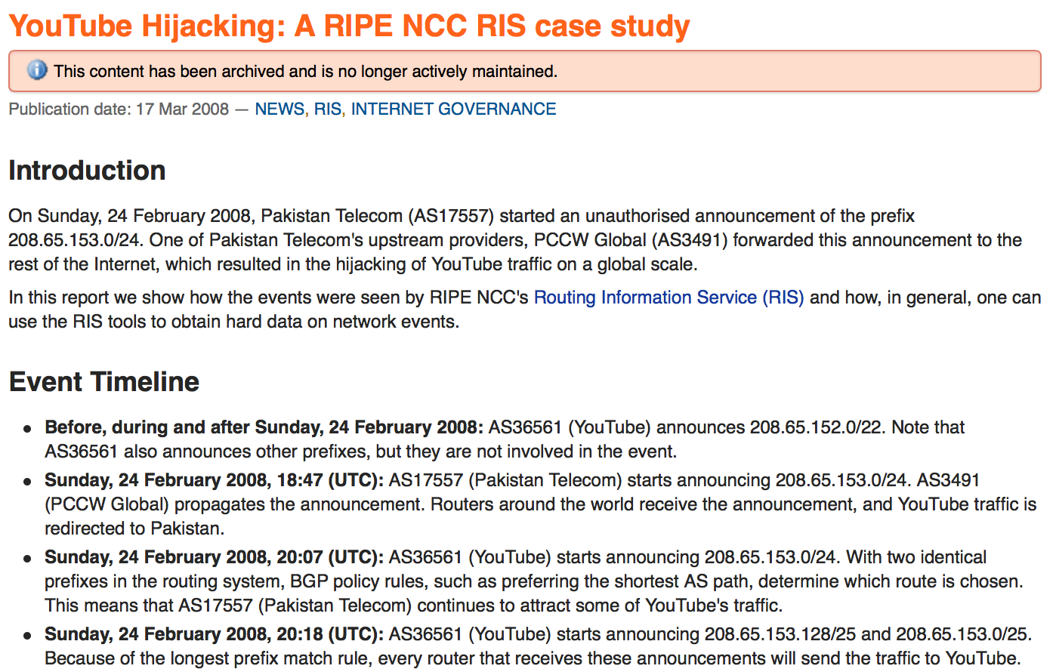
Notes:
In 2008, Pakistan Telecom announced a specific prefix for YouTube, taking YouTube off of the Internet

Slide 51
Why Hijack?
Hijacks happen all the time, but why?
Human or software errors
Routers leak internal routes to the world
People fat finger routing entries
Censorship
Many ASs are obliged block access to specific IP ranges (e.g. Facebook, YouTube)
Sometimes these black hole routes leak to world
Spying
Easy to monitor or MiTM traffic once it’s routed through your network :)
Cybercrime
Recent incident where a prefix hijack was used to steal Bitcoins from a large mining operation

Slide 52
Hijacking Techniques
Prefix hijack
Most basic attack
Announce a prefix that the attacker doesn’t actually own
Neighbors may route traffic for the prefix to the attacker, depending on preferences and AS topology
Subprefix hijack
Most devastating type of hijack
Announce a very specific prefix (e.g. a /24)
Routing is based on longest prefix matching, so the attackers route is likely to be selected by all ASes globally
Path shortening
Announce a bogus update with very few ASes on the path
Neighbors are likely to select the bogus path because it has a short AS path

Slide 53
Prefix Hijack Example
Prefix hijacking is successful at drawing in some, but not all, of the victim’s traffic
B chooses the new, short route
A→B:
A
8.0.0.0/22
AS B
AS D
AS A
AS C
AS E
8.0.0.0/22
C continues to use the old route, since D is a customer
8.0.0.0/22
A→C:
A
8.0.0.0/22

Slide 54
Short Path Hijack
As we’ll see later, this attack is particularly useful in certain situations
B chooses the new, short route
A→B:
E, A
8.0.0.0/22
AS B
AS D
AS A
AS C
AS E
8.0.0.0/22
A→C:
E, A
8.0.0.0/22

Slide 55
Subprefix Hijack Example
Announcement for a novel subprefix is likely to propagate
/24 is more specific than /22, successfully hijacks all traffic destined for the subprefix
A→B:
A
8.0.0.0/24
AS B
AS D
AS A
AS C
AS E
8.0.0.0/24
8.0.0.0/22
A→C:
A
8.0.0.0/24
C→D:
A, C
8.0.0.0/24
D→E:
A, C, D
8.0.0.0/24

Slide 56
Mechanisms to Secure BGP
Many mechanisms have been proposed over the years
We’ll discuss three
Secure BGP (S-BGP)
RPKI and ROAs
Anomaly Detection

Slide 57
Secure BGP
Use PKI to authenticate BGP
Dual hierarchies of certificates bind prefix ownership to ASes and routers to ASes
Certificate hierarchy distributed and validated out-of-band
Routers only accept updates that are covered by valid certificates
Route attestations using “onion” signatures
Each BGP update is signed by the announcer
These signatures accumulate as the update propagates
Any AS receiving the announcement can verify the signature added by each AS back to the source

Slide 58
S-BGP vs. Subprefix Hijack Example
E → 8.0.0.0/22
PKI Server
A→B:
A
8.0.0.0/24
AS A does not own
8.0.0.0/24
AS B
AS D
AS A
AS C
AS E
8.0.0.0/24
8.0.0.0/22
A→C:
A
8.0.0.0/24
In practice, ASes download, validate, and cache the certs in the PKI ahead of time

Slide 59
S-BGP vs. Short Path Hijack
A→B:
E, A
8.0.0.0/22
{H(E’s update)}_{SEvil}
E → 8.0.0.0/22
PKI Server
AS B
AS E does own
8.0.0.0/24
AS D
AS A
AS C
AS E
8.0.0.0/22
A→B:
E, A
8.0.0.0/22
{H(E’s update)}_{SEvil}
Route attestations are forged!

Slide 60
(The Lack of) S-BGP Deployment
S-BGP was proposed at least a decade ago, and implementations were available soon afterwards
But, it was never deployed. Why?
Trust rooted in ICANN, a US organization
Other countries are wary of centralizing power in the US
Verification of signed attestations is costly in terms of CPU
Routers are expensive and resource constrained
Entire chain of attestations must be cryptographically validated for each received update
In contrast, PKI validation can be done out of band and applied using simple filters

Slide 61
Resource PKI
Resource Public Key Infrastructure (RPKI) achieves some of what S-BGP does – i.e., origin validation
RPKI prevents prefix and subprefix hijacking
But, security is optional and can be incrementally deployed
Regional Internet Registries (RIRs) publish signed attestations of prefix ownership and how those prefixes can be announced
Five RIRs: ARIN (North America), LACNIC (Latin America), APNIC (Asia and Australia), RIPE (Europe, Russia, Middle East), AfriNIC (Africa)
Attestations called Route Origin Authorizations (ROAs)
By default, RPKI does not include path attestations
Thus, RPKI is vulnerable to short path hijacks
BGPSEC is an RPKI extension that adds cryptographic path attestation back in

Slide 62
Route Origin Attestations
Route origin authorizations (ROA) bind ownership of network prefixes to ASes
ROAs also define the minimum specificity of a route announcement
e.g., 192.168.0.0/16 (min=22) → AS 7007
AS 7007 "owns" 192.168.0.0/16
Route announcements within this prefix cannot be more specific than /22

Slide 63
RPKI Hierarchy Example
ARIN
American Registry of Internet Numbers
Verizon Wireless
66.174.0.0/16
ROAs
AS 3356
8.0.0.0/9
Level 3
8.0.0.0/8
AS 6167
66.174.0.0/16
AS 22394
66.174.0.0/24
AS 15169
8.8.8.8/24
Google
8.8.8.8/24
ROAs

Slide 64
RPKI Deployment
As of January 13, 2014, 20K prefix-to-origin pairs were RPKI secured
Out of 488K prefixes that were announced that day
Roughly 4% of routes
After years of efforts we are still a long way away from cryptographically secured BGP

Slide 65
Routing Anomalies
Cryptographic attestation and verification is one approach to securing BGP (i.e. S-BGP and RPKI)
Out-of-band monitoring is another – e.g., detection of routing anomalies
Route announcements collected at many different Internet vantage points
Use heuristics to filter updates that seem suspicious
Do route announcements make sense with respect to...
Geography?
Internet topology?
AS classifications?

Slide 66
Anomalous Features
Geography
Routes should not advertise paths that "jump" across large geographical distances
e.g., a route from CA to NY that transits Russia
Topology / AS classifications
Routes should not enter and exit the Internet core (i.e., transit ASes) multiple times
Origin authenticity
Multiple ASes should not announce ownership of the same prefix

Slide 67
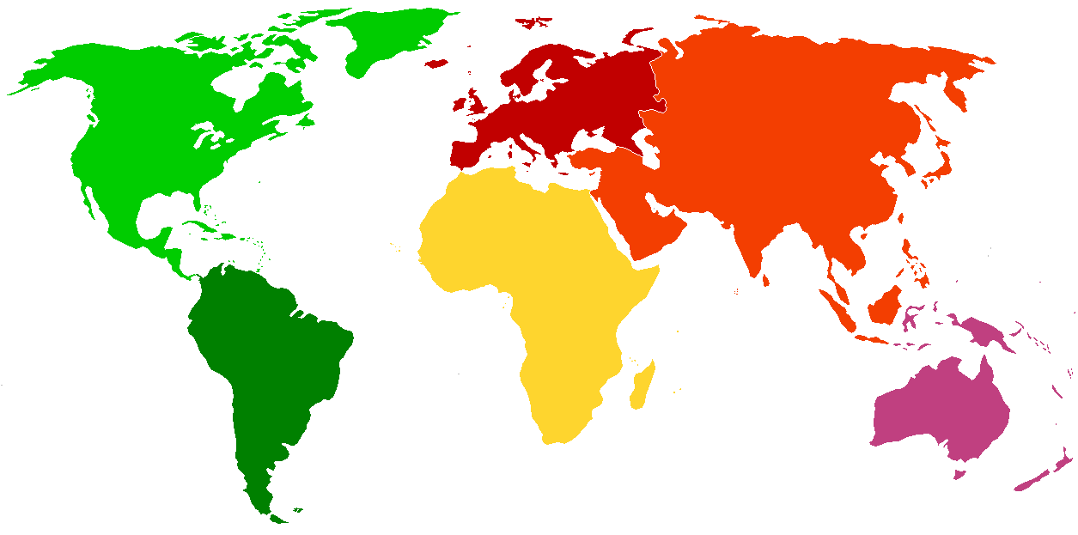
Geographic Anomaly Example
AS 17557
Pakistan Telecom
208.65.152.0/24
7700 miles
AS 36561
YouTube
208.65.152.0/22

Slide 68
Topology Anomaly Example
The A, E route doesn’t make sense
It violates the typical customer, provider relationship
It also enters the core multiple times
Transit (Tier 1) ASes
AS D
AS A
AS E
8.0.0.0/22
A→D:
A, E
8.0.0.0/22

Slide 69
Final Thoughts
DNS and BGP are crucial to the security of the Internet
Both are fundamentally insecure
Protocols lack strong (or any, in the case of BGP) authentication
Solutions exist for both, but they are not yet fully deployed
DNS is doing better than BGP, but not by much

Slide 70
Sources
Many slides courtesy of Wil Robertson: https://wkr.io
An Illustrated Guide to the Kaminsky Attack: http://unixwiz.net/techtips/iguide-kaminsky-dns-vuln.html
Secure-BGP: http://www.net-tech.bbn.com/sbgp/IEEE-JSAC-April2000/IEEE-JSAC-S-BGP.html
RPKI and ROA courtesy of Sharon Goldberg: http://queue.acm.org/detail.cfm?id=2668966

