Slide 1
Peeking Beneath the Hood of Uber
Le Chen, Alan Mislove, Christo Wilson
Northeastern University

Slide 2
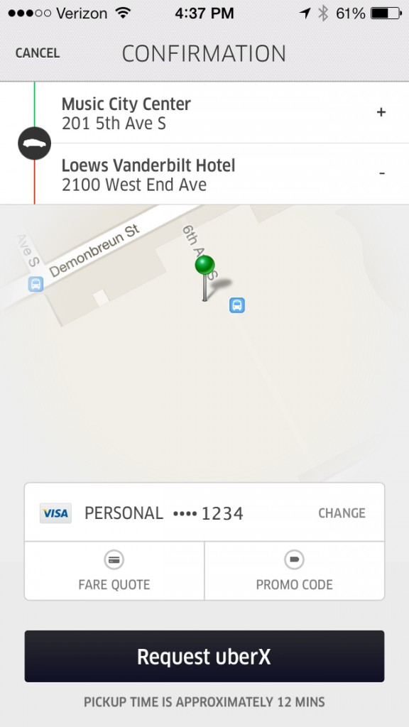
What is Uber?
Select a pickup location
Choose type of car
UberX: cheap sedan
UberSUV: cheap SUV or van
UberBlack: fancy sedan
UberXL: fancy SUV
UberPool: car pool with some randos
Etc…
Request and ride away

Slide 3
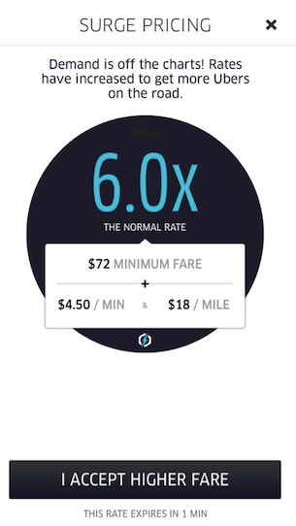
Simple and Convenient, Except…

Slide 4
Marketplaces
Transparent
Opaque
Suppliers set their own prices
Customers may observe all products and their prices
Supply and demand are hidden from customers
Suppliers do not choose their own prices
Prices are set by an algorithm

Slide 6
Goals
Determine how the surge pricing algorithm works
Does it work the way Uber claims?
Is it responsive to changes in supply and demand?
Can surges be predicted and/or avoided?
Impact of surges on drivers and passengers

Slide 7
Data Collection Measuring Surges Avoiding Surges Impact of Surges Conclusions

Slide 8
Data Collection
Uber’s official surge pricing patent says the calculation is based on supply, demand, and other factors
How can we collect this data?
Uber API
Pros: easy to use, includes surge multipliers and Estimated Wait Times (EWT)
Cons: no cars, demand, or supply information
Uber Rider App

Slide 9
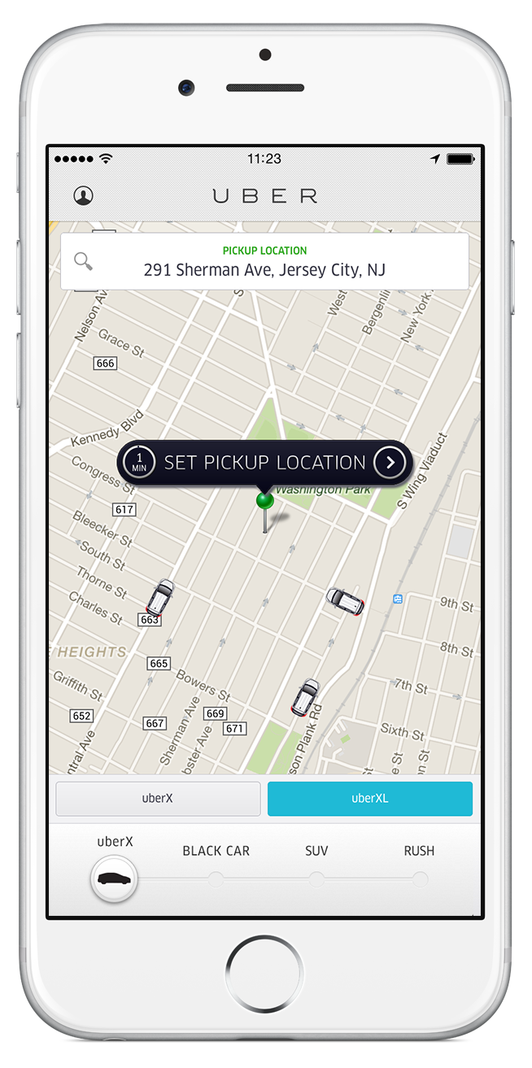
Uber App
Pings Uber’s servers every 5 seconds
8 nearest cars
Estimated Wait Time (EWT)
Surge multiplier

Slide 10
Limitations
Measuring supply is straightforward
Supply = observed cars on the road
Measuring demand is tricky
Cars may get booked…
Or just go offline…
Or drive out of the area
We can only estimate demand
Fulfilled demand = number of cars that go offline
Upper bound on true fulfilled demand

Slide 11
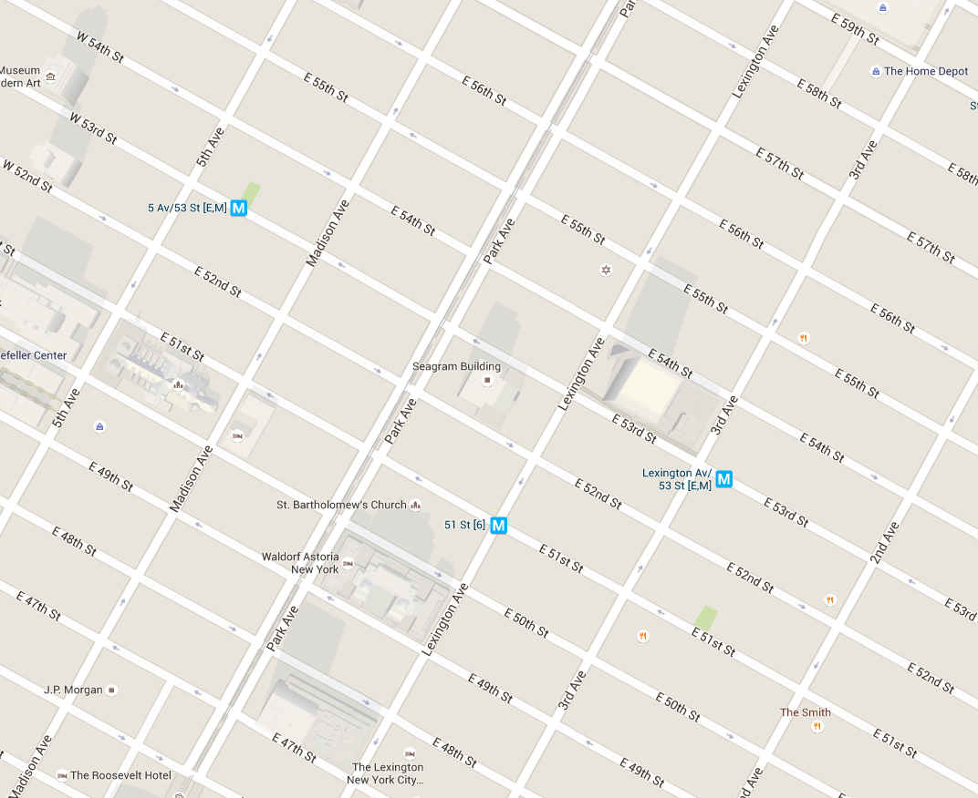
Limited Visibility
Recall: the Uber app only sees the 8 closest cars
3pm on Sunday
Radius r

Slide 12
Limited Visibility
How far apart should we place our measurements points?
5pm on Monday
r’ < r

Slide 13
Radius Measurements
Cars observed by all apps:
Radius r

Slide 14
Final Data Collection
Collected four months of data from Midtown Manhattan and San Francisco
2 months from each city, 43 measurement points
2nd and 3rd largest Uber markets
Very different public transport options
Radius experiments
247 meters in Midtown Manhattan
387 meters in downtown San Francisco
Validated methodology using ground-truth data from NYC taxis
Built an “Uber simulator” and used our methods to measure the taxis
Observed 97% of supply and 95% of demand

Slide 15
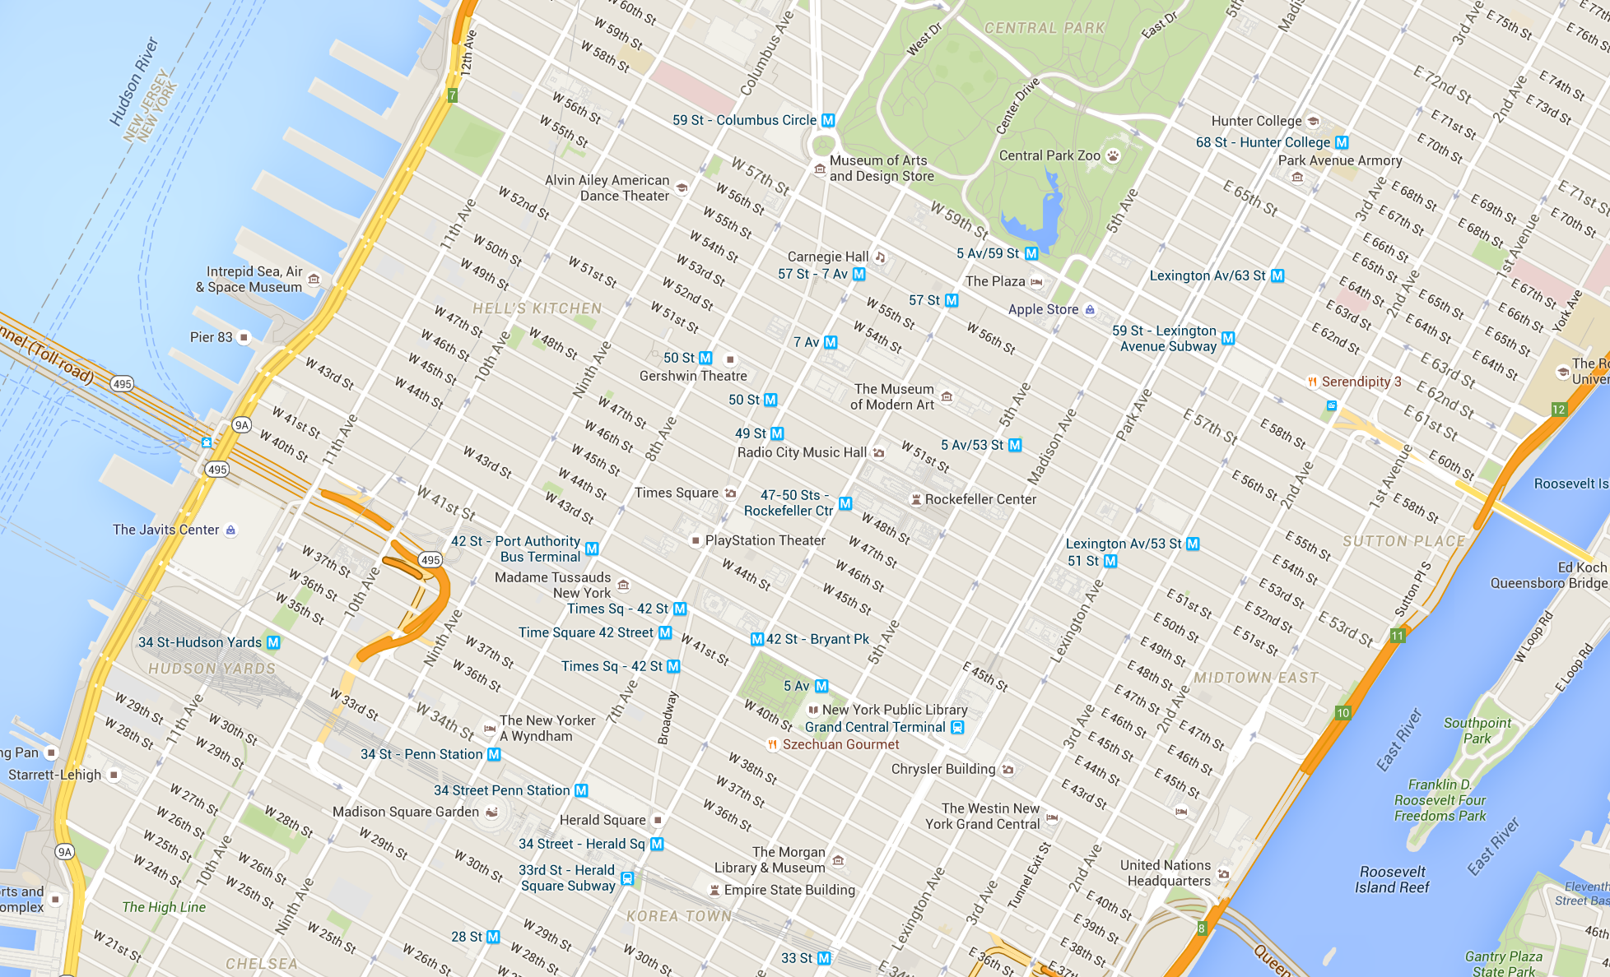
Example Measurement Grid
43 measurement points
Collected 2 months of data in Midtown

Slide 16
Ethics
We did not collect any personal information about Uber drivers or passengers
We never booked any rides
We did not induce any surges
We placed 40 “users” in random locations with no surge, in the middle of the night
Did not observe surges for one hour
Repeated 100 times at different locations and hours

Slide 17
Data Collection Measuring Surges Avoiding Surges Impact of Surges Conclusions

Slide 18
Research Questions
How much and how often does it surge?
How long do surges last?
How do surge prices vary by location?
What features does Uber use to calculate surge prices?

Slide 19
How much does it surge?
14% of the time it is surging in Manhattan
57% of the time in SF
Surge multipliers tend to be higher in SF

Slide 20
How long do surges last?
Noisiness: 70% of surges last <=10 minutes
Staircase: surges last multiples of 5 minutes

Slide 21
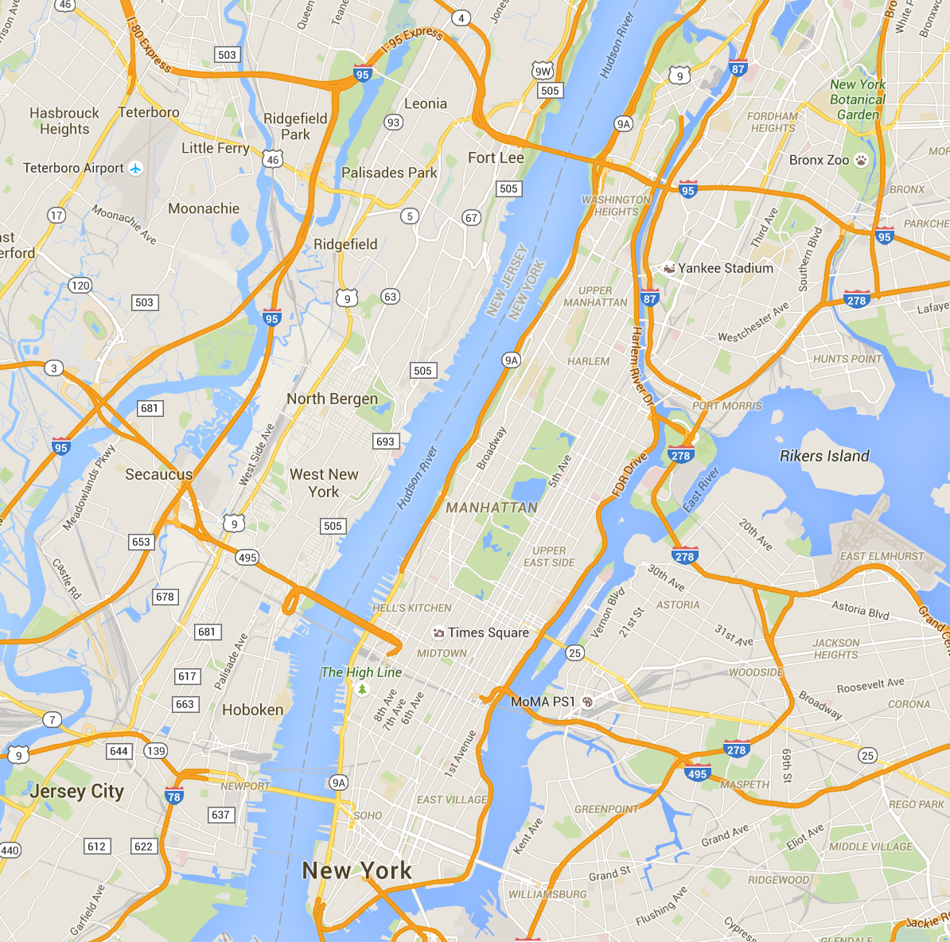
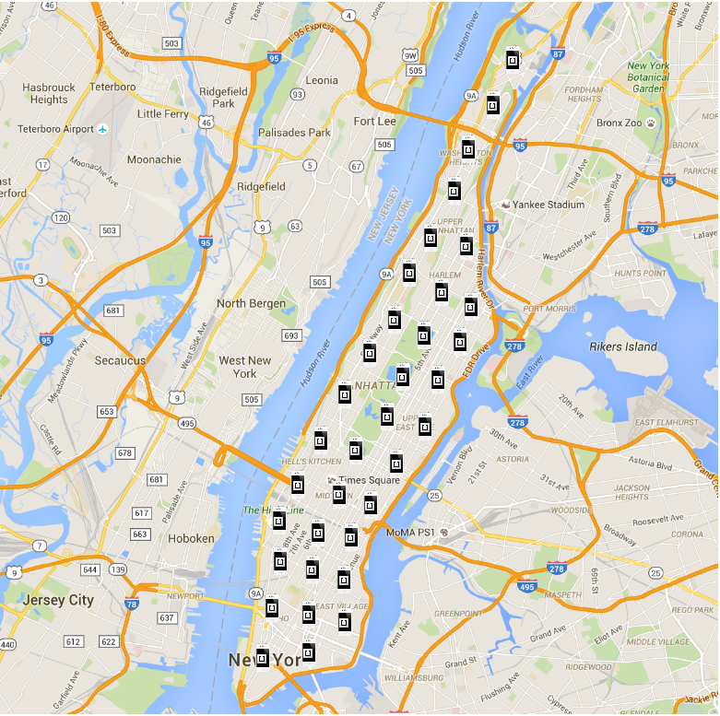
How does surge vary by location?

Slide 22
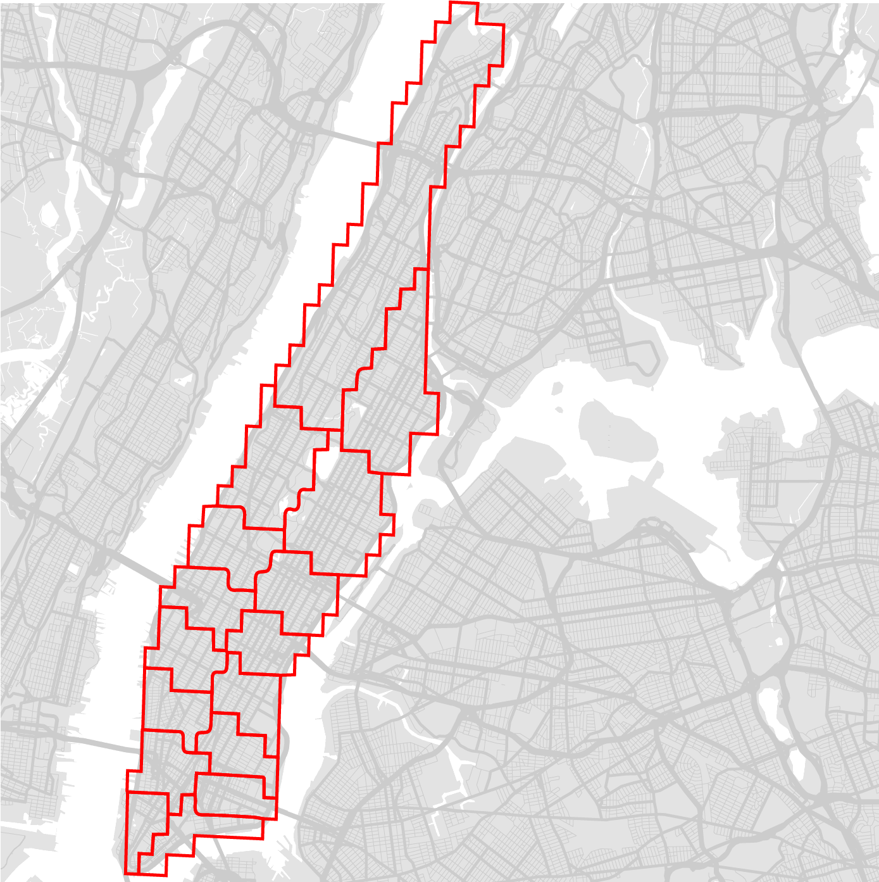
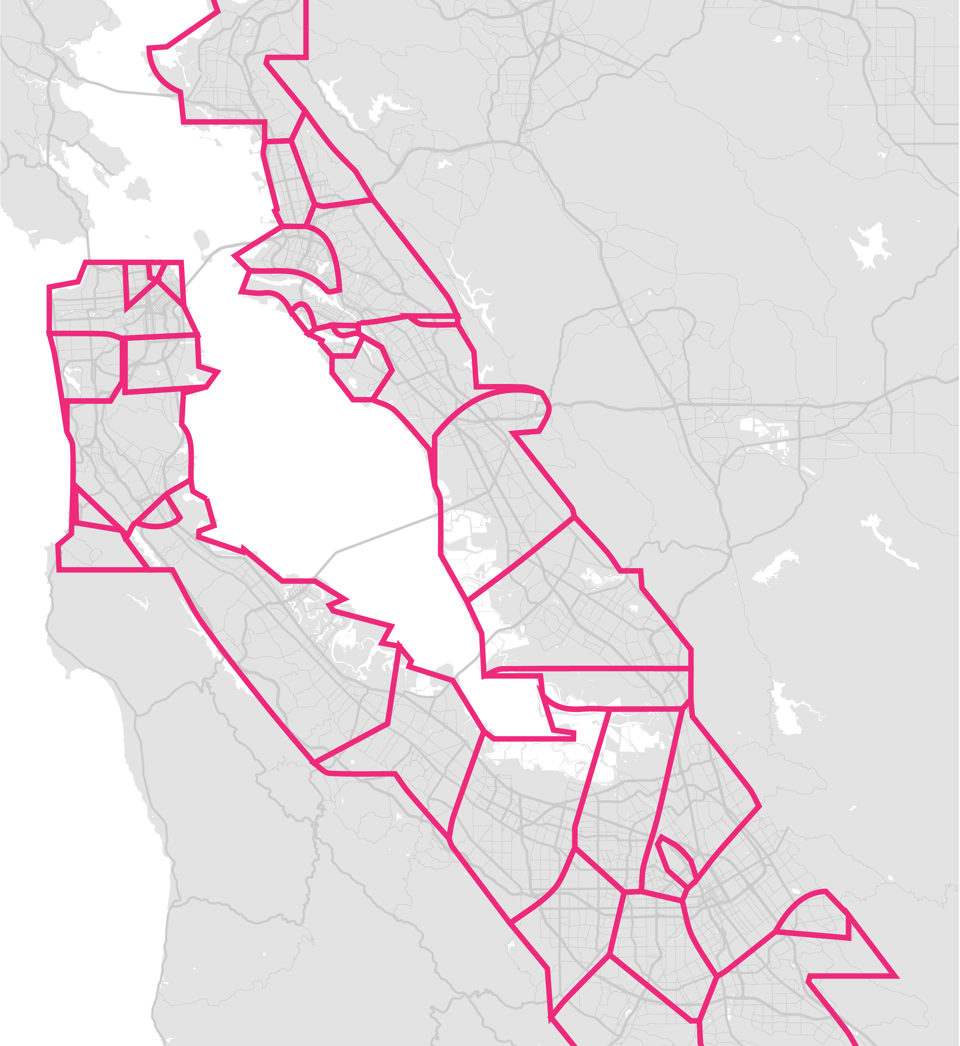

Slide 23
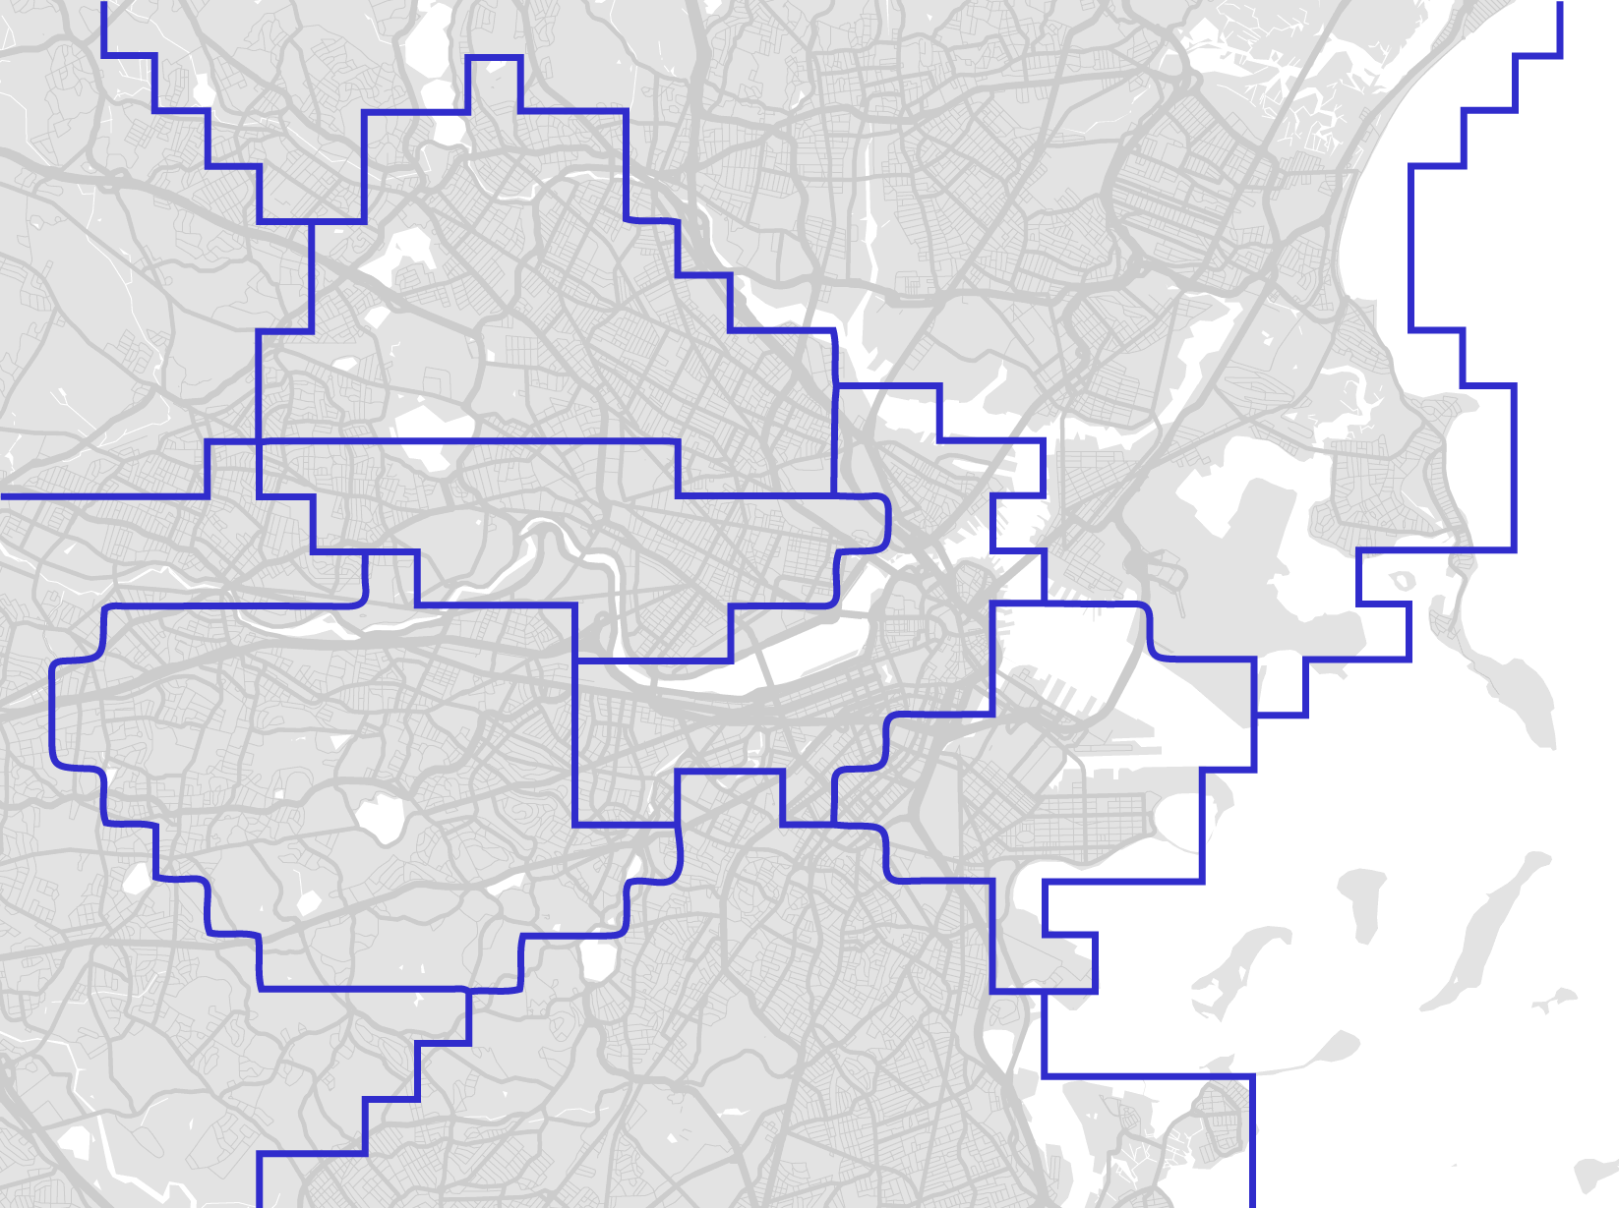
Cambridge,
Somerville
Back Bay
South End,
Seaport
Mass Ave
Roxbury

Slide 24
How is surge calculated?
Many possible variables
Supply, demand, EWT, etc.
Use cross-correlation to perform time-series analysis
Match
Match
Supply
High correlation at -10 minutes
No Match
Surge
Time
12pm
12:05
12:10
12:15
12:20
12:25
12:30

Slide 25
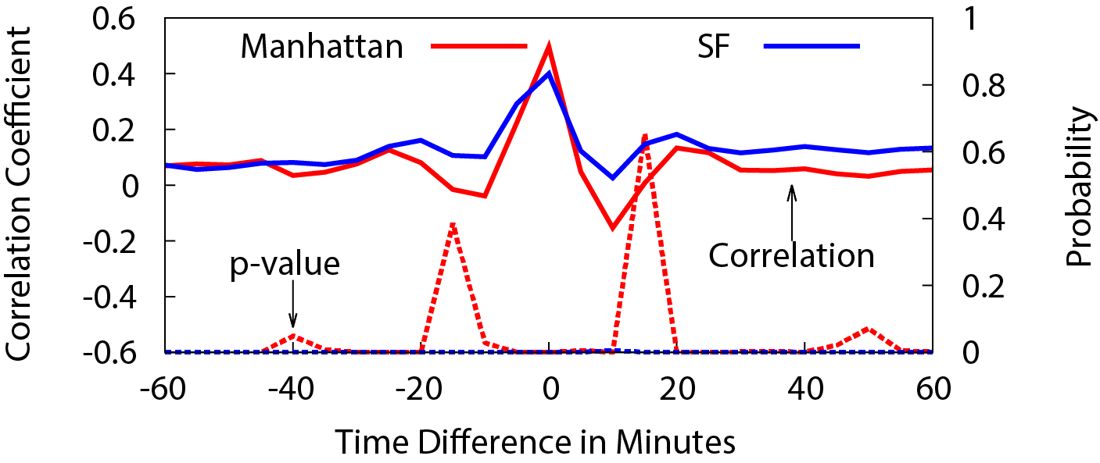
Cross-correlation
(Supply – Demand) vs. Surge
EWT vs. Surge
Moderately strong correlations when time difference is zero
Suggests Uber uses data from the last 5 minute window when calculating surge
Zero correlation in other time windows
Surge pricing algorithm is responsive but noisy

Slide 26
Data Collection Measuring Surges Avoiding Surges Impact of Surges Conclusions

Slide 27
Can we predict surges?
Useful variables
Supply, demand, EWT
Previous surge multiplier(s)
Predictive models
Linear and non-linear regressions
Performance
R² ranges from 0.37 – 0.57
These results are terrible, i.e. we cannot reliably predict surges
Missing some key variable(s)
Unfulfilled demand: how many people tried to book a ride but couldn’t?

Slide 28
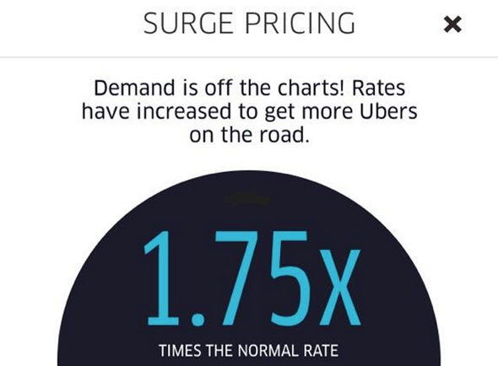
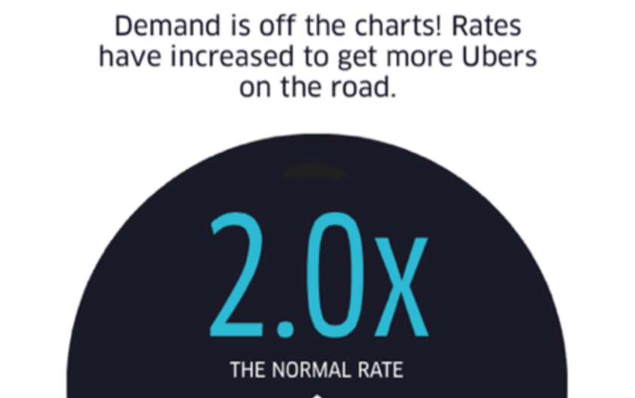
Avoiding Surges
No Surge!
EWT = 6 min
5 min
7 min
No Surge!
EWT = 3 min

Slide 29
Avoiding Surges
10-15% chance you’ll save money
Savings up to 50% by avoiding surges

Slide 30
Data Collection Measuring Surges Avoiding Surges Impact of Surges Conclusions

Slide 31
Impact on Supply and Demand
Why did Uber implement surge pricing?
To equalize supply and demand
Reduce demand by raising prices
Increase supply by incentivizing drivers
In economic terms, surge pricing is about incentives
Are the incentives provided by the surge pricing system working?

Slide 32
State Transitions
If one area is surging, we expect the following five things to happen
(Supply) New: cars should prefer to come online in the surging area
(Supply) Move-in: cars should drive into the surging area
(Supply) Move-out: few cars should drive out of the surging area
(Demand) Booked: fewer cars should get booked in the surging area
(Demand) Old: more cars that began in the surge area should remain after 5 minutes

Slide 33
Comparing State Transitions
Lee et al. surveyed Uber drivers and found that experts “do not chase surges”
State | Change When Area is Surging | Expected?
New | +2% | Yes
Move-in | -13% | No
Move-out | +14% | No
Booked | -7% | Yes
Old | +14% | Yes
(Supply) New: cars should prefer to come online in the surging area
(Supply) Move-in: cars should drive into the surging area
(Supply) Move-out: few cars should drive out of the surging area
(Demand) Booked: fewer cars should get booked in the surging area
(Demand) Old: more cars that began in the surge area should remain after 5 minutes

Slide 34
Data Collection Measuring Surges Avoiding Surges Impact of Surges Conclusions

Slide 35
Summary
First systematic audit of Uber’s surge pricing algorithm
Prices update every 5 minutes
70% of surges last <= 10 minutes
Uber divides cities into surge areas
May save significant money by walking into an adjacent area
Supply and demand do correlate with surge pricing
Results call the surge pricing system into question
Very effective at suppressing demand
Not effective at incentivizing short-term behavior of drivers

Slide 36
The Press

Slide 37
The Drivers

Slide 38
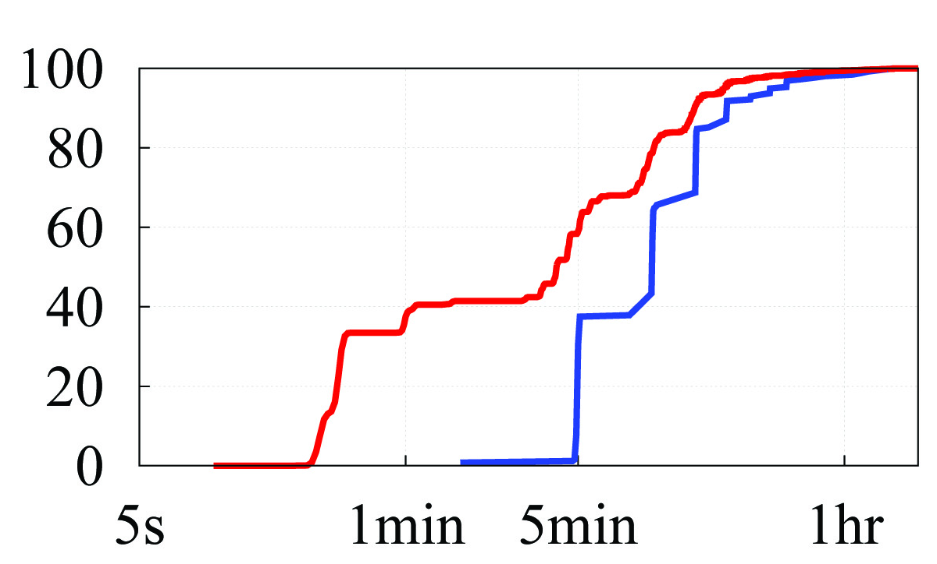
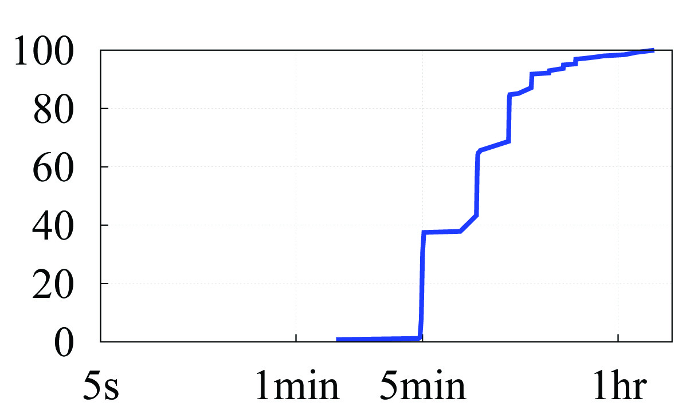
The Bug
In April 2015, Uber users began to receive incorrect surge multipliers at random times
Uber confirmed this was a consistency bug in their systems
Pricing bug existed for over 6 months, only corrected because of our study
Apr ‘15
CDF
Feb ‘15
Duration of Surges

Slide 39
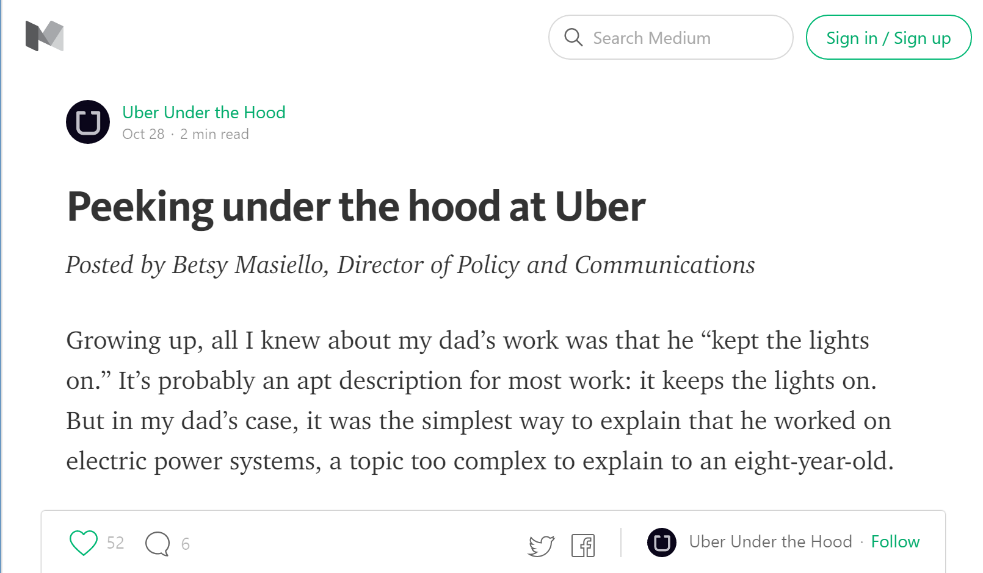
The Blog

Slide 40
The Lawsuit
Both sides have filed briefs that heavily cite our paper
One side uses our data to claim Uber is fixing prices
The other uses our results to claim the opposite…

Slide 41
Thanks! Questions?
Christo Wilson
Assistant Professor, Northeastern University
cbw@ccs.neu.edu

